Slide 1
UPPER INTERMEDIATE STRUCTURE
YANUARTI APSARI

Slide 2
What do you think about STRUCTURE?

Slide 3
WHY STRUCTURE?
Structure is the basic knowledge and skill for understanding the language naturally constructed and used.
structure should be mastered by the learners that they can use English language in appropriate way.
Without knowing the structure of the language, we may get a lot of difficulties.
Therefore, it can be concluded that..................
grammatical competence is CRUCIAL for communication to take place.

Slide 4
WHAT IS NEED ANALYSIS?
need analysis is the procedures used to collect information about learners’ needs (Richards, 2001 : 51).
Brown (1995 : 35) stated that needs analysis refers to the activities involved in gathering INFORMATION that will serve as the BASIS for DEVELOPING A CURRICULUM that will meet the learning needs of a particular group of students.

Slide 5
Need analysis affecting curriculum development

Slide 6
CURRICULUM DEVELOPMENT
Foundation of English Grammar
Teaching Grammar
Upper Intermediate Structure
Advanced Structure

Slide 7
FOUR COMPONENTS OF CURRICULUM
1. The objective of the subject (Goal)
2. Teaching and learning material (Syllabus)
3. Teaching and learning Process (Teaching Method)
4. Assessment (What to be evaluated)

Slide 8
GOAL OF UPPER INTERMEDIATE STRUCTURE
At the end of this semester, the students are expected to be able to improve their grammatical competence
Objective 1
Objective 2
GOAL
Objective 3
Objective 4
Objective 5

Slide 9
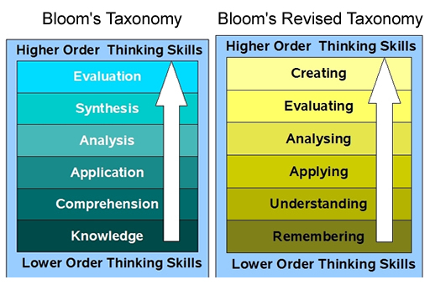
OBJECTIVE AND TAXONOMY BLOOM

Slide 10
(1)THE OBJECTIVE OF THE LESSON
At the end of this semester the students are expected to be able to:
1. Identify simple sentence, compound sentence and and complex sentence
2. write simple sentence, compound sentence and and complex sentence correctly

Slide 11
SYLLABUS
Pertemuan | Materi
1 | Introduction to the course and syllabus & Review
2 | Pre Test: Present, Past, Future Tenses
3 | Simple Sentences
4 | Be
5 | Have
6 | Do
7 | QUIZ 1
8 | Active and Passive Forms
9 | Mid Test
10 | Compund Sentences
11 | The Complex Sentence: Noun Clauses
12 | The Complex Sentence: Relative Pronouns and Clauses; defining/non-defining clauses
13 | The Complex Sentence: time, place, manner, reason, contrast, purpose, result, and comparison
14 | The Complex Sentence: present participle constuctions, perfect/past constructions QUIZ 2
15 | Review
16 | FINAL TEST

Slide 12

Teaching Material
This module contains various rules about English structure and provide exercises for students. The contents of this module are adopted from various sources in order to be suitable for students of English study program of IKIP Siliwangi.

Slide 13
(3)Teaching and Learning Process
(Teaching Method)
Group discussion
Cooperative learning
Quiz

Slide 14
(4)ASSESSMENT: means of evaluation
1. Attendence : min 80 persen
2. Assignment : 30 %
4. Active Participation : 20 %
Quiz : 20 %
5. Mid test : 15 %
6. Final Test : 15 %

Slide 15
(4)ASSESSMENT: what to be evaluated
1. Knowledge
2. Skill
3. Attitude

Slide 16
PART OF SPEECH

Slide 17
FALL
VERB

Slide 18
Among
Preposition

Slide 19
However
Conjunction

Slide 20
Flood
Noun

Slide 21
Huge
Adjective

Slide 22
Imeditelly
Adverb

Slide 23
Forbid
verb

Slide 24
Therefore
Conjunction

Slide 25
About
Preposition

Slide 26
Crucial
Adjective

Slide 27
Scenery
Noun

Slide 28
Now
Adverb

