Slide 1
NOUN CLAUSE

Slide 2
What is a Clause ???
A clause is a group of words that contains a subject and predicate. It forms a part of a sentence.
If a clause makes complete sense in itself, it is called the Main Clause or The Principal Clause of that sentence. If it dependent on another clause to complete its meaning, it is called Subordinate Clause.
The word or words that can join a subordinate clause with the principal clause are called subordinating conjunction.
There are three types of Subordinate Clauses :
NOUN CLAUSES
ADVERB CLAUSES
ADJECTIVE CLAUSES

Slide 3
What is a Noun Clause ???
A noun clause is a subordinate clause that does the work of a noun in a sentence.
Example:
I know that she left for dance class in the morning.
Main Clause
Noun Clause
How to identify a noun clause ? By asking who or what question in given sentence.
We need to ask a question to find out what the subject knows.
Question : I know what ?
Answer : That she left for dance class in the morning.
The answer to this question is the subordinate clause. It is the noun clause of the sentence.

Slide 4
A noun clause usually begins with words like :
That
What
If
Whether
How
Where
Who
Whom
Whose
Why
However
Whatever
Wherever
Whoever
,etc
For example:
She does not know where he went.
Whether he will win is undecided.
Whatever you do, do it well.

Slide 5
A noun clause acts as a noun in a sentence. It can function in different ways.
Function of Noun Clause | Example
As subject of a Verb | What route we take is our choice. How the documents went missing is anyone’s guess.
As object of a Verb | I thought that we would watch a movie. Sometimes people wish that they could go back in time.
As object of a Participle | Discovering that it was right, I jumped with joy. Hoping that she loved chocolates, Joshua bought a box of silverqueen.
As object of a Preposition | Sometimes I think of what he said.

Slide 6
Let us look at more function of the noun clause.
Function of Noun Clause | Example
As subject of an Infinitive | Jim wants to know where his friends are.
As an Adjective Complement | The girls were happy that Saturday was a holiday.
As a Complement of a verb of Incomplete Predication. | The problem is that we do not have a leader. My belief is that we will win.
In Apposition to a Noun or a Pronoun. | The man that we saw there is Mr. Harris

Slide 7
That Clause
We use a noun + that-clause to express opinions and feelings, often about certainty and possibility. We also use that with reporting nouns. Some nouns commonly used in this way are belief, fact, hope, idea, possibility, suggestion, statement, claim, comment, argument :
I believe that someday I will be a good writer.
Indonesian police are investigating the possibility that a bomb was planted on the train.
We use a noun + that-clause to express opinions and feelings, often about certainty and possibility. We also use that with reporting nouns. Some nouns commonly used in this way are belief, fact, hope, idea, possibility, suggestion, statement, claim, comment, argument :
I believe that someday I will be a good writer.
Indonesian police are investigating the possibility that a bomb was planted on the train.

Slide 8
Noun clause dalam bentuk pernyataan selalu didahului oleh “That” yang berarti “bahwa”. Noun clause ini biasanya didahului oleh induk kalimat dengan kata kerja seperti: assume, believe, discover, dream, guess, hear, hope, know, learn, notice, predict, prove, realize, suppose, suspect dan think.
Example :
You must realize that you don’t deserve to marry her. She comes from a rich family, and you are not

Slide 9
Noun clauses which begin with a question word* are also called Embedded Questions
We use a noun + that-clause to express opinions and feelings, often about certainty and possibility. We also use that with reporting nouns. Some nouns commonly used in this way are belief, fact, hope, idea, possibility, suggestion, statement, claim, comment, argument :
I believe that someday I will be a good writer.
Indonesian police are investigating the possibility that a bomb was planted on the train.
• What did he say?
• When do they arrive?
Does, did, and do are used in
questions but not in noun
clauses.
Look what happens to the
word order above in blue.
► I couldn’t hear what he said.
► Do you know when they arrive?
The noun clause comes after the main
verb in the sentence.(hear, know)
Do not use question word order in a
noun clause. Use question wordplus-subject-plus-verb
order and
keep the same tense (past and
present in the examples above).

Slide 10
Examples :
Where does Anna live?
What should they do?
How long has Amir been living here?
Whose house is that?
I don’t know where Anna lives.
What they should do is obvious.
I don’t know how long Amir has been living here.
I wonder whose house that is.
What I said upset her.
(noun clause as subject)
He didn’t understand what I said.
(noun clause as object)
Remember:
In a noun clause, the subject should be before the verb.

Slide 11
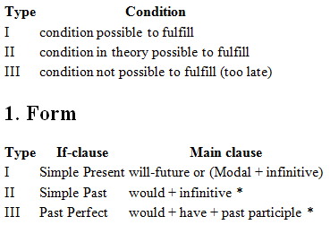
If Clause

Slide 12
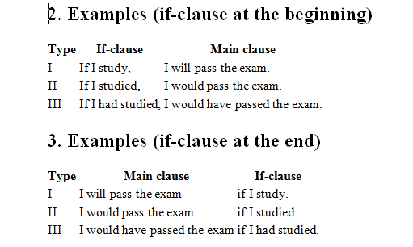
We use a noun + that-clause to express opinions and feelings, often about certainty and possibility. We also use that with reporting nouns. Some nouns commonly used in this way are belief, fact, hope, idea, possibility, suggestion, statement, claim, comment, argument :
I believe that someday I will be a good writer.
Indonesian police are investigating the possibility that a bomb was planted on the train.

Slide 13
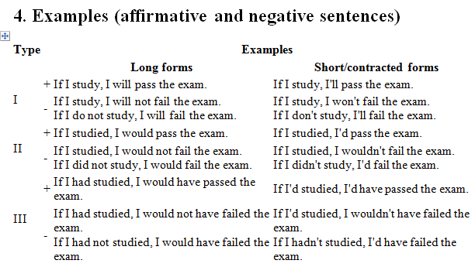
We use a noun + that-clause to express opinions and feelings, often about certainty and possibility. We also use that with reporting nouns. Some nouns commonly used in this way are belief, fact, hope, idea, possibility, suggestion, statement, claim, comment, argument :
I believe that someday I will be a good writer.
Indonesian police are investigating the possibility that a bomb was planted on the train.

Slide 14
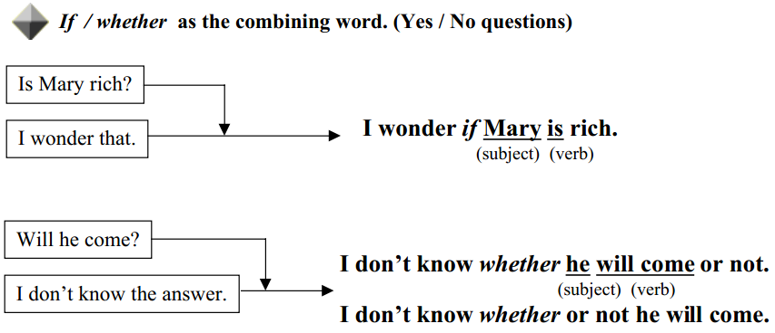

Slide 15
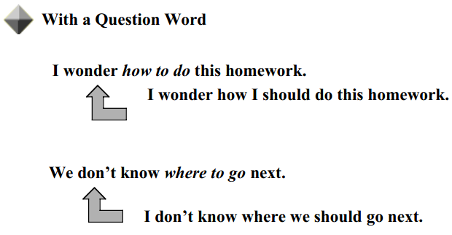
Infinitives with Question Words and Whether

Slide 16
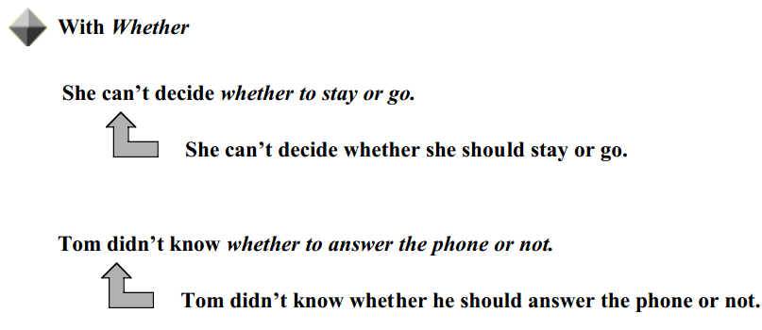
S

Slide 17
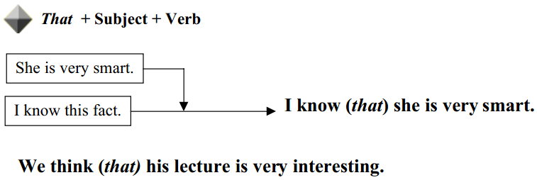
Noun Clauses with that as their combining word
S

Slide 18
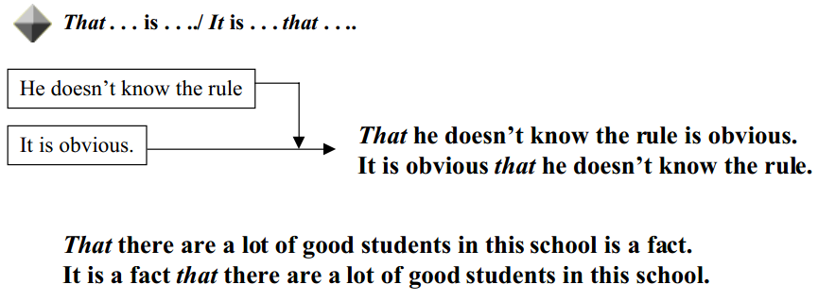
S

Slide 19
SEQUENCE OF TENSES
Sequence of Tense is a grammatical rule, which set the agreement and relation of tenses used in the independent clause and dependent clause, or the main clause and the subordinate clause.
The rules governing verb tenses are dictated by logic; an action in the future cannot happen before an action in the past; the past must come before the present, and the present before the future, etc. The sequence of tenses applies to adverb clause of purpose and noun clause.

Slide 20
By understanding the sequence of tenses, it will helps us to the following things:
It helps us explain what someone said (indirect quotation)
Eg: Someone says, “I get a new car.” (direct)
She/He got a new car. (indirect)
It helps us with conditional sentences (using the word “if”
Eg: If you could take me home, I would be grateful.
It helps us make sentences using the word “wish”
Eg: I wish I could go with you.

Slide 21
There are some basic rules to the sequence of tenses:
A past tense in the main clause is usually followed by a past tense in the subordinate clause.
She said that she would come.
I told you that I passed the exam.
Exception: A past tense in the main clause may be followed by a present tense in the subordinate clause when the subordinate clause expresses a general fact/universal truth.
The teacher told us that the earth moves around the sun

Slide 22
A present or future tense is the main clause may be followed by any tense in the subordinate clause.
She says that she was at home
She says that is at home
She says that she will be at home
He will say that he is fine
He will say that he was fine
He will say that he will be fine
Notes:
Note: When the verb in the main clause is in the future tense, we often use a present tense in the subordinate clause to refer to future time.
I will call you when he arrives. (NOT I will call you when he will arrive.)

Slide 23
TQ

