Slide 1



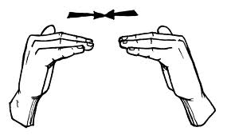
Equivalence and Equivalent Effect
SYAFRYADIN 1101138

Slide 2

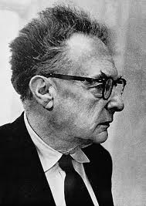

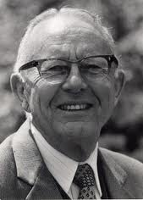
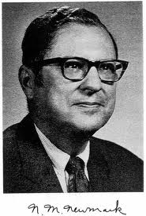
Equivalence and Equivalent Effect
Roman Jakobson: The Nature of Linguistic Meaning and Equivalence
Nida and the Science of Translating
Koller
Korrespondenz and Aquivalenz
Semantic and Communicative translation

Slide 3
Roman Jakobson: The Nature of Linguistic Meaning and Equivalence
The level of gender: house is feminine in Romance languages, neuter in German and English; honey is masculine in French, German and Italian, feminine in Spanish, neuter in English.
The level of aspect: in Russian, the verb morphology varies according to whether the action has been completed or not;
The level of semantic fields: the German Geschwister is normally explicated in English as brothers and sisters, and the English children in the statement ‘I have got two children’ is translated as gender specific hijas in Spanish if both children are female.
intralingual
interlingual,
intersmiotic

Slide 4
Nida and the Science of Translating
The nature of Meaning: Advances in Semantics and Pragmatics
The Influence of Chomsky
Formal and Dynamic equivalence

Slide 5
Nida and the Science of Translating
The nature of Meaning:
Advances in Semantics and Pragmatics
Nida describes various scientific approaches to meaning related to work that had been carried out by theorists in semantics and pragmatics. Meaning is divided into several parts like linguistic meaning, referential meaning (denotative dictionary meaning), emotive (connotative meaning) meaning

Slide 6
Nida and the Science of Translating
The Influence of Chomsky
A (source language) B (receptor language)
(analysis) (Restructuring)
X (transfer) Y

Slide 7
Nida and the Science of Translating
Formal and Dynamic equivalence
Formal equivalence
It focuses attention on the message itself, in both form and content. Formal equivalence is thus keenly oriented towards the ST structure, which exerts strong influence in determining accuracy and correctness.
Dynamic equivalence
It is based on what Nida calls the principle of equivalent effect, where the relationship between receptor and message should be substantially the same as that which existed between the original receptors and message.

Slide 8
Semantic and Communicative translation
Newmark tries to explain semantic translation and communicative translation. Communicative translation attempts to produce on its readers an effect as close as possible to that obtained on the readers of the source language. While, semantic translation, on the other hand, attempts to render, as closely as the semantic and syntactic structures of the TL allow, the exact contextual meaning of the original

Slide 9
Koller
Korrespondenz and Aquivalenz
Field | Contrastive | Science of Translation
Research area | Correspondence Phenomena and conditions, describing corresponding structures and sentences in the TL and SL systems | Equivalence phenomena, describing hierarchy of utterances and texts in SL and TL according to equivalence criterion
Knowledge | langue | parole
Competence | Foreign language competence | Translation competence

Slide 10


