Slide 1
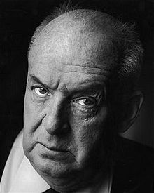
Problems of translation: onegin in english
(vladimir nabokov)
Siska Rizkiani 1104332

Slide 2
Parts of chapter
I. What is Onegin?
II. What are the differences?
III. Who is Pushkin?
IV. What is literal translation?
V. What are the facts found?
VI. What are the results?
VII. What are the conclusions?

Slide 3
I. What is onegin?
contained 8 chapters and 5,551 lines
is a Russian novel in verse
concerned with the afflictions, affections, and fortunes of 3 young men (Onegin, Lenski, and Pushkin), and 3 young ladies (Tatiana, Olga, and Pushkin’s Muse).
written from May 1823 to October 1831
1st complete edition published in Spring of 1833 in St. Petersburg
taken place between the end of 1819 and the spring of 1825
at midway between Opochka and Moscow.

Slide 4
II. What are the differences?
-between Russian, French, and English
- in terms of language and prosody
The number of rhymes, both masculine and feminine is comparably greater that in English and leads to the cult of the rare and the rich.
No matter the length of a word in Russian there is never a secondary accent or two accents as occurs in English.
Polysyllabic words are considerably more frequent than in English
In Russian, all syllables are fully pronounced.; there are no elisions and slurs as there are in English verse
Russian poems composed in iambics tetrameter contain a larger number of modulated lines than of regular ones, while the reserve is true in regard to English poems.
Inversion so commonly met with in English iambics. In Russian is rare.

Slide 5
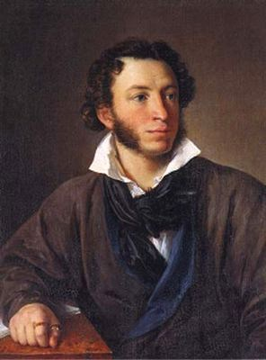
iii. Who is pushkin?
Alexandr Sergeyev Pushkin (1799-1837)
A national poet of Russia
Produced a product of French literature as much as of Russian culture
Zhukovski and Batyushkov were the predecessors of Pushkin; harmony and precision
He was acquainted with English poets only through the French models or French versions

Slide 6
iv. What is literal translation
One who desires to turn a literary masterpiece into another language has only one duty to perform
To reproduce with absolute exactitude the whole text, and nothing but the text
“Literal translation” is tautological (repeat what has already said) since anything but that is not truly a translation but an imitation, an adaptation or a parody.
The problem is a choice between rhyme and reason; can a translation keep the form of the original, its rhythm and its rhyme?
Literal translation or directed translation, is rendering of text from one language to another word-by-word, rather than conveying the sense of the original

Slide 7
example
It’s raining cats and dogs
→ hujan kucing dan anjing
The sooner or the later the weather will change
→ lebih cepat atau lebih lambat cuaca akan berubah.
(tak bermakna dan tak lazim).
This approach should be the beginning process of translation (Machali, 2009)

Slide 8
v. What are the facts found?
(from the French, english & german version of onegin)
german
Lippert (1840)
Seubert (1873)
Bodenstedt (1854)
→are the worst of the a lot
french
Turgenev & Viardot (1863)
→ A really good translation
Dupont (1847)
→ More idiomatic
english
Lieut,-Col.Spalding (1881)
Babette Deutsch (1936)
Oliver Elton (1936, 1937, 1938)
Dorothea Prall Radin & George Z.Patrick (1937)
→ All contains ingenuity, dreadful verse, mistranslations.

Slide 9
vi. What are the results?
Pushkin’s line is an excellent illustration of what Nobokov means by “literalism, literality, literal interpretation”. He takes literalism as “absolute accuracy”
The translator should constantly bear in mind not only the essential pattern of the text but also the borrowings with which that pattern is interwoven. Nor can anything can be added for the sake of rhyme or meter.

Slide 10
vii. What are the conclusions?
1. It is impossible to translate Onegin in rhyme.
2. It is possible to describe in a series of footnotes the modulations and rhymes of the text as well as all its associations and other special features.
3. It is possible to translate Onegin with reasonably accuracy by substituting for 14 rhymed tetrameter lines of each stanza 14 unrhymed lines of varying length, from iambic dimeter to iambic pentameter.

Slide 11
☺ Thank you ☺
The clumsiest literal translation is a thousand times more useful than the prettiest paraphrase (Vladimir Nobokov)

