Slide 1
Introduction to Systemic Functional Grammar

Slide 2
Functional View
B.K Malinowski views meaning as function in context. (see Figure 1.1.)
Firth continued Malinowski’s emphasis on a social and functional approach to language.
He began to use the word “system”.
``The first principle of analysis is to distinguish between STRUCTURE and SYSTEM. Structure consists of elements in interior syntagmatic relation and these elements have their places in an order of mutual expectancy. ... Systems of commutable terms or units are set up
to state the paradigmatic values of the elements.'' [Firth 1957]

Slide 3
Firth emphasizes the equal importance of “anatomy and “physiology” of language.
“anatomy” | “physiology”
chain syntagmatic structural formal logical | choice paradigmatic systematic functional rhetorical

Slide 4
Firth disagreed with American structuralists (led by Bloomfield) as they were only concerned with language “anatomy”.
Halliday (Firth’s student) also disagreed with American formalists (led by Chomsky) for the same reason.
Halliday is closer to European functionalists, e.g. Prague School (theme/rheme)
Halliday developed a systematic and comprehensive theory of language with a new terminology, known as Systemic Functional Grammar.

Slide 5
Why called systemic functional
Systemic Functional Grammar
Systemic => development of detailed system networks
Functional =>development of the theory of metafunctions of language
CRITICISM: SFG does not accept morphology as a separate level of language. It can be handled by systems and realization in the same ways as clause structure.

Slide 6
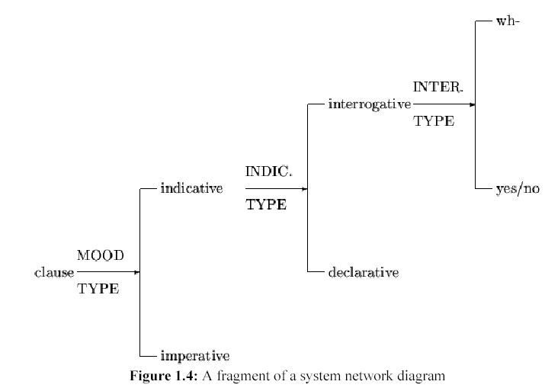
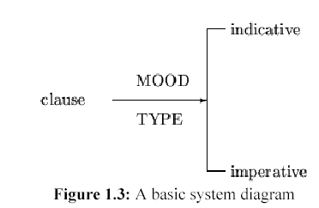
System Networks
A systems consists of an entry condition and a set of output features.
An output of one system may become the entry condition for another system. Then, systems are linked together to build a system network.

Slide 7
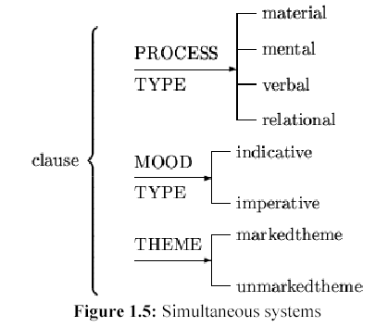
More than one system share the same entry conditions. Then, the systems are entered in parallel form.

Slide 8
Systems represent paradigmatic choice between grammatical alternatives and between lexical alternatives.
Lexicon is considered as a thesaurus.
Halliday has no clear definition between grammar and lexicon; he calls it lexicogrammar to include both.
The explicit desciption of paradigmatic choices distinguishes SFG drom other approaches to grammar.
Halliday describes the choices as “meaning potential” of that language.
The system shows meanings, which are realized in the structure of the language as wording.
Realization rule shows how the paradigmatic choices are expressed as syntagmatic chains in the structure of the language.
The process of realization is like a mapping from “physiology” to “anatomy”, from “choices” to “chain”, from “function” to “form”.

Slide 9
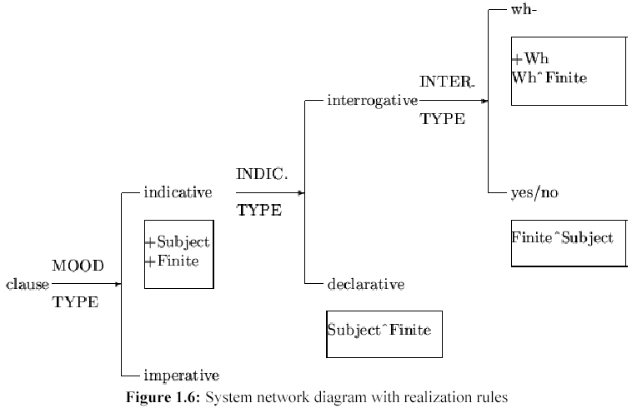
The process of realization is like a mapping from “physiology” to “anatomy”, from “choices” to “chain”, from “function” to “form”.
The output feature “indicative” has two associated realization rules: “+Subject” and “+Finite”. The output of Declarative has one associated realization rule” “Subject ^Finite”.
+Subject” requires the presence of a subject when a clause is indicative, and “+Finite” requires the presence of a finite verb.
The “Subject ^ Finite” requires the subject to precede the finite verb when the clause is declarative.

Slide 10
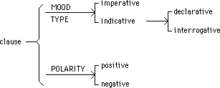
Systemic Grammar
Grammar is represented as a graph called a system network. This comprises
and systems (curly braces)
conjunctive features in boldface
or systems (straight vertical lines)
disjunctive features in normal face
realisation statements (in italic).
specify how disjunctive features are realised
 |  | MOOD TYPE:
 |  | indicative | imperative
POLARITY: | positive | The spy came in from the cold. | Come in from the cold!
 | negative | The spy didn't come in from the cold. | Don't come in from the cold!

Slide 11
Realisation statement
+X: insert the function X e.g. +subject
X=Y: conflate the functions X and Y e.g. goal = subject
X>Y: order X somewhere before Y e.g. subject > predicator
X/Y: function X has grammatical feature Y e.g. subject/noun phrase
X!L: assign function X to lexical item L e.g. passive!be

Slide 12
FUNCTIONAL MODEL OF LANGUAGE
Language is a resource. Man can narrow the meanings which speaker/writer means from the entire context of culture to specific context of situation by means of extra linguistics factors: FIELD, TENOR, MODE

Slide 13
Three language functions
In any context, people use language to do three main functions:
Ideational (to tell about subject matter, FIELD)
Interpersonal (to interact with other people, TENOR)
Textual (to structure the text, MODE)

Slide 14
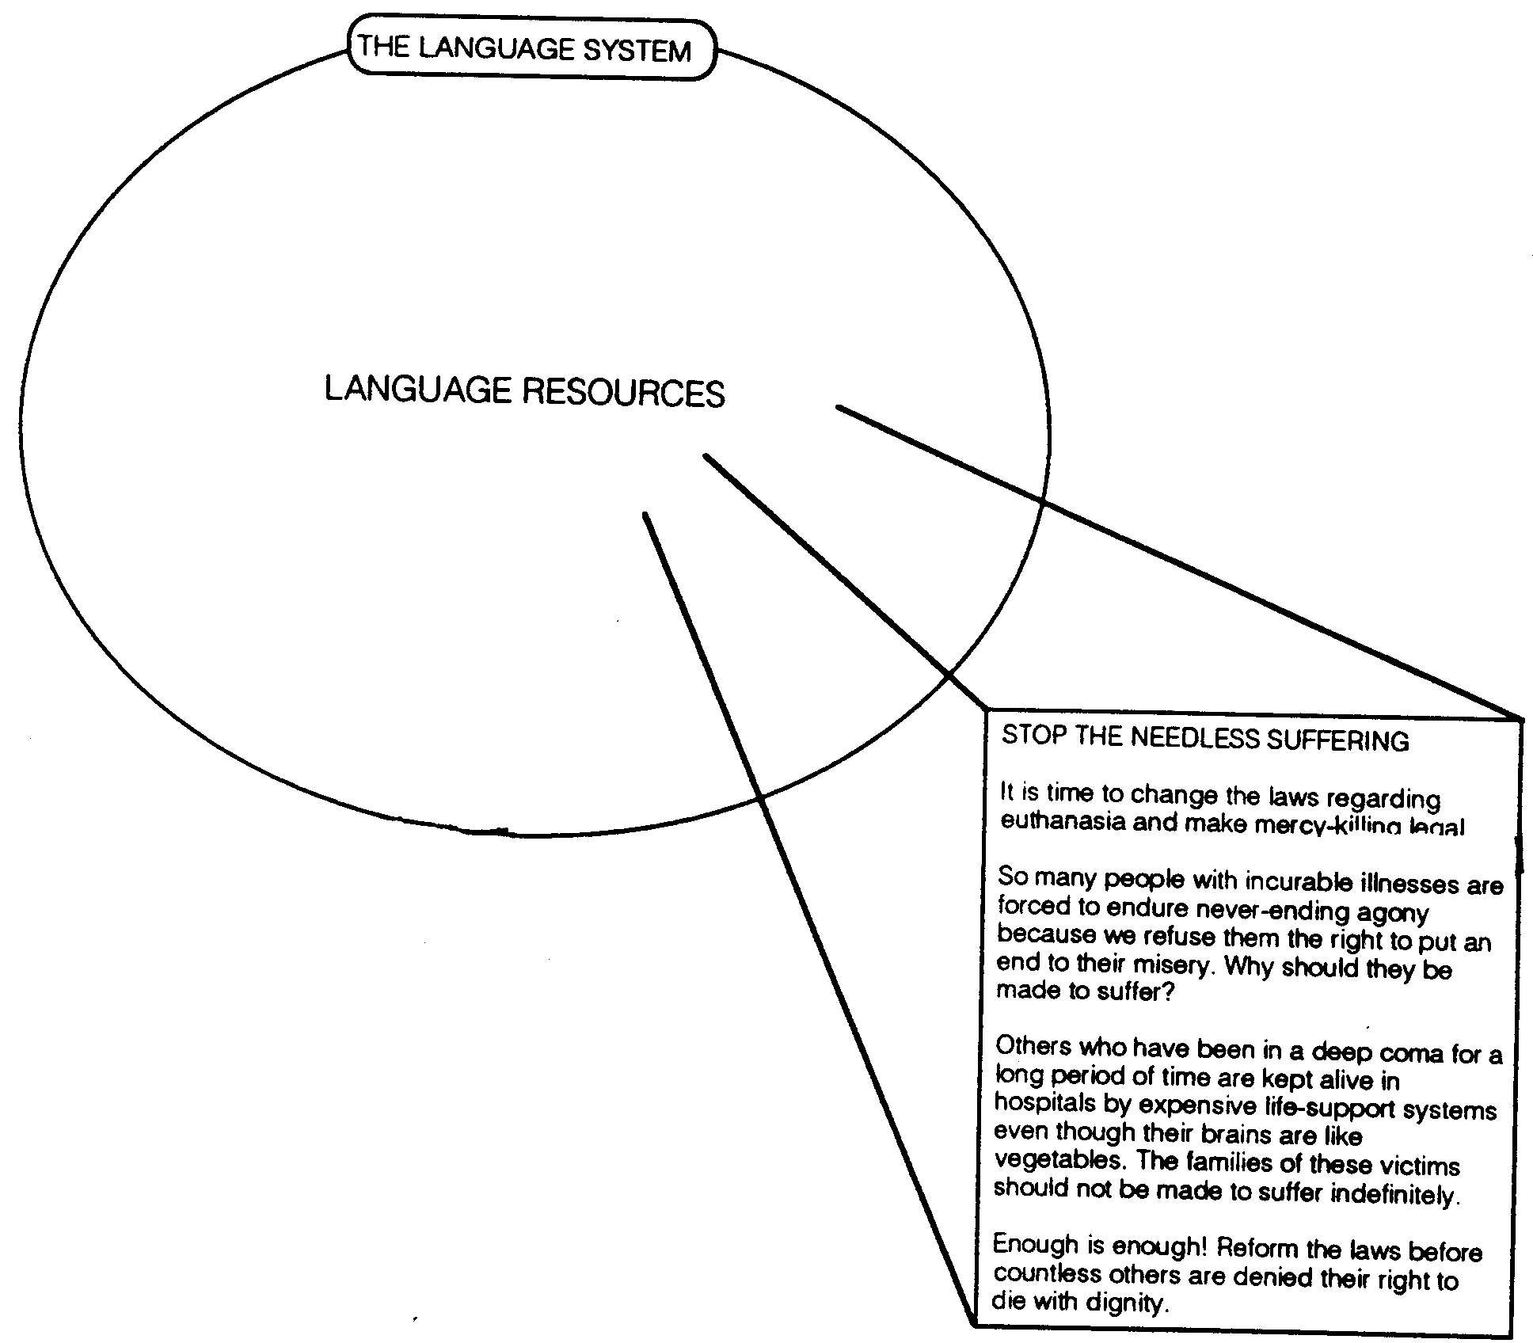
FUNCTIONAL MODEL OF LANGUAGE

Slide 15
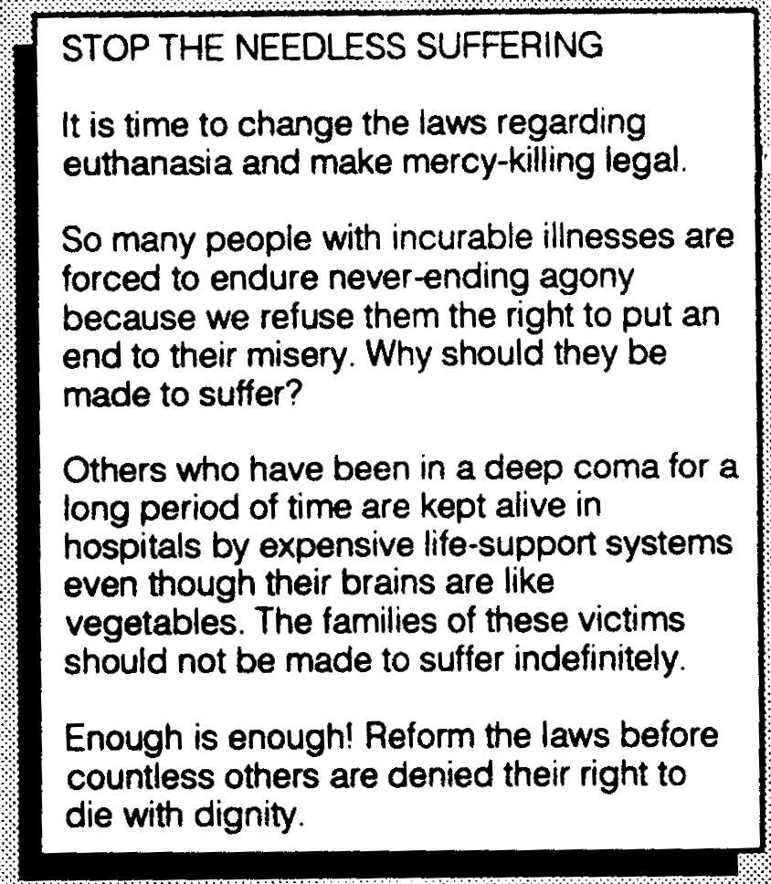
Context and Text
CULTURE
Genre
(Purpose)
SITUATION
Who is involved?
(Tenor)
Subject
matter
Channel
(Mode)
(Field)
REGISTER
TEXT

Slide 16
As a matter of fact, the text consists of clauses.
Each clause carries: ideational, interpersonal and textual function of language
How the writer “wrap” the function in those clauses?
How the writer connect clauses to form the whole paragraph?

Slide 17
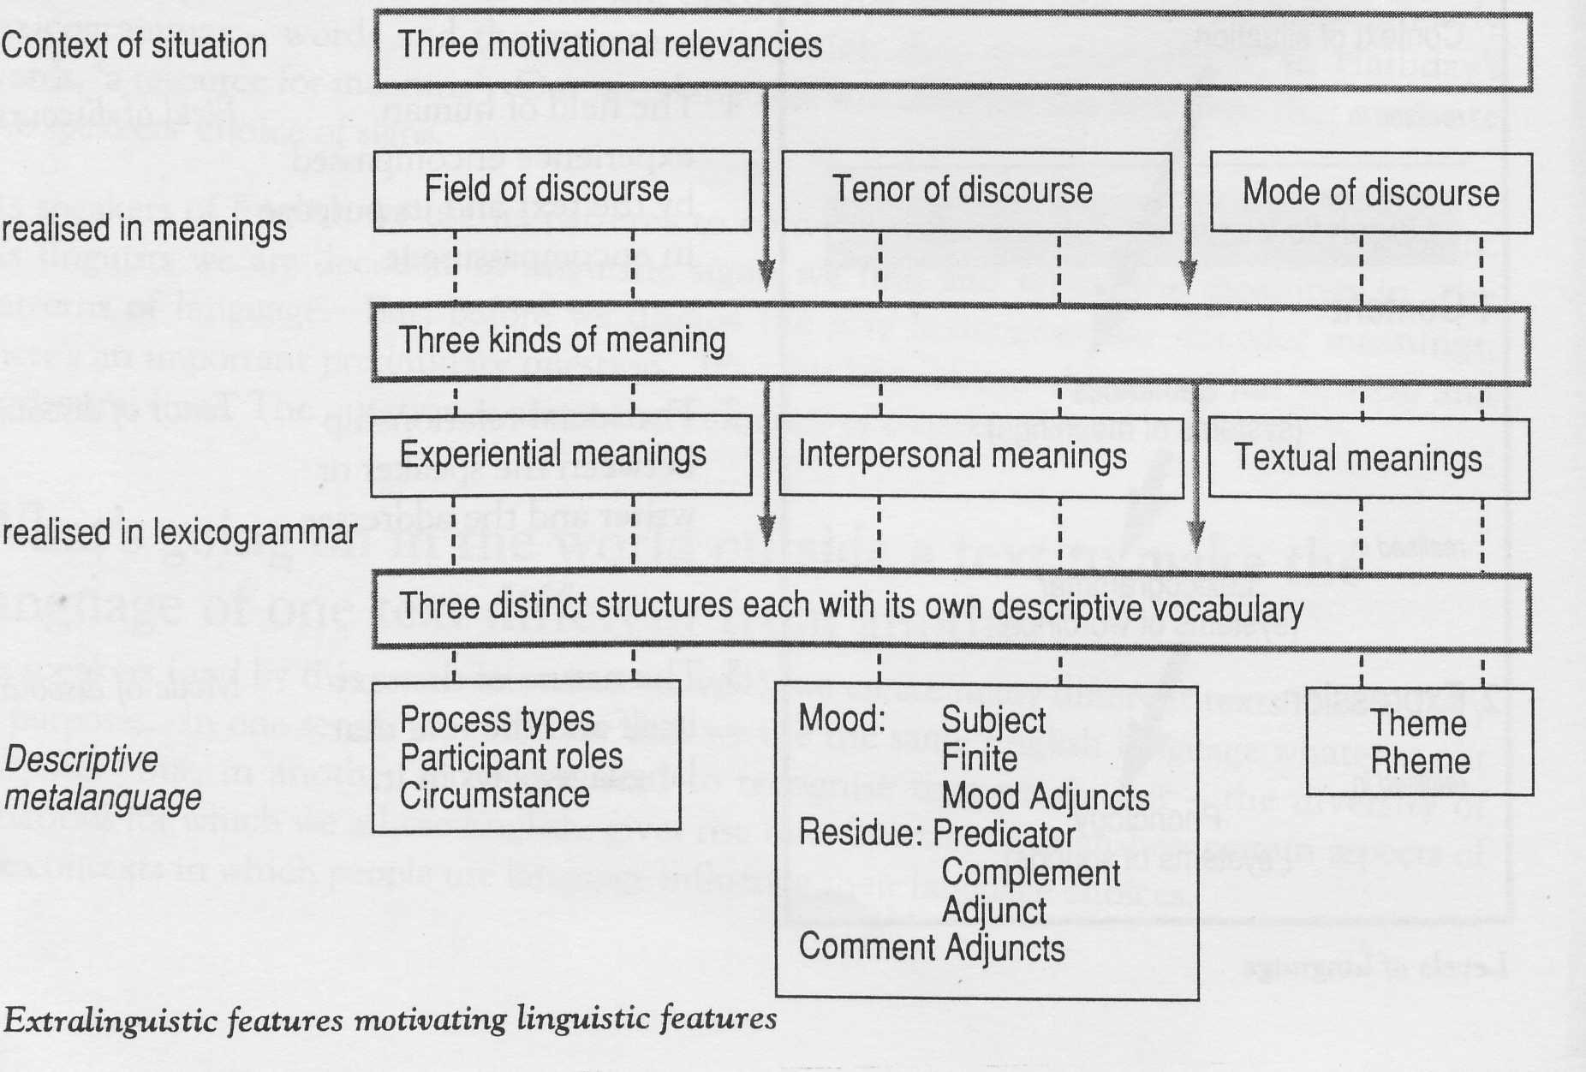
From context to clause

Slide 18
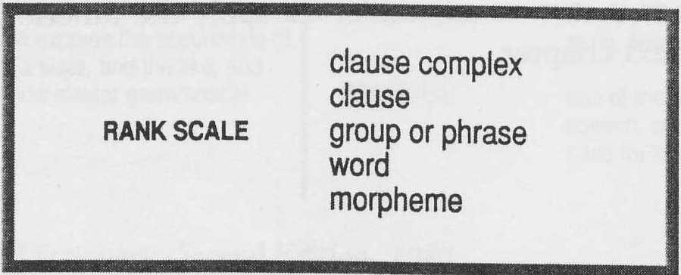
Rank Scales and units
Rank Scales
Units

Slide 19
Example
The children played with their toys (1 clause)
The children / played / with their toys (3 groups)
The / children / played /with / their / toys (6 words)
The / child / ren / play / ed/ with / their /toy / s / (9 morphemes)
Go! (1 clause)
go / (1 group)
go / (1 word)
go / (1 morpheme)

Slide 20
Clause Level
In clause level we will describe any clause from three functional perspective.
We use metalanguage.
We will show how to describe the clause from the functional perspective one by one: ideational, interpersonal, textual
metafunction | System network: | in the open glade | the wild rabbits | danced | with their shadows.
textual | THEME | Theme | Rheme
interpersonal | MOOD | Adjunct | Subject | Finite/ Predicator | Adjunct
 |  | Residue (1) | Mood |  | Residue (2)
ideational | TRANSITIVITY | Location | Actor | Process | Accompaniment

Slide 21
Three types of meaning in one clause
Language encodes all three kinds of meanings simultaneously in one clause. When you say “Robinho plays football.” you are:
representing or describing something (experiential meaning)
interacting with someone (interpersonal meaning), by
Telling something and organizing your message in a linear flow (textual meaning).
Each of this aspects is achieved through your choice of lexico-grammar options.
Robinho plays football.
Situation

Slide 22
TRANSITIVITY, MOOD, THEME
TRANSITIVITY: grammatical system that aims to describe the option of representational/ideational meaning
MOOD: grammatical system that relates to interpersonal meaning
THEME: grammatical system that captures the organization of message
If we put these part of grammar in the previous system network, we have the following graphs.

Slide 23
Independence of metafunction

Slide 24
TRANSITIVITY
In order to talk about language used to express experience, we need the following metalanguages:
ACTOR
AGENT
PARTICIPANT GOAL
CARRIER
SAYER
MATERIAL
PROCESS RELATIONAL
PROJECTING
Cause
Location
Circumstance Manner
Accompaniment
Etc.

Slide 25
Processes in Transitivity

Slide 26
Transitivity
PROCESS TYPE
 | category meaning |  |  |  |  | PROJECT-ION | TENSE
material | doing & happening | Actor the company | Process is giving | Goal a new teapot | Recipient to my aunt |  | present-in-present
mental | sensing | Senser: conscious my aunt | Process wants | Phenomenon a new teapot |  | + projection | present
 |  | my aunt | wants |  |  | them to buy a new teapot
verbal | saying | Sayer: symbol source the company's letter | Process says | Verbiage kind things | Receiver to my aunt | + projection | present
 |  | the company's letter | says |  | to my aunt | that she is entitled to a new teapot
relational | being & having | Carrier this teapot | Process is | Attribute beautiful |  |  | present
 |  | Identified this | Process is | Identified the teapot the company gave my aunt

Slide 27
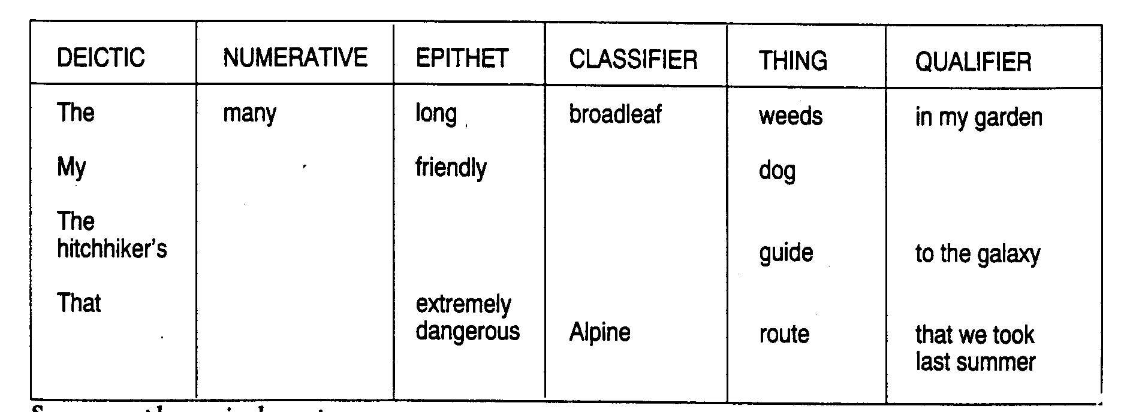
Phrase Level
Participant

Slide 28
MOOD
MOOD BLOCK = Subject + Finite
Predicator = Verbal group – Finite
Adjunct = Circumstances
Complement = Other nominal group, that complete argument
Residue = Predicator + Complement + Adjunct

Slide 29
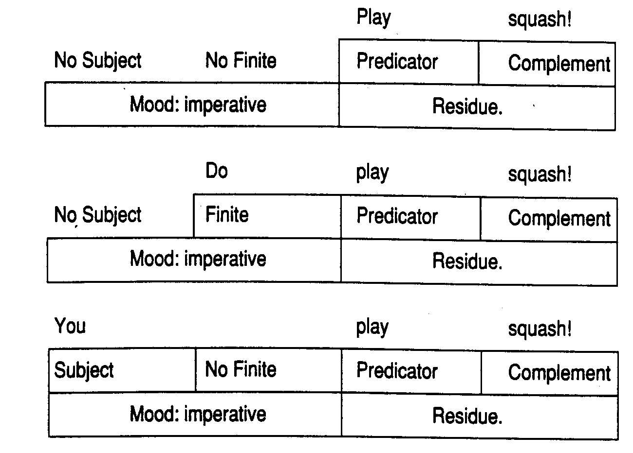

Slide 30
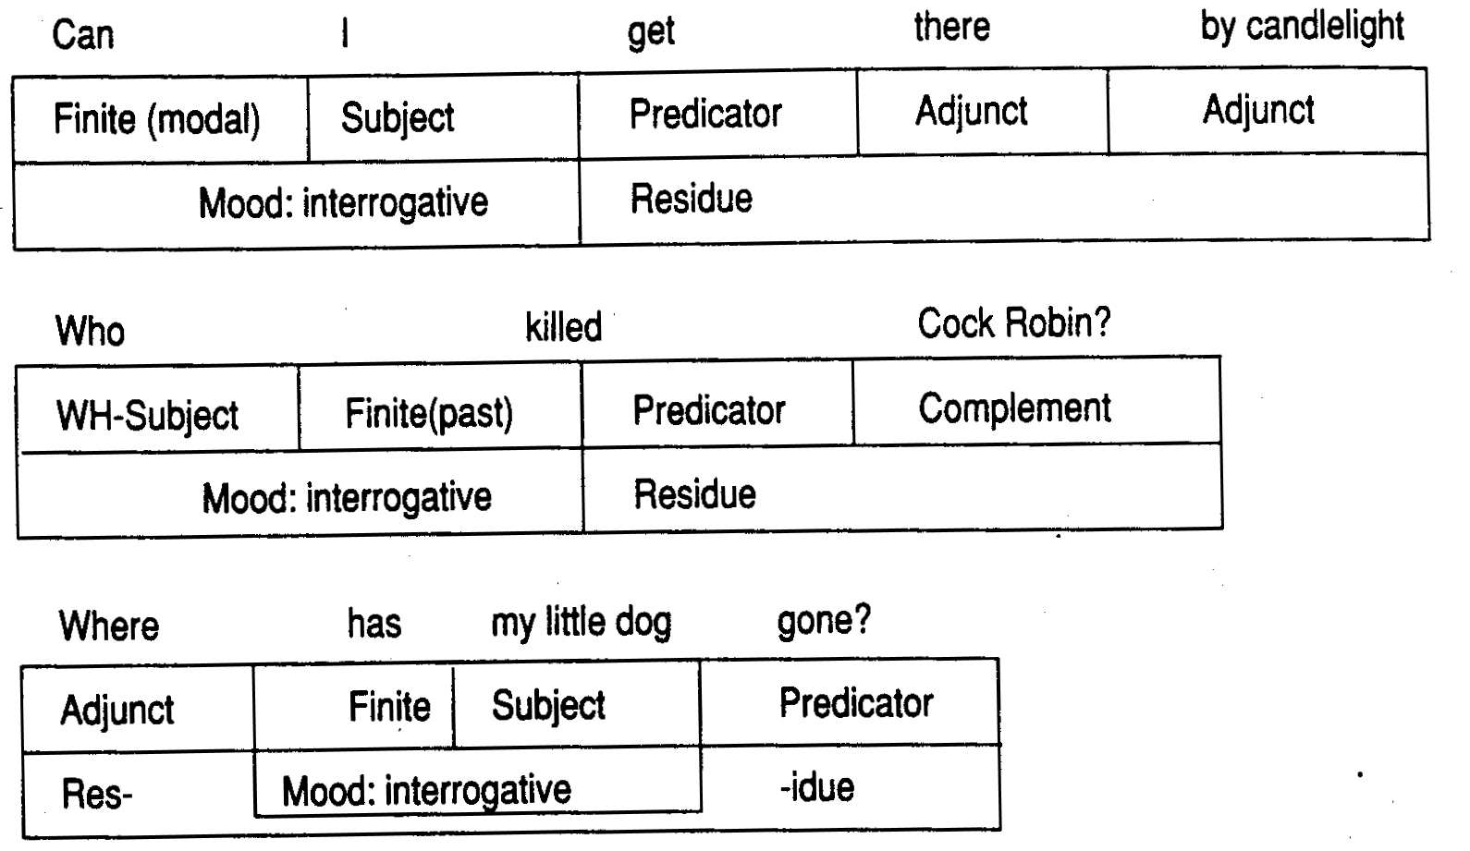
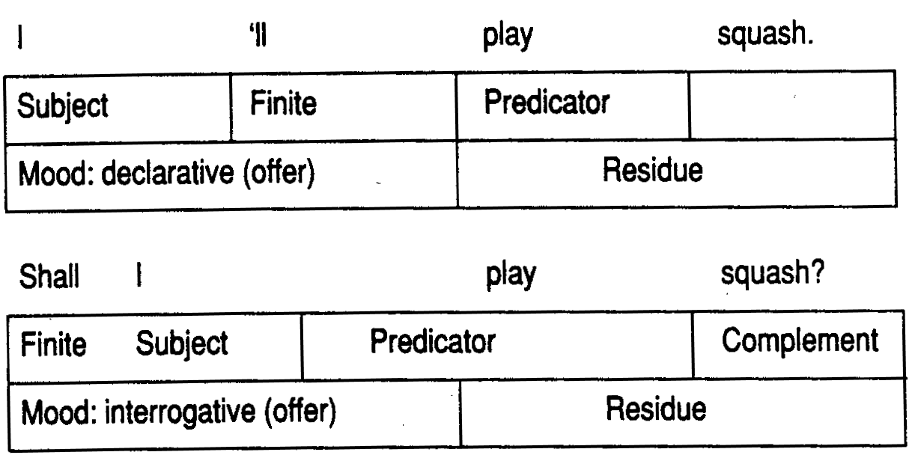

Slide 31
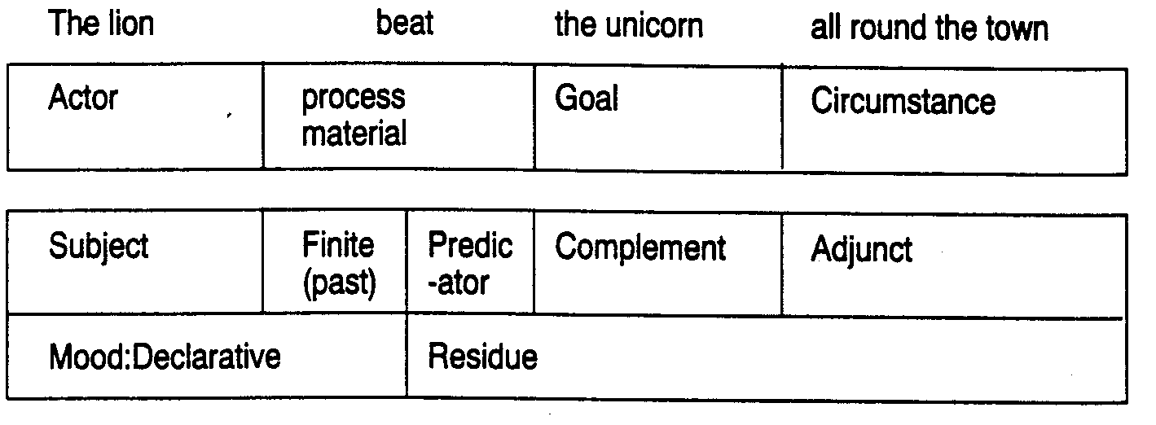
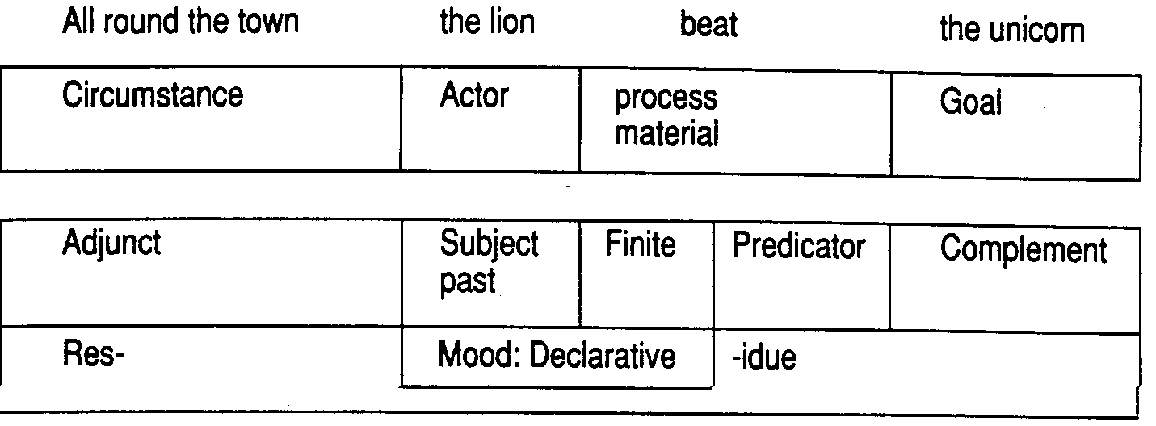
Ideational and Interpersonal

Slide 33
THEME (Textual Meaning)
Theme = what the message is concerned with: the point of departure for what the speaker is going to say
Simple theme
Multiple theme
Types of theme:
Topical theme
Textual theme
Interpersonal
SIMPLE THEME
Theme Rheme
The lion beat the unicorn all round the town.
All round the town the lion beat the unicorn.
By the lion the unicorn was beaten all round the town.
The unicorn was beaten by the lion all round the town.

Slide 34
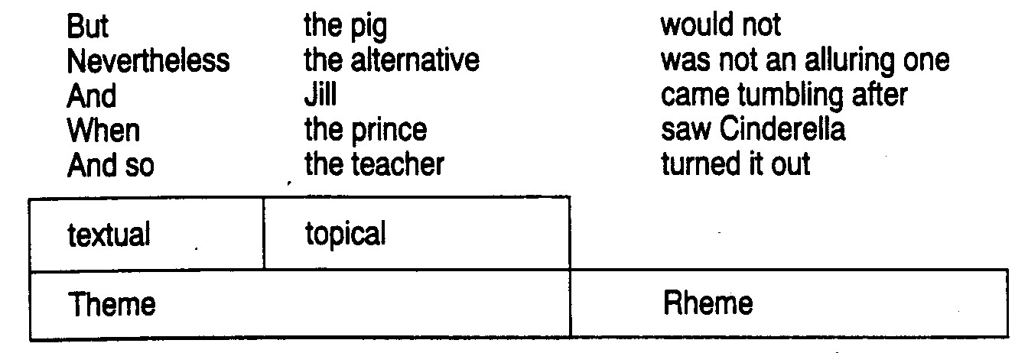
Multiple theme

Slide 35
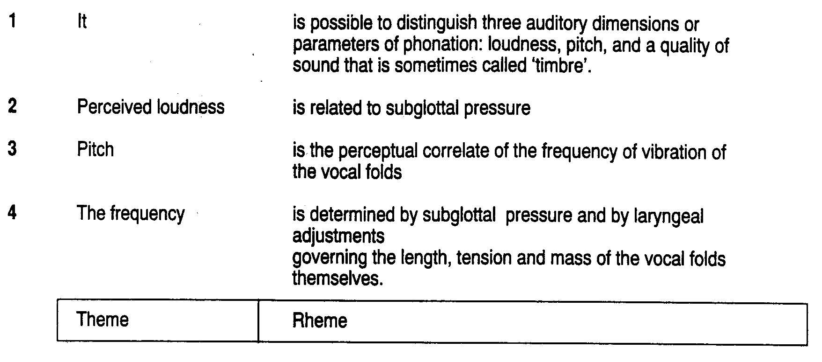
How theme connects clauses

Slide 36
How clauses further joint together to form a text?
The use of cohesive marker
Reference
Synonymy, antonymy, collocation
This will form text “texture”

Slide 37
Application of SFL
Education, e.g. Indonesia
Computer => Natural language Generation
Translation => to improve translation machine

