Slide 1
Selisih Terhingga Biasa,
Selisih Pembagi dan Selisih Pembagi Newton
Aflich yusnita f, m.Pd.

Slide 2
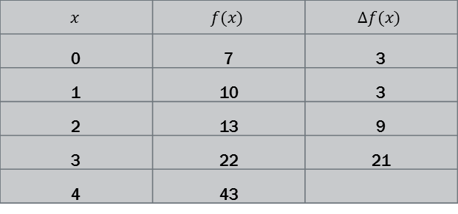

Selisih terhingga biasa
Bila diberikansuatufungsi$f(x)$dansuatudaftar yang memuat$f\left(a\right),f\left(a+h\right), f\left(a+2h\right)$denganvariabelbebas$x$bertambahpadajarak interval yang sama, makaselisihantaraduanilai$x$ yang berturutandisebutselisih interval danditulisdengan$h$.
Misalkan$f\left(x\right)=x^{3}−3x^{2}+5x+7$
$$x$$ | $$f(x)$$ | $$∆f(x)$$
0 | 7 | 3
1 | 10 | 3
2 | 13 | 9
3 | 22 | 21
4 | 43
h
h
h
h

Slide 3

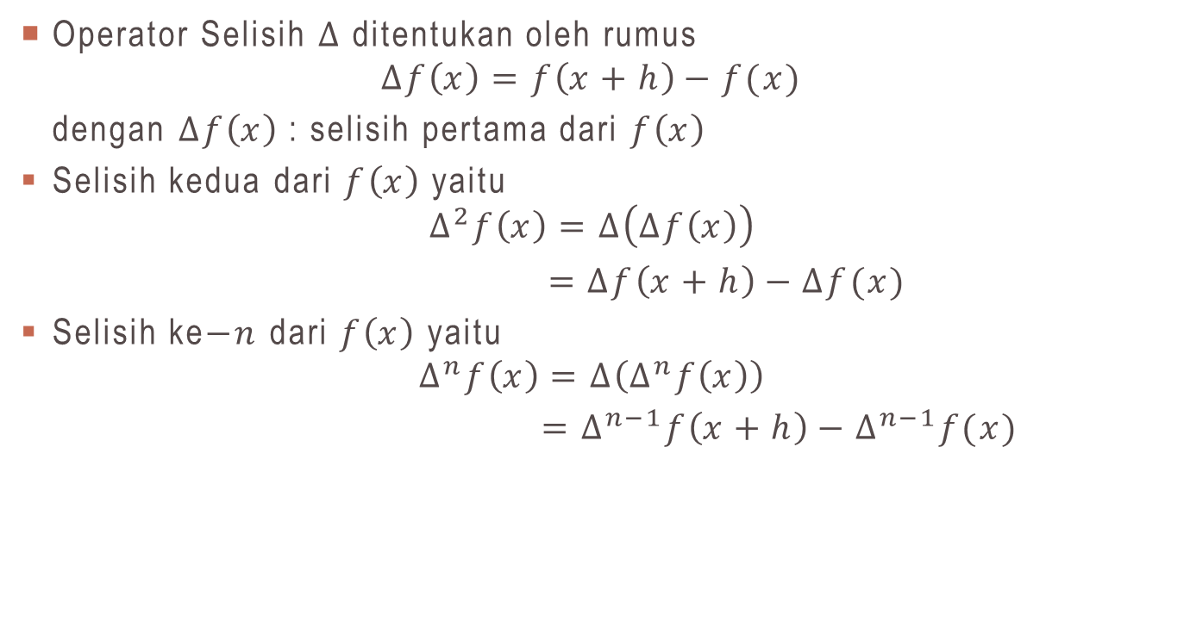
Operator Selisih$∆$
Operator Selisih$∆$ditentukanolehrumus
$$∆f\left(x\right)=f\left(x+h\right)−f(x)$$
dengan$∆f\left(x\right)$ : selisihpertamadari$f\left(x\right)$
Selisihkeduadari$f\left(x\right)$ yaitu
$$∆^{2}f\left(x\right)=∆\left(∆f\left(x\right)\right)$$
$$=∆f\left(x+h\right)−∆f(x)$$
Selisihke$−n$dari$f\left(x\right)$yaitu
$$∆^{n}f\left(x\right)=∆\left(∆^{n}f\left(x\right)\right)$$
$$=∆^{n−1}f\left(x+h\right)−∆^{n−1}f(x)$$

Slide 4
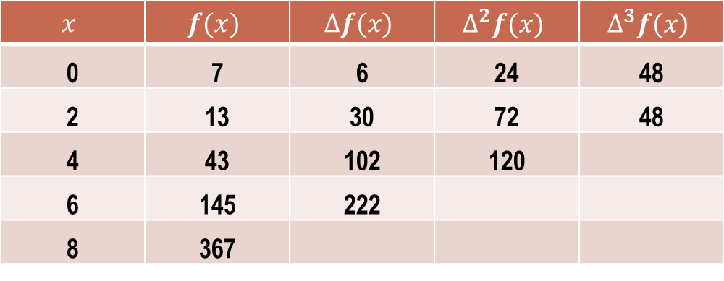

Contoh soal selisih terhingga biasa
Diketahui $f\left(x\right)=x^{3}−3x^{2}+5x+7$dimulaidengan$x=0$sebagainilaiawal, sampaidengan$x=8$dengannilai$h=2,$makatabelselisihadalahsebagaiberikut
$$x$$ | $$f(x)$$ | $$∆f(x)$$ | $$∆^{2}f(x)$$ | $$∆^{3}f(x)$$
0 | 7 | 6 | 24 | 48
2 | 13 | 30 | 72 | 48
4 | 43 | 102 | 120
6 | 145 | 222
8 | 367

Slide 5
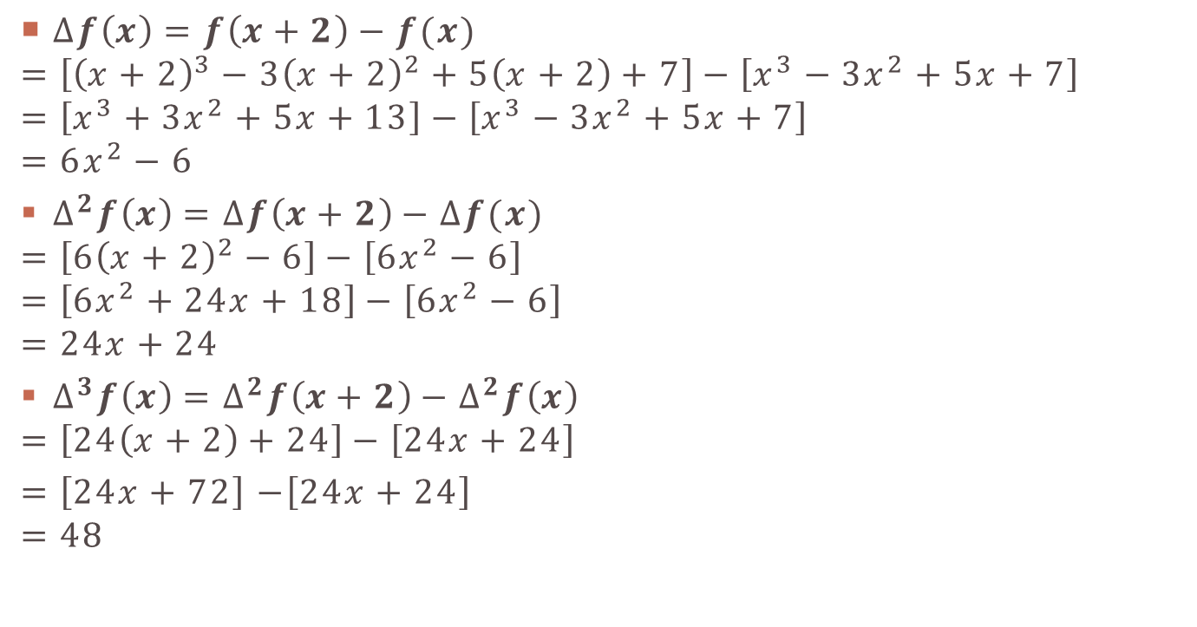
Formula ANALITIK
$∆f\left(x\right)=f\left(x+2\right)−f(x)$
$$=\left[{\left(x+2\right)}^{3}−3{\left(x+2\right)}^{2}+5\left(x+2\right)+7\right]−\left[x^{3}−3x^{2}+5x+7\right]$$
$$=\left[x^{3}+3x^{2}+5x+13\right]−\left[x^{3}−3x^{2}+5x+7\right]$$
$$=6x^{2}−6$$
$∆^{2}f\left(x\right)=∆f\left(x+2\right)−∆f(x)$
$$=\left[{6\left(x+2\right)}^{2}−6\right]−\left[6x^{2}−6\right]$$
$$=\left[6x^{2}+24x+18\right]−\left[6x^{2}−6\right]$$
$$=24x+24$$
$∆^{3}f\left(x\right)=∆^{2}f\left(x+2\right)−∆^{2}f\left(x\right)$
$$=\left[24\left(x+2\right)+24\right]−\left[24x+24\right]$$
$$=\left[24x+72\right]−\left[24x+24\right]$$
$$=48$$

Slide 6


Hukum-hukum operator $∆$
$∆\left[f\left(x\right)+g(x)\right]=∆f\left(x\right)+∆g\left(x\right)$
$∆\left[cf\left(x\right)\right]=c∆f\left(x\right),c$merupakankonstanta

Slide 7
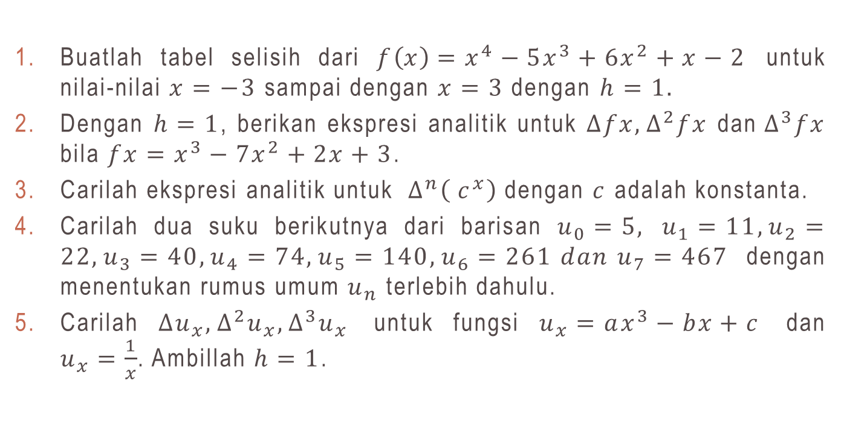
Soal latihan selisih terhingga biasa
Buatlahtabelselisihdari$f\left(x\right)=x^{4}−5x^{3}+6x^{2}+x−2$untuknilai-nilai$x=−3$sampaidengan$x=3$ dengan $h=1.$
Dengan$h=1$, berikanekspresianalitikuntuk$∆fx,∆^{2}fx$ dan${ ∆}^{3}fx$ bila $fx=x^{3}−7x^{2}+2x+3$.
Carilahekspresianalitikuntuk${ ∆}^{n}\left({ c}^{x}\right)$ dengan $c$adalahkonstanta.
Carilahduasukuberikutnyadaribarisan$u_{0}=5,u_{1}=11,u_{2}=22,u_{3}=40,u_{4}=74,u_{5}=140,u_{6}=261 dan u_{7}=467$denganmenentukanrumusumum$u_{n}$terlebihdahulu.
Carilah$∆u_{x},∆^{2}u_{x},∆^{3}u_{x}$untukfungsi$u_{x}=ax^{3}−bx+c$ dan $u_{x}=\frac{1}{x}$. Ambillah $h=1$.

Slide 8
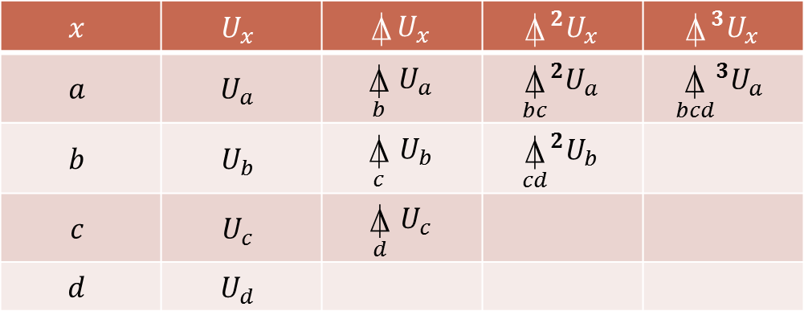

Selisih pembagi
Misalkan diberikannilai-nilaifungsi$U_{x}$untuk $x=a,b,c,d,⋯$denganpanjang interval $b−a,c−b,d−c,⋯$tidakharussama.
Definisikanselisihpembagidari$U_{a}$ ke $b$olehpersamaan
$$\underset{b}{⍋}{U_{a}}=\frac{U_{b}−U_{a}}{b−a}$$
TabelSelisihpembagidarifungsitersebutadalah
$$x$$ | $$U_{x}$$ | $$⍋U_{x}$$ | $$⍋^{2}U_{x}$$ | $$⍋^{3}U_{x}$$
$$a$$ | $$U_{a}$$ | $$\underset{b}{⍋}{U_{a}}$$ | $${\underset{bc}{⍋}}^{2}U_{a}$$ | $${\underset{bcd}{⍋}}^{3}U_{a}$$
$$b$$ | $$U_{b}$$ | $$\underset{c}{⍋}{U_{b}}$$ | $${\underset{cd}{⍋}}^{2}U_{b}$$
$$c$$ | $$U_{c}$$ | $$\underset{d}{⍋}{U_{c}}$$
$$d$$ | $$U_{d}$$

Slide 9
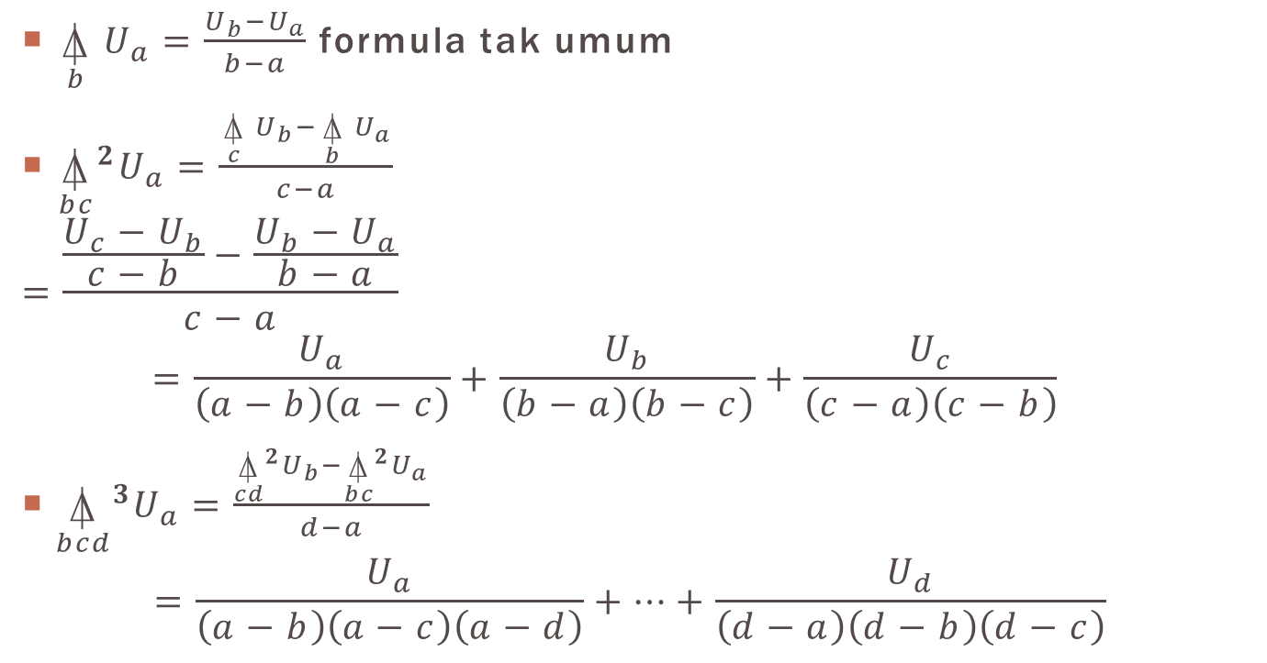
Selisih pembagi untuk sembarang n
$\underset{b}{⍋}{U_{a}}=\frac{U_{b}−U_{a}}{b−a}$ formula takumum
${\underset{bc}{⍋}}^{2}U_{a}=\frac{\underset{c}{⍋}{U_{b}}−\underset{b}{⍋}{U_{a}}}{c−a}$
$$=\frac{\frac{U_{c}−U_{b}}{c−b}−\frac{U_{b}−U_{a}}{b−a}}{c−a}=\frac{U_{a}}{\left(a−b\right)\left(a−c\right)}+\frac{U_{b}}{\left(b−a\right)\left(b−c\right)}+\frac{U_{c}}{\left(c−a\right)\left(c−b\right)}$$
${\underset{bcd}{⍋}}^{3}U_{a}=\frac{{\underset{cd}{⍋}}^{2}U_{b}−{\underset{bc}{⍋}}^{2}U_{a}}{d−a}$
$$=\frac{U_{a}}{\left(a−b\right)\left(a−c\right)\left(a−d\right)}+⋯+\frac{U_{d}}{\left(d−a\right)\left(d−b\right)\left(d−c\right)}$$

Slide 10

Teorema
Bila $a,b,c,⋯$adalahnilai-nilaidariargumen$x,$ maka
$${\underset{bcd⋯k}{⍋}}^{r}U_{a}=\frac{U_{a}}{\left(a−b\right)\left(a−c\right)⋯\left(a−k\right)}+⋯+\frac{U_{k}}{\left(k−b\right)\left(k−c\right)⋯\left(k−j\right)}$$

Slide 11
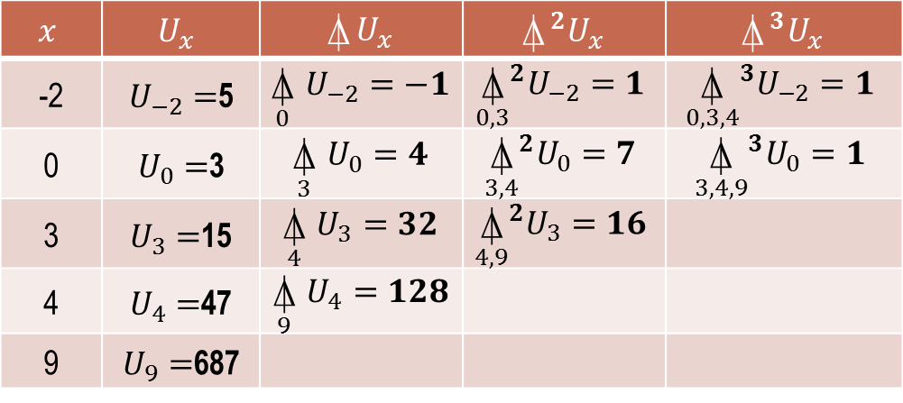

Contoh soal selisih pembagi(1)
Buatlah tabelselisihpembagi, untuk$U_{x}$ dengan
$$U_{−2}=5,U_{0}=3,U_{3}=15,U_{4}=47,U_{9}=687$$
Terlihatbahwa
$\underset{0}{⍋}{U_{−2}}=\frac{U_{0}−U_{−2}}{0−\left(−2\right)}=\frac{3−5}{2}=−1$ dan ${\underset{34}{⍋}}^{2}U_{0}=\frac{\underset{4}{⍋}{U_{3}}−\underset{3}{⍋}{U_{0}}}{4−0}=\frac{32−4}{4−0}=7$
$$x$$ | $$U_{x}$$ | $$⍋U_{x}$$ | $$⍋^{2}U_{x}$$ | $$⍋^{3}U_{x}$$
-2 | $U_{−2}=$5 | $$\underset{0}{⍋}{U_{−2}}=−1$$ | $${\underset{0,3}{⍋}}^{2}U_{−2}=1$$ | $${\underset{0,3,4}{⍋}}^{3}U_{−2}=1$$
0 | $U_{0}=$3 | $$\underset{3}{⍋}{U_{0}}=4$$ | $${\underset{3,4}{⍋}}^{2}U_{0}=7$$ | $${\underset{3,4,9}{⍋}}^{3}U_{0}=1$$
3 | $U_{3}=$15 | $$\underset{4}{⍋}{U_{3}}=32$$ | $${\underset{4,9}{⍋}}^{2}U_{3}=16$$
4 | $U_{4}=$47 | $$\underset{9}{⍋}{U_{4}=128}$$
9 | $U_{9}=$687

Slide 12
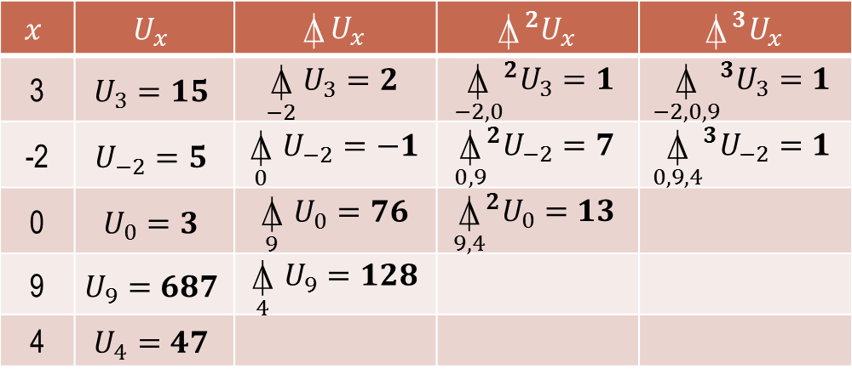

Contoh soal selisih pembagi(2)
Buatlah tabelselisihpembagi, untuk$U_{x}$ dengan
$$U_{3}=15,U_{−2}=5,U_{0}=3,U_{9}=687,U_{4}=47$$
Dapatdilihatbahwa$⍋^{3}U_{x}=1,U_{x}=x^{3}−5x+3$
$$x$$ | $$U_{x}$$ | $$⍋U_{x}$$ | $$⍋^{2}U_{x}$$ | $$⍋^{3}U_{x}$$
3 | $$U_{3}=15$$ | $$\underset{−2}{⍋}{U_{3}}=2$$ | $${\underset{−2,0}{⍋}}^{2}U_{3}=1$$ | $${\underset{−2,0,9}{⍋}}^{3}U_{3}=1$$
-2 | $$U_{−2}=5$$ | $$\underset{0}{⍋}{U_{−2}}=−1$$ | $${\underset{0,9}{⍋}}^{2}U_{−2}=7$$ | $${\underset{0,9,4}{⍋}}^{3}U_{−2}=1$$
0 | $$U_{0}=3$$ | $$\underset{9}{⍋}{U_{0}}=76$$ | $${\underset{9,4}{⍋}}^{2}U_{0}=13$$
9 | $$U_{9}=687$$ | $$\underset{4}{⍋}{U_{9}=128}$$
4 | $$U_{4}=47$$

Slide 13

teorema
Bila $U_{x}$suatupolinomberderajat$n$, maka$⍋^{n}$konstan

Slide 14
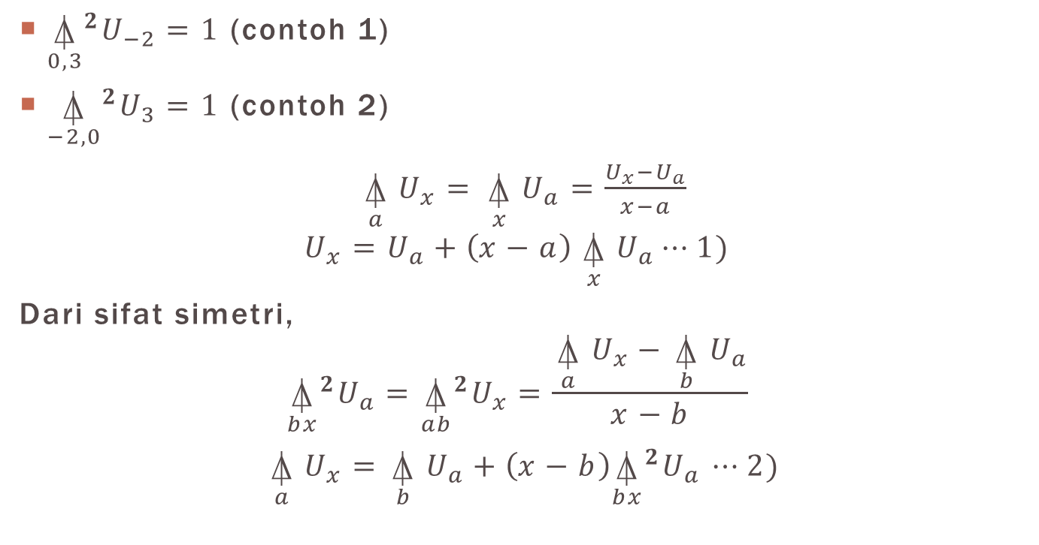
Selisih pembagi newton
${\underset{0,3}{⍋}}^{2}U_{−2}=1$ (contoh 1)
${\underset{−2,0}{⍋}}^{2}U_{3}=1$(contoh2)
$$\underset{a}{⍋}{U_{x}=}\underset{x}{⍋}{U_{a}=\frac{U_{x}−U_{a}}{x−a}}$$
$$U_{x}=U_{a}+\left(x−a\right)\underset{x}{⍋}{U_{a}}⋯1)$$
Dari sifatsimetri,
$${\underset{bx}{⍋}}^{2}U_{a}={\underset{ab}{⍋}}^{2}U_{x}=\frac{\underset{a}{⍋}{U_{x}}−\underset{b}{⍋}{U_{a}}}{x−b}$$
$$\underset{a}{⍋}{U_{x}=\underset{b}{⍋}{U_{a}}+\left(x−b\right){\underset{bx}{⍋}}^{2}U_{a}}⋯2)$$

Slide 15
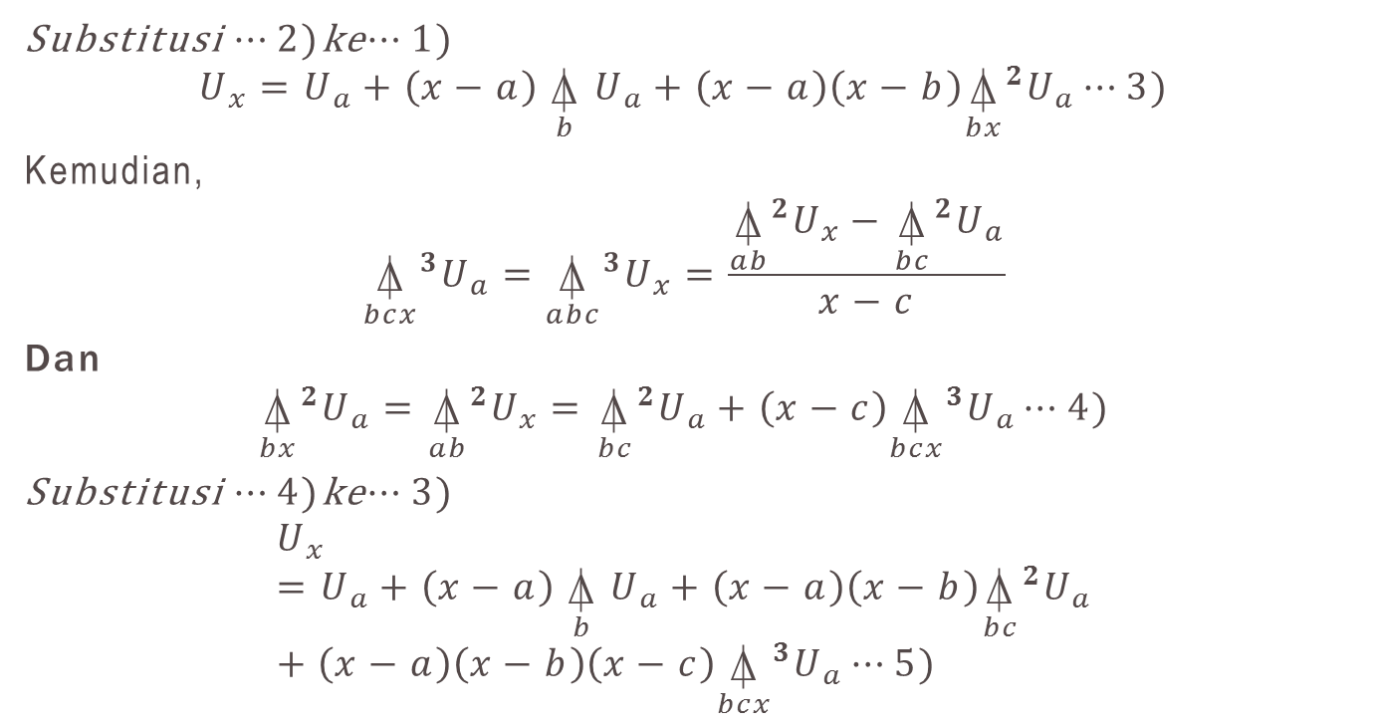
Selisih pembagi newton(2)
Substitusi $⋯2)$ke$⋯1)$
$$U_{x}=U_{a}+\left(x−a\right)\underset{b}{⍋}{U_{a}+\left(x−a\right)\left(x−b\right){\underset{bx}{⍋}}^{2}U_{a}}⋯3)$$
Kemudian,
$${\underset{bcx}{⍋}}^{3}U_{a}={\underset{abc}{⍋}}^{3}U_{x}=\frac{{\underset{ab}{⍋}}^{2}U_{x}−{\underset{bc}{⍋}}^{2}U_{a}}{x−c}$$
Dan
$${\underset{bx}{⍋}}^{2}U_{a}={\underset{ab}{⍋}}^{2}U_{x}={\underset{bc}{⍋}}^{2}U_{a}+\left(x−c\right){\underset{bcx}{⍋}}^{3}U_{a}⋯4)$$
Substitusi $⋯4)$ke$⋯3)$
$$U_{x}=U_{a}+\left(x−a\right)\underset{b}{⍋}{U_{a}+\left(x−a\right)\left(x−b\right){\underset{bc}{⍋}}^{2}U_{a}}+\left(x−a\right)\left(x−b\right)\left(x−c\right){\underset{bcx}{⍋}}^{3}U_{a}⋯5)$$

Slide 16

Selisih pembagi newton(3)
Untuk nilaiargumen$x,a$,$b,c,⋯,j,k$ dan
$x−a=A$
$x−b=B$
$⋯$
$x−j=J$
$x−k=K$
Diperoleh
$$U_{x}=U_{a}+A\underset{b}{⍋}{U_{a}+AB{\underset{bc}{⍋}}^{2}U_{a}}+ABC{\underset{bcd}{⍋}}^{3}U_{a}+⋯+ABC⋯J{\underset{bc⋯k}{⍋}}^{n}U_{a}$$

Slide 17
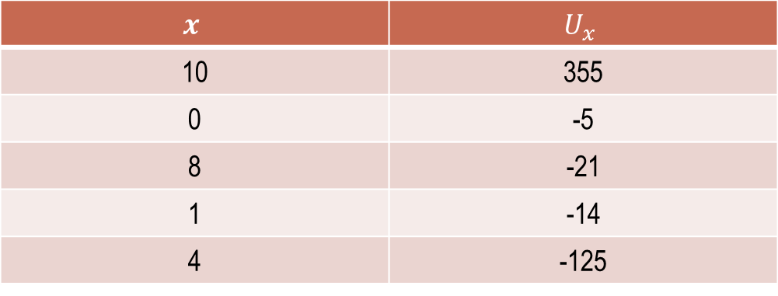

Contoh soal selisih pembagi newton(1)
Gunakanselisihpembagi newton untukmengaproksimasipolinom$U_{x}$dari data
$$x$$ | $$U_{x}$$
10 | 355
0 | -5
8 | -21
1 | -14
4 | -125

Slide 18
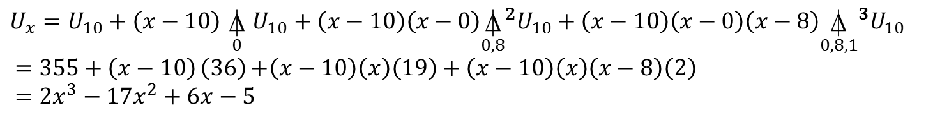
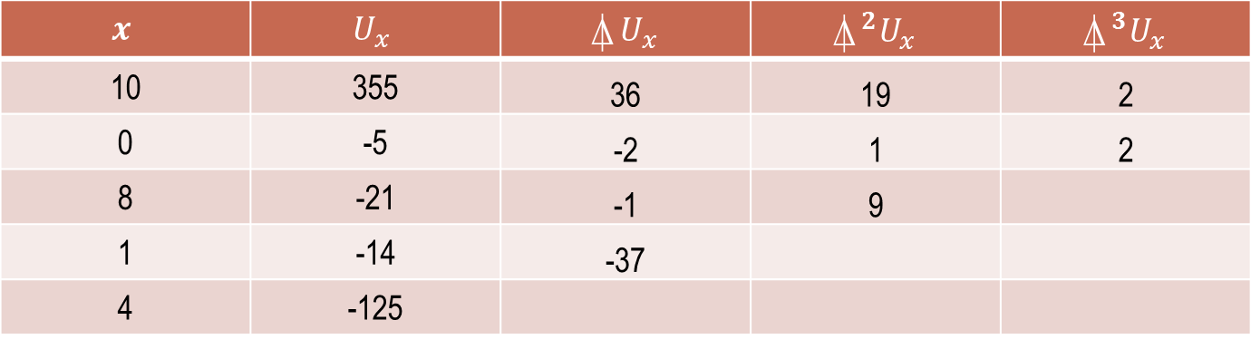
$$x$$ | $$U_{x}$$ | $$⍋U_{x}$$ | $$⍋^{2}U_{x}$$ | $$⍋^{3}U_{x}$$
10 | 355 | 36 | 19 | 2
0 | -5 | -2 | 1 | 2
8 | -21 | -1 | 9
1 | -14 | -37
4 | -125
$$U_{x}=U_{10}+\left(x−10\right)\underset{0}{⍋}{U_{10}+\left(x−10\right)\left(x−0\right){\underset{0,8}{⍋}}^{2}U_{10}}+\left(x−10\right)\left(x−0\right)\left(x−8\right){\underset{0,8,1}{⍋}}^{3}U_{10}$$
$$=355+\left(x−10\right)\left(36\right){+\left(x−10\right)\left(x\right)\left(19\right)}+\left(x−10\right)\left(x\right)\left(x−8\right)\left(2\right)$$
$$=2x^{3}−17x^{2}+6x−5$$

Slide 19
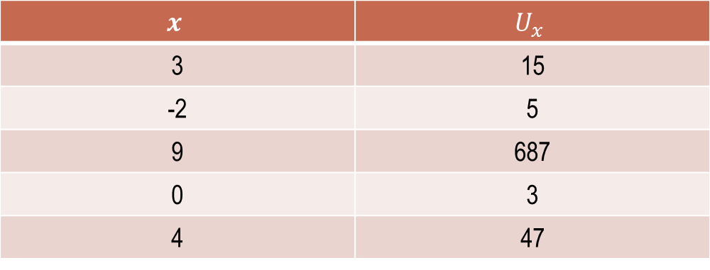

Soal latihan selisih Pembagi dan pembagi newton
Buatlah tabelselisihpembagidari data berikut
Dari tabel di atas, carilah$\underset{−2}{⍋}{U_{3},}\underset{9}{⍋}{U_{−2},}\underset{9,0}{⍋}{U_{−2},\underset{−2,9,0}{⍋}{U_{3}}}$
Carilah Ux!
$$x$$ | $$U_{x}$$
3 | 15
-2 | 5
9 | 687
0 | 3
4 | 47

