Slide 1
Defining the language

Slide 2
The definition of Language
System of communication by sound, operating through the organs of speech, among members of a given community, and using vocal symbols possessing arbitrary conventional meaning (Pei, 1966)
Language

Slide 3
Language
a system of conventional spoken, manual (signed), or written symbols by means of which human beings, as members of a social group and participants in its culture, express themselves. The functions of language include communication, the expression of identity, play, imaginative expression, and emotional release.

Slide 4
Language is the expression of ideas by means of speech-sounds combined into words. Words are combined into sentences, this combination answering to that of ideas into thoughts.

Slide 5
Pohon
Tree
Sajaroh

Slide 6
Defining linguistics in general

Slide 7
The definition of Linguistics
,
the scientific study of language and its structure
Linguistics

Slide 8
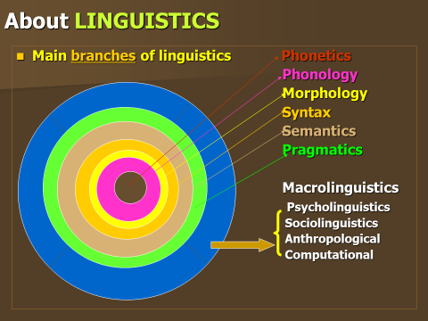

Slide 9
Core branches of Linguistics
Linguistics
Language
Sounds
Sign
words
sentences
meaning
semantics/
pragmatics
Phonetics/
phonology
Semiotics
syntax
morphology

Slide 10
Microlinguistics
Phonetics
is the scientific study of speech sounds. It studies how speech sounds are articulated, transmitted, and received.
Phonology
is the study of how speech sounds function in a language, it studies the ways speech sounds are organized. It can be seen as the functional phonetics of a particular language.
Morphology
is the study of the formation of words. It is a branch of linguistics which breaks words into morphemes. It can be considered as the grammar of words as syntax is the grammar of sentences.

Slide 11
Syntax
the combination of words into phrases, clauses and sentences. It is the grammar of sentence construction.
Semantics
a branch of linguistics which is concerned with the study of meaning in all its formal aspects. Words have several types of meaning.
Pragmatics
the study of language in use. It deals with how speakers use language in ways which cannot be predicted from linguistic knowledge alone, and how hearers arrive at the intended meaning of speakers.

Slide 12
Macrolinguistics
Psycholinguistics:
Language + psychology
Sociolinguistics:
Language + society
Anthropological linguistics:
Language + anthropology
Computational linguistics:
Language + computer

Slide 13
Macrolinguistics
Sociolinguistics
studies the relations between language and society: how social factors influence the structure and use of language.
Psycholinguistics
the study of language and mind: the mental structures and processes which are involved in the acquisition, comprehension and production of language.
Neurolinguistics
the study of language processing and language representation in the brain. It typically studies the disturbances of language comprehension and production caused by the damage of certain areas of the brain.

Slide 14
Discourse analysis
the study of the relationship between language and the contexts in which language is used. It deals with how sentences in spoken and written language form larger meaningful units.
Computational linguistics
an approach to linguistics which employs mathematical techniques, often with the help of a computer.

