Slide 1
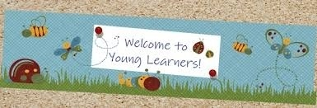
CHILDREN LANGUAGE TEACHING AND PRACTICE (CELTP) /TECHING ENGLISH TO YOUNG LEARNERS (TEYL) /ENGLISH FOR YOUNG LEARNERS (EYL) By: Sri Supiah Cahyati, M.Pd
English Education Study Program
IKIP SILIWANGI
2019

Slide 2
Session 1
Introduction: Syllabus, Scoring system, References, CELTP’s Project
Basic Concept of EYL: Characteristics of YL, Myths and misconceptions about language learning)

Slide 3
Syllabus:
See the appendix

Slide 4
Some Terms in Teaching English
TESL (Teaching English as a Second Language) :
Learning of English by immigrants to a country where English is the native language.
Ex : Korean child moved to Australia is an ESL learner in her English class.
TEFL (Teaching English as a Foreign Language):
Learning of English by students in a country where English is not the native language.
Ex: Children are learning English at school, university, or a language school in their own country.

Slide 5
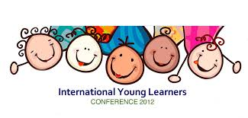
Slattery & Willis (2005)
TEVYL: Teaching English to Very Young Learners (children under 7).
TEYL: Teaching English to Young Learners (children between 7-12).
Pinter (2006)
Older learners: children at junior & senior high school.
Adult learners: students at university level/above secondary school.

Slide 6
Using English as a Means of Communication to Students
Teacher as a role model
Daily conversation (classroom language) as exposure to the students.
Students tend to imitate the teacher.

Slide 7
1➔ Good Morning
Good morning everybody, how are you? (I’m good)
Good morning everybody, how are you?
(I’m good)
Good morning to you,
Good morning to you,
Good morning everybody, how are you?
(I’m good)
=> Good morning, Eci
Good morning, Irfan

Slide 8
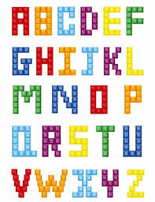
1➔ Alphabet Song
A B C D E F G
H I J K L M N O P
Q R S T U V
W X Y and Z
Now I know my ABC
Next time won’t you sing with me
A B C D E F G
H I J K L M N
O P Q R S T U
V W X Y Z

Slide 9
Basic Concept of CELTP
Characteristics of Young Language Learners
Some Myths and Misconception about SL/FL Learning
Skills should be Taught First in TEYL

Slide 10
Characteristics of Young Learners (Pinter, 2006)
Children are at pre-school/in the first couple of years of schooling.
Generally they have a holistic approach to language, which means that they understand meaningful messages but cannot analyze language yet.
They have lower levels of awareness about themselves as language learners as well as about process of learning.
They have limited reading & writing skills even in their first language.
Generally, they are more concerned about themselves than others.
They have a limited knowledge about the world.
They enjoy fantasy, imagination, & movement.

Slide 11
VYLs (under 7) | YLs (7-12)
Acquire through hearing and experiencing lots of English, in much the same way they acquire L1 Learn things through playing; they are not consciously trying to learn new words or phrases – for them it’s incidental Love playing with language sounds, imitating, and making funny noises Not able to organize their learning Not able to read or write in L1; important to recycle language through talk and play Their grammar will develop gradually on its own when exposed to lots of English in context | Are learning to read and write in L1 Are developing as thinkers Understand the difference between the real and the imaginary Can plan and organize how best to carry out an activity Can work with others and learn from others Can be reliable and take responsibility for class activities and routines For more information, see: Slattery, M., & Willis, J. (2001). English for primary teachers. Oxford: Oxford University Press.

Slide 12
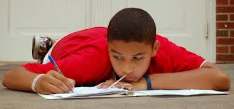
Characteristics of Older/Adult Learners
These children are well established at school & comfortable with school routines.
They show a growing interest in analytical approaches, which means that they begin to take an interest in language as an abstract system.
They show a growing in their learning.
They have well developed skills as readers & writers.
They have a growing awareness of others & their viewpoints.
They have a growing awareness about the world around us.
They begin to show interest in real life issues.

Slide 13
Misconceptions in teaching approach to younger learners can lead to failure (Musthafa, 2000)
Teacher tend to approach the teaching-learning process & employ teaching methods & techniques for the teaching English to young learners in an exactly the same way as they would teach adult learners.
Actually, children have their own culture & learning preferences. They learn by way of physical activities that embedded in their daily life, they have a relatively short attention span, & they learn with the motive of meeting immediate goals (here & now principle)

Slide 14
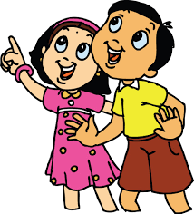
Some myths and misconceptions about second/foreign language learning (Musthafa: 2000)
A. Children learn second/foreign languages quickly & easily.
Adolescents & adults perform better than young children under controlled conditions, except pronunciation. Young children do not have access to the memory techniques & other strategies that more experiences learners use in acquiring vocabulary & in learning grammatical rules. Children are more likely to be shy & embarrassed around peers that are adults.

Slide 15
Some myths and misconceptions about second/foreign language learning (Musthafa: 2000)
B. The younger the child, the more skilled in acquiring an L2/FL
Oyama (in Pinter, 2006) found that the earlier a learner begins a second language, the more native like the accent he/she developed. An early start for “foreign” language learners makes a long sequence of instruction leading to potential communicative proficiency possible & enables children to view L2 learning & related cultural insight as normal & integral. Beginning language instruction gives children more exposure to the language.

Slide 16
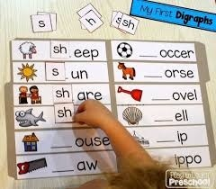
Some myths and misconceptions about second/foreign language learning (Musthafa: 2000)
C. The more time students spend in an L2/FL context, the quicker they learn the language.
The increased exposure to English does not necessarily speed the acquisition of English. Children with exposure to the home language & to English acquire English language skills equivalent to those acquired by children who have been in English-only program.

Slide 17
Some myths and misconceptions about second/foreign language learning (Musthafa: 2000)
D. Children have acquired an L2/FL once they can speak it
For school-aged children, proficiency in face-to-face communication does not imply proficiency in the more complex academic language needed to engage in many classroom activities. Children may have language problems in reading & writing that are not apparent if their oral abilities are used to gauge their English proficiency.

Slide 18
Some myths and misconceptions about second/foreign language learning (Musthafa: 2000)
E. All children learn an L2/FL in the same way
Some children are outgoing, sociable & learn the second language quickly, they do not worry about mistakes, but use limited resources to generate input from native speakers. Other children are shy & quite, they learn by listening & watching, they say little, for fear of making a mistake. Children are likely to be more responsive to a teacher who affirms the values of the home culture.

Slide 19
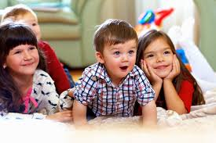
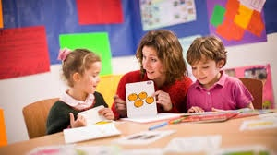
Skills should be taught in TEYL
As in mother tongue learning, English should start with an emphasis on listening & then speaking because children often cannot read & write at all yet.
listening should precede speaking
(communicative skills should be the aim of the good language classroom).
comprehension of language should precede production.
reading and then writing will emerge when the language learner is ready and should not be forced.

Slide 20
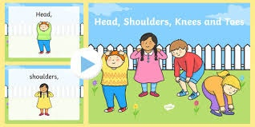
2 ➔ Head, Shoulder, Knees, and Toes (Kepala, Pundak, Lutut, Kaki)
Head, shoulder, knees, and toes (knees and toes)
Head, shoulder, knees, and toes (knees and toes)
And eyes, and ears, and mouth, and nose
Head, shoulder, knees, and toes (knees and toes)
Kepala, pundak, lutut, kaki (lutut, kaki)
Kepala, pundak, lutut, kaki (lutut, kaki)
Mata, telinga, mulut, hidung, dan pipi
Kepala, pundak, lutut, kaki (lutut, kaki)

Slide 21
Days (Nama-Nama Hari)
Sunday, Monday,
Tuesday, Wednesday,
Thursday, Friday, Saturday
=> (2x)
Senin, Selasa,
Rabu, Kamis,
Jumat, Sabtu, Minggu
Itu nama-nama hari

Slide 22
Basic Concepts of Language Teaching

Slide 23
How to teach English in Classroom Context

Slide 24
Discussion
How to be a good teacher?
How to describe learning and teaching?
How to teach across age levels?
Teaching children,
Teaching teens,
Teaching adults
How to plan lessons?
Workshop: Teaching Materials and supplementary

Slide 25
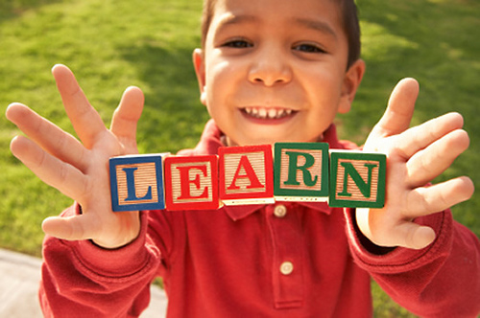
How to be a good teacher? A. How should teachers give instruction? B. Who should talk in class?

Slide 26
A. What makes a good teacher? Source: Private language School students in Britain (Harmer, 2004)
He/she should make his/her lesson interesting so you don’t fall asleep in them
I like the teacher who has his/her own personality & doesn’t hide it from the students- those come through the lesson
I like a teacher who has a lot of knowledge, not only of his subject
The teacher should be able to correct students without offending them
A good teacher is an entertainer in a positive sense, not a negative sense

Slide 27
B. How should teachers give instructions?
The worst activity in the world is a waste of time if the students DON’T understand what it is they are supposed to do.
2 rules for giving instructions
It must be kept as simple as possible: “what is the important information I'm trying to convey?”
It must be logical: “which information do they need first?, which should come next?”.

Slide 28
C. Who should talk in class?
TTT (Teacher Talking Time) -- STT (Student Talking Time)
Students are the people who need practice, in other words, not the teacher .
A good teacher maximizes STT and minimizes TTT
How is TTT ineffective?
when the teacher’s voice drones on and on day after day and where she/he hardly ever hear the students say anything /apply the lesson – TTT is considered over-used and not very attractive.
When TTT is EFFECTIVE?
when the T knows the rough-tune language to students’ level → The Ss get a change to hear the language which is certainly above their own productive level, but they can more or less understand!

Slide 29
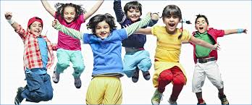
How to describe learning and teaching?
Language learning
The necessary elements for successful language learning in classroom
How do the three elements of ESA fit together in lesson sequences?
What teaching model have influenced current teaching practice?

Slide 30
What do we know about language learning?
The students are usually exposed to language which they more or less understand even if they can’t produce the language spontaneously themselves.
They are motivated to learn language in order to be able to communicate.
The students have opportunities to use the language they are learning (they need to be motivated, be exposed to language, given chances to use it)

Slide 31
The important elements in a language classroom: ESA
Engage
Study
Activate

Slide 32
The important elements in a language classroom
Engage
Teaching sequence where teachers try to arouse the students’ interest, thus involving their emotions
Activities and materials involved more fun & better learning
Study
The activities that the students are to focus on language (or information) and how it is constructed
Activate
Exercises and activities which are designed to get students using language as freely and ‘communicatively’ as they can

Slide 33
Teaching Models which have influenced current teaching practice
Grammar Translation
PPP: Presentation, practice, and production
Task-Based Learning
Communicative Language Teaching (CLT)
Audio Lingualism
Notes:
CLT has 2 main strands: language is not just bits of grammar, it also involves language functions such as inviting, agreeing, disagreeing, suggesting etc., which students should learn how to use (formal, informal, tentative, technical etc.)

Slide 34
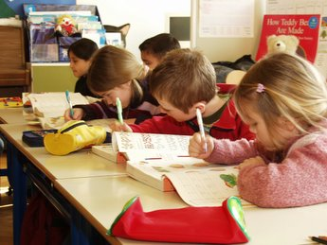
Teaching Across Age Levels

Slide 35
Five Categories in Teaching Children
Intellectual Development
Don’t teach Grammar (at the first time they learn English)
Attention Span
Here and now activities
A variety of lesson
Sensory Input
TPR
Hands on activities
Rules stated in abstract terms grammatical concepts
Require more repetition than adult
Animated teacher
A sense of humor
Children have a lot of natural curiosity
Sensory aids
Nonverbal language/gestures
Authentic, meaningful language

Slide 36
Teaching Teens
The “Terrible teens” are an age of transition, confusion, self-consciousness, growing, and changing bodies and minds.
Teens are in between childhood and adulthood, therefore a very special set of considerations applies to teaching them (Brown, 2001).

Slide 37
Complex problems can be solved with logical thinking
Attention spans are lengthening as a result of intellectual maturation
Varieties of sensory input are still important
Factors surrounding ego, self-image, and self-esteem are at their pinnacle
Secondary school students are of course becoming increasingly adultlike in their ability to make those occasional diversions from the “here and now” context.
Harmer (2005); Brown (2001)

Slide 38
Teaching Adults
Adults are able to handle abstract rules and concepts
Adults have longer attention spans for material
Adults often bring a modicum of general self-confidence
Adults, with their abstract thinking, are better to understand a context-reduced segment of language

Slide 39
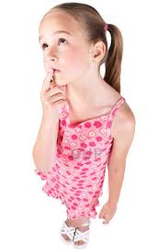
Basic Concepts of Language Teaching
What can go wrong?
We do not give the children space to notice.
They do what we want them to do.
They do not try for themselves.
They do not experiment enough.
They are unsuccessful.
They do not make links.

Slide 40
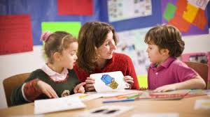
Factors influencing successful in language learning (Brewster, Ellis, Grard, 2003)
Motivation
Willing to make mistakes
Good at guessing
Making accurate prediction

Slide 41
Noticing
Wanting
Linking/
Internalization
Child-Centered Learning
(Paul, 2003)
Challenging/
Taking a risk
Succeeding
Playing/
Experimenting
The teacher explained/demonstrated before the children started practicing.

Slide 42
Essential principles of how to facilitate children a foreign language (Pinter, 2006; Andini, 2007; Utami, 2004; Harmer 2002)
Giving exposure by using English for the instruction
Giving children chances to be engaged in the teaching and learning process
Giving support to children
Providing good techniques of teaching
Providing good media
Providing good environment

Slide 43
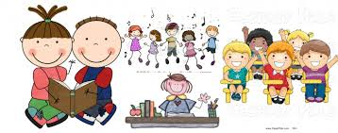
Although children may use similar processes for acquiring L1 and L2, the environment for L1 and L2 acquisition can be quite different
(Brewster, Ellis & Girard, 2004).
L1 Environment | L2 Environment
Language highly contextualized In the real world the language used is authentic Learner highly motivated | Language more decontextualized In the classroom the language used tends to be artificial Learners may not be highly motivated
Therefore, it is important to remember that an early start alone will not necessarily improve children’s ability to learn English. It is also very important that L2 instruction include language structures that are presented within a context that is meaningful and communicative.

Slide 44
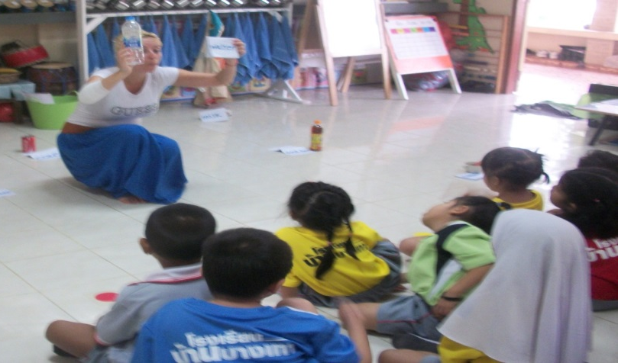
Now that we have looked at different learning styles and characteristics of young language learners, try to fill in the boxes in this mind map. With a partner, take turns reading each bubble before describing what word best fits each box.
Use these words to fill in the boxes:
Enjoyable
Full of practice
Meaningful
Purposeful
Social
Supported
This mind map can be found in the following article:
Read, C. (1998, April). The challenge of teaching children. English Teaching Professional, 7: 8-10. Retrieved August 1, 2005, from http://www.etprofessional.com/articles/challenge.pdf

Slide 45
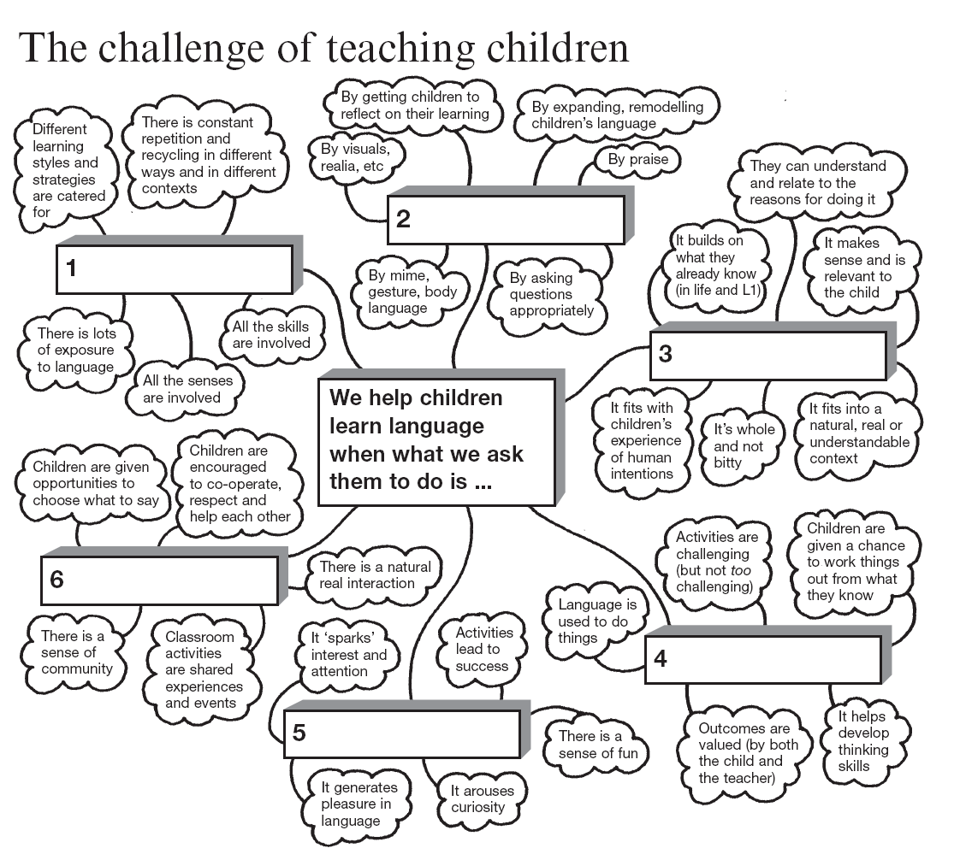

Slide 46
Teaching implication
Teacher should be sensitive, open to the needs and interests of various age groups, and continually monitor their changing needs.

Slide 47
Assignment:
Identifying English teaching-learning for YL in your neighborhood, the name of the school, the book used, the way the teacher teach, the assignment given to the students, etc.

Slide 48
Bland, Janice (ed.) (2015). Teaching English to Young Learners: Critical Issues in Language Teaching with 3-12 Year Olds. London: Bloomsbury Publishing Plc.
Brewster, Jean; Ellis, Gail; Grard, Dennis. (2003). The Primary English Teacher’s Guide (New Edition). England: Penguin English.
Cameron, L. (2001). Teaching Languages to Young Learners. Cambridge: Cambridge University Press.
Damayanti, Ika Lestari. (2017). From Story Telling to Story Writing: The Implementation of Reading to Learn (R2L) Pedagogy to Teach English as a Foreign Language in Indonesia. Indonesian Journal of Applied Linguistics vol. 6 no. 2, January 2017, pp. 229-242.
Fadilah, Rahmi. (2017). Madeline Hunter’s Lesson Plan as Alternative Model for TEYL. Proceedings in English Conference at STKIP Pasundan.
Garton, Sue & Copland, Fiona (ed.). (2019). Teaching English to Young Learners. New York: Routledge.
Halliwell, S. (2004). Teaching English in the primary classroom. Essex: Pearson Education Limited.
Harmer, Jeremy. (2004). How to Teach English: An Introduction to the Practice of English Language Teaching. England: Longman.
Harmer, Jeremy. (2007). How to teach English (New Edition). Essex: Pearson Longman.
Ioannou-Georgiou, Sophie & Pavlou, Pavlos. 2003. Assessing Young Learners. Oxford: Oxford University Press.
Linse, Caroline T. (2005). Practical English Language Teaching: Young Learners. New York: McGraw-Hill.

Slide 49
Mckay, P. (2006). Assessing young language learners. Cambridge: Cambridge University Press.
Mooney, Carol Garhart. (2000). Theories of Childhood: An Introduction to Dewey, Montessori, Erikson, Piaget, and Vygotsky. USA: Redleaf Press.
Musthafa, Bachrudin. (2000). Teaching English to Young Learners: Principles & Techniques. Bandung: Pasca Sarjana Universitas Pendidikan Indonesia.
Mustafa, Bachrudin. (2008). Teaching English to young learners. Bandung: UPI Press.
Mustafa, Bachrudin. (2010). Teaching English to young learners in Indonesia: Essential requirements. Jurnal Educationist.Vol. 4 no.2, Juli 2010 pp. 120-125.
Paul, David. (2003). Teaching English to Children in Asia. Hongkong; Longman Asia ELT.
Pinter, Annamaria. (2006). Teaching Young Language Learners. Oxford: Oxford University Press.
Slattery, M. & Willis, J. (2005). English for Primary Teachers: A Handbook of Activities and Classroom Language. Oxford: Oxford University Press.
Youtube

