Slide 1
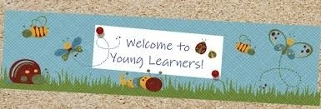
CHILDREN LANGUAGE TEACHING AND PRACTICE (CELTP) /TECHING ENGLISH TO YOUNG LEARNERS (TEYL) /ENGLISH FOR YOUNG LEARNERS (EYL) By: Sri Supiah Cahyati, M.Pd
English Education Study Program
IKIP Siliwangi
2019

Slide 2
Session 2
Theories of Children Learning Development
Mutiple Intelligences
TEYL in Indonesia Context
(Identifying English teaching-learning for YL, the name of the school, the book used, the way the teacher teach, the assignment given.
Classroom Language

Slide 3
Theories of Children Learning Development (Mooney, 2000)
1. Jean Piaget:
There are 4 universal stages of development that all children go through & the development was a process of acquiring the principles of formal logic
1. Sensory-motor stage
(from birth to 2 years of age):
The young child learns to interact with the environment by manipulating objects around him.
2. Pre-operational stage
( from 2 – 7 years of age): The child thinking is largely reliant on perception but he/she gradually becomes more & more capable of logical thinking. On the whole this stage is characterized by egocentrism & a lack of logical thinking.
3. Concrete operational stage
(from 7 – 11 years of age): Year 7 is the turning point in cognitive development because children’s thinking begins to resemble “logical” adult-like thinking. They develop the ability to apply logical reasoning in several areas of knowledge at the same time but this ability is restricted to the immediate context. This means that children at this stage cannot yet generalize their understanding.
4. Formal operational stage (from 11 onwards):
Children are able to think beyond the immediate context in more abstract terms. They are able to carry out logical operations such as deductive reasoning in a systematic way. They achieve “formal logic”.

Slide 4
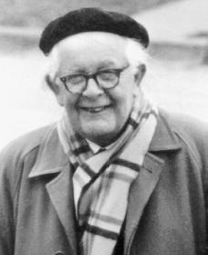
Child Development
Formal operational stage (11-onwards)
1. Jean Piaget
Concrete operational stage (7-11)
Pre Operational stage (2-7)
Sensory-motor stage (0-2)

Slide 5
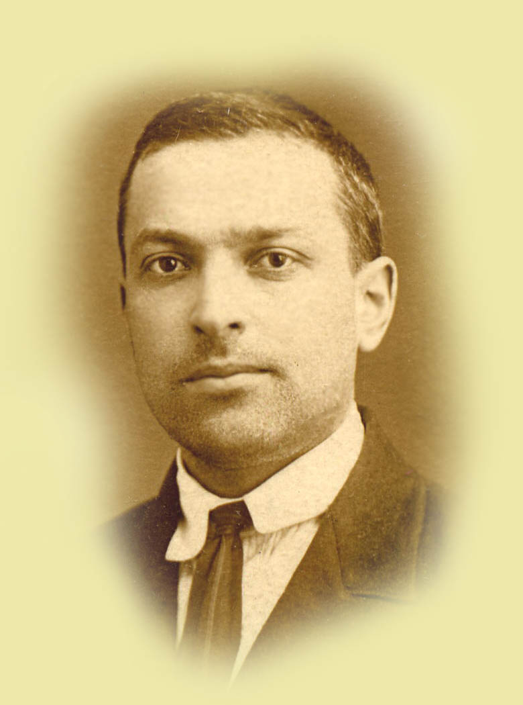
Theories of Children Learning Development (Mooney, 2000)
The social environment, the cultural context, and the influence of peers, teachers & parents engaged in interactions with children are major sources of learning & development (Social Constructivism).
The other concept is the Zone of Proximal Development (ZPD). It is the difference between the current knowledge of the child & the potential knowledge achievable with some helps from a more knowledgeable peer/adult.
2. Lev Vygotsky

Slide 6
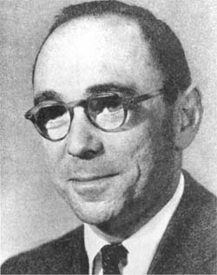
Theories of Children Learning Development (Mooney, 2000)
“Scaffolding: helping children to learn by offering systematic support”
“The social environment, i.e. social interaction with parents & teacher can make a difference in terms of offering unique, enriching experiences. “
3. Jerome Bruner

Slide 7
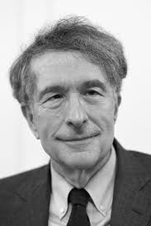
Theories of Children Learning Development (Mooney, 2000)
“When assessing children’s intelligent, it had no unitary character, rather, it manifested itself in many different ways in different children (multiple intelligences). The types of intelligences are linguistic, logico-mathematical, musical, spatial, bodily/kinesthetic, interpersonal, intrapersonal, and natural. “
4. Howard Gardner

Slide 8
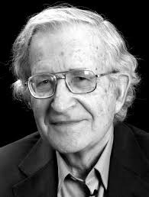
Theories of Children Learning Development (Mooney, 2000)
“Children often produced language that they could not have heard in natural interaction with others (Universal Grammar)”
5. Noam Chomsky

Slide 9
Theories of Children Learning Development (Mooney, 2000)
“Brain plasticity was only conducive to language learning until puberty (Critical period hypothesis). Children below 11-12, who are given advantageous learning circumstances, such as plenty of input & interaction in an English environment, are more likely to acquire English to native levels without an accent”
6. Eric Lenneberg

Slide 10
Theories of Children Learning Development (Mooney, 2000)
Total Physical Response (TPR):
Kinesthetic intelligence and memory is used because children do not learn in a conscious intellectual way. Children do not learn by thinking, but by “doing” things.
7. James Asher

Slide 11
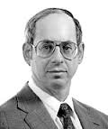
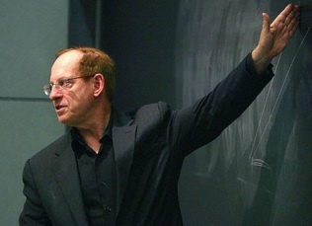
Theories of Children Learning Development (Mooney, 2000)
8. Krashen & Terrell
The Input Hipothesis
Spoken fluency in second language is not taught directly. Rather the ability to speak fluently and easily in a second language emerges by itself, after a sufficient amount of competence has been acquired through input.
Stephen Krashen
We acquire (not learn) language by understanding input that is a little beyond our current level of (acquired) competence. Listening comprehension and reading are the primary importance in the language program, and the ability to speak (or write) fluently in a second language will come on its own with time. Speaking ability "emerges" after the acquirer has built up competence through comprehending input.
Tracey Terrel

Slide 12
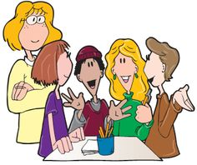
Input Hypothesis (Cont.)
The Major Points On the Input Hypothesis are:
It relates to acquisition, not to learning;
Spoken fluency emerges gradually and is not taught directly
We acquire by understanding language a bit beyond our current level of competence.
This is done with the help of context
When caretakers talk to acquirers so that the acquirers understand the message, input automatically contains "i+1", the grammatical structures the acquirer is "ready" to acquire

Slide 13
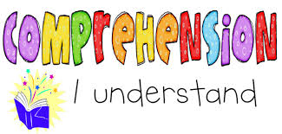
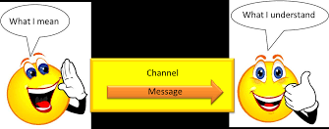
Input Hypothesis (Cont.)
The implications for classroom practice
Whatever helps comprehension is important
Vocabulary is important. With more vocabulary, there will be more comprehension, and there will be more acquisition.
In giving input, in talking to students, the teacher needs to be concerned primarily with whether the students understand the message.

Slide 14
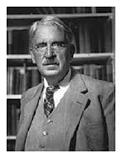
Theories of Children Learning Development (Mooney, 2000)
9. John Dewey
Education should be child centered.
Education must be both active & interactive.
Education must involve the social world of the child and the community.
Plan purposeful curriculum.
Make sense of the world for children.
“It’s fun” is not enough.

Slide 15
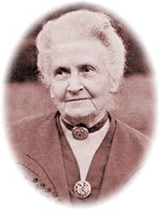
Theories of Children Learning Development (Mooney, 2000)
Children learn language and other significant life skills, without conscious effort, from the environments where they spend their time.
Children learn best through sensory experiences, by doing & through repetition.
Children are capable of great concentration when they are surrounded by many interesting things to do & given the time and freedom to do them.
Children need more physical activity.
10. Maria Montessori

Slide 16
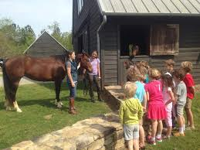
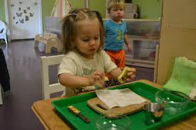
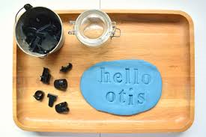
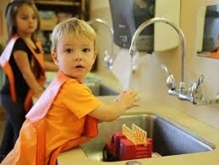
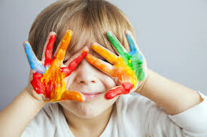

Slide 17
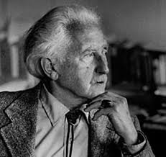
Theories of Children Learning Development (Mooney, 2000)
How children develop the foundation for emotional & social development & mental health.
Consider individual differences.
Focus curriculum on real things.
Stages of Psychosocial Development (“Eight Ages of Man”); theory of emotional development, which covers the life spans of human beings.
11. Erik Erikson

Slide 18
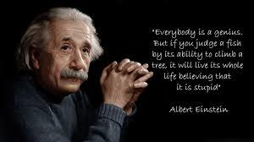
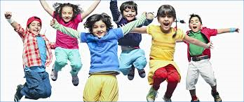
Multiple Intelligences & Implication to EYL Class
“One child may be more intelligent in one way and another may be more intelligent in another”
(Paul, 2003)

Slide 19
Multiple Intelligences & Implication to EYL Class
For teachers (responsibility):
To learn about the different learning styles or intelligences to cater every type of learners in the classrooms.

Slide 21
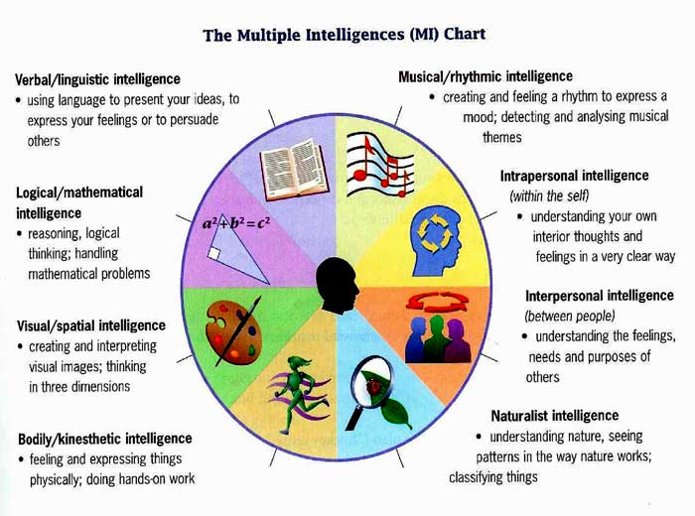

Slide 22
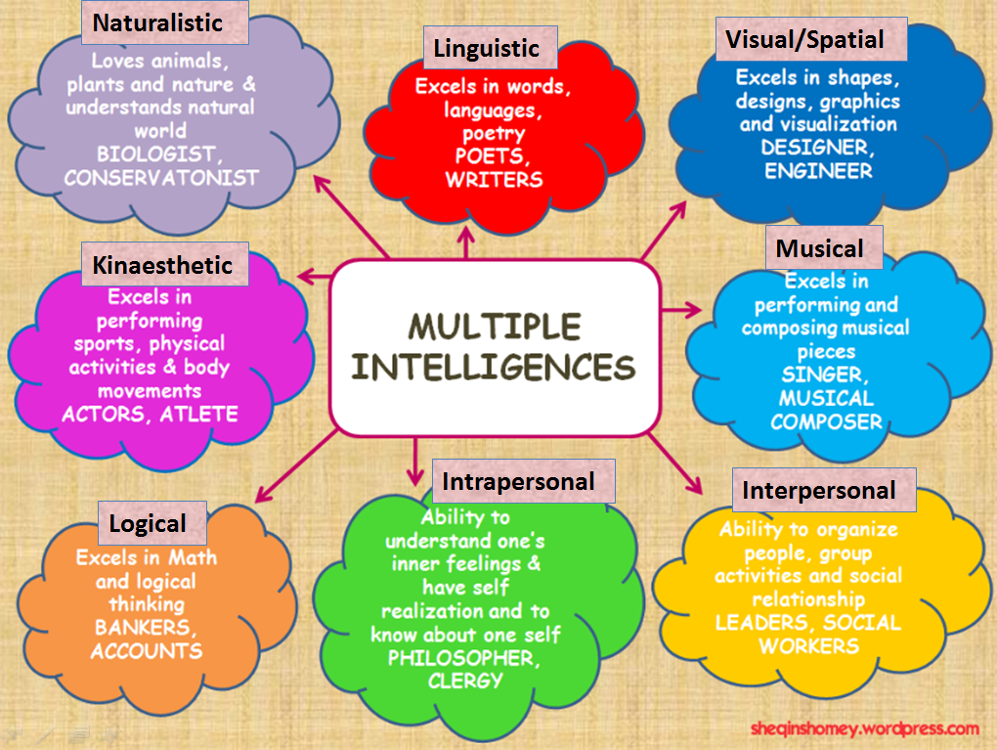

Slide 23
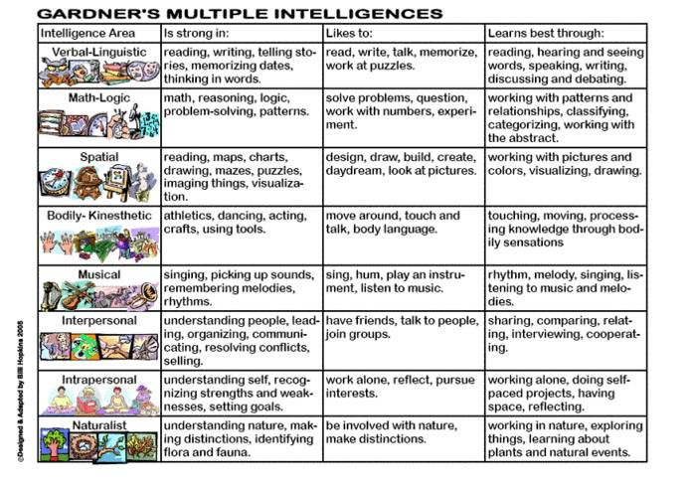

Slide 24
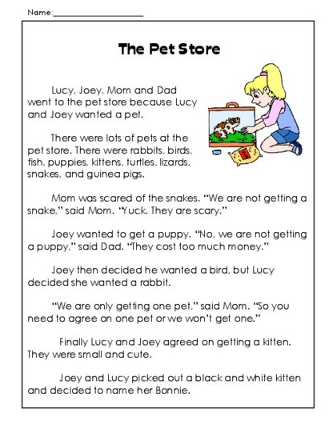
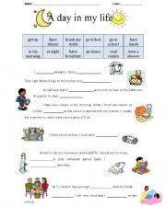
Multiple Intelligences (from different sources)
Linguistic :
Express oneself
Understand what others are trying to say through words
Teacher centered explanations
Essays and written reports
Reading selections
Book based grammar and language function explanations
Gap-fill exercises

Slide 25
Multiple Intelligences (from different sources)
Grammar categorizing activities
Grammar rules study and inductive explanations
Error recognition
Correcting work based on teacher indications
Develop mind-maps and other vocabulary charts
2. Logical/mathematical :
Understand and manipulate numbers
See cause and effect relationship

Slide 26
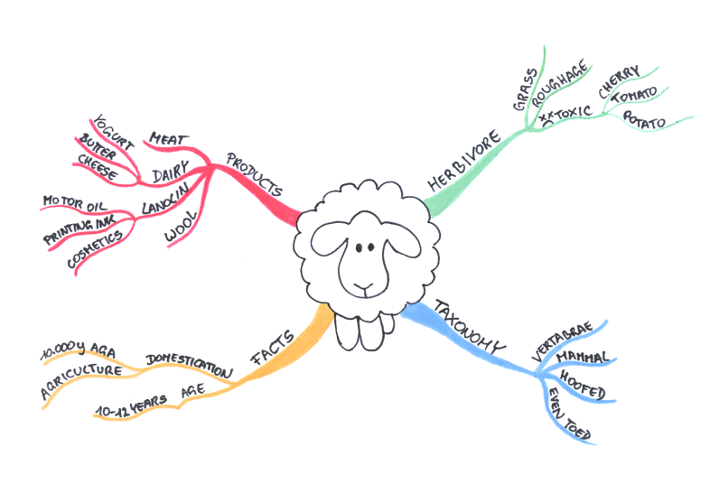
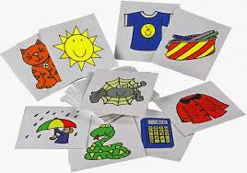
Multiple Intelligences (from different sources)
3. Spatial :
Form mental images of layouts
Find ways around
Learn through pictures and drawings
Mind maps
Using photos, paintings, etc. to encourage discourse
Creating personal road maps / other visual aids to use during discourse
Graphs used to initiate explanations of statistics
Videos
Creating multimedia projects
Highlighting texts in different colors to indicate tense, or function
Games such as Pictionary

Slide 27
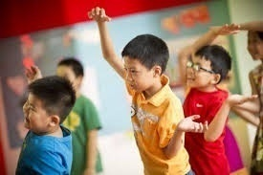
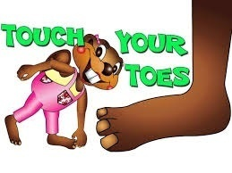
Multiple Intelligences (from different sources)
4. Bodily/Kinesthetic:
Use parts of body to make things
Do activities such as playing ball games
Typing
Movement games (especially popular in children's English classes)
Role plays / drama
Pantomime vocabulary activities
Facial expression games
For classes with access to athletic facilities, explanation of sporting rules

Slide 28
Multiple Intelligences (from different sources)
5. Musical :
Produce and recognize songs
Play around with melodies
Singing
Composing rhythm
Adapting/modifying song

Slide 29
3➔Rainbow (Pelangi)
Rainbow, rainbow
How beautiful you are
Red, yellow, and green
In the blue blue sky
Your creator is great
I wonder who is it
Rainbow rainbow
The creation of God
?

Slide 30
3➔ I Love Everybody (Aku Sayang Ibu )
One and one
I love my mommy
Two and two
I love my daddy
Three and three
I love brother, sister
One and two and three
I love everybody
?

Slide 31
3➔ Family
I love my father,
and I love my mother,
I love my brother,
and my sister too
(2x)
Yes, they are my family (2x)
Famili...family...oh...oh...oh...oh..

Slide 32
3 ➔Little Teapot (Teko Kecil )
I’m a little teapot, short and stout
Here is my handle, here is my spout
When I get my steam up then I shout (tweeeeet)
Tip me over and pour me out
Aku teko kecil yang mungil
Ini gagangku dan corongku
Bila mendidih, aku bersiul (tuiiiiit)
Miringkan aku dan tuangkan

Slide 33
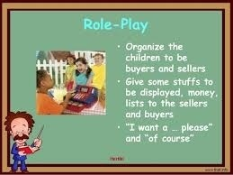
Multiple Intelligences (from different sources)
6. Interpersonal:
Understand others
Cooperate with others
Small group work
Team competitions
Role plays using dialogues
Peer teaching

Slide 34
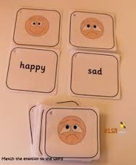
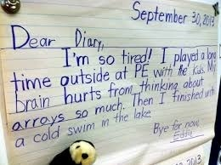
Multiple Intelligences (from different sources)
7. Intrapersonal:
Understand ourselves
Know similarities and differences from others
Deal with emotions
Writing in logs and diaries
Estimating learning strengths, weaknesses, progress over time
Understanding learner objectives
Speaking about one's personal history with confidence

Slide 35
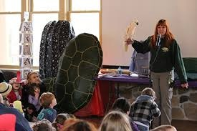
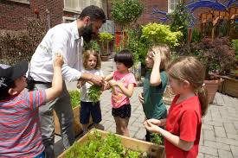
Multiple Intelligences (from different sources)
8. Naturalist :
Recognize species of plants
Characterize different animals
Relate to natural world
Exploring outdoors but in English
Shopping and other field trips
Collecting plants to learn appropriate vocabulary

Slide 36
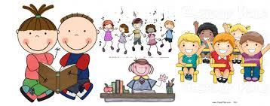
Implication to EYL Class (Paul, 2003)
1. Understand and respect, different children learn in different ways
2. Be careful about putting individual children into categories
3. Avoid making generalized statement about children
4. Provide a wide variety of activities

Slide 37
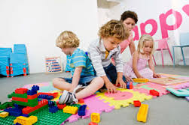
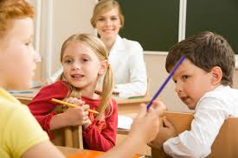
“Exposure to English”: How much children hear & how often they have opportunity to interact in English. It’s important that opportunities are created in the classroom for children to be exposed to natural language & to interact with each other
The implication: Teachers’ competencies in terms of their proficiency in English to provide the necessary exposure to the language, and their methodology to offer appropriate tasks & activities for children to communicate in a variety ways.

Slide 38
Creating English-rich environment at schools
Wise words in the halls
Labels in English
Wall magazines in English

Slide 40
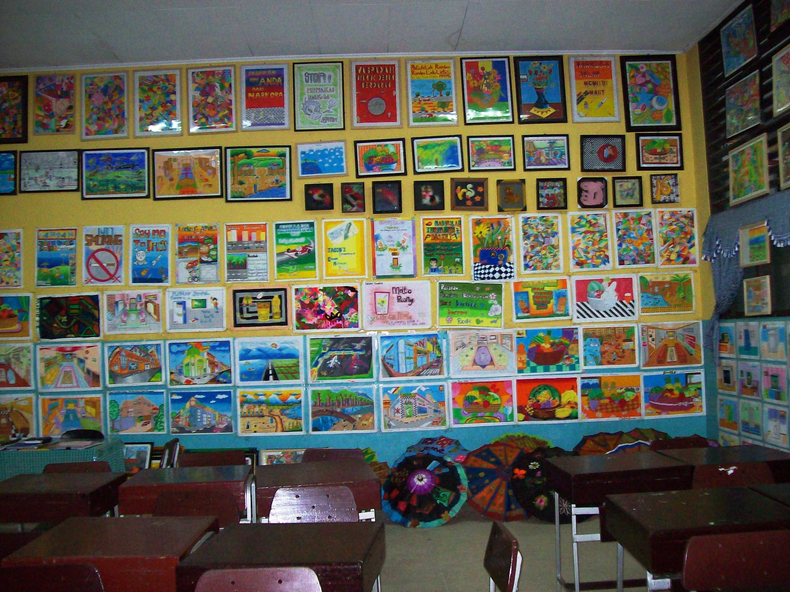
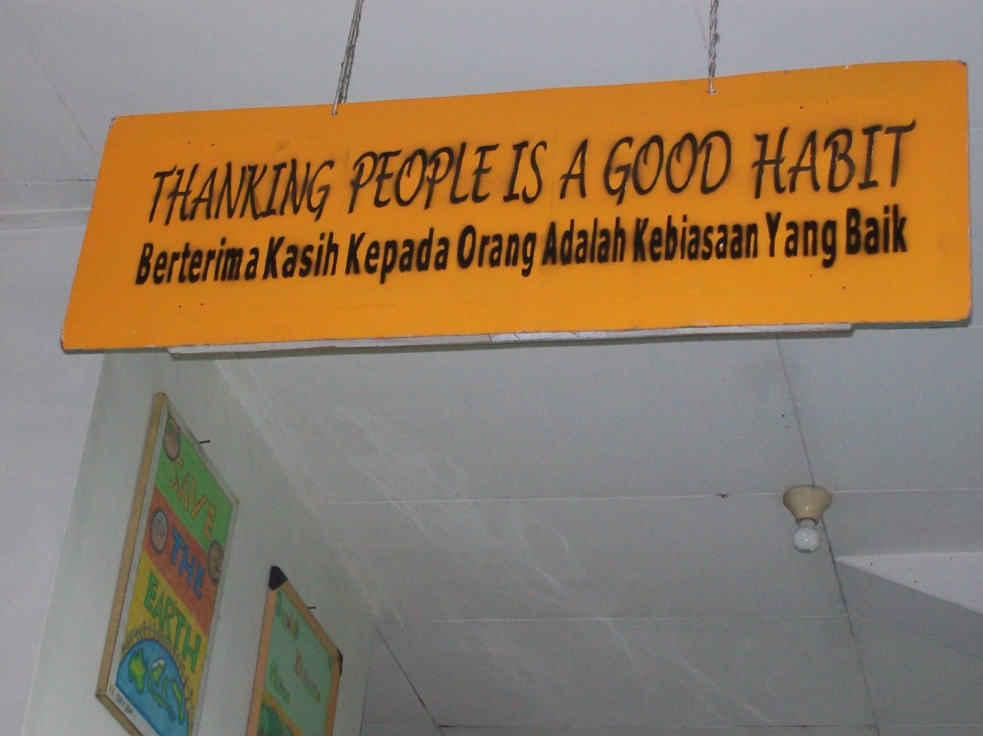

Slide 41
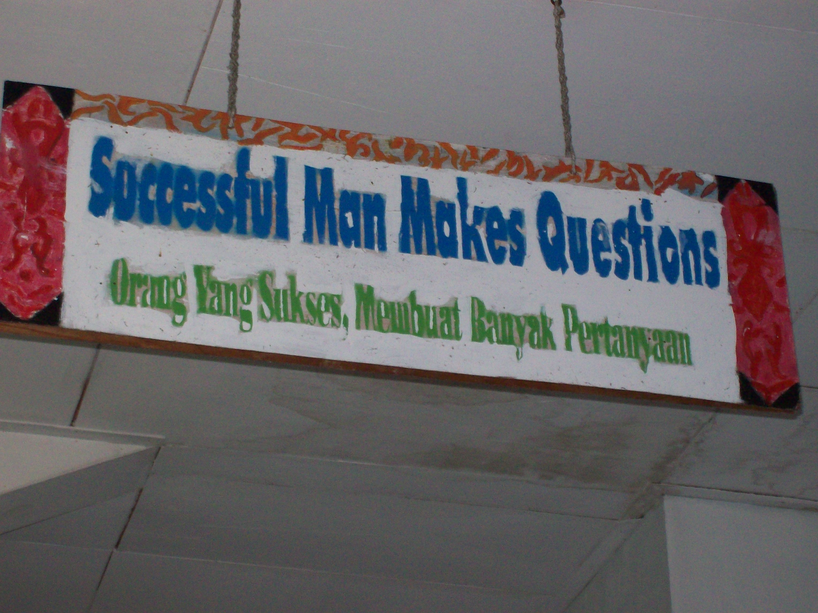

Slide 43
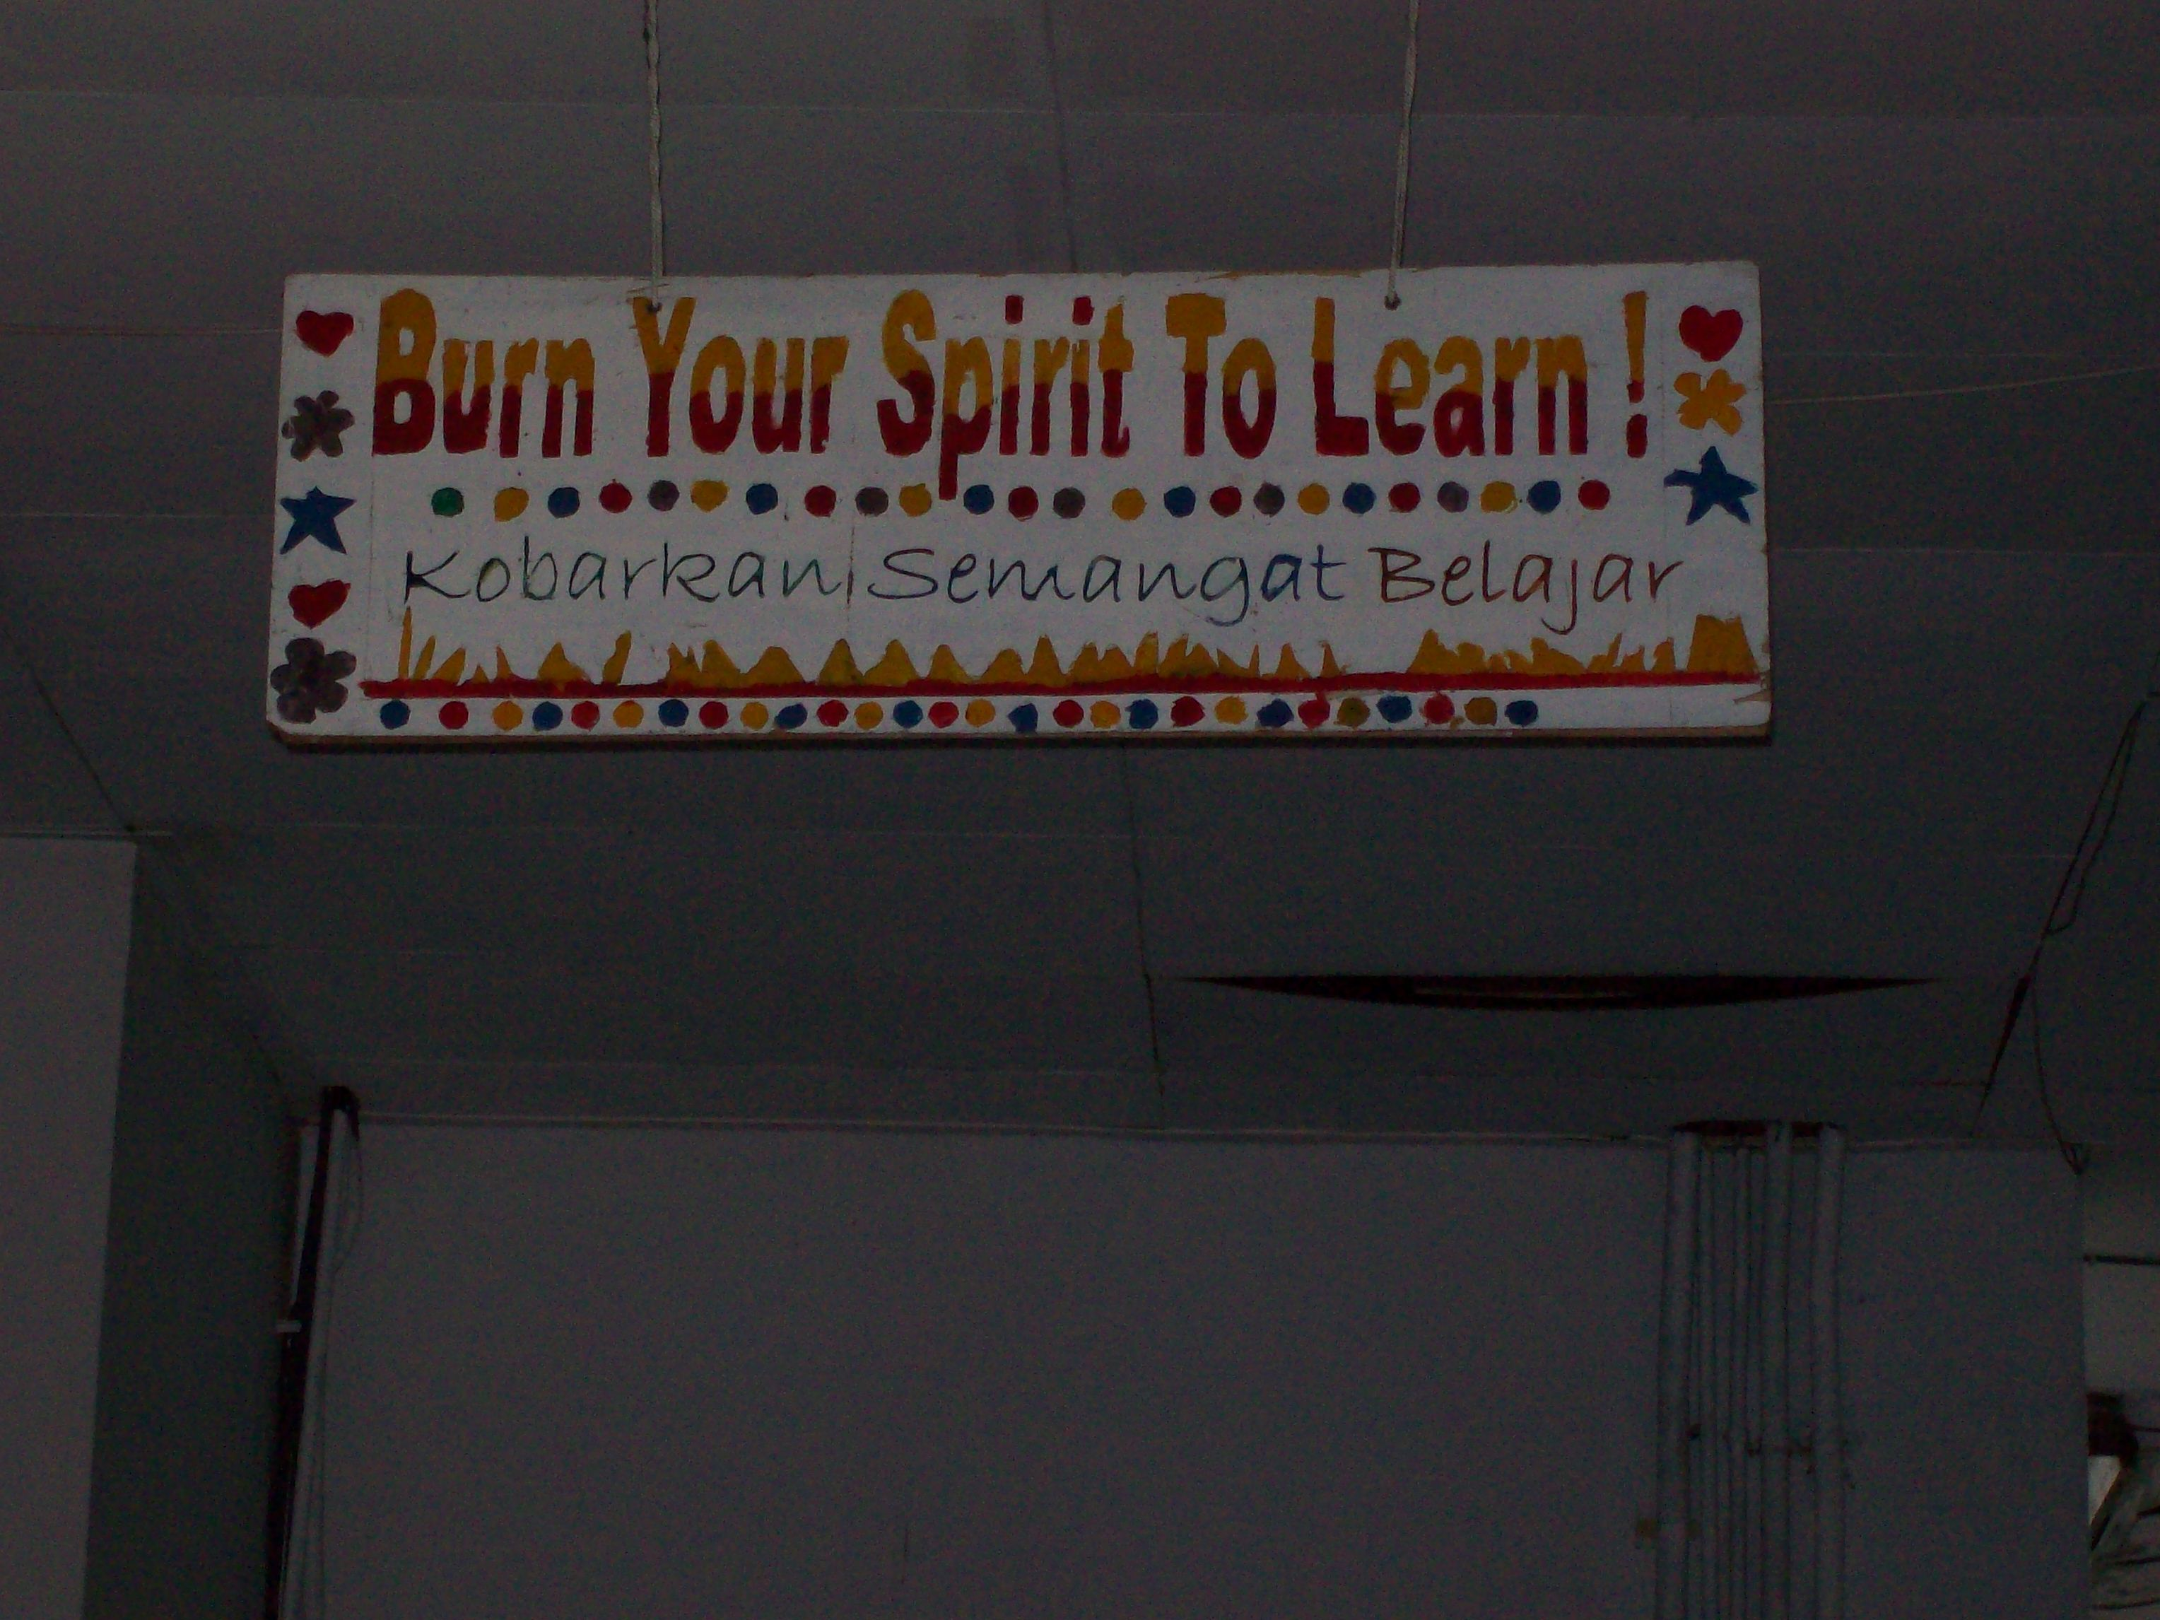

Slide 44
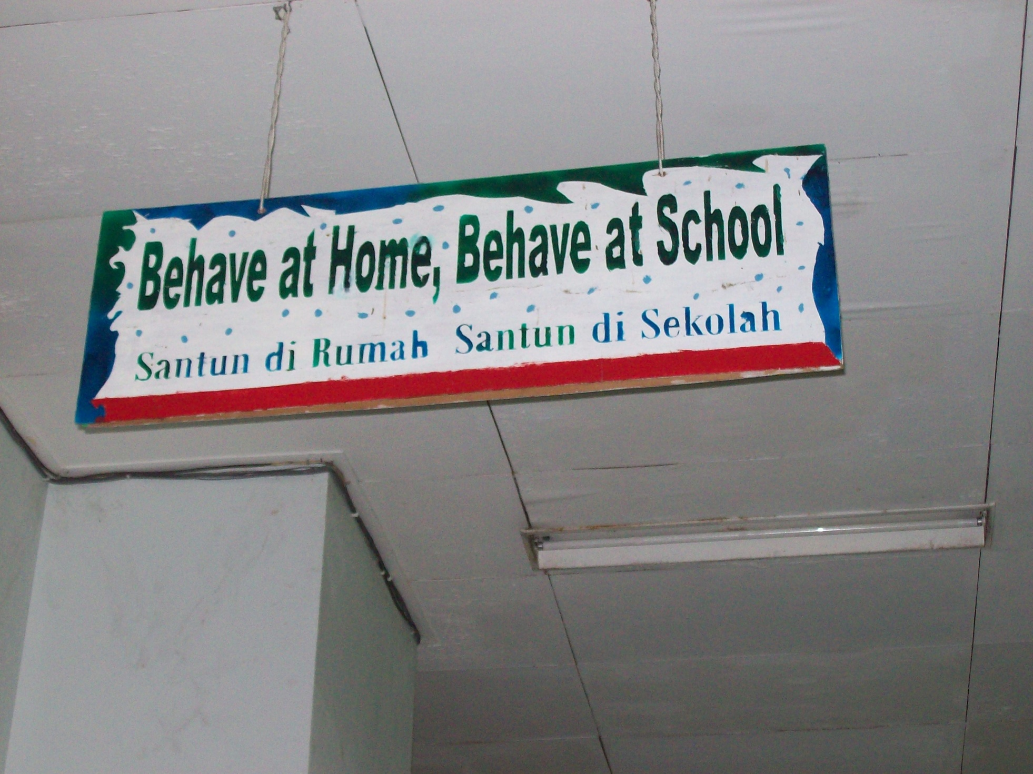

Slide 45
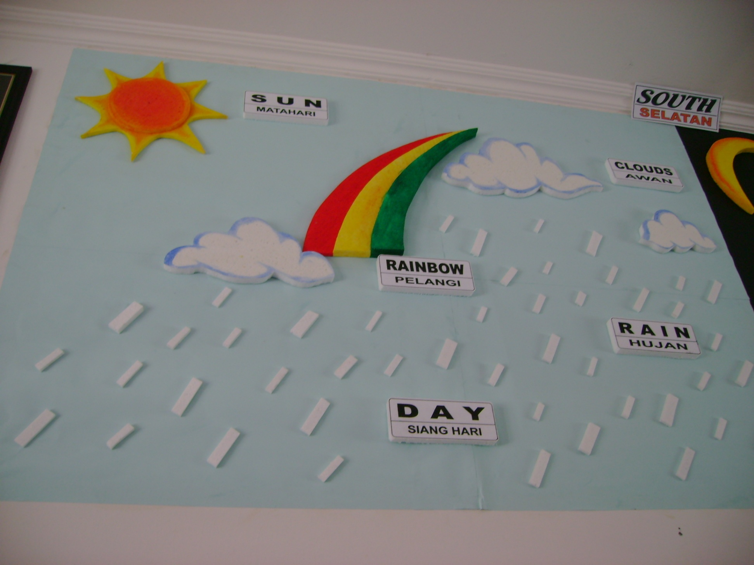

Slide 46
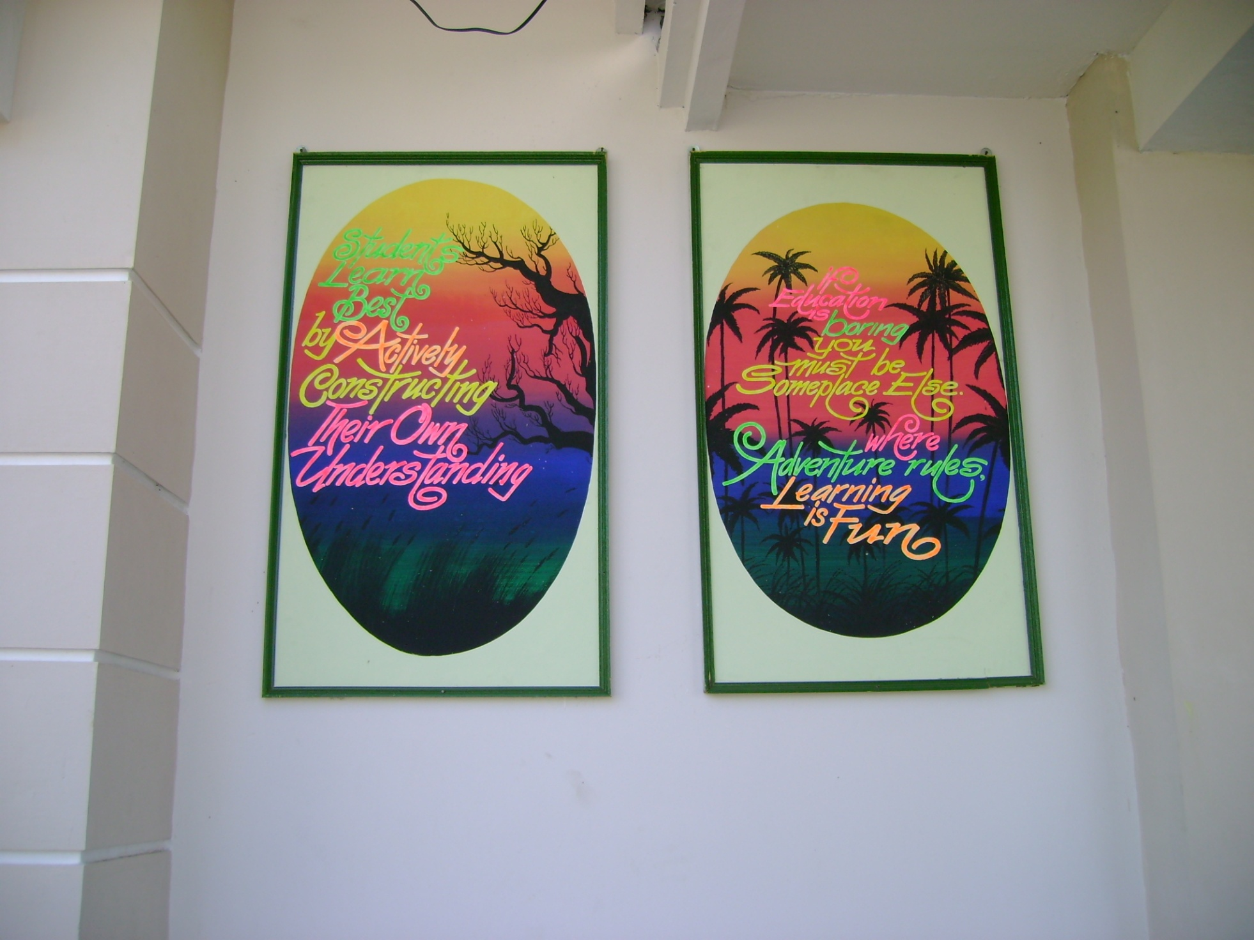

Slide 47
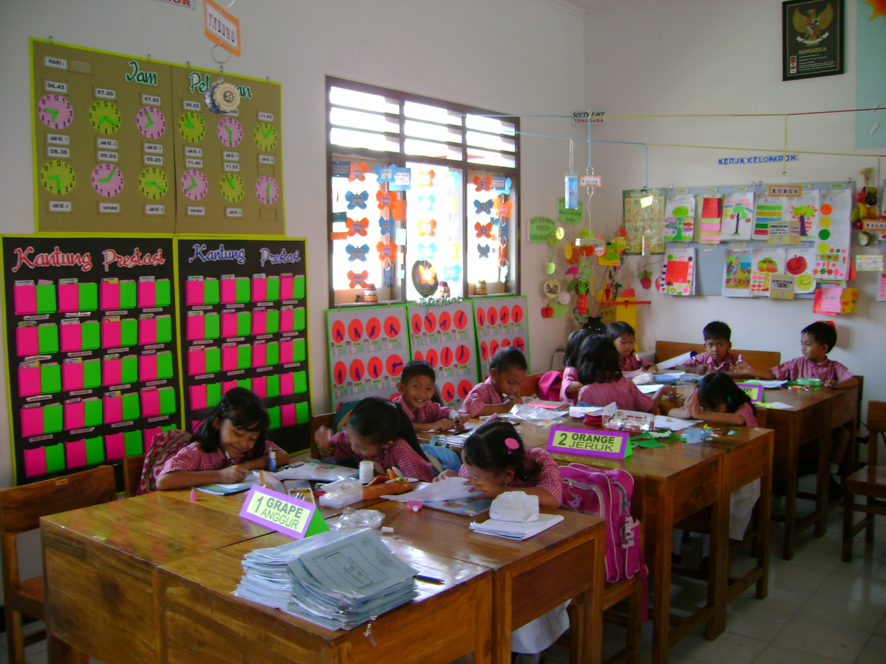

Slide 48
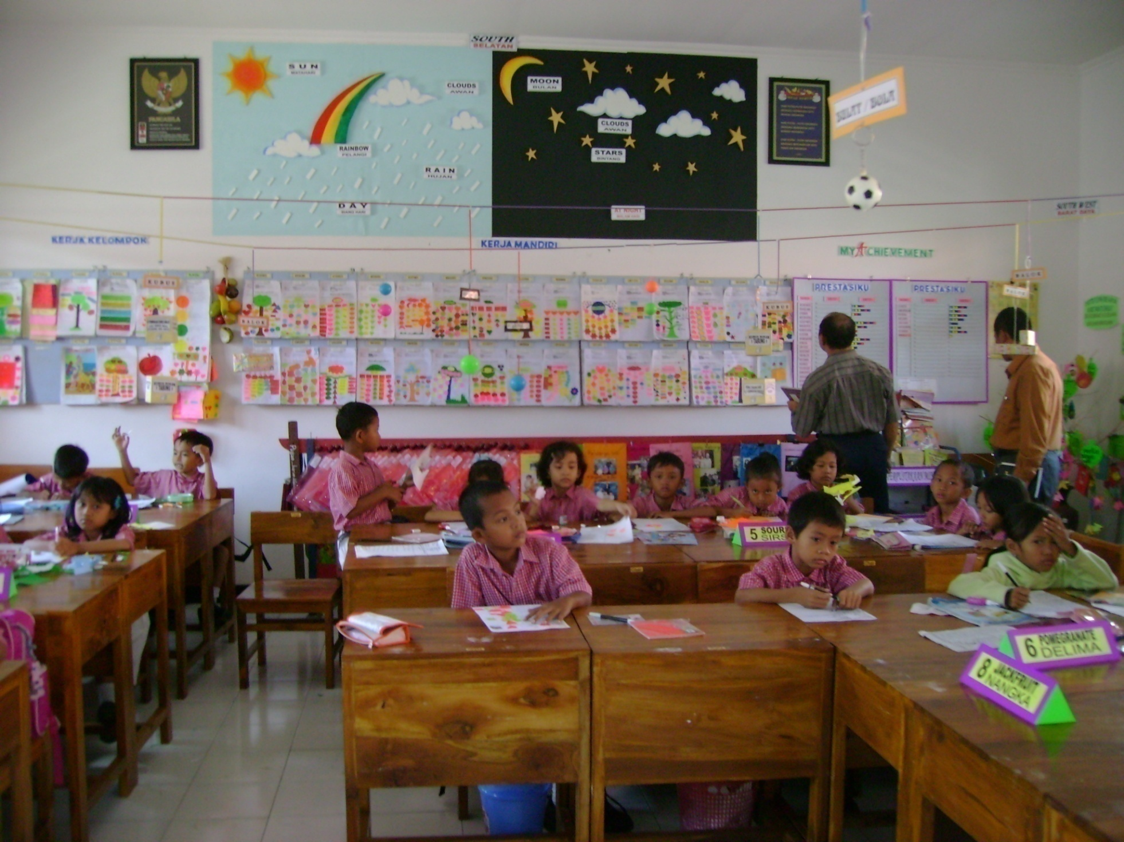

Slide 49
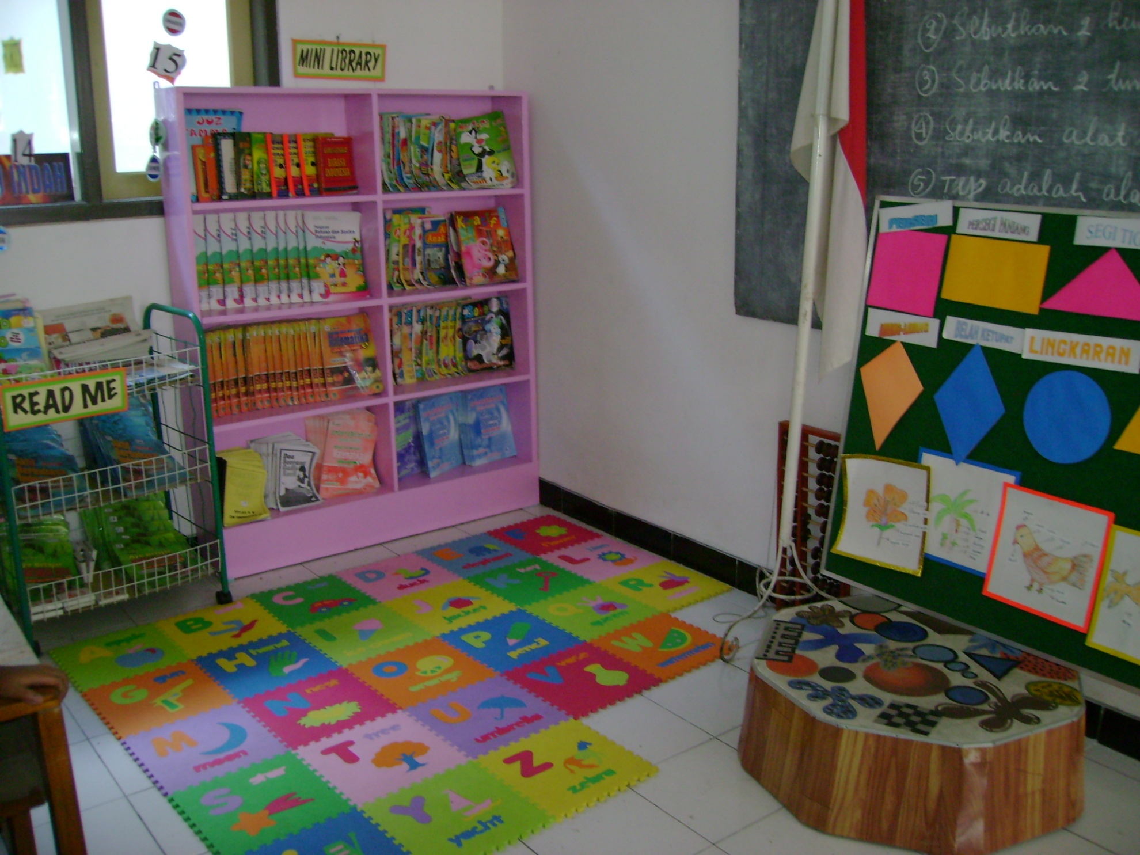

Slide 50
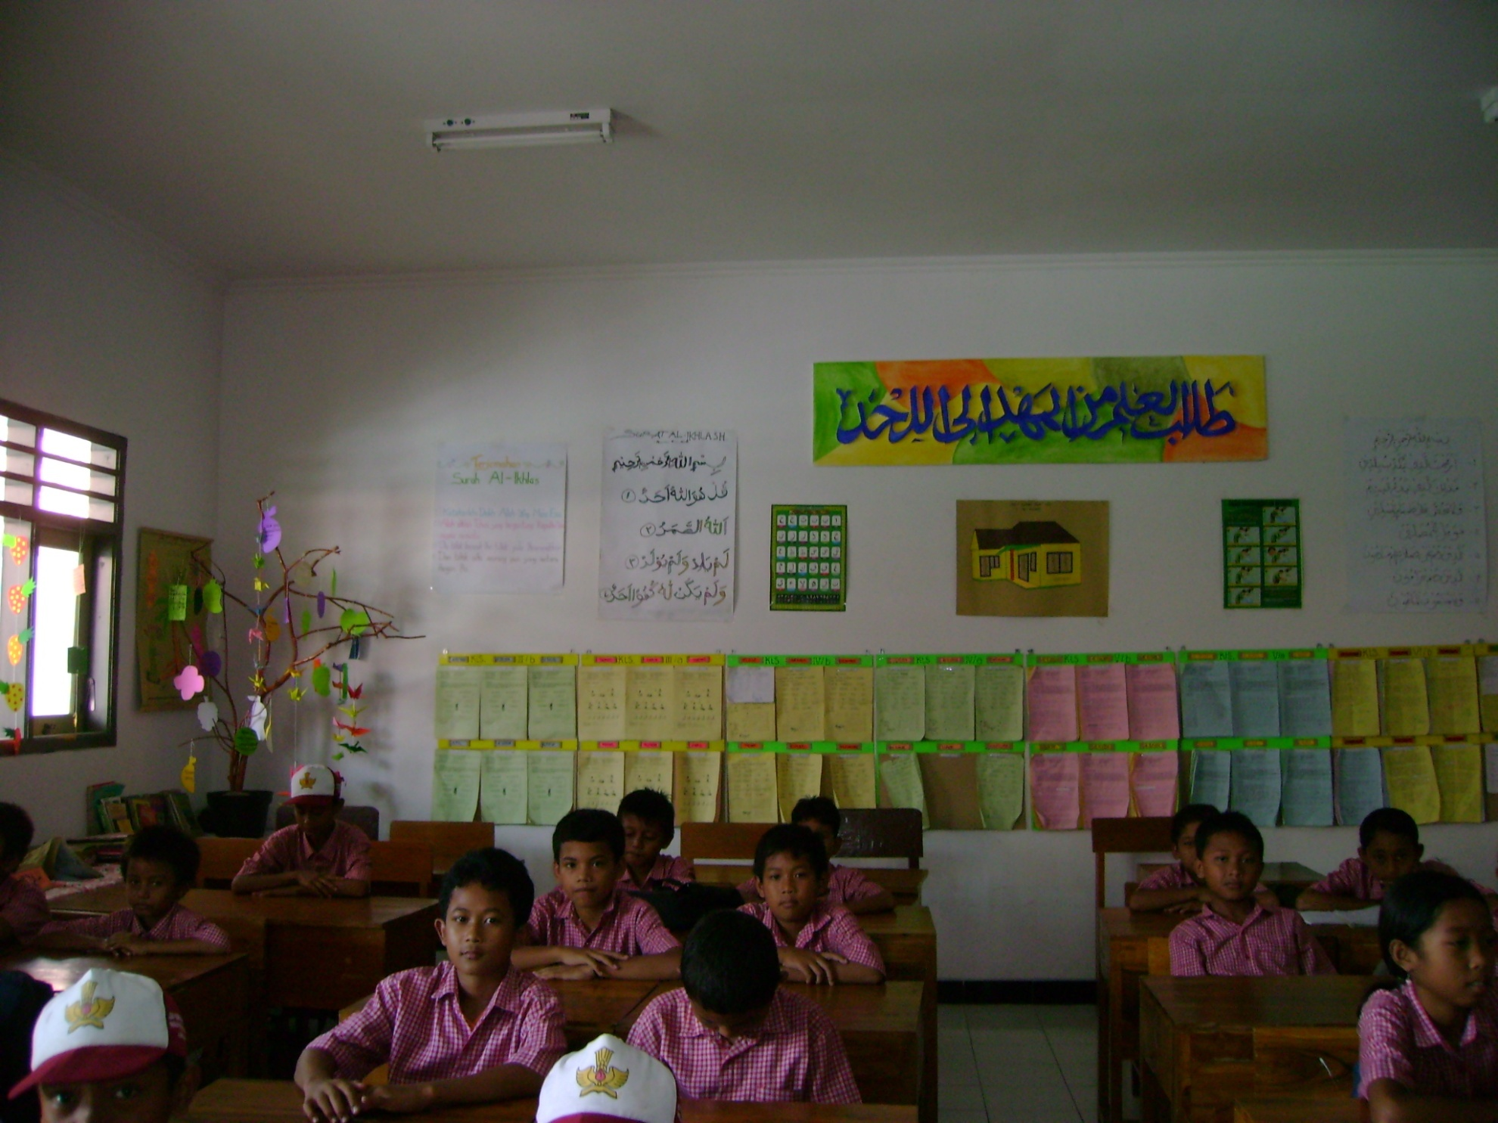

Slide 51
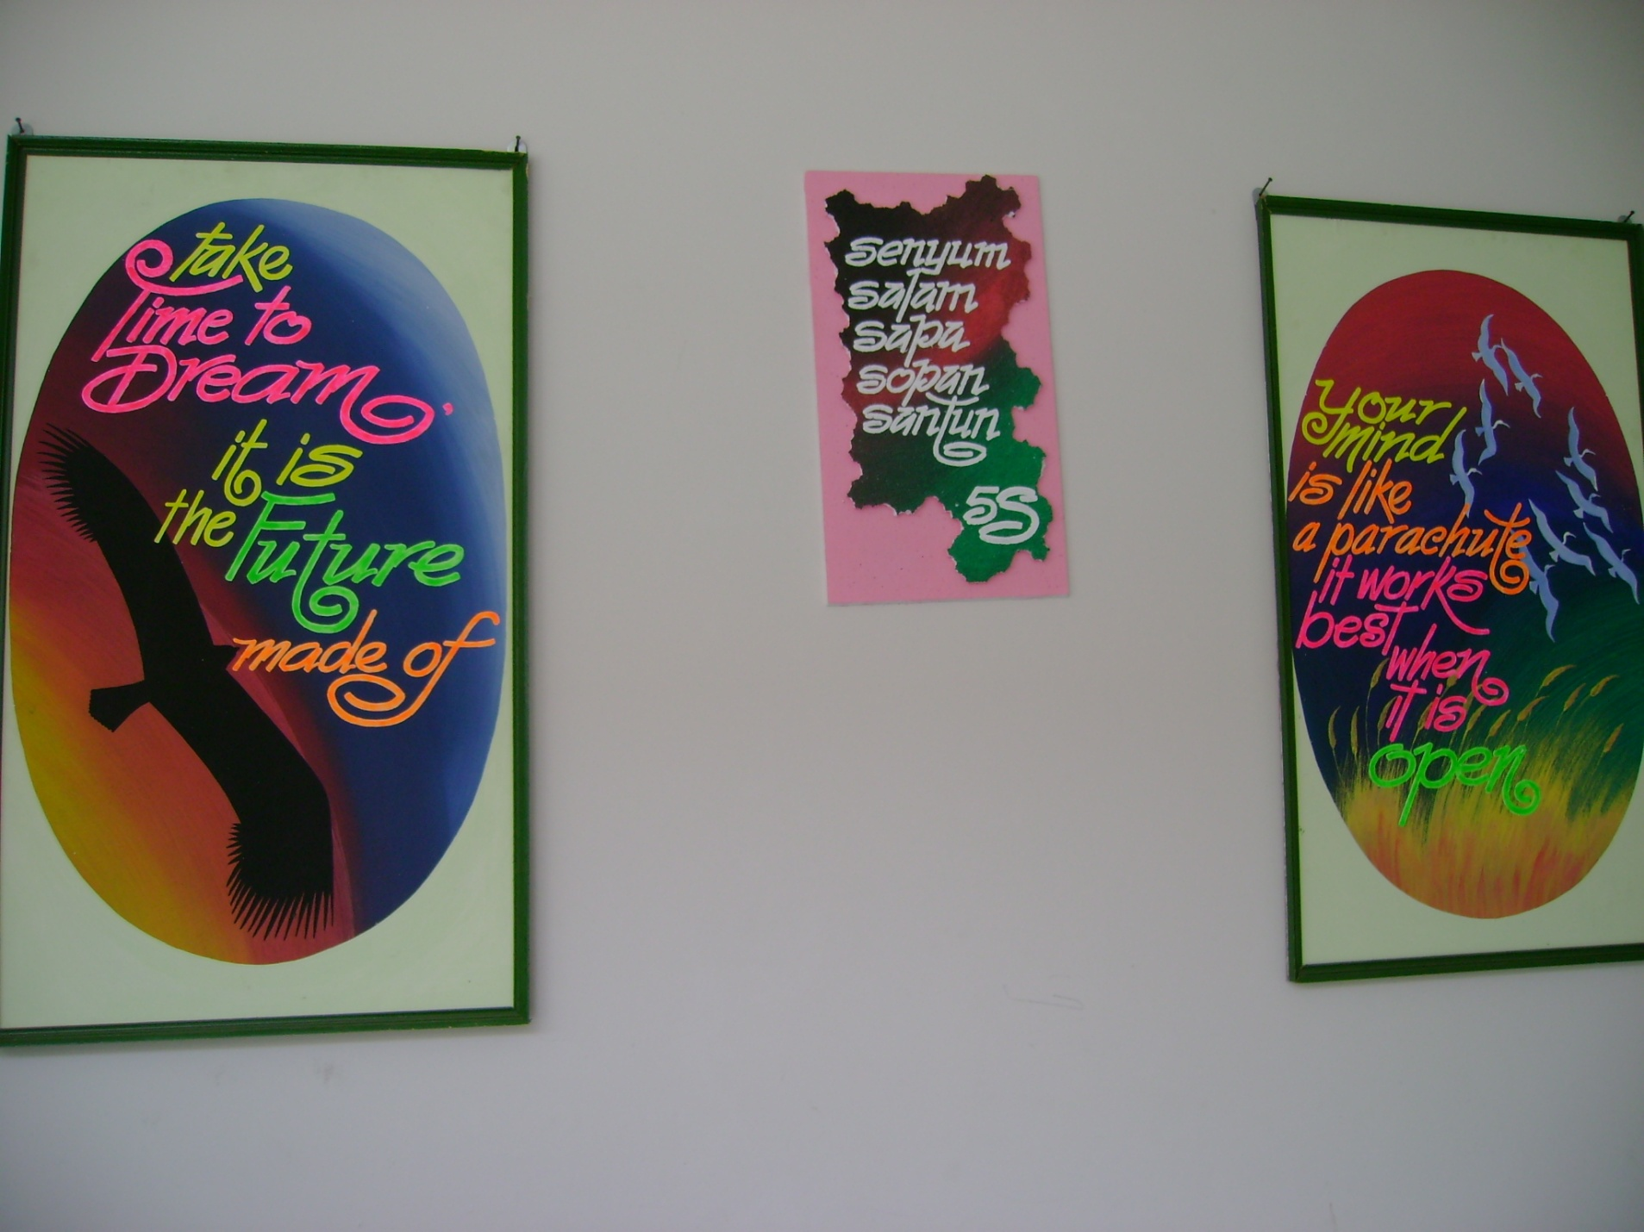

Slide 53
Always check the spelling!

Slide 62
MATERI PEMBELAJARAN ANAK USIA DINI

Slide 63
Materi usia 0 – 3 tahun:
Pengenalan diri sendiri (Pengembangan konsep diri)
Pengenalan perasaan (perkembangan emosi)
Pengenalan tentang orang lain (perkembangan sosial)
Pengenalan berbagai gerak (perkembangan fisik)
Mengembangkan komunikasi (perkembangan bahasa)
Keterampilan berfikir
(perkembangan kognitif)

Slide 64
Materi usia 3 tahun ke atas:
Keaksaraan (peningkatan kosa kata & bahasa, kesadaran phonologui, wawasan p[engetahuan, percakapan, memahami buku-buku & teks lainnya.
Konsep Matematika (pengenalan angka-angka, pola-pola & hubungan, geometri & kesadaran ruang, pengukuran, pengumpulan data, pengorganisasian & mempresentasikannya.
Pengetahuan alam (objek fisik, kehidupan, bumi & lingkungan)
Pengetahuan sosial (tempat hidup
orang banyak, bekerja, berinteraksi)

Slide 65
Materi usia 3 tahun ke atas:
Seni (tari, musik, bermain peran, menggambar & melukis)
Teknologi (alat-alat & penggunaan operasi dasar)
Keterampilan proses (pengamatan & eksplorasi, eksperimen, pemecahan masalah, koneksi, pengorganisasian, komunikasi & informasi)

Slide 66
Hal penting bagi orang tua:
Peka terhadap perbedaan kemampuan masing-masing anak
Terbuka terhadap perubahan anak
Pendampingan dan penghargaan yang tepat.
Kecerdasan tidak ditentukan oleh gen namun lebih banyak ditentukan oleh perlakuan/lingkungan.

Slide 67
Metode Pembelajaran
Bermain.
Bercerita
Bernyanyi
Bercakap (dialog dan tanya jawab)
Piknik
Praktik langsung
Bermain peran (sosio-drama)
Penugasan
Noble, Professional & Global Educator

Slide 68
TEYL in Indonesia Context (Musthafa, 2010)
English is as a local content in Elementary school & EFL in Indonesia.
Requirements for effective TEYL:
English should be used all the time to ensure that children have relatively much exposure to English.
Print-rich environment in English should be created and around the classroom.
Teachers of EYL should use activity-based teaching-learning techniques such as TPR, games, & projects.
The teachers should use various techniques for short periods of time to maintain the interest level of the children in engaging the English lessons.

Slide 69
TEYL in Indonesia Context (Musthafa, 2010)
e. The teachers should focus on functional English for vocabulary development & for immediate fulfillment of communicative needs of the learners.
f. The teachers should reiterate often to ensure the acquisition of English expressions/vocabulary items.
g. The teachers should provide useful, acquisition-promoting routines.
h. The teachers should have a good command of English & have an ability to act as a role model to the learners they teach.

Slide 70
The Problem of EYL in Indonesia Context (Fadilah, 2017)
No exact curriculum/lesson plan for teachers to teach EYL conducted by the government in Indonesia.
The English teachers in primary schools are confuse of how to conduct a good lesson plan.
The stage is not clear enough to achieve the lesson’s objectives which are appropriate with the level of the students.

Slide 71
English Lesson at Elementary Education (Maili, 2018)
The purpose: provide students’ competence in understanding oral and written information and simple expressions
Students learn English better at Elementary school because there has not been a process of separation of left brain and right brain function in children (Lenneberg’s theory).
Learning English at elementary school can help the students in learning English at Junior high school.
The teaching method, model, materials should be varied and appropriate with the children’s development & characteristics.

Slide 72
Benefit of Learning More Languages (Chapelton, 2016).
Children learning an additional language tend to score better on standardized tests because learning languages develops listening, observation, problem-solving, and critical thinking skills.
These are transferable skills that are of life-long benefit, both personally and professionally.
Encouraging in children a love of language at an early age prepares them well for school and for life

Slide 73
Classroom Language
Instructions in Organizing the Classroom

Slide 77
Teacher’s Instructions in Organizing the Classroom

Slide 78
1. Pre-activities:
Greetings:
Good morning, students. Good afternoon, everybody.
b. Do the prayer
before we start let’s pray together.
Notes:
Pada bagiaan ini bapa menjelakan dan membantu peserta untuk melakukan greeting dengan baik. Yang kemudian akan dilanjutkan dengan menyanyi kan lagi GOOD MORNING

Slide 79
LET’S SING A SONG
Good morning every body, how are you?
(I’m good)
Good morning every body, how are you?
(I’m good)
Good morning to you, Good morning to you,
Good morning every body, how are you?
(I’m good)
=> Just fine / I’m OK
Notes:
Pada bagian ini bapa membimbing seluruh peserta untuk menyanyikan lagu. Bapa sebelumnya bisa memberikan contoh terlebih dahulu lalu kemudian meminta seluruh peserta untuk menyanyi bersama. Para pembimbing dapat membantu seluruh peserta agar bernyanyi bersama (note: yang perlu dipersiapkan adalah back soundnya)

Slide 80
Teacher’s Instructions in Organizing the Classroom (Classroom Language)
Pre-activity
Whilst-activity
a. Waiting to start:
Greetings:
Good morning, students / Good afternoon, everybody.
Register:
Who is absent today? / Who isn’t here today? / What’s the matter with ... today? / Why were you absent last ...?
I’m waiting for you to be quiet / We won’t start until everyone is quiet / Stop talking & be quiet.
b. Time to begin:
Let’ s begin our lesson now / Is everybody ready to start? / Open your book at page...
c. Late:
Where have you been? / Did you oversleep?
d. Checking Ss’ understanding :
Is there any questions? / Do you understand? / Do you get it? / Are you with me?

Slide 81
b. Checking attendance
- Let’s call the roll.
- Let’s take the register.
- Let’s check to see who is here.
- Is anyone away?
- Is everybody here?
- Who is missing?
Notes:
Di bagian ini bapa menjelaskan slide diatas. Pada kegiatan ini tidak terjadi interaksi langsung dengan peserta. Peserta hanya memperhatikan bapa. Namun bapa bisa juga bisa melatih peserta untuk melafalkan ungakapan-ungkapan diatas.

Slide 82
c. Ways of starting lessons
- Arrange the classroom
- Sing a song
- Say a rhyme
- Play a game
Notes:
Di bagian ini bapa menjelaskan slide diatas. Pada kegiatan ini tidak terjadi interaksi langsung dengan peserta. Peserta hanya memperhatikan bapa. Bapa perlu menjelaskan bahwa sanya kita akan mempraktekan pengunaan lagu dan game pada kegiatan ini.

Slide 83
2. Main-activity:
- I’m waiting for you to be quiet
- Stop talking & be quiet.
- Let’ s begin our lesson now
- Is everybody ready to start?
- Open your book at page...
- Is there any questions?
- Do you understand?
- Do you get it?
- Are you with me?
Notes:
Di bagian ini bapa menjelaskan slide diatas. Pada kegiatan ini tidak terjadi interaksi langsung dengan peserta. Peserta hanya memperhatikan bapa. Namun bapa bisa juga bisa melatih peserta untuk melafalkan ungakapan-ungkapan diatas.

Slide 84
Daily Conversation in Classroom
Listen!
Repeat!
Sit down
Work in pairs
Raise your hand
May I borrow your pen?
May I go to the toilet ?
How do you say ……. In English?
Make a line
Close the door.
Come forward, please.
Open the book
Notes:
Pada bagian ini bapa membantu para peserta untuk melafalkan seluruh ungkapan dengan baik. Bapa juga perlu unutuk memberikan arti dan fungsi dari ungkapan tersebut.

Slide 85
Teacher’s Instructions in Organizing the Classroom (Classroom Language)
Post-activity
a. Time to stop:
It’s almost time to stop / We’ll have to stop here / That’s all for today.
b. Next time:
We’ll do the rest of this chapter next time / We’ll continue this chapter next…
c. Homework:
Do exercise … on page … for your homework.
d. Goodbye:
Goodbye, students. See you on… / See you again next … / Have a good holiday.

Slide 86
3. Post-activity:
a. That’s all for today.
b. Goodbye, students.
c. See you on…
d. See you again tomorrow
e. Have a good holiday.
Notes:
Di bagian ini bapa menjelaskan slide diatas. Pada kegiatan ini tidak terjadi interaksi langsung dengan peserta. Peserta hanya memperhatikan bapa. Namun bapa bisa juga bisa melatih peserta untuk melafalkan ungkapan-ungkapan diatas.

Slide 87
Classroom language: General Closing
Good Bye
Bye
See you again
See you tomorrow
Thanks for coming
Have a good day
Have a nice day

Slide 88
Classroom Language: General greetings
Hello!
Good morning/afternoon.
Good day
Good to see you.
How are you?
How are you doing?
How is everything?
How’s everything going?
Hi.
What’s up?
How are things (with you)?
How’s it going? It’s always a pleasure to see you.

Slide 89
Classroom Language: Teacher’s Instructions
Listen to me, please.
Trace the words on the paper.
Color the pictures/objects.
Draw a butterfly on the paper.
Glue it on the colored paper.
Stick it on the board.
Cut this paper out carefully.
Don’t speak too loud.
Don’t say it anymore, it’s not good.
Sit down on the mat, please.
Put your things in your bag.
Cut and paste this paper please.
Take off your bag children.
Let’s sing and dance together!
Don’t play with your chair, it’s dangerous!
Come forward and hit the board.
Touch something red!
Let’s make a big/small circle.
Take out your color pencils.
Don’t take off your shoes!

Slide 90
Classroom Language: Teacher’s Questions (1)
What’s your name?
How old are you?
Are you happy now?
Are you sad?
Are you hungry?
Are you tired?
Have you done your home work?
How’s your weekend?
How’s your long holiday?
Do you understand?
Is that clear enough?
Do you listen to me?
Can you write (it/that) to me?
Can you come forward?
Are you with me?
Can you repeat after me?
Would you like to read for us?
Can you draw the ship?
Can you color the pictures?
What color is your bag?
What’s your favorite color?
What’s your favorite food/drink?
What’s your favorite number?
How many… have you got?
What time do you get up/go to bed?
What time do you finish at school?
When is your birthday?
Where do you live?

Slide 91
Classroom Language: Teacher’s Questions (2)
Do you like…?
Can you say that again?
Can you give it back to me?
Can you put the rubbish into the trash bin?
Can you cut this paper out?
Can you stick this paper on the board?
Can you fold the paper into two sides?
Can you move your chair a little?
Can you sit next to him/her?
Who likes going to the zoo?
Can you tell me about your work?
Can you stand up?
Can you touch your finger on your nose?
Can you touch something green?
Who feeds a pet?
Who likes singing?
Who had a big breakfast this morning?
Who is your favorite hero?
Who can answer me?
Whose pen is this?
What does your father do?
Who wants to be an astronaut?

Slide 92
MOTIVATING EXPRESSIONS
Notes:
Pada slides ini bapa meminta setiap kelompok untuk menyebutkan satu Pujian untuk siswa. (para dosen sudah diberikan satu kata yang kemudian di ajukan kepada anggota kelompoknya) selanjutanya bapa akan menyebutkan kelompok mana saja dengan acak dan kelompok yang dipanggil oleh bapa harus dengan keras dan lantang menyebutkan kata pujian yang mereka miliki.

Slide 93
Motivating Expressions:
That’s good!
You’re right!
Good work!
Great!
That’s it!
Excellent!
Good remembering!
Keep on trying!
Keep up the good work!
=> see more

Slide 94
Bland, Janice (ed.) (2015). Teaching English to Young Learners: Critical Issues in Language Teaching with 3-12 Year Olds. London: Bloomsbury Publishing Plc.
Brewster, Jean; Ellis, Gail; Grard, Dennis. (2003). The Primary English Teacher’s Guide (New Edition). England: Penguin English.
Cameron, L. (2001). Teaching Languages to Young Learners. Cambridge: Cambridge University Press.
Chapelton ,Tracey . 2016. How can young children best learn languages?. British Council. https://www.britishcouncil.org/voices-magazine/how-can-young-children-best-learn-languages
Damayanti, Ika Lestari. (2017). From Story Telling to Story Writing: The Implementation of Reading to Learn (R2L) Pedagogy to Teach English as a Foreign Language in Indonesia. Indonesian Journal of Applied Linguistics vol. 6 no. 2, January 2017, pp. 229-242.
Fadilah, Rahmi. (2017). Madeline Hunter’s Lesson Plan as Alternative Model for TEYL. Proceedings in English Conference at STKIP Pasundan.
Garton, Sue & Copland, Fiona (ed.). (2019). Teaching English to Young Learners. New York: Routledge.
Halliwell, S. (2004). Teaching English in the primary classroom. Essex: Pearson Education Limited.
Harmer, Jeremy. (2004). How to Teach English: An Introduction to the Practice of English Language Teaching. England: Longman.
Harmer, Jeremy. (2007). How to teach English (New Edition). Essex: Pearson Longman.
Ioannou-Georgiou, Sophie & Pavlou, Pavlos. 2003. Assessing Young Learners. Oxford: Oxford University Press.
Linse, Caroline T. (2005). Practical English Language Teaching: Young Learners. New York: McGraw-Hill.

Slide 95
Maili, Sjafty Nursiti. 2018. Bahasa Inggris pada SD: Mengapa Perlu dan Mengapa Dipersoalkan. Jurnal Pendidikan Unsika vol 6 no. 1, Maret 2018 pp.23-28.
Mckay, P. (2006). Assessing young language learners. Cambridge: Cambridge University Press.
Mooney, Carol Garhart. (2000). Theories of Childhood: An Introduction to Dewey, Montessori, Erikson, Piaget, and Vygotsky. USA: Redleaf Press.
Musthafa, Bachrudin. (2000). Teaching English to Young Learners: Principles & Techniques. Bandung: Pasca Sarjana Universitas Pendidikan Indonesia.
Mustafa, Bachrudin. (2008). Teaching English to young learners. Bandung: UPI Press.
Mustafa, Bachrudin. (2010). Teaching English to young learners in Indonesia: Essential requirements. Jurnal Educationist.Vol. 4 no.2, Juli 2010 pp. 120-125.
Paul, David. (2003). Teaching English to Children in Asia. Hongkong; Longman Asia ELT.
Pinter, Annamaria. (2006). Teaching Young Language Learners. Oxford: Oxford University Press.
Slattery, M. & Willis, J. (2005). English for Primary Teachers: A Handbook of Activities and Classroom Language. Oxford: Oxford University Press.
Youtube

