Slide 1
Children language teaching and practice
Member of group 3
Class B3
Rani Indrayani (17220174)
Resti Nuraeni (17220393)
Aam Samirah (17220182)
Siska sri Astuti N (17200172)
Ninda Adelia (17220403)
Dea Riva Salsabila (17220181)

Slide 2
TEACHING MATERIAL
Teaching Grammar to young learners
Teaching English through Song and chants & Rhymes young learner

Slide 3
Teaching Grammar to young learner
Grammar is the set of language rules that you use,, most of the time unconsciously, to create phrases and sentence that convey meaning

Slide 4
Grammar should be taught & learnt together. It’s better if grammar is noticed & learnt from meaning-focused input, children need to be able to see the relationship between form & function.
Teacher should provide lots of meaningful practice, recycling, & guidance in attending to language form. So children will learn grammar in a holistic way

Slide 5
What Grammar to teach?
Facts.
Example: the plural of foot is feet, not foots.
Patterns.
Example: My favorite (color/food) is (blue/fried chicken).
Choices.
Example: I like swimming/reading/…etc.
I go to school by car/on foot/…etc.

Slide 6
Characteristic of Children
Children, especially young children are repetitive learner-repetition in content is the keystone to making progress.
Children learn their first language by identifying the most relevant content words in the content of their own experience

Slide 7
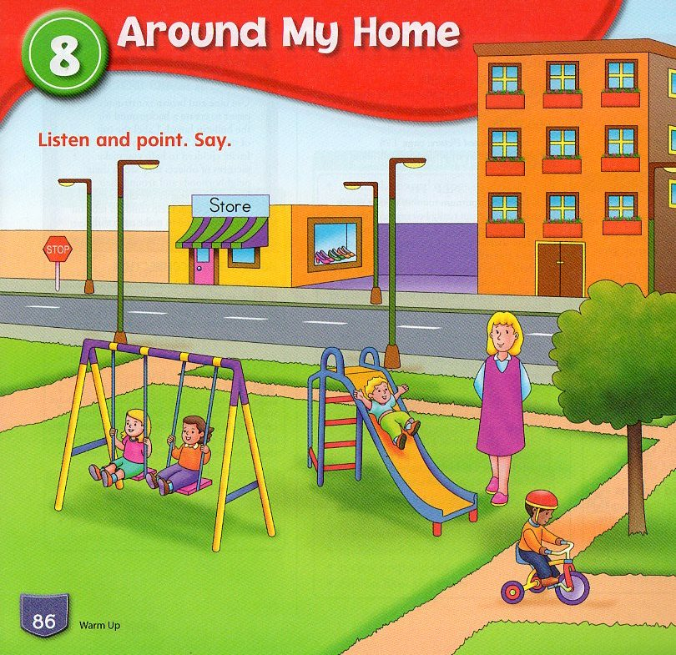
Example of Patterns
Teacher Talk: (Wave your hand over the page.) “Look! I see a park. I see boys and girls. The boys and girls are in the park.” Repeat. “The boys and girls are in the park.”
. Teacher: (Point to the slide. Ask children to listen, point, and repeat) This is a slide
Children’s Response: (Listen, point, and repeat.) This is a slide
. Teacher: (Point to the swings. Ask children to listen, point, and repeat.) These are swings.
Children’s Response: (Listen, point, and repeat.) These are swings.

Slide 8
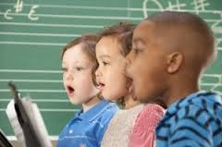
Teaching English through Song and Chants & Rhymes young learner
Song, chants and rhymes are full of lexicon, they use authentic language and students can take advantage of their repetition and musicality, contributing to the learning of new expressions.
Song, chants and rhymes are easy memorize
(songs work on our short or long term memory)

Slide 9
When and How to use song, chants and rhymes?
Playing the song or rhymes for pupils to listen to.
Singing the song or rhymes by ourselves, using mime, gesture or visual aids
Reading and singing the song with the whole class.

Slide 10
Activities which are for children
Listen
Sing, whistle, tap, and snap finger while we listen
Sing without listening to any recording
Use songs and music to change an atmosphere or mood.
Use songs and music to make a social environment, from a feeling of community, make friends

Slide 11
ANIMALS HOME
Dear rabbit, dear rabbit where do you live?
I live in the burrow, joyful and happy.
Dear monkey, dear monkey where do you live?
I live in the treetops, joyful and happy
Dear birdie, dear birdie where do you live?
I live in the nest, joyful and happy
Dear duck, dear duck where do you live?
I live in the pond, joyful and happy
Dear doggie, dear doggie where do you live?
I live in the kennel joyful and happy
Dear horse, dear horse where do you live?
I live in the stable joyful and happy

Slide 13
References
www.vocabulary.com
http/://www.academia.edu
Power point of miss sri supiah

Slide 14
Thanks for attention

