Slide 1
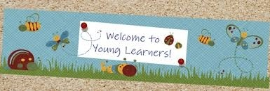
CHILDREN LANGUAGE TEACHING AND PRACTICE (CELTP) /TECHING ENGLISH TO YOUNG LEARNERS (TEYL) /ENGLISH FOR YOUNG LEARNERS (EYL) By: Sri Supiah Cahyati, M.Pd
English Education Study Program
IKIP Siliwangi
2019

Slide 2
Session 3
Teaching Vocabulary, Grammar, and the Language Skills (Principles, techniques, and activities)
ICT for Young Learners

Slide 3
Teaching Vocabulary & Grammar

Slide 4
Teaching vocabulary and grammar
Vocabulary & grammar should be taught & learnt together. It’s better if grammar is noticed & learnt from meaning-focused input, children need to be able to see the relationship between form & function.
Teacher should provide lots of meaningful practice, recycling, & guidance in attending to language form. So children will learn grammar in a holistic way.

Slide 5
What grammar to teach? (Brewster, Ellis, Grard, 2003)
Facts.
Example: the plural of foot is feet, not foots.
Patterns.
Example: My favorite (color/food) is (blue/fried chicken).
Choices.
Example: I like swimming/reading/…etc.
I go to school by car/on foot/…etc.

Slide 6
Teknik Pembelajaran (Damayanti, 2014)
Grammar sebaiknya diajarkan tidak secara terpisah terutama untuk very young learners , tunggu sampai mereka siap (diatas 8-9 tahun).
Belajar grammar dapat dimulai dari menghapal ‘formulaic chunks’. Membicarakan sesuatu yang bermakna dengan anak dapat dijadikan cara yang jitu untuk memperkenalkan grammar. Grammar dapat diajarkan tanpa perlu menjelaskan label-label teknis (seperti: intensifying adverb, past tense, etc.)

Slide 7
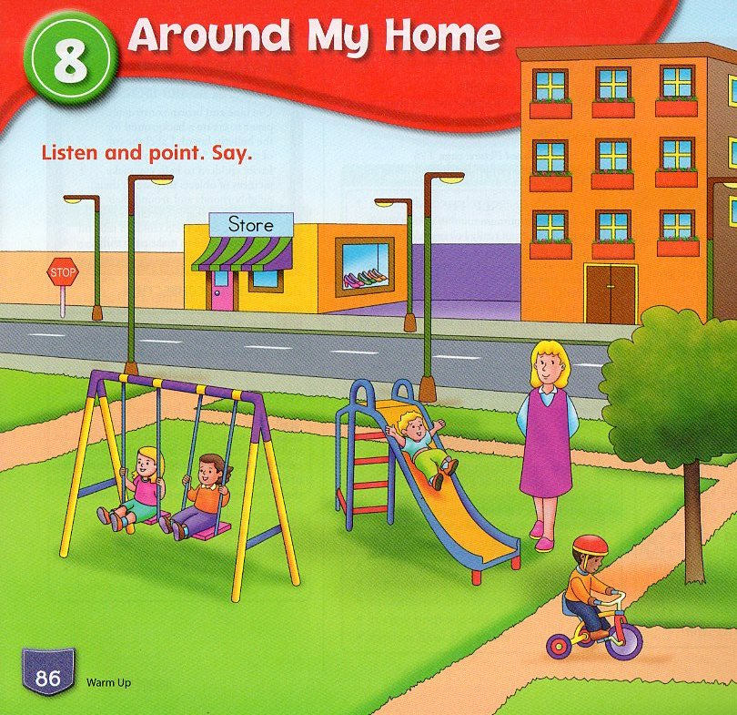
Example of Pattern
Teacher Talk: (Wave your hand over the page.) “Look! I see a park. I see boys and girls. The boys and girls are in the park.” Repeat. “The boys and girls are in the park.”
1. Teacher: (Point to the slide. Ask children to listen, point, and repeat) This is a slide.
3. Children’s Response: (Listen, point, and repeat.) This is a slide.
4. Children’s Response: (Listen, point, and repeat.) These are swings.
2. Teacher: (Point to the swings. Ask children to listen, point, and repeat.) These are swings.

Slide 8
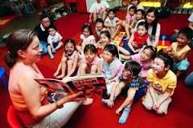
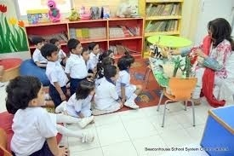
Teaching using Story Telling
Purposes :
To expose children to more language.
To revise language/vocabulary.
To present new language.
To practice listening, speaking, reading, writing.
To extend/enrich children’s language

Slide 9
Assessment activities (Brewster, Ellis, Grard, 2003):
Listen/read, then change from singular to plural, etc.
Fill in gaps with the correct grammatical/vocabulary item.
Correct grammatical/vocabulary mistakes in sentence.
Correct the word order in a sentence.
Read/listen to lists of words & classifying them.
Sequence time expressions, such as: today, yesterday, tomorrow.
Use picture prompts to contrast things using comparatives, tenses, etc.

Slide 10
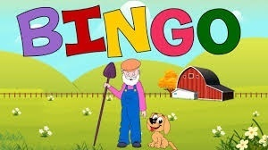
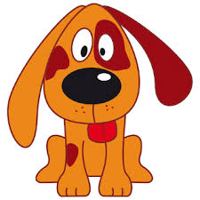
4➔ BINGO (=> spelling)
There was a farmer had a dog and Bingo was it’s name..o..
B…I…N…G…O… B…I…N…G…O B…I…N…G…O
And Bingo was it’s name … o…
There was a farmer had a dog and Bingo was it’s name..o..
(clap)…I…N…G…O, (clap)…I…N…G…O, (clap)…I…N…G…O
And Bingo was it’s name … o…

Slide 11
4➔ The Itsy Bitsy Spider (Binatang Kecil )
Binatang kecil naik
tembok yang tinggi
Turun hujan, binatang jatuh
Terbit matahari, hujan berhenti
Binatang kecil naik tembok kembali

Slide 12
6➔ If You’re Happy and You Know it (Jika kau suka hati)
If you’re happy and you know it clap your hands (clap clap)(2x)
If you’re happy and you know it
Then your face will surely show it
If you’re happy and you know it clap your hands (clap clap)
Stomp your feet
Nod your head/Say hurray
Do all three (clap, stomp, nod/say hurray)
?

Slide 13
Teaching Listening & Speaking

Slide 14
Teaching Listening (Pinter, 2006)
Children should start with easier “listen & do” activities, teacher often talk a lot in the target language because they provide the language input, teacher use “language modification” to avoid & solve misunderstandings, like repetitions, comprehension checks, clarification requests, & confirmation checks, TPR, and listening to stories.

Slide 15
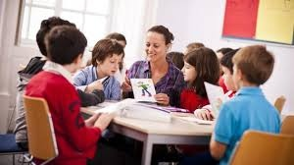
Teaching Tips (Slattery & Willis, 2001)
Support children’s early efforts in speaking by:
Look at what they have done & talk about it, even if they won’t understand everything you say. Give your shy pupils more chance to talk to you individually.
Waiting for their responses
Repeating what they say in English
Frequently summarizing what different pupils say
Give children lots of opportunities to speak, BUT …
Don’t pressure on children to speak if they are not ready
Remember: silent children are still likely to be listening & learning

Slide 16
The Initial Stages In Teaching Speaking (Brewster, Ellis, Grard, 2003)
Use Formulaic language:
Simple greetings:
Good morning, how are you?/ I’m fine, thank you. And you?
Social English:
Did you have a nice weekend?/ Have a nice weekend!
Routines:
What date is it today?/ What day is it today?
Classroom language:
Listen. Repeat. Sit down. Work in pairs. Good.
Asking permission:
May/Can I go to the toilet, please?/ May I wash my hand?/Can I look at the book?
Communication strategies:
Can you say that again, please?/How do you say… in English?/I don’t know.

Slide 17
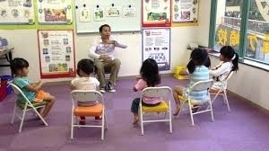
We can help our pupils understand what we say in English:
With our tone of voice, eye contact.
By using gestures, facial expressions, pictures/diagrams, real things.
By using familiar contexts & topics, rephrasing what we say in as many ways as we can, occasional use of their mother tongue.

Slide 18
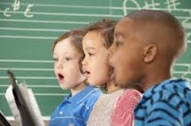
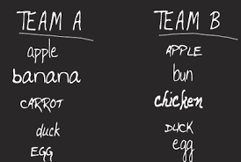
Activities Recommended in Teaching Listening & Speaking
“Singing, reciting rhymes, listening to stories, playing games according to the learners’ age, interests & abilities”

Slide 19
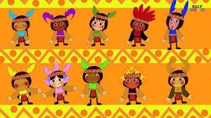
5➔ Ten Little Indian Boys (=>counting)
One, little two, little three, little Indian,
Four, little five, little six, little Indian,
Seven, little eight, little nine, little Indian,
Ten, little Indian boys
Ten, little nine, little eight, little Indian,
Seven, little six, little five, little Indian,
Four, little three, little two, little Indian,
One, little Indian boy

Slide 20
5➔ Ten Aeroplanes(=>counting)
One, little two, little three, little aeroplanes,
Four, little five, little six, little aeroplanes,
Seven, little eight, little nine, little aeroplanes,
Ten aeroplanes flying high
Ten, little nine, little eight, little aeroplanes,
Seven, little six, little five, little aeroplanes,
Four, little three, little two, little aeroplanes,
One aeroplane flying high

Slide 21
5➔Little Ducks (1)
Five little ducks went out one day
Over the hills and far away
Mother duck said: “quack quack quack quack”
But only four little ducks came back
Four little ducks went out one day
Over the hills and far away
Mother duck said: “quack quack quack quack”
But only three little ducks came back

Slide 22
5➔Little Ducks (2)
Three little ducks went out one day
Over the hills and far away
Mother duck said: “quack quack quack quack”
But only two little ducks came back
Two little ducks went out one day
Over the hills and far away
Mother duck said: “quack quack quack quack”
But only one little duck came back

Slide 23
5➔Little Ducks (3)
One little duck went out one day
Over the hills and far away
Mother duck said: “quack quack quack quack”
But none of those little ducks came back
Mother duck, she, went out one day
Over the hills and far away
Mother duck said: “quack quack quack quack”
And all of those little ducks came back

Slide 24
Teaching Reading & Writing

Slide 25
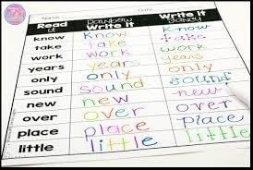
Teaching Reading and writing (Pinter, 2006):
“It would be controversial to introduce reading & writing in a second language to children who are not yet literate in their first language.”
“Reading & writing are usually taught in parallel because children who begin to read enjoy writing too. Children can only benefit from phonics training if the meaning of the words makes sense to them.”

Slide 26
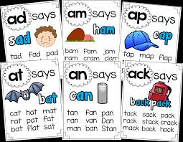
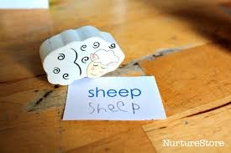
Teaching Reading and writing (Pinter, 2006):
It is useful for children to start:
Reading with phonics (see another slide)
Writing with tracing, copying, or air writing. Visual aids like Posters containing commonly used phrases, calendars, and English notice board would attract children’s attention & help them make the links between spoken & written forms.

Slide 27
Slattery & Willis (2001)
All children listen from birth & naturally acquire speech
All children have to learn how to read & write
If children’s mother tongue is written in Roman script, you can use a teaching method that focuses on meaning from the beginning
If children have a mother tongue that is not based on Roman script, then you will have to spend some more time on sounds, letter shape & word recognition
Meaning is the most important element in reading just as it is in listening
So, reading comes before writing.

Slide 28
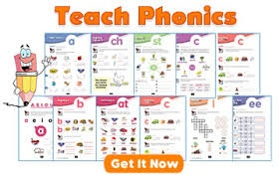
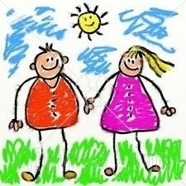
Priorities when teaching reading & writing (Slattery & Willis, 2001)
Focus on meaning
Word recognition
Making the connection between familiar sounds & written words/phrases
Naming the letters of the alphabet
Predicting the pronunciation of a written word

Slide 29
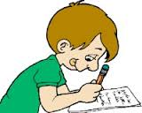
Teaching reading & writing using cards
Reading
Matching words/phrases with pictures
Labelling pictures/objects
Predicting from initial sounds
Re-arranging jumbled letters to make a word
Classifying words into sets
Ordering sentences in the correct sequence
Guessing the missing word
Games that involve recognizing words & meaning
Writing
Copy/write from memory the word/phrase that matches
Write a label
Finish the word st…
Write the whole word
Copy/write the names of all the people in the story
Copy/write out the story in the right order
Copy the phrase/sentence putting in the missing word
Bingo, writing races

Slide 30
ICT for Young Learners
Software: Learn to speak English
Software: Tell me more
Software: Aplikasi Kamus Anak
Software : Cambridge Dictionary
Software: Duolingo
Software for android: Play store ENGLISH GRAMMAR OFFLINE.
https://lessonwriter.com/per.html
https://analyze.academichelp.net/free.grade.my.paper.html
https://onlinequizcreator.com
https://edpuzzle.com
http://learenglishteens.britishcouncil/org.
https://kahoot.com
Google for education
Hot potatoes
Canva
Augmented reality apps:
http://arflashcards.com/
http://www.octagonstudio.com
http://chromville.com
http://www.zookazam.com
http://www.quivervision.com/

Slide 31
Bland, Janice (ed.) (2015). Teaching English to Young Learners: Critical Issues in Language Teaching with 3-12 Year Olds. London: Bloomsbury Publishing Plc.
Brewster, Jean; Ellis, Gail; Grard, Dennis. (2003). The Primary English Teacher’s Guide (New Edition). England: Penguin English.
Cameron, L. (2001). Teaching Languages to Young Learners. Cambridge: Cambridge University Press.
Damayanti, Ika Lestari. (2017). From Story Telling to Story Writing: The Implementation of Reading to Learn (R2L) Pedagogy to Teach English as a Foreign Language in Indonesia. Indonesian Journal of Applied Linguistics vol. 6 no. 2, January 2017, pp. 229-242.
Fadilah, Rahmi. (2017). Madeline Hunter’s Lesson Plan as Alternative Model for TEYL. Proceedings in English Conference at STKIP Pasundan.
Garton, Sue & Copland, Fiona (ed.). (2019). Teaching English to Young Learners. New York: Routledge.
Halliwell, S. (2004). Teaching English in the primary classroom. Essex: Pearson Education Limited.
Harmer, Jeremy. (2004). How to Teach English: An Introduction to the Practice of English Language Teaching. England: Longman.
Harmer, Jeremy. (2007). How to teach English (New Edition). Essex: Pearson Longman.
Ioannou-Georgiou, Sophie & Pavlou, Pavlos. 2003. Assessing Young Learners. Oxford: Oxford University Press.
Linse, Caroline T. (2005). Practical English Language Teaching: Young Learners. New York: McGraw-Hill.

Slide 32
Mckay, P. (2006). Assessing young language learners. Cambridge: Cambridge University Press.
Mooney, Carol Garhart. (2000). Theories of Childhood: An Introduction to Dewey, Montessori, Erikson, Piaget, and Vygotsky. USA: Redleaf Press.
Musthafa, Bachrudin. (2000). Teaching English to Young Learners: Principles & Techniques. Bandung: Pasca Sarjana Universitas Pendidikan Indonesia.
Mustafa, Bachrudin. (2008). Teaching English to young learners. Bandung: UPI Press.
Mustafa, Bachrudin. (2010). Teaching English to young learners in Indonesia: Essential requirements. Jurnal Educationist.Vol. 4 no.2, Juli 2010 pp. 120-125.
Paul, David. (2003). Teaching English to Children in Asia. Hongkong; Longman Asia ELT.
Pinter, Annamaria. (2006). Teaching Young Language Learners. Oxford: Oxford University Press.
Slattery, M. & Willis, J. (2005). English for Primary Teachers: A Handbook of Activities and Classroom Language. Oxford: Oxford University Press.
Youtube

