Slide 1
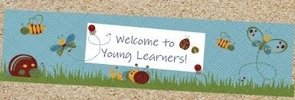
ENGLISH LANGUAGE TEACHING (ELT) FOR YOUNG LEARNERS By: Sri Supiah Cahyati, M.Pd
English Education Study Program
IKIP Siliwangi
2019

Slide 2
Session 4
Assessing Young Learners
Classroom Management
Materials & Media for YL

Slide 3
ASSESSING YOUNG LANGUAGE LEARNERS
The use of traditional methods is problematic because:
Traditional “paper & pencil test” (like filling in gaps in sentences, answering multiple choice questions /translating vocabulary lists) often do not work because such isolated exercises do not show what children know & can do with confidence (The negative washback effect of test). It would discourage children & cause them to lose their motivation to learn English.

Slide 4
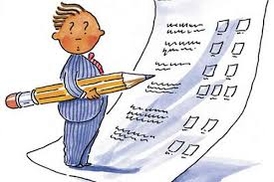
TRADITIONAL ASSESSMENTS
One-shot standardized exams
Timed, multiple-choice format
Decontextualized test items
Scores suffice for feedback
Norm-referenced scores
Focus on the ‘right’ answer
Non-interactive performance
Fosters extrinsic motivation

Slide 5
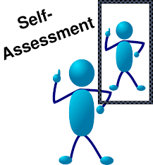
Assessment techniques which are appropriate to measure the children progress:
1
1
2
3
4

Slide 6
ALTERNATIVE ASSESSMENT
Continuous long-term assessment
Untimed, free-response format
Contextualized communicative tasks
Formative, interactive feedback
Criterion-referenced scores
Open-ended, creative answers
Interactive performance
Fosters intrinsic motivation

Slide 7
Examples:
Portfolio assessment
Structured assessment
activities/tasks
Projects
Self-assessment
Peer-assessment
Learner-developed assessment tasks
Take-home tasks
Observation
Conferencing

Slide 8
Child-friendly Assessment:
Definisi Evaluasi:
Proses pengumpulan informasi untuk mengetahui sejauh mana program pembelajaran bahasa telah berhasil mencapai tujuannya (Ioannou-Georgiou & Pavlou, 2003)
Berbagai macam permasalahan yang berkenaan dengan pendidikan bahasa dan memberikan penilaian terhadapnya (Cameron, 2001).
Menjaring informasi mengenai pengetahuan, kemampuan, pemahaman, sikap dan motivasi anak-anak (Ioannou-Georgiou & Pavlou, 2003)

Slide 9
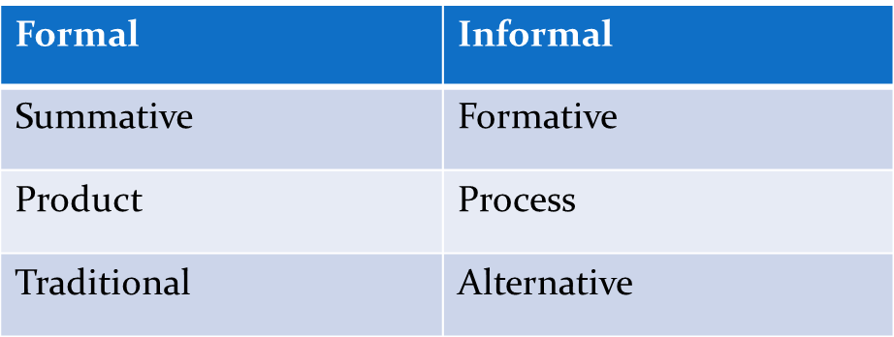
TESTING:
Salah satu alat asesmen yang biasanya berupa paper-pencil test
Asssessment:

Slide 10
Portofolio bahasa adalah koleksi sampel pekerjaan yang dihasilkan oleh anak dalam jangka waktu tertentu
Sampel ini dapat berupa:
Pekerjaan tertulis
Gambar
Proyek
Catatan buku yang telah dibaca
Hasil tes
Catatan self-assessment
Komentar orang tua dan guru

Slide 11
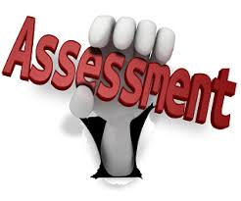
WHAT IS ASSESSMENT?
It is a general term which includes all methods used to gather information about children`s knowledge, ability, understanding, atitudes and motivation (Ioannou-Georgiou,& Pavlou, 2003).
It refers to collecting information & making judgments on a learner’s knowledge (Brindley in Linse, 2005).

Slide 12
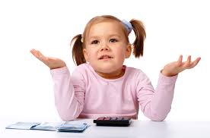
WHY ASSESS YOUNG CHILDREN
To monitor and aid children’s progress
To provide children with evidence of their progress and enhance motivation
To monitor your performance and plan future work
To provide information for parents, collegues and school authorities

Slide 13
WHAT DO WE ASSESS?
Skill developments : listening, speaking, reading, writing, integrated skills
Learning how to learn
Attitudes
Behavioural and social skills

Slide 14
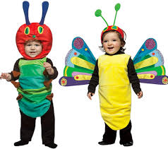
HOW DO WE ASSESS CHILDREN?
Portfolio Assessment | Traditional Test
Structured Assessment Activities/Task | Leaner Developed Assessment Test
Projects | Take Home Tasks
Self Assessment | Observation
Peer Assessment | C0nferencing

Slide 15
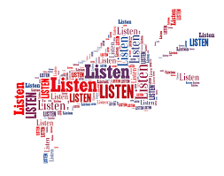
Assessment activities in Listening (Brewster, Ellis, Grard, 2003):
Listen & discriminate between sound
Listen & point to things/follow instruction
Listen & select the appropriate pictures
Listen to a description & draw/color a picture
Listen to a description & label a picture
Listen & match 2 pictures/a word & a picture
Listen & sequence pictures, words/sentences.
Listen to a description/story & tick items on a simple chart
Listen & complete gaps in words/sentences.
Listen & select the correct response (multiple choice)

Slide 16
Assessment activities in Speaking (Brewster, Ellis, Grard, 2003):
Listen & repeat words that rhyme/have the same/opposite meanings.
Listen & repeat only things which are true.
Sing a song, say a rhyme/poem memory.
Do pair work tasks.
Speak from picture prompts.
Finish off a sentence.
Pass on a telephone message.
Play a guessing game.
Listen to a story, sequence pictures
& retell the story.

Slide 17
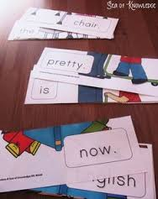
Assessment activities in Reading (Brewster, Ellis, Grard, 2003):
Do simple reading games at word level, like Odd One Out.
Read a rhyme, poem/part of a dialog aloud.
Read vocabulary items & group them into families.
Read a description & label a drawing/diagram.
Read a description & color/draw a picture.
Read letters & rearrange them to produce words sentences.
Read & answer multiple choice, true/false, or comprehension questions.

Slide 18
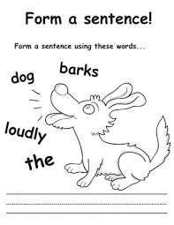
Assessment activities in Writing (Brewster, Ellis, Grard, 2003):
Rearrange & copy: letters to spell a word.
Read a description & write labels/captions for pictures.
Complete a crossword.
Fill in gaps in sentences to test grammar/vocabulary.
Write speech bubbles for characters from a story/dialogue.
Transfer simple notes on a chart into sentences.
Answer simple questions in written form.
Correct mistake in a sentence/text.
Write sentences from picture prompts.

Slide 19
HOW TO GIVE FEEDBACK
Feedback can be given in a variety of ways : individually to each child, to groups of children, or the whole class. Can also be given in the form of self correction or peer feedback.
One of the best way to give feedback is through conferencing with the children when you diccuss the result of the assessment.

Slide 20
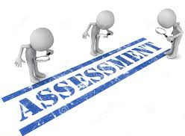
HOW EACH ASSESSMENT TASK IS ORGANIZED
Level : beginners, elementary, pre-intermediate | Preparation
Age group | In class
Time | Feedback
Description | Follow up
Language | Variations
Skills | Assessment of outcome
Assessment criteria | Portfolio
Materials | Comments

Slide 21
8➔ Old Mc Donald’s Farm (1)
Old Mc Donald had a farm (ee i ee i oh)
And on his farm he had a duck (ee i ee i oh)
With a quack quack here and a quack quack there
Here quack there quack
Everywhere a quack quack
Old Mc Donald had a farm (ee i ee i oh)

Slide 22
8➔ Old Mc Donald’s Farm (2)
Old Mc Donald had a farm (ee i ee i oh)
And on his farm he had a cow (ee i ee i oh)
With a moo moo here and a moo moo there
Here moo there moo
Everywhere a moo moo
Quack quack here and a quack quack there
Here quack there quack
Everywhere a quack quack
Old Mc Donald had a farm (ee i ee i oh)

Slide 23
8➔ Old Mc Donald’s Farm (3)
Old Mc Donald had a farm (ee i ee i oh)
And on his farm he had a pig (ee i ee i oh)
With an oink oink here and an oink oink there
Here oink there oink
Everywhere an oink oink
Moo moo here and a moo moo there
everywhere moo moo
Quack quack here and a quack quack there
Everywhere quack quack
Old Mc Donald had a farm (ee i ee i oh)

Slide 24
8➔ Old Mc Donald’s Farm (4)
Old Mc Donald had a farm (ee i ee i oh)
And on his farm he had a turkey (ee i ee i oh)
With a gobble gobble here and a gobble gobble there
Here gobble there gobble
Everywhere a gobble gobble
oink oink here and oink oink there
Here an oink there an oink
Everywhere an oink oink
Moo moo here and a moo moo there
here moo there moo
everywhere moo moo
Quack quack here and a quack quack there
here quack there quack
Everywhere quack quack
Old Mc Donald had a farm (ee i ee i oh)

Slide 25
Classroom Management
Children with Special Needs
What If

Slide 26
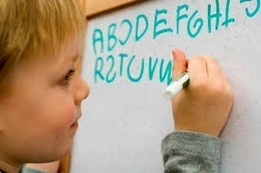
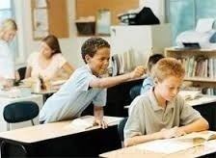
Children with Special Needs (Linse, 2005):
Dyslexia: difficulty with words.
ADD: Attention Deficit Disorder
ADHD: Attention Deficit Hyperactivity Disorder
Symptoms:
fails to give close attention to details/makes careless mistakes.
may have poorly formed letters/words/messy writing.

Slide 27
The Amazing Brain
Experience shapes the brain
Emotions and learning
Memory is multi-sensory
Making sense of meaning

Slide 28
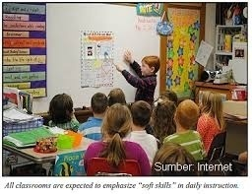
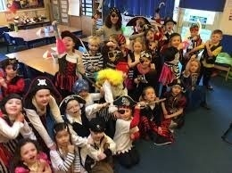
Classroom Management: What if? (Harmer, 2004)
Students are at different levels?
Do different task with the same material.
Use peer help (better students can help the weaker ones).
The class is very big?
Use worksheet.
Use pairwork & groupwork.
Think about vision & acoustics.
Use the size of the group to your advantages: humour is funnier, drama is more dramatic.

Slide 29
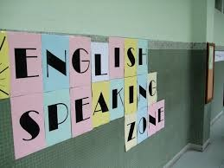
What if? (Harmer, 2004)
The students keep using their own language? - Encourage them to use English appropriately. - Create an English environment - Keep reminding them.
Students are uncooperative?
- Talk/write to individuals.
- Use activities.
- Make a learning contract.

Slide 30
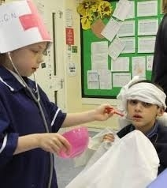
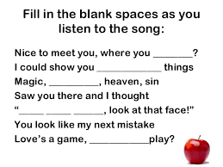
What if? (Harmer, 2004)
Students don’t want to talk?
- Use pairwork.
- Allow them to speak in a controlled way at first.
- Use acting out & reading aloud.
- Use role play.
Student do not understand the listening tape?
- Introduce interview questions.
- One task only.
- Use the tapescript which cut into bits/have words blanked out.

Slide 31
Materials & Media for Young Learners
Teaching Media for Young Learners
Preparing the Project (Media & Video)

Slide 32
The content of the Video
Duration: 4-8 minutes
Name of the media
Course
Materials
Steps
Instruction (How to use)
Institution {student’s name & number, faculty, year),
Credits (include the person in charge, backsound)
Spelling => double tip, Mrs. Supia’ah Cahyati, Sri Suipiah Cahyati
Grammar => the media ready to use
Wording => cut scissor, paint the wood with red colour, use double tape to temple item into the cork, learning & teaching process, makers
The contrast => if the background is white/grey, the letter should be dark colour

Slide 33
Materials for Young Learners Classroom

Slide 34
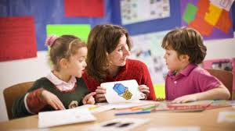
Young learners’ coursebook should be well designed with attractive features:
Colourful visuals
Fun games and tasks
Crafts
Projects
Yet, no coursebook can be perfect for any teaching-learning situation (Pinter, 2009).

Slide 35
Smart Book

Slide 36
Transportation

Slide 37
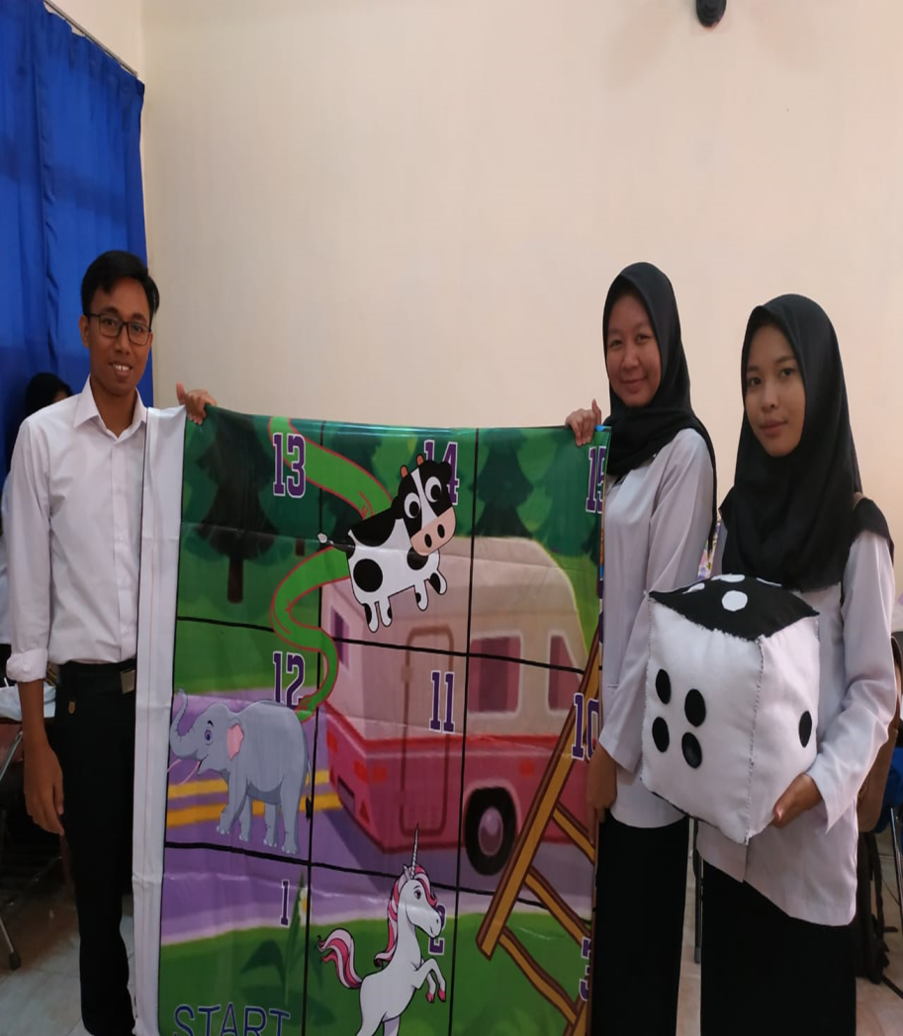
Snake and Ladder

Slide 38
Animals

Slide 39
Caterpillar of Words

Slide 40
Guess the Word

Slide 41
Magic Spinner

Slide 42
Smart Box

Slide 43
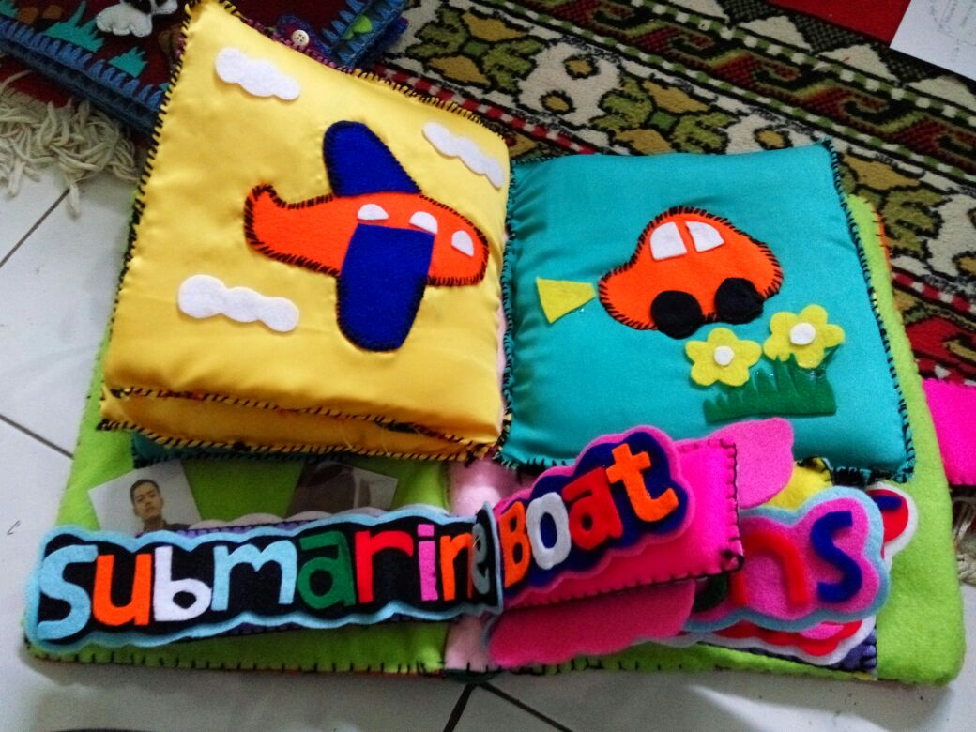

Slide 44
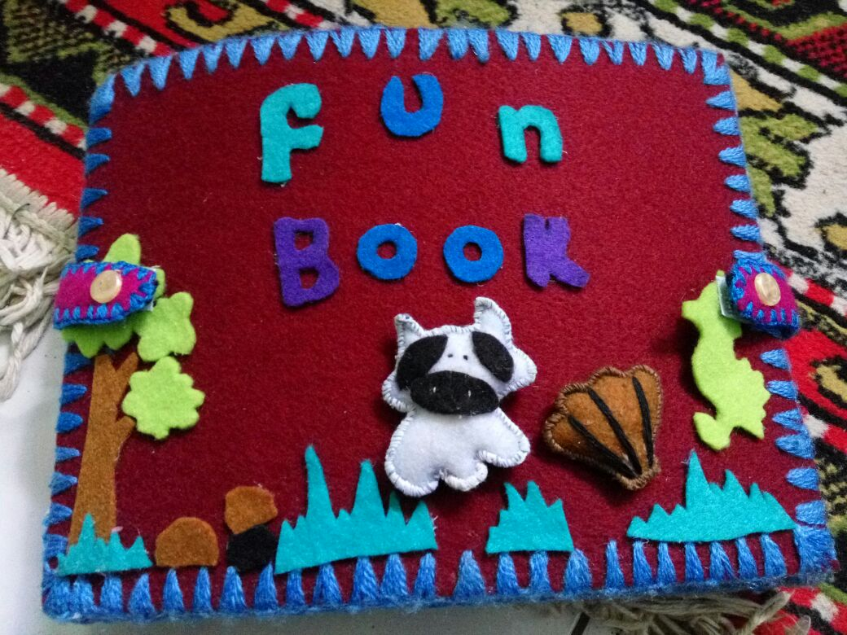

Slide 45
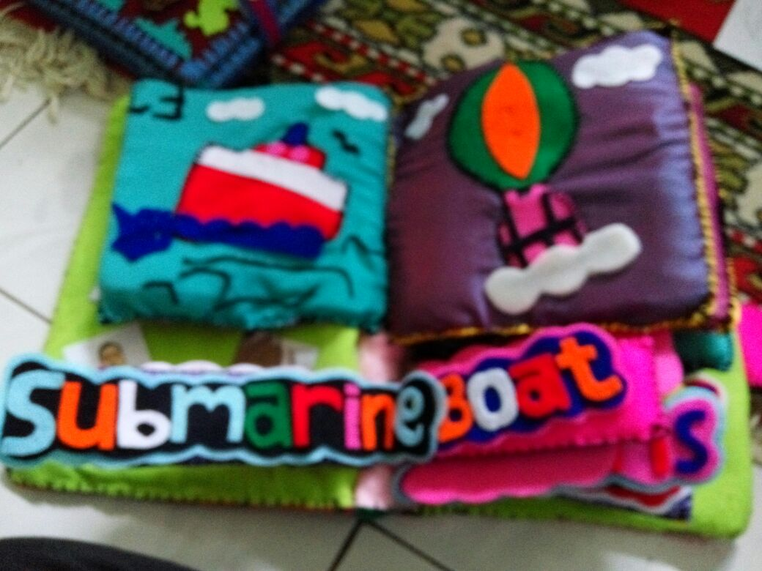

Slide 46
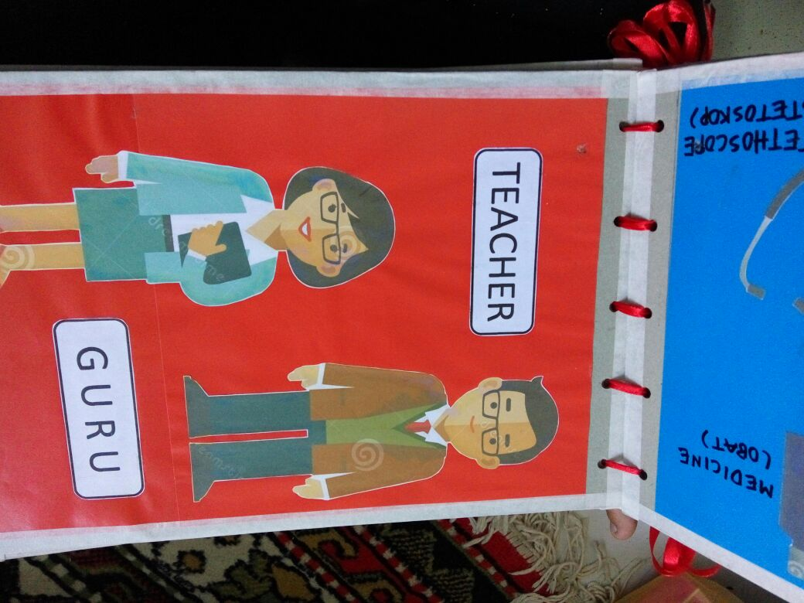

Slide 47
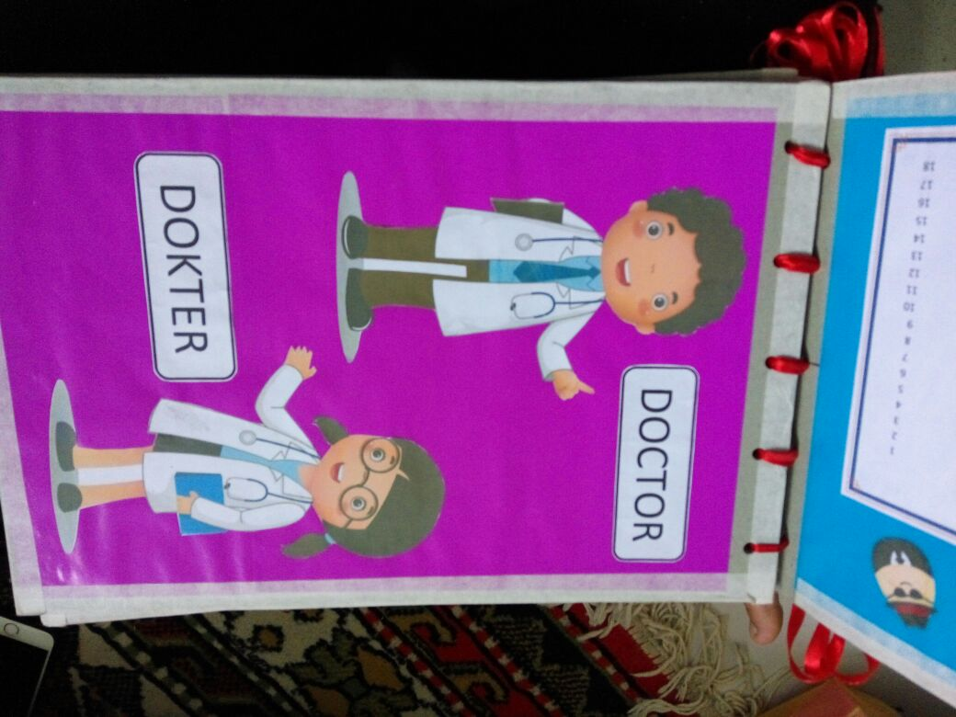

Slide 48
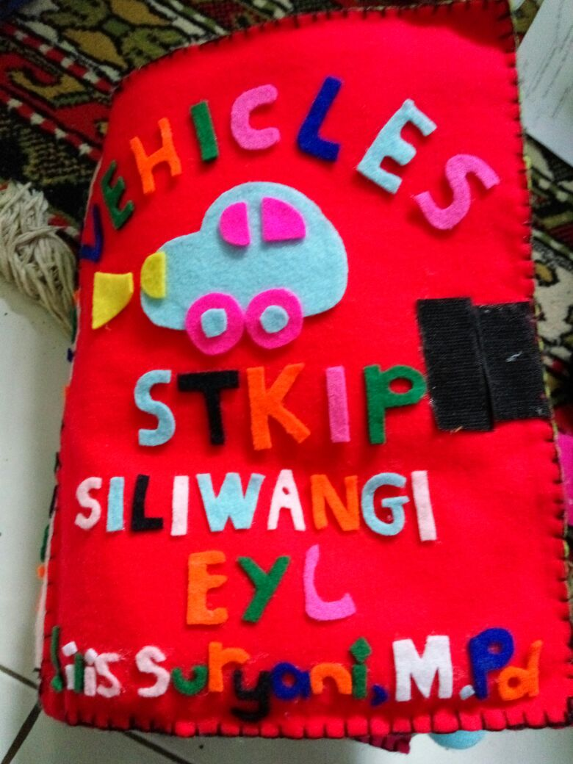

Slide 49
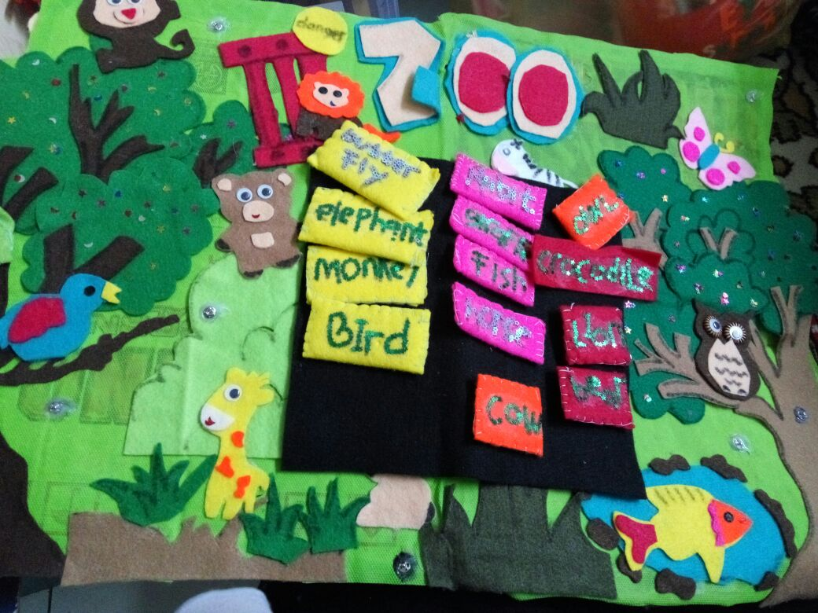

Slide 50
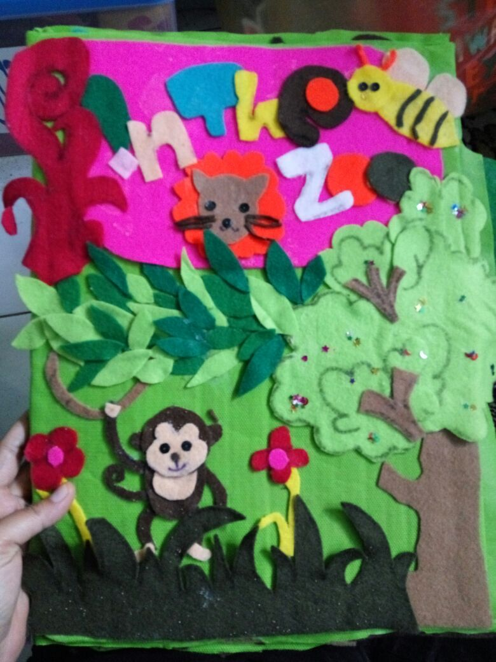

Slide 51
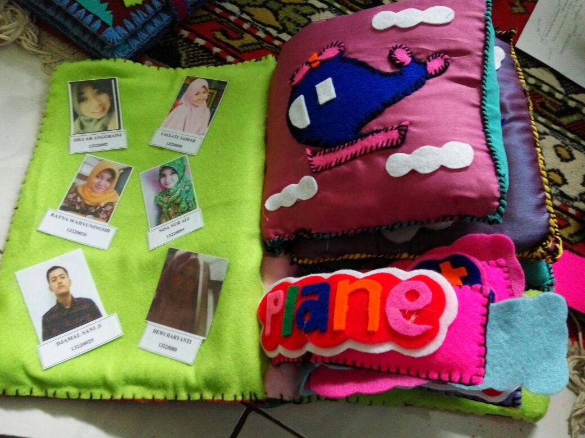

Slide 52
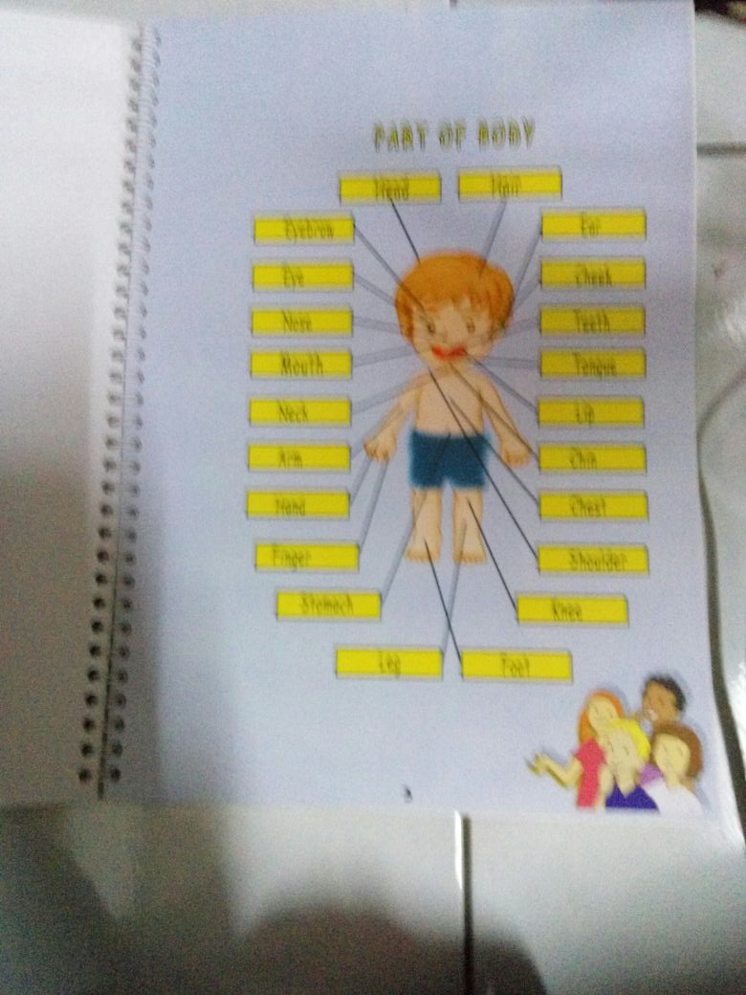

Slide 53
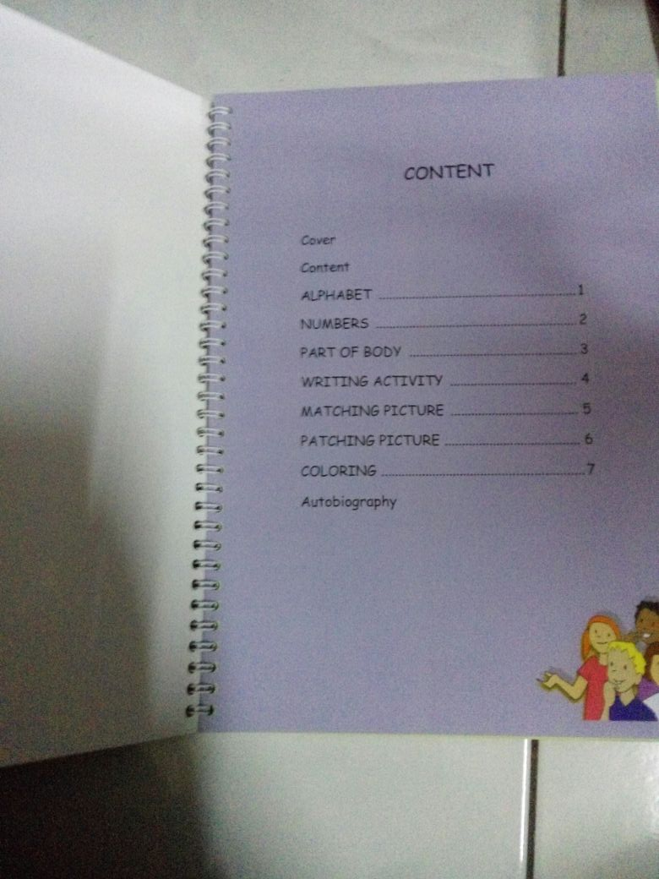

Slide 54
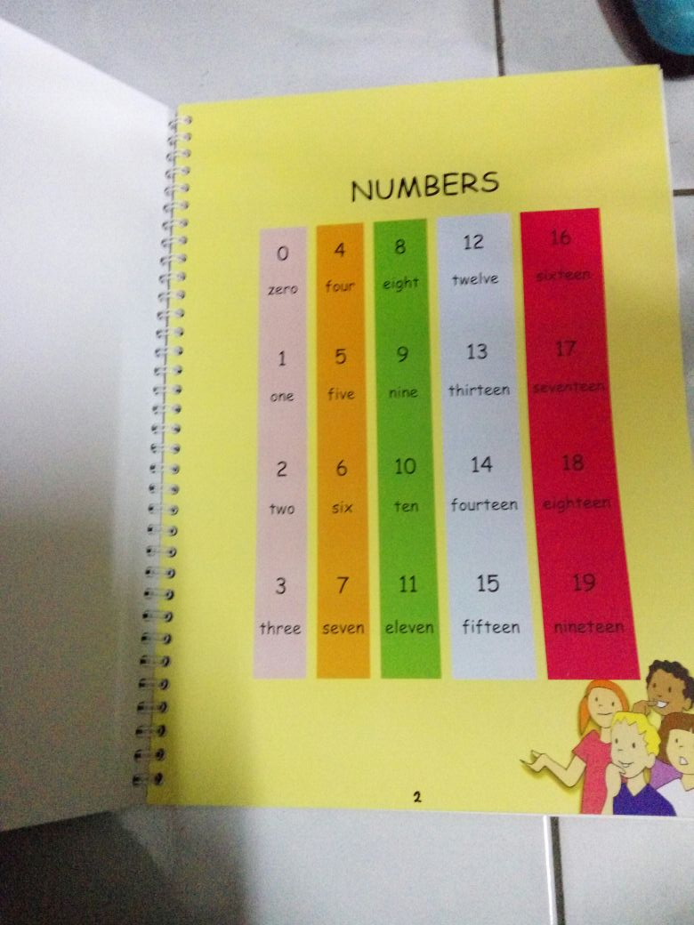

Slide 55
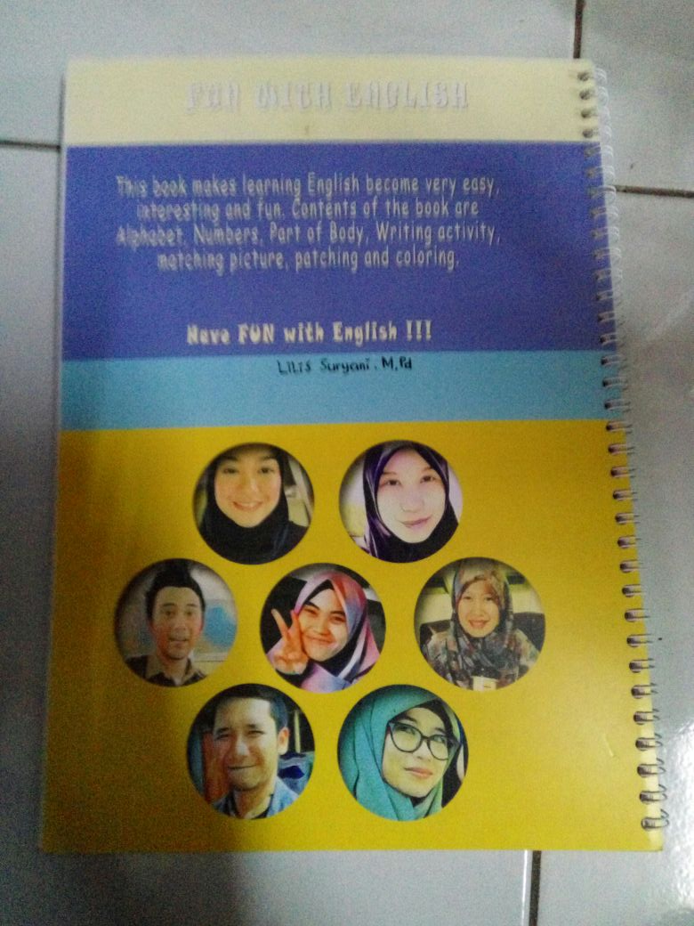

Slide 56
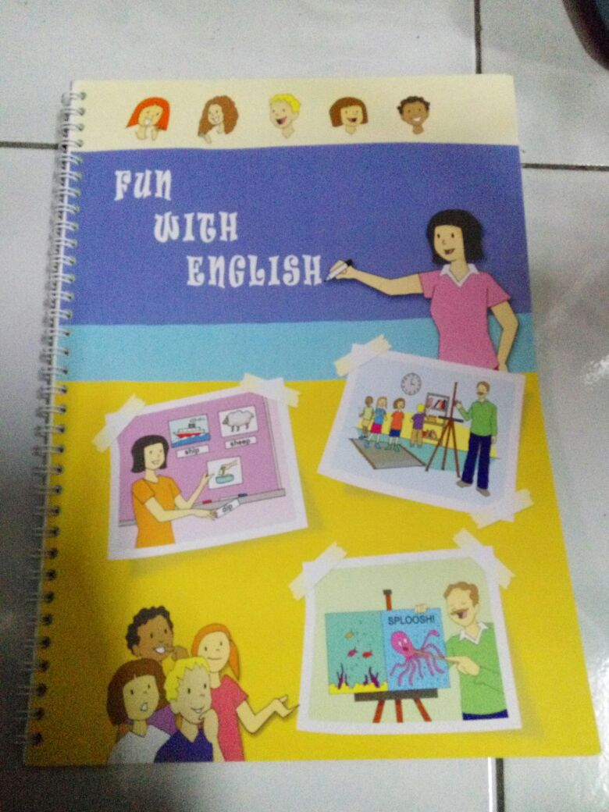

Slide 57
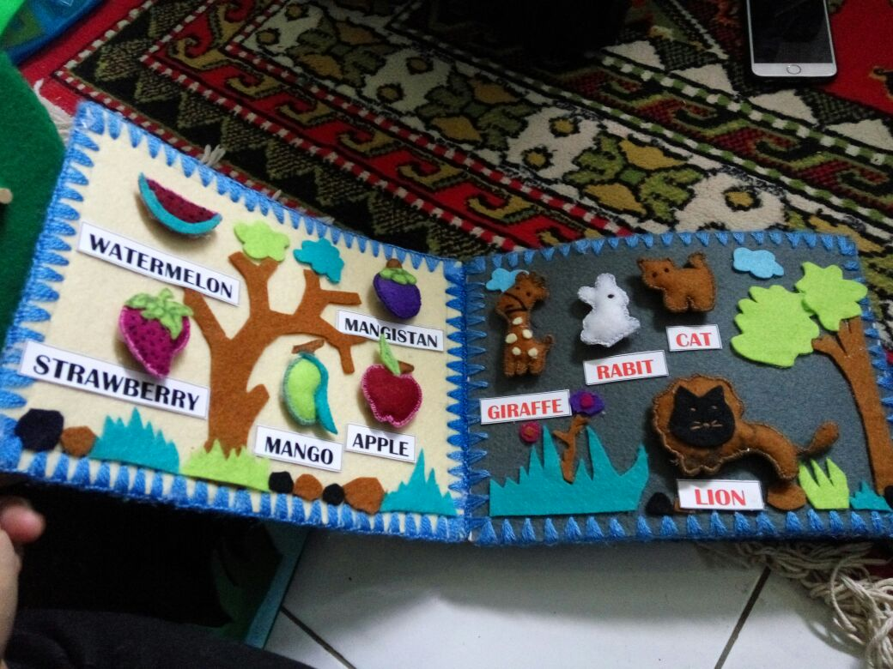

Slide 58
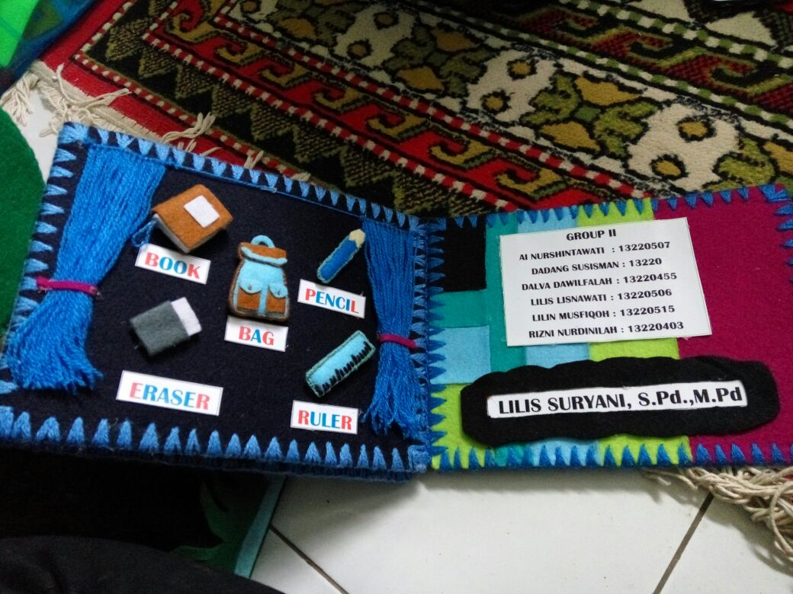

Slide 59
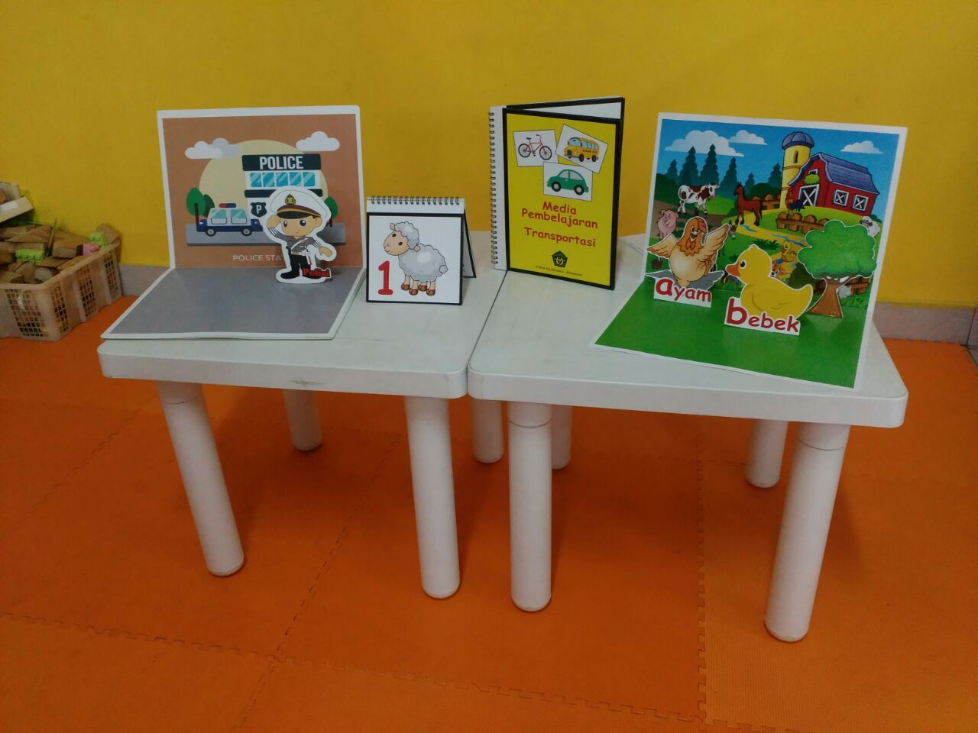

Slide 60
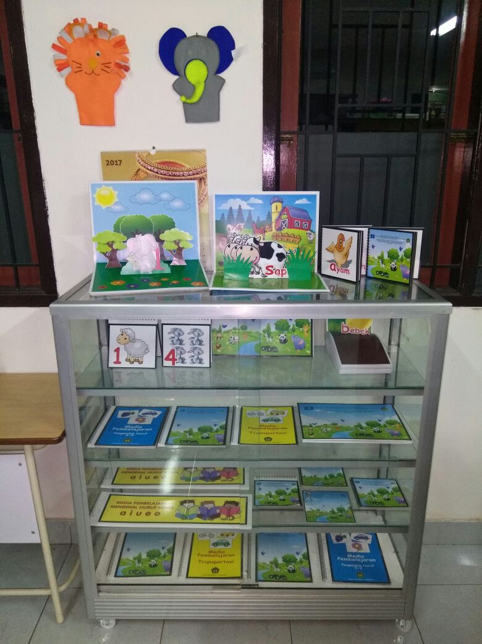

Slide 61
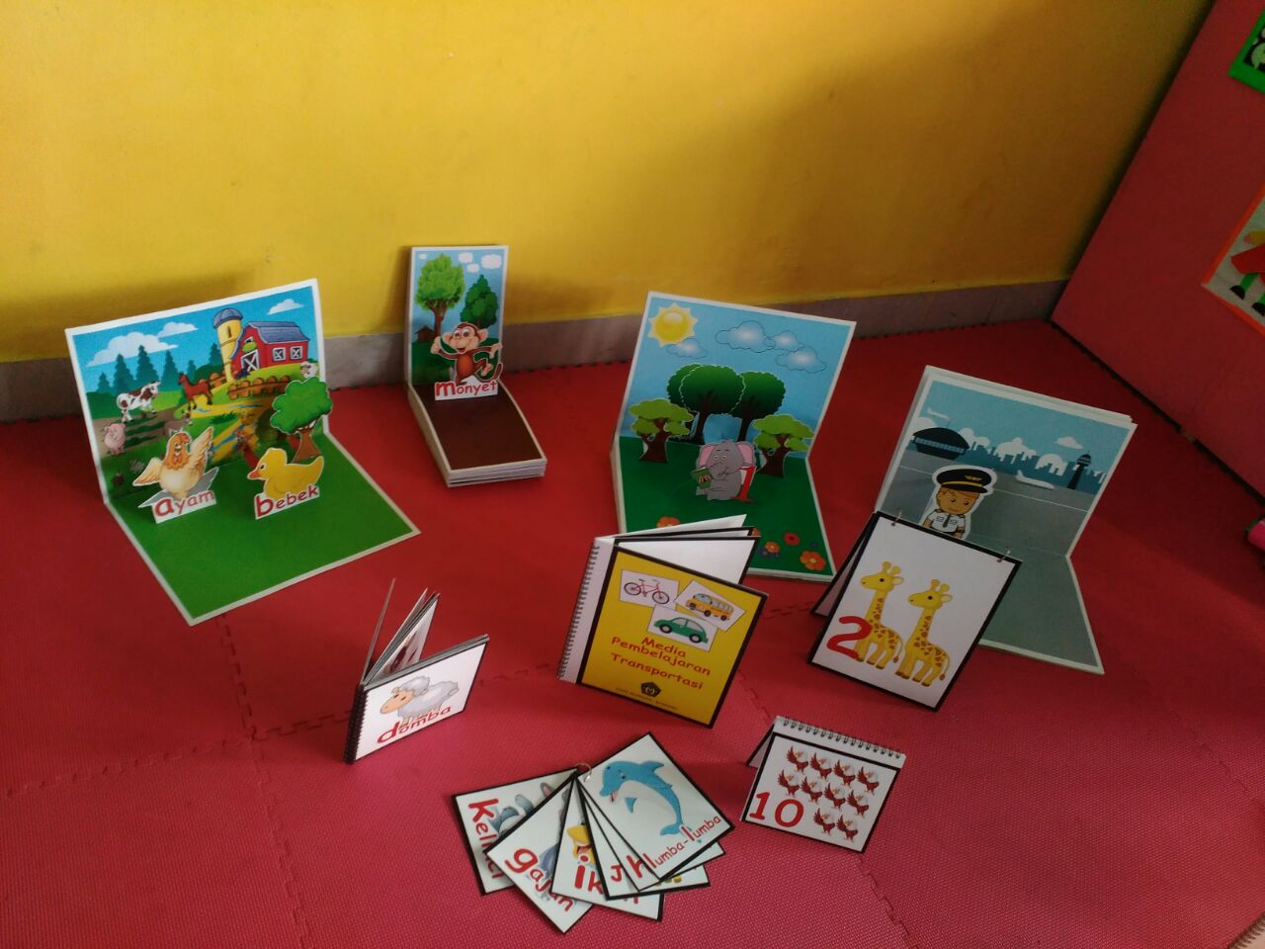

Slide 62
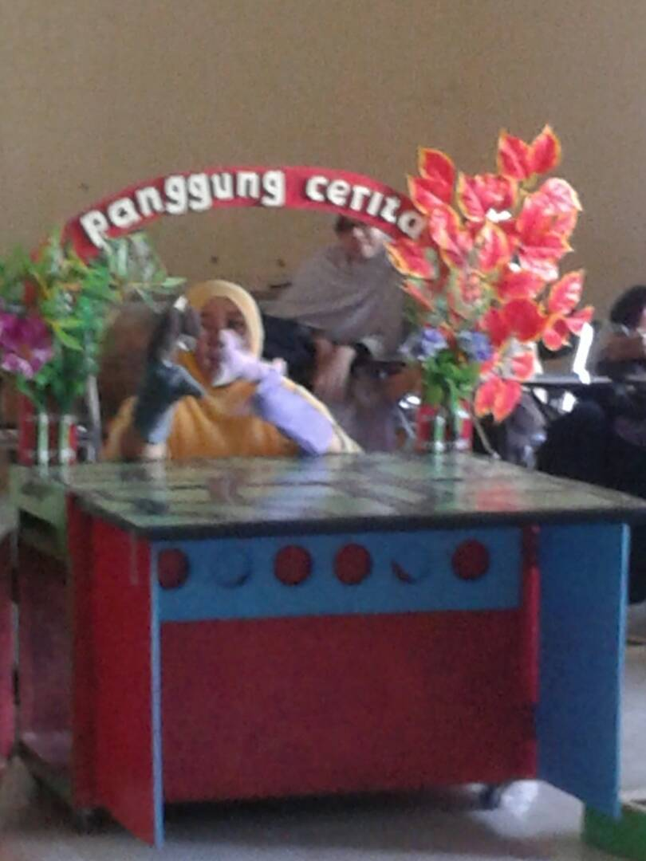
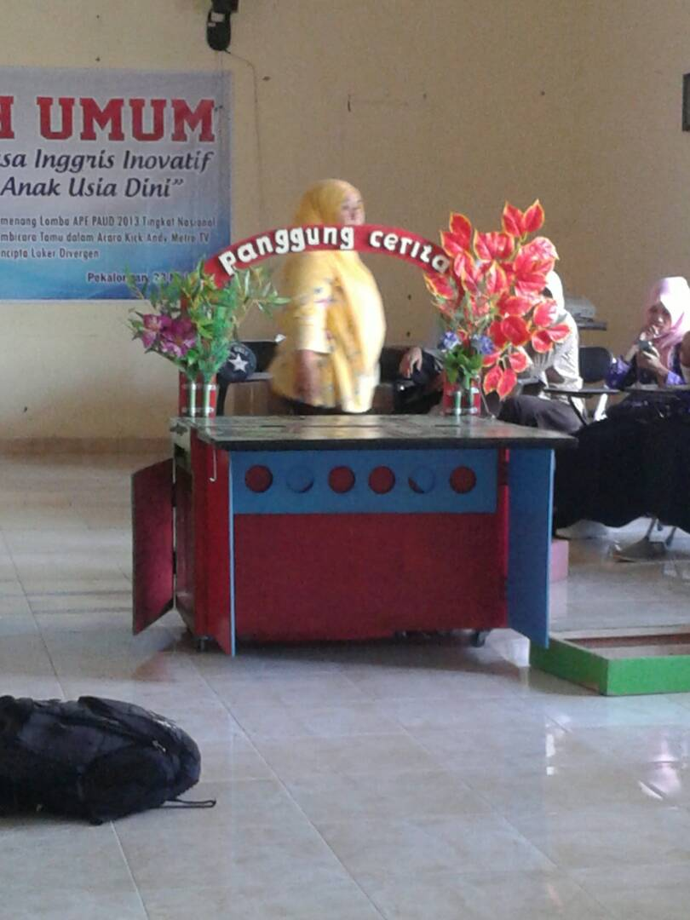

Slide 63
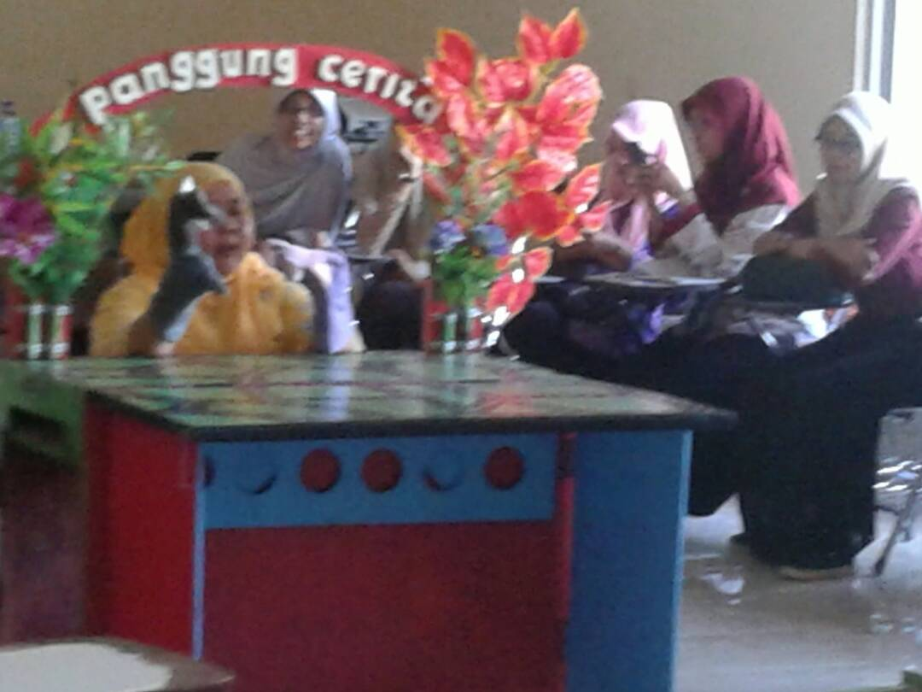

Slide 64
See more examples

Slide 65
Bland, Janice (ed.) (2015). Teaching English to Young Learners: Critical Issues in Language Teaching with 3-12 Year Olds. London: Bloomsbury Publishing Plc.
Brewster, Jean; Ellis, Gail; Grard, Dennis. (2003). The Primary English Teacher’s Guide (New Edition). England: Penguin English.
Cameron, L. (2001). Teaching Languages to Young Learners. Cambridge: Cambridge University Press.
Damayanti, Ika Lestari. (2017). From Story Telling to Story Writing: The Implementation of Reading to Learn (R2L) Pedagogy to Teach English as a Foreign Language in Indonesia. Indonesian Journal of Applied Linguistics vol. 6 no. 2, January 2017, pp. 229-242.
Fadilah, Rahmi. (2017). Madeline Hunter’s Lesson Plan as Alternative Model for TEYL. Proceedings in English Conference at STKIP Pasundan.
Garton, Sue & Copland, Fiona (ed.). (2019). Teaching English to Young Learners. New York: Routledge.
Halliwell, S. (2004). Teaching English in the primary classroom. Essex: Pearson Education Limited.
Harmer, Jeremy. (2004). How to Teach English: An Introduction to the Practice of English Language Teaching. England: Longman.
Harmer, Jeremy. (2007). How to teach English (New Edition). Essex: Pearson Longman.
Ioannou-Georgiou, Sophie & Pavlou, Pavlos. 2003. Assessing Young Learners. Oxford: Oxford University Press.
Linse, Caroline T. (2005). Practical English Language Teaching: Young Learners. New York: McGraw-Hill.

Slide 66
Mckay, P. (2006). Assessing young language learners. Cambridge: Cambridge University Press.
Mooney, Carol Garhart. (2000). Theories of Childhood: An Introduction to Dewey, Montessori, Erikson, Piaget, and Vygotsky. USA: Redleaf Press.
Musthafa, Bachrudin. (2000). Teaching English to Young Learners: Principles & Techniques. Bandung: Pasca Sarjana Universitas Pendidikan Indonesia.
Mustafa, Bachrudin. (2008). Teaching English to young learners. Bandung: UPI Press.
Mustafa, Bachrudin. (2010). Teaching English to young learners in Indonesia: Essential requirements. Jurnal Educationist.Vol. 4 no.2, Juli 2010 pp. 120-125.
Paul, David. (2003). Teaching English to Children in Asia. Hongkong; Longman Asia ELT.
Pinter, Annamaria. (2006). Teaching Young Language Learners. Oxford: Oxford University Press.
Slattery, M. & Willis, J. (2005). English for Primary Teachers: A Handbook of Activities and Classroom Language. Oxford: Oxford University Press.
Youtube

