Slide 1
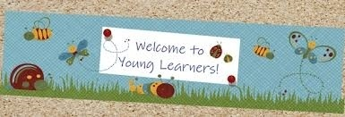
CHILDREN LANGUAGE TEACHING AND PRACTICE (CELTP) /TECHING ENGLISH TO YOUNG LEARNERS (TEYL) /ENGLISH FOR YOUNG LEARNERS (EYL) By: Sri Supiah Cahyati, M.Pd
English Education Study Program
IKIP Siliwangi
2019

Slide 2
Session 9-11
Teaching Practice

Slide 3
How to plan Lesson?
Lesson plan gives the lesson framework, an overall shape.
Good teachers are flexible and respond creatively to what happens in the classroom, but they also need to have thought ahead, have a destination they want their students to reach, and know how they are going to get there.
What are the aims of a plan?
a good plan needs to reflect coherence and variety

Slide 4
The ideal compromise is to plan a lesson that has an internal coherence but which nevertheless allows the students to do different things.
A good Lesson plan
Coherence
Students can see a logical pattern to the lesson
Variety
There has to be some variety in a lesson period

Slide 5
A number of important questions before teacher starts to plan an activity:
Why do you want to do it?
What will it achieve?
How long will it take?
What might go wrong?
What will you need to do it?

Slide 6
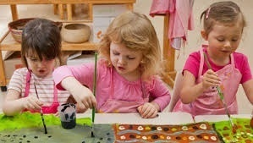
A Lesson Plan of TEYL (Paul, 2003)
Child-centered Learning:
Noticing
Wanting
Challenging/taking a risk
Playing/experimenting
Succeeding
Linking/Internalization

Slide 7
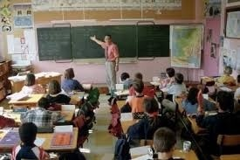
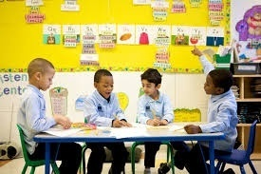
Teacher-centered
Child-centered
We can plan a lesson carefully
We can use time effectively
We can teach clearly and logically
The children behave well and do not chat so much.
The children enjoy themselves
They learn naturally and actively
They are spontaneous
Their eyes shine brightly

Slide 8
What can go wrong?
We do not give the children space to notice
They do what we want them to do
They do not try for themselves
They do not experiment enough
They are unsuccessful
They do not make links

Slide 9
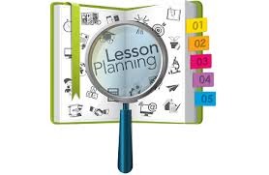
Planning a Lesson
Preparation
From familiar to unfamiliar
Varying the focus
Varying the style
Moving on to the next target

Slide 10
Techniques
- Repetition
- Introducing new words
- Introducing new patterns
- Creating a need

Slide 11
Organization
One-to-one, pairs, and groups
Routines
Scoring systems
Homework

Slide 12
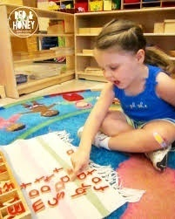
LEARNING CONDITIONS
Plenty of exposure
Lots of repetition and routine
Friendly environment
No compulsion of communication—based on desire
Unlimited time
Parent and child do things together

Slide 13
Sample of Lesson plan
Goal : students will increase their familiarity with past tenses, word
formation and time expression.
2. Skills: speaking and writing
3. Objectives:
Students will comprehend a simple sentence in past tense (T elicits using pictures, invites, and introduces the past tense verbs)
Students will identify past tense verbs and try to memorize some (pair work/group work board game)
Students will comprehend and produce verbs-studied and necessary vocabulary in past tense (speaking activity)
Students will comprehend the word formation of past tense and they are able to make in written form(exercises from workbook/student’s book)
Homework
4. Materials and Equipment: pictures, worksheets, books.
5. Duration/Time: 90 minutes

Slide 14
Quickie Procedure/Scenario:
Opening: Greeting.. Chit chat
Review previous lesson (5’)
Checking (5’)
Intro new materials →elicit some pictures, cards, board rush etc (10’)
Past tense Board game (group work) → test them (15’)
T invites the questions (drill/repetition) (10’)
Worksheet 1 (speaking worksheet-pair work) (10’)
Worksheet 2 (all students are involved-Mingle) (10’)
Do and check the exercise → Std Bk page.? (15)
Review (10’)
Home work (SB/WB exercises) + Closing
NB: Back up activities: Bingo/ any games
Notes:
/

Slide 15
See more: Lesson Plan

Slide 16
Next Meeting
Teaching Practice
& Recorded

Slide 17
Some terms in TEFL
TELL; Technology Enhanced Language Learning.
CALL: Computer Assisted Language Learning.
MALL: Mobile Assisted Language Learning.

Slide 18
See Folder: Video of TEYL

Slide 19
8➔ Old Mc Donald’s Farm (1)
Old Mc Donald had a farm (ee i ee i oh)
And on his farm he had a duck (ee i ee i oh)
With a quack quack here and a quack quack there
Here quack there quack
Everywhere a quack quack
Old Mc Donald had a farm (ee i ee i oh)

Slide 20
8➔ Old Mc Donald’s Farm (2)
Old Mc Donald had a farm (ee i ee i oh)
And on his farm he had a cow (ee i ee i oh)
With a moo moo here and a moo moo there
Here moo there moo
Everywhere a moo moo
Quack quack here and a quack quack there
Here quack there quack
Everywhere a quack quack
Old Mc Donald had a farm (ee i ee i oh)

Slide 21
8➔ Old Mc Donald’s Farm (3)
Old Mc Donald had a farm (ee i ee i oh)
And on his farm he had a pig (ee i ee i oh)
With an oink oink here and an oink oink there
Here oink there oink
Everywhere an oink oink
Moo moo here and a moo moo there
everywhere moo moo
Quack quack here and a quack quack there
Everywhere quack quack
Old Mc Donald had a farm (ee i ee i oh)

Slide 22
8➔ Old Mc Donald’s Farm (4)
Old Mc Donald had a farm (ee i ee i oh)
And on his farm he had a turkey (ee i ee i oh)
With a gobble gobble here and a gobble gobble there
Here gobble there gobble
Everywhere a gobble gobble
oink oink here and oink oink there
Here an oink there an oink
Everywhere an oink oink
Moo moo here and a moo moo there
here moo there moo
everywhere moo moo
Quack quack here and a quack quack there
here quack there quack
Everywhere quack quack
Old Mc Donald had a farm (ee i ee i oh)

Slide 23
Bland, Janice (ed.) (2015). Teaching English to Young Learners: Critical Issues in Language Teaching with 3-12 Year Olds. London: Bloomsbury Publishing Plc.
Brewster, Jean; Ellis, Gail; Grard, Dennis. (2003). The Primary English Teacher’s Guide (New Edition). England: Penguin English.
Cameron, L. (2001). Teaching Languages to Young Learners. Cambridge: Cambridge University Press.
Damayanti, Ika Lestari. (2017). From Story Telling to Story Writing: The Implementation of Reading to Learn (R2L) Pedagogy to Teach English as a Foreign Language in Indonesia. Indonesian Journal of Applied Linguistics vol. 6 no. 2, January 2017, pp. 229-242.
Fadilah, Rahmi. (2017). Madeline Hunter’s Lesson Plan as Alternative Model for TEYL. Proceedings in English Conference at STKIP Pasundan.
Garton, Sue & Copland, Fiona (ed.). (2019). Teaching English to Young Learners. New York: Routledge.
Halliwell, S. (2004). Teaching English in the primary classroom. Essex: Pearson Education Limited.
Harmer, Jeremy. (2004). How to Teach English: An Introduction to the Practice of English Language Teaching. England: Longman.
Harmer, Jeremy. (2007). How to teach English (New Edition). Essex: Pearson Longman.
Ioannou-Georgiou, Sophie & Pavlou, Pavlos. 2003. Assessing Young Learners. Oxford: Oxford University Press.
Linse, Caroline T. (2005). Practical English Language Teaching: Young Learners. New York: McGraw-Hill.

Slide 24
Mckay, P. (2006). Assessing young language learners. Cambridge: Cambridge University Press.
Mooney, Carol Garhart. (2000). Theories of Childhood: An Introduction to Dewey, Montessori, Erikson, Piaget, and Vygotsky. USA: Redleaf Press.
Musthafa, Bachrudin. (2000). Teaching English to Young Learners: Principles & Techniques. Bandung: Pasca Sarjana Universitas Pendidikan Indonesia.
Mustafa, Bachrudin. (2008). Teaching English to young learners. Bandung: UPI Press.
Mustafa, Bachrudin. (2010). Teaching English to young learners in Indonesia: Essential requirements. Jurnal Educationist.Vol. 4 no.2, Juli 2010 pp. 120-125.
Paul, David. (2003). Teaching English to Children in Asia. Hongkong; Longman Asia ELT.
Pinter, Annamaria. (2006). Teaching Young Language Learners. Oxford: Oxford University Press.
Slattery, M. & Willis, J. (2005). English for Primary Teachers: A Handbook of Activities and Classroom Language. Oxford: Oxford University Press.
Youtube

