Slide 1
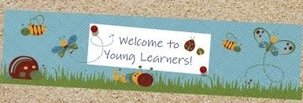
CHILDREN LANGUAGE TEACHING AND PRACTICE (CLTP) /TECHING ENGLISH TO YOUNG LEARNERS (TEYL) /ENGLISH FOR YOUNG LEARNERS (EYL) By: Sri Supiah Cahyati, M.Pd
English Education Study Program
IKIP Siliwangi
2019

Slide 2
Making Teaching Media

Slide 3
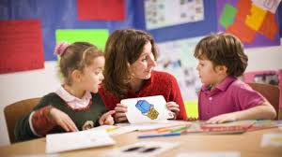
Young learners’ coursebook should be well designed with attractive features:
Colourful visuals
Fun games and tasks
Crafts
Projects
Yet, no coursebook can be perfect for any teaching-learning situation (Pinter, 2009).

Slide 4
Young learners’ coursebook should be well designed with attractive features:
Colourful visuals
Fun games and tasks
Crafts
Projects
Yet, no coursebook can be perfect for any teaching-learning situation (Pinter, 2009).

Slide 5
Young learners’ coursebook should be well designed with attractive features:
Colourful visuals
Fun games and tasks
Crafts
Projects
Yet, no coursebook can be perfect for any teaching-learning situation (Pinter, 2009).

Slide 6
Young learners’ coursebook should be well designed with attractive features:
Colourful visuals
Fun games and tasks
Crafts
Projects
Yet, no coursebook can be perfect for any teaching-learning situation (Pinter, 2009).

Slide 7
The content of the Video
Duration: 4-8 minutes
Name of the media
Course
Materials
Steps
Instruction (How to use)
Institution {student’s name & number, faculty, year),
Credits (include the person in charge, backsound)
Problems:
Mispelling => double tip, Mrs. Supia’ah Cahyati, Sri Suipiah Cahyati
Grammar => the media ready to use
Wording => cut scissor, paint the wood with red colour, use double tape to temple item into the cork, learning & teaching process, makers
The contrast => if the background is white/grey, the letter should be dark colour

Slide 8
Examples

Slide 9
Smart Book

Slide 10
Transportation

Slide 11
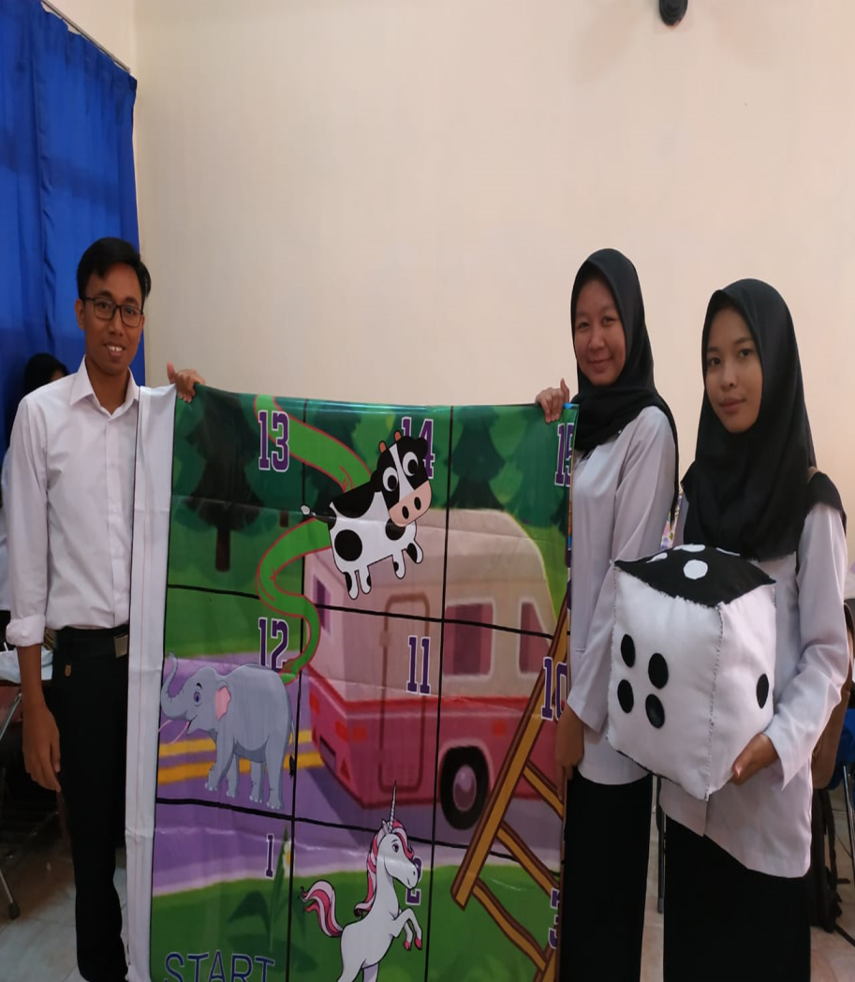
Snake and Ladder

Slide 12
Animals

Slide 13
Caterpillar of Words

Slide 14
Guess the Word

Slide 15
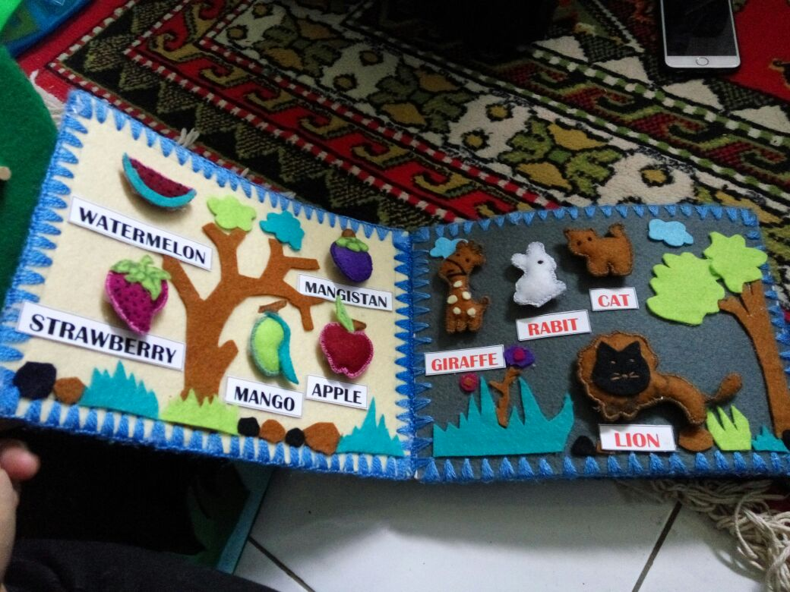

Slide 16
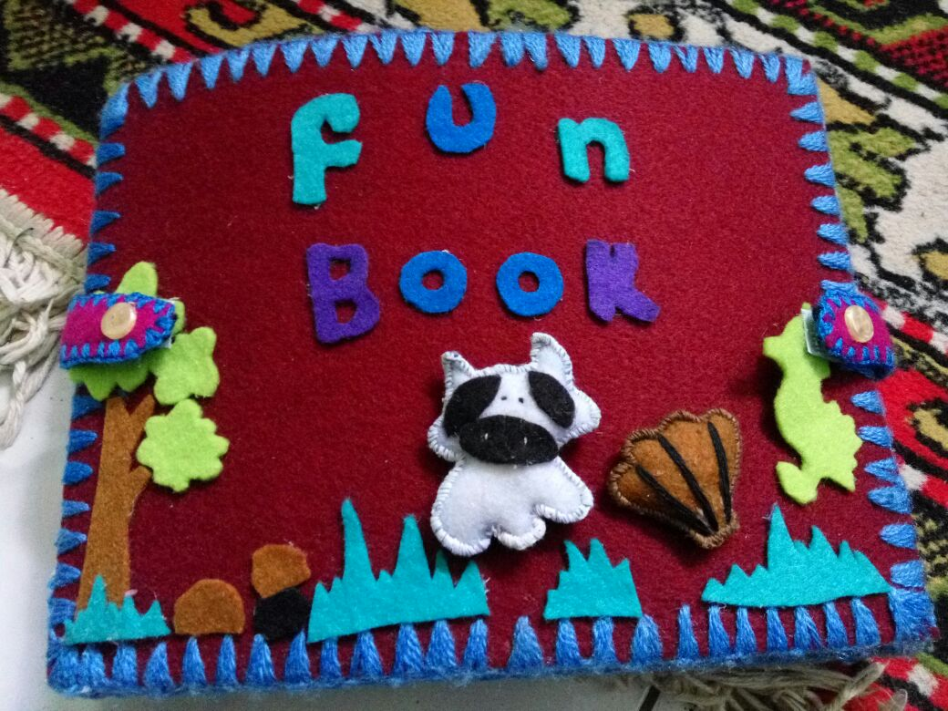

Slide 17
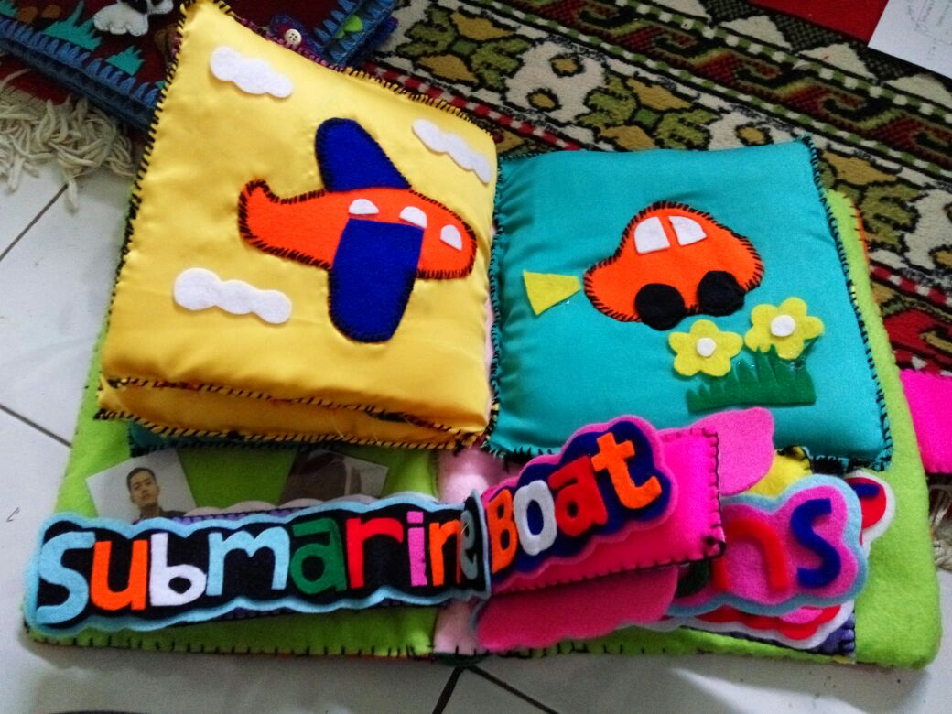

Slide 18
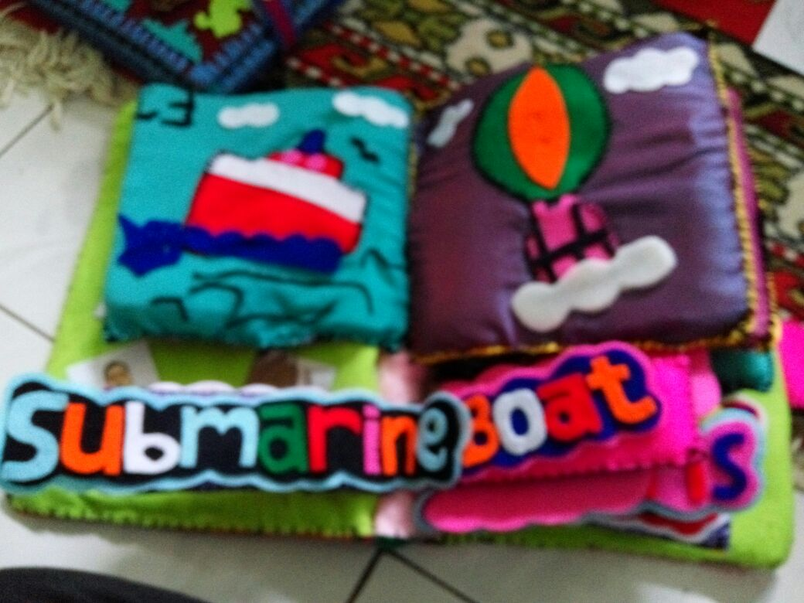

Slide 19
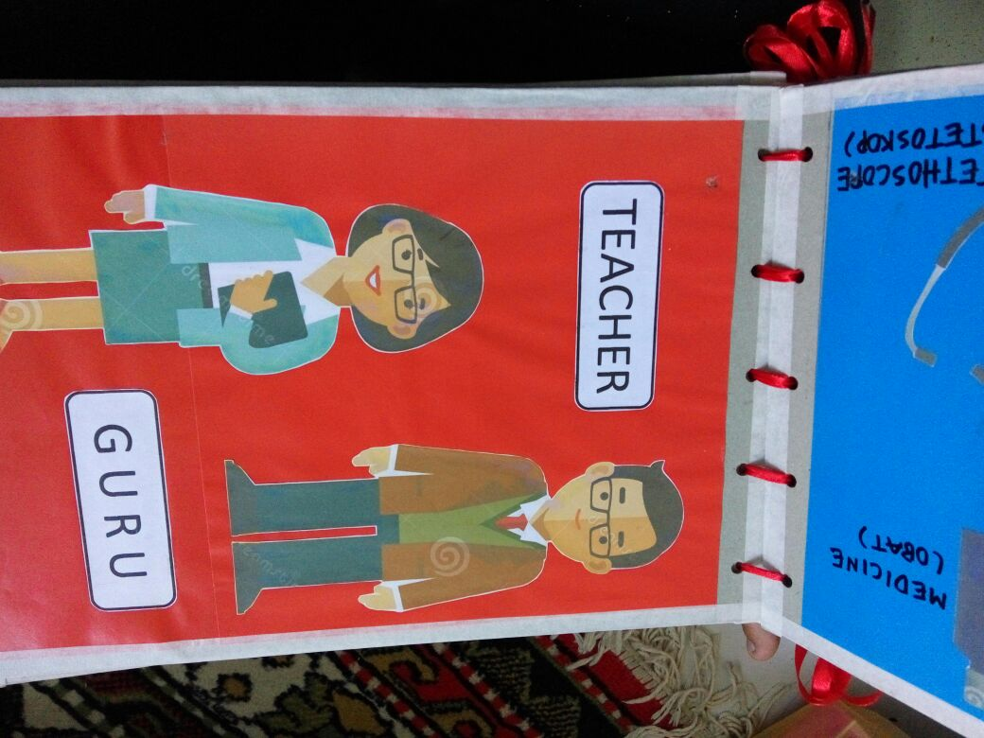

Slide 20
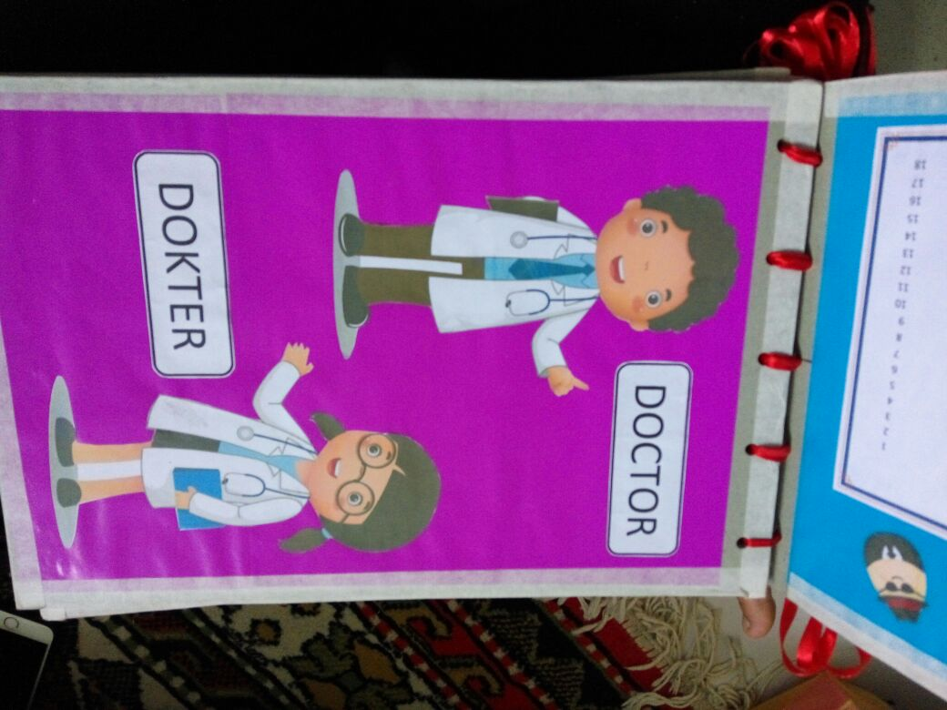

Slide 21
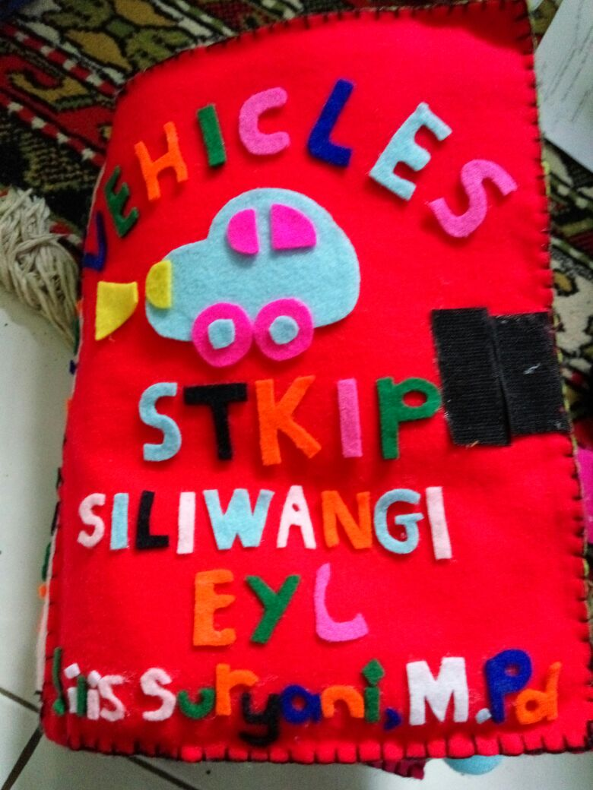

Slide 22
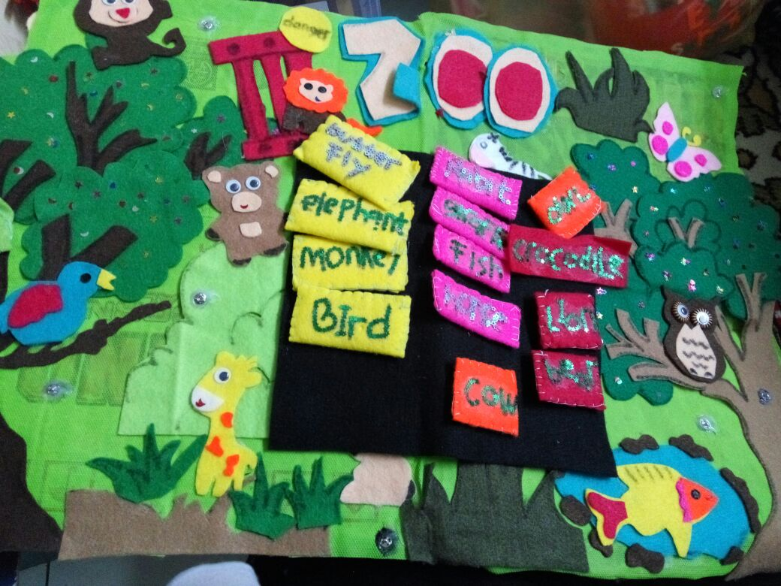

Slide 23
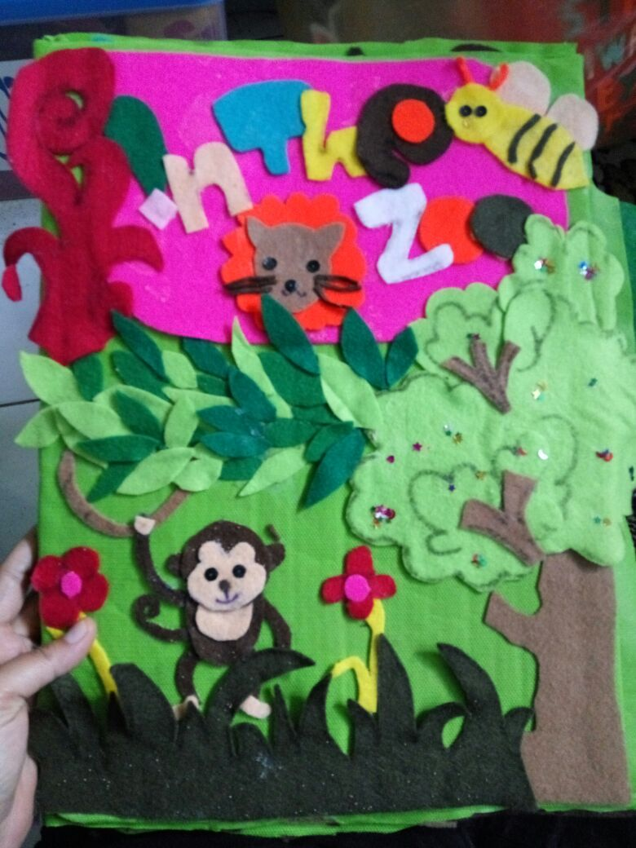

Slide 24
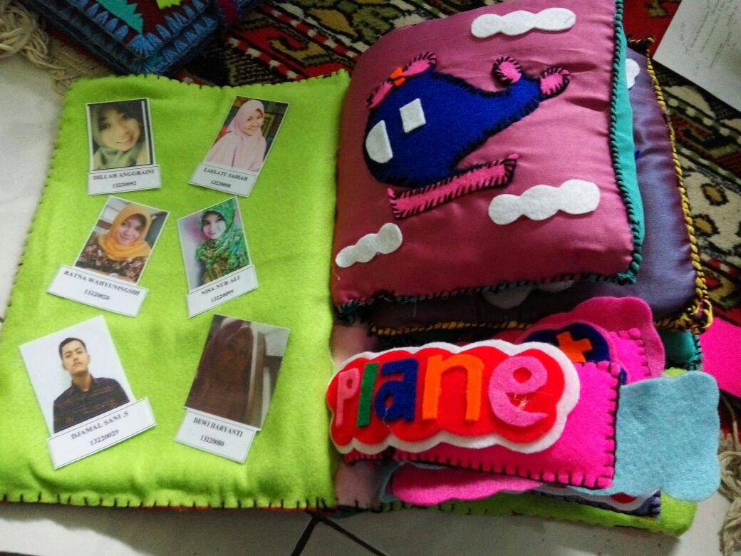

Slide 25
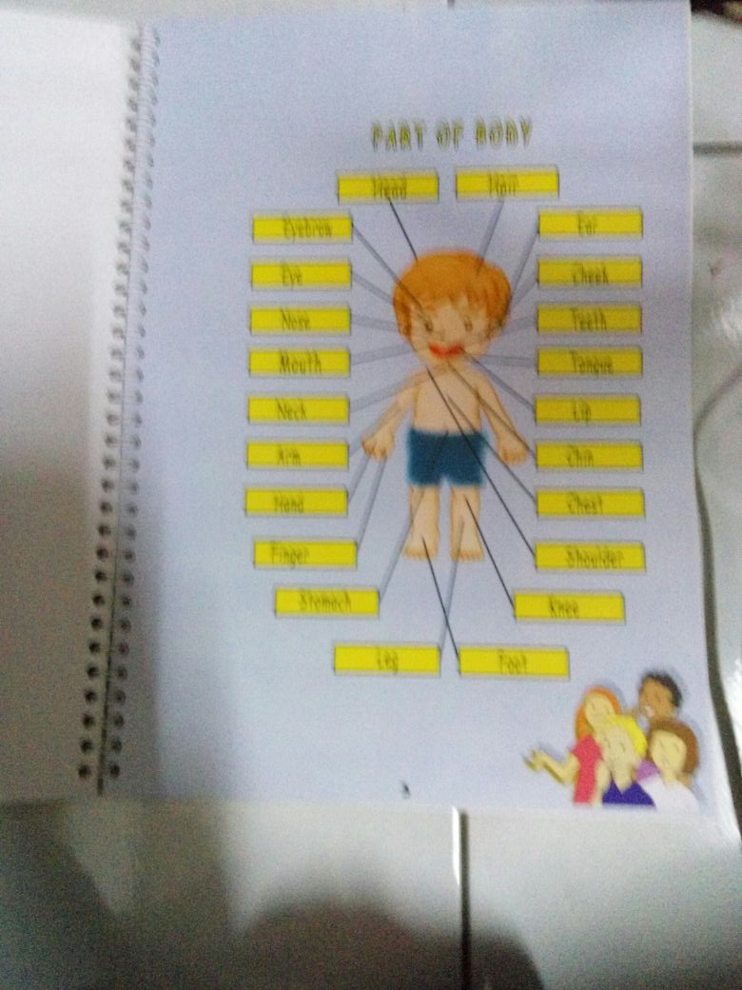

Slide 26
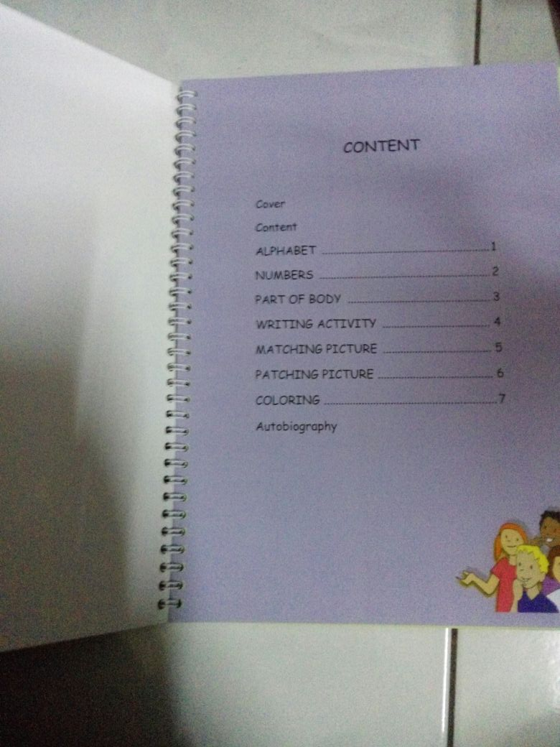

Slide 27
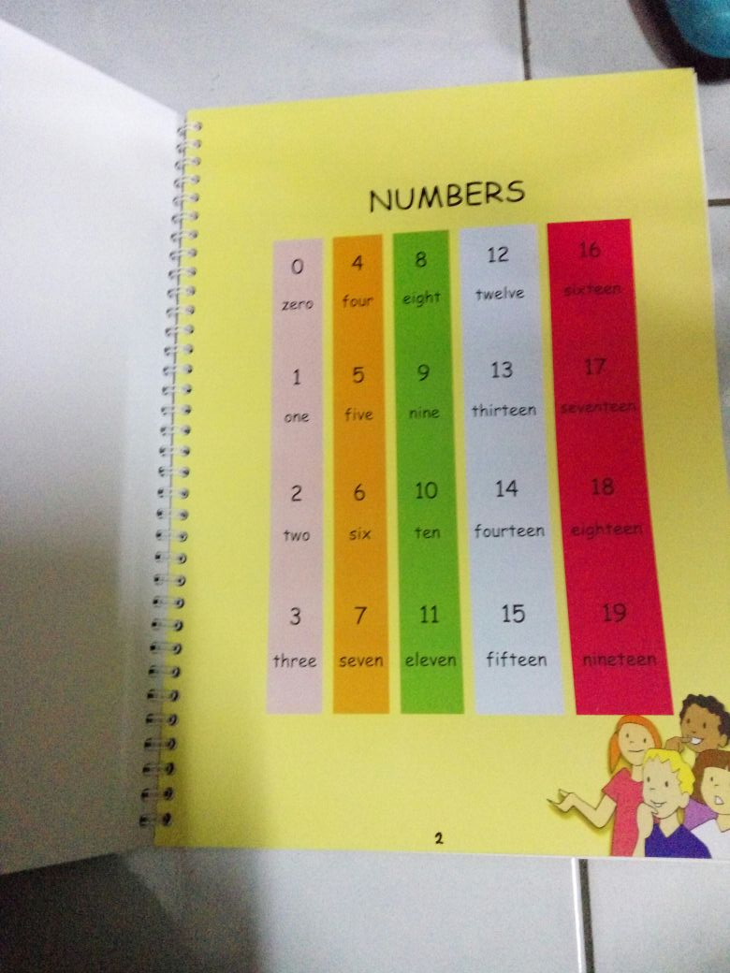

Slide 28
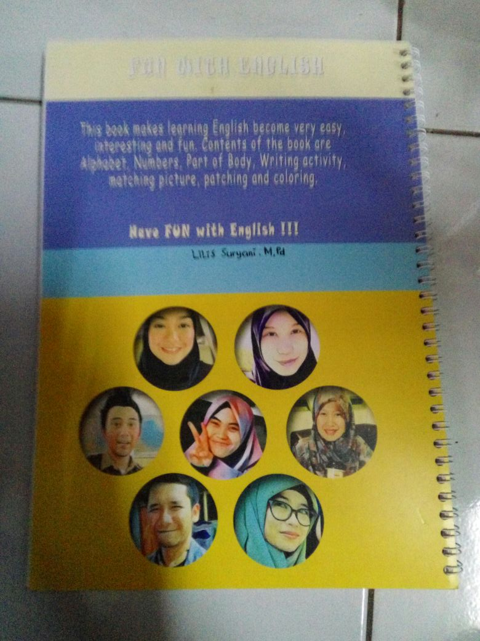

Slide 29
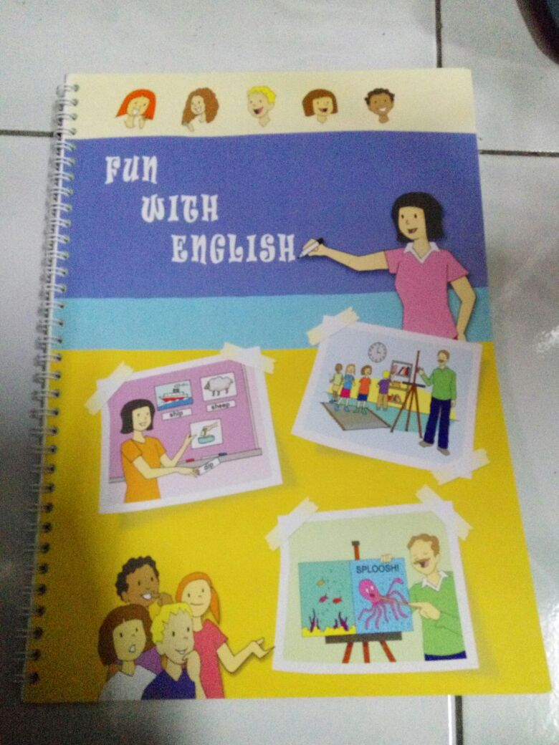

Slide 31
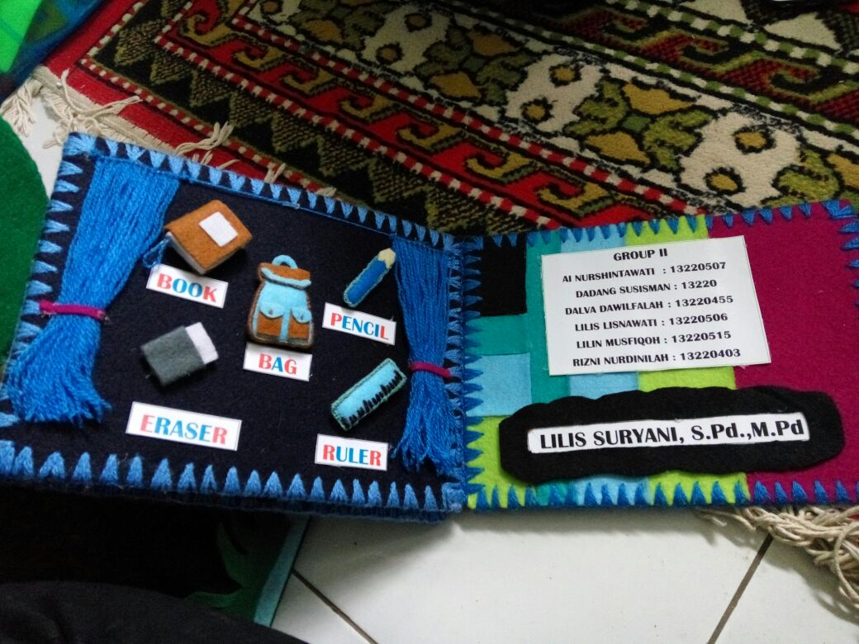

Slide 32
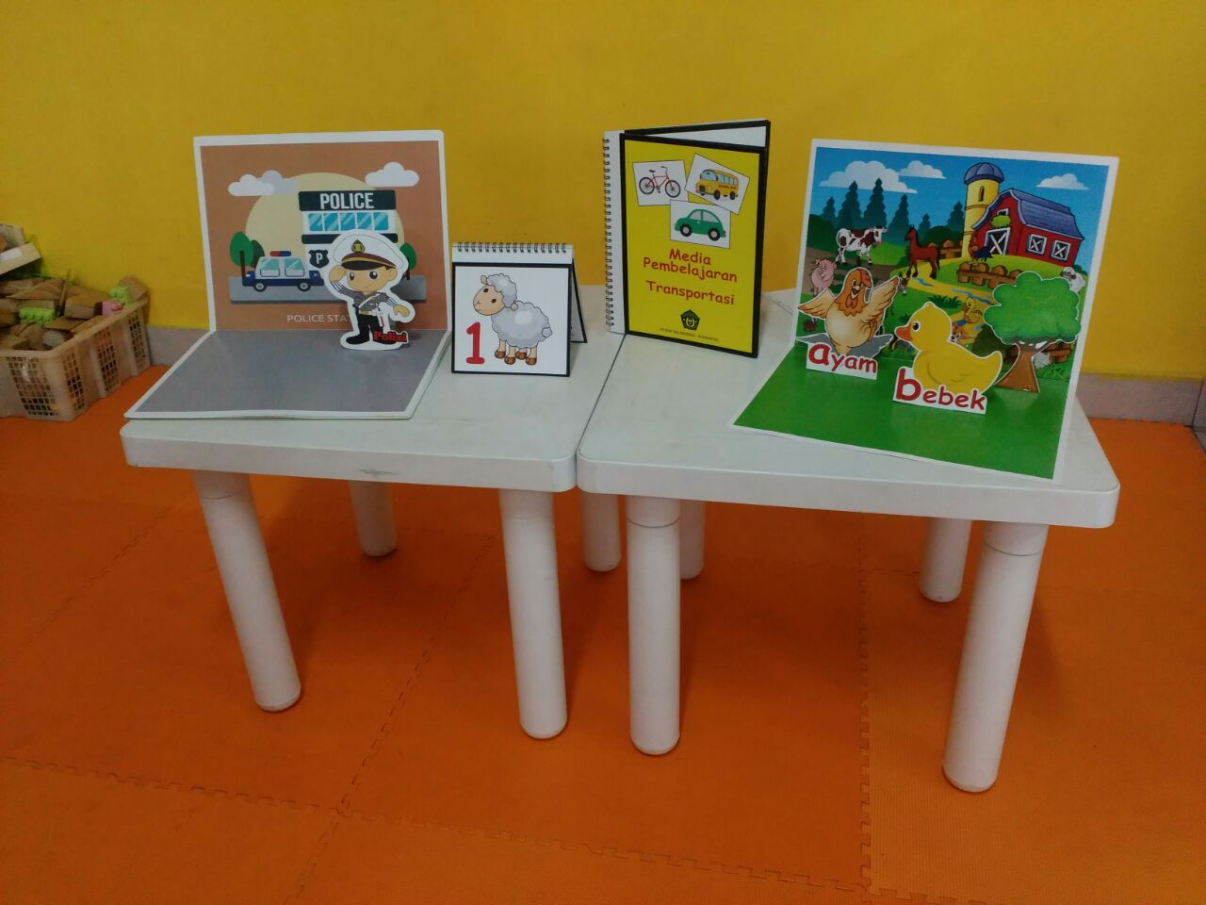

Slide 33
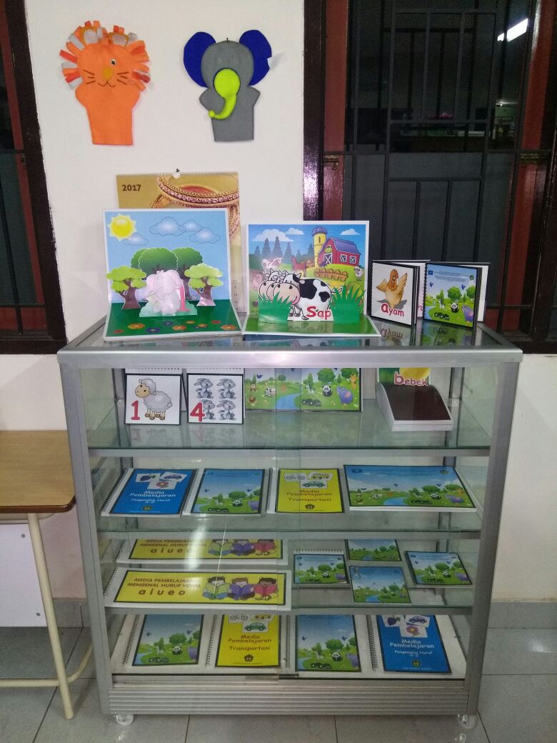

Slide 34
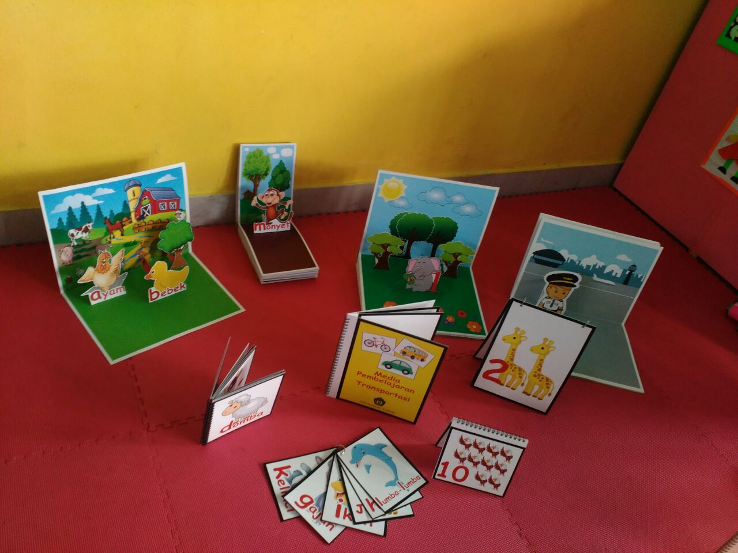

Slide 35
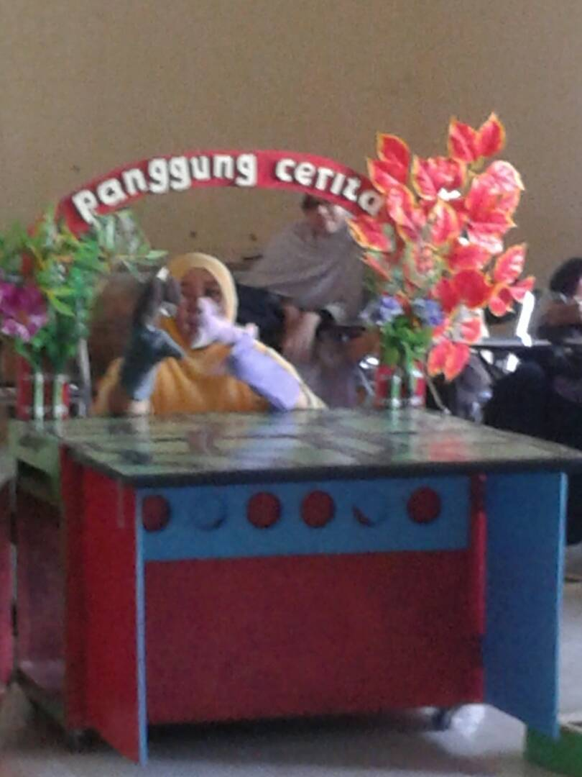
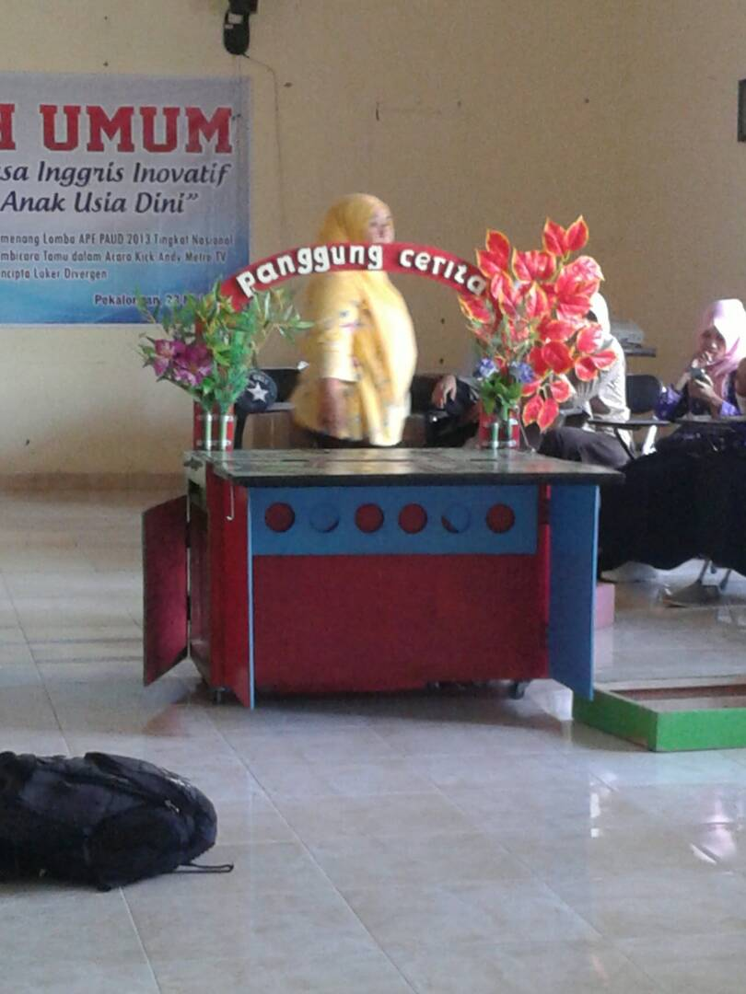

Slide 36
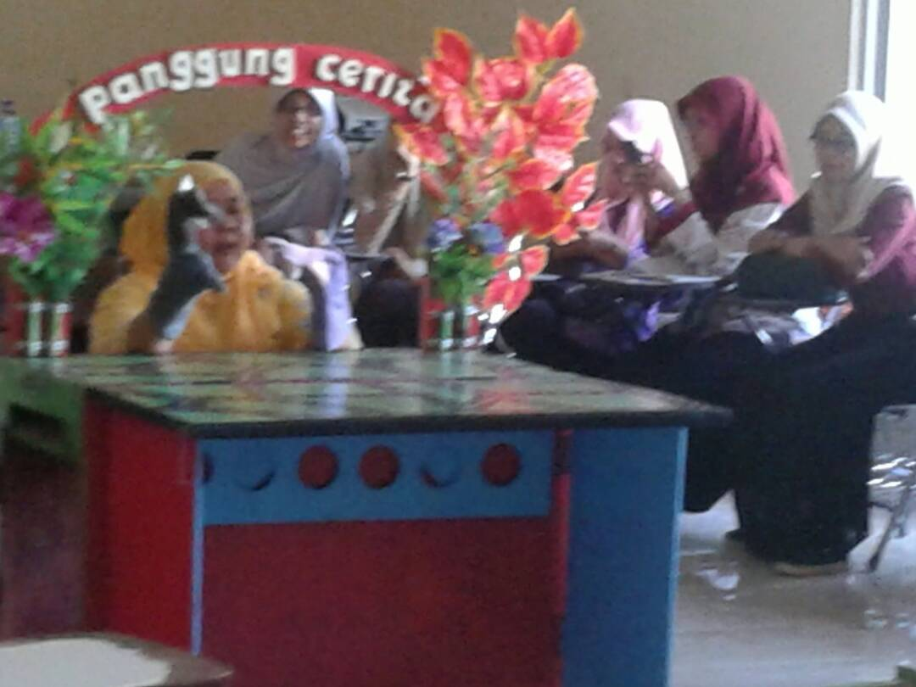

Slide 37
Bland, Janice (ed.) (2015). Teaching English to Young Learners: Critical Issues in Language Teaching with 3-12 Year Olds. London: Bloomsbury Publishing Plc.
Brewster, Jean; Ellis, Gail; Grard, Dennis. (2003). The Primary English Teacher’s Guide (New Edition). England: Penguin English.
Cameron, L. (2001). Teaching Languages to Young Learners. Cambridge: Cambridge University Press.
Damayanti, Ika Lestari. (2017). From Story Telling to Story Writing: The Implementation of Reading to Learn (R2L) Pedagogy to Teach English as a Foreign Language in Indonesia. Indonesian Journal of Applied Linguistics vol. 6 no. 2, January 2017, pp. 229-242.
Fadilah, Rahmi. (2017). Madeline Hunter’s Lesson Plan as Alternative Model for TEYL. Proceedings in English Conference at STKIP Pasundan.
Garton, Sue & Copland, Fiona (ed.). (2019). Teaching English to Young Learners. New York: Routledge.
Halliwell, S. (2004). Teaching English in the primary classroom. Essex: Pearson Education Limited.
Harmer, Jeremy. (2004). How to Teach English: An Introduction to the Practice of English Language Teaching. England: Longman.
Harmer, Jeremy. (2007). How to teach English (New Edition). Essex: Pearson Longman.
Ioannou-Georgiou, Sophie & Pavlou, Pavlos. 2003. Assessing Young Learners. Oxford: Oxford University Press.
Linse, Caroline T. (2005). Practical English Language Teaching: Young Learners. New York: McGraw-Hill.

Slide 38
Mckay, P. (2006). Assessing young language learners. Cambridge: Cambridge University Press.
Mooney, Carol Garhart. (2000). Theories of Childhood: An Introduction to Dewey, Montessori, Erikson, Piaget, and Vygotsky. USA: Redleaf Press.
Musthafa, Bachrudin. (2000). Teaching English to Young Learners: Principles & Techniques. Bandung: Pasca Sarjana Universitas Pendidikan Indonesia.
Mustafa, Bachrudin. (2008). Teaching English to young learners. Bandung: UPI Press.
Mustafa, Bachrudin. (2010). Teaching English to young learners in Indonesia: Essential requirements. Jurnal Educationist.Vol. 4 no.2, Juli 2010 pp. 120-125.
Paul, David. (2003). Teaching English to Children in Asia. Hongkong; Longman Asia ELT.
Pinter, Annamaria. (2006). Teaching Young Language Learners. Oxford: Oxford University Press.
Slattery, M. & Willis, J. (2005). English for Primary Teachers: A Handbook of Activities and Classroom Language. Oxford: Oxford University Press.
Youtube

