Slide 1
Defining
Pragmatics
@trisnendri
Trisnendri Syahrizal

Slide 2
http://bit.ly/pragmaticsws1

Slide 3
THE EXPERTS
@trisnendri
Trisnendri Syahrizal

Slide 4
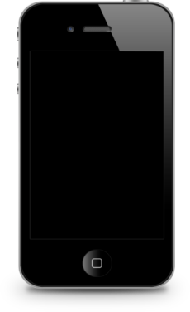
Gorge yule
Charles Morris
David Crystal
The Oxford Companion to Philosophy (Fotion 1995).

Slide 5
“The study of the relations between linguistic forms and its users(…)
Only pragmatics allows humans into the analysis: their assumptions, purposes, goals, and actions they perform while speaking.” (G.Yule)
The study of contextual meaning communicated by a speaker or writer, and interpreted by a
listener or reader.
George Yule is a British linguist

Slide 6
“The study of the relation of signs to their interpreters”

Slide 7
Pragmatics studies the factors that
govern our choice of language in social interaction and the
effects of our choice on others.

Slide 8
The Oxford Companion to Philosophy (Fotion 1995)
Pragmatics is the study of language
which focuses
attention on the users and the
context of language use rather than
on reference, truth, or grammar.

Slide 9
Pragmatics is needed if we want a fuller, deeper, and generally more reasonable account of
human language behavior
Web Definitions
Pragmatics is a subfield of linguistics which
studies the ways in which context contributes to meaning.

Slide 10
Pragmatics
Competence
@trisnendri
Trisnendri Syahrizal

Slide 11
Semantics and
Syntax
Non-verbal communication
Context
Utterance
Interpretation
Interlocutor’s Status
Utterance
inference
Cross Cultural Difference
Register

Slide 12
The Keywords
@trisnendri
Trisnendri Syahrizal

Slide 13
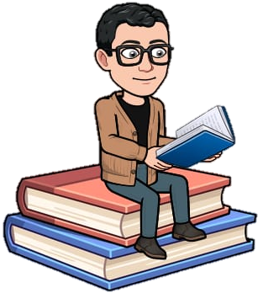
1. SPEAKER MEANING
WHAT PEOPLE MEAN by their
utterances rather than what the words or phrases might mean by themselves.

Slide 14
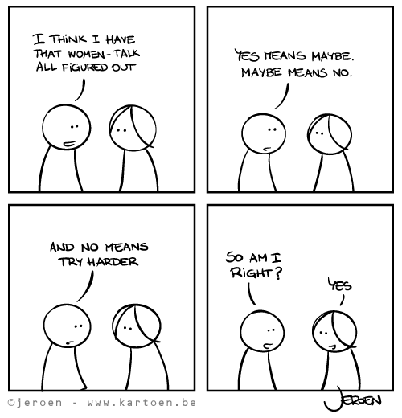
What’s the woman implies?

Slide 15
The Keywords
@trisnendri
Trisnendri Syahrizal

Slide 16
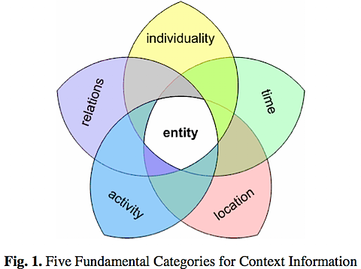
2. Contextual Meaning
Importance of the CONTEXT:
the circumstances and the audience or public.

Slide 17
The Keywords
@trisnendri
Trisnendri Syahrizal

Slide 18
3. Invisible Meaning
The study of how more gets communicated than said
The INFERENCES made by listeners or
readers in order to arrive at an
interpretation of the intended meaning.
A great deal of what is UNSAID is recognized as part of what is communicated.

Slide 19
The Keywords
@trisnendri
Trisnendri Syahrizal

Slide 20
4. Relative Distance
The CLOSENESS or DISTANCE of the listener or reader
determines how much needs to be said.

Slide 21
The Keywords
@trisnendri
Trisnendri Syahrizal

Slide 22
5. REGULARITY
Luckily, people tend to behave in
fairly REGULAR ways when it
comes to using language. As part of social groups we follow general expected patterns of behaviour.

Slide 23
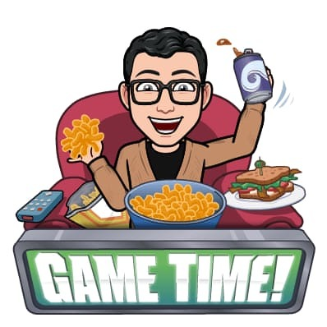
http://bit.ly/tfpday2
Go to the link
Do the True and False game
There will 10 statements
Determine either the statement is TRUE or FALSE
You have 3 lives
You have 2 minutes to finish all the statement
Do it once

Slide 24
Exit Ticket
@trisnendri
Trisnendri Syahrizal

Slide 25
https://bit.ly/pragmaticsday2
@trisnendri
Trisnendri Syahrizal

Slide 26
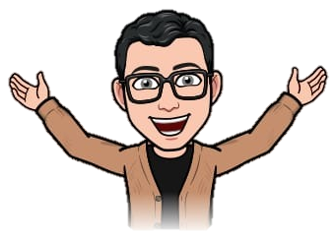
THANK YOU!!!
STAY AT HOME
STAY INSPIRED

