Slide 1




Panduan Cara Akses
Jurnal
DOAJ,
Internasional Terindex
SCOPUS & THOMSON
Yoris Adi Maretta
Associate Editor DOAJ

Slide 2
Panduan Cara Akses
Jurnal
Internasional Terindex
DOAJ
Yoris Adi Maretta
Associate Editor DOAJ

Slide 3

Ketik
doaj.org
DOAJ ^{DIRECTORY OF}
SUPPORT OOAJ
OPEN ACCESS
JOURNALS
Search DOAJ Q.
@ journals @ articles (Advanced Search)
10,576 Journals
6,371 searchable at Article level
1,907,156 Articles
134 Countries
FAQs
Features
Open Access lnfoonation
Best Practice
Download metadata
~ New Journals Feed
Directory of Open Access Journals (DOAJ)
OOAJ is an online directory that indexes and provides access to high quality, open access. peer-reviewed journals.
All journals that were accepted into OOAJ before March 2014 are now required to reapply. If you have a journal indexed in OOAJ. please log
into your Publisher Area and follow the instructions.
Latest News
Copyright and Licensing Incompatibility - Part 1
Copyright and Licensing Not always compatible and yet we see these two thrown together in incompatible ways all the time This is the first of two posts on this subject In this post, I'll Illustrate DOAJ's experience in this murl<yarea showing you the sorts of conundrums we come up against every day in the ( .. J Read More
Tue, 19 May 2015 at 08·33
Our sponsors
Our members
Our publisher members
a am

Slide 4

Klik
Search

Slide 5
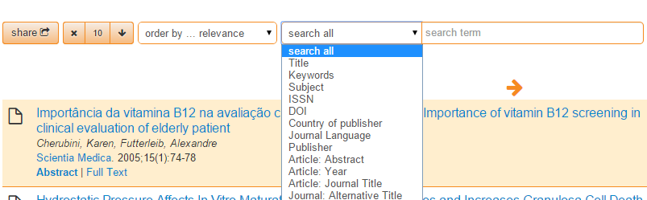
Pilih
Country

Slide 6

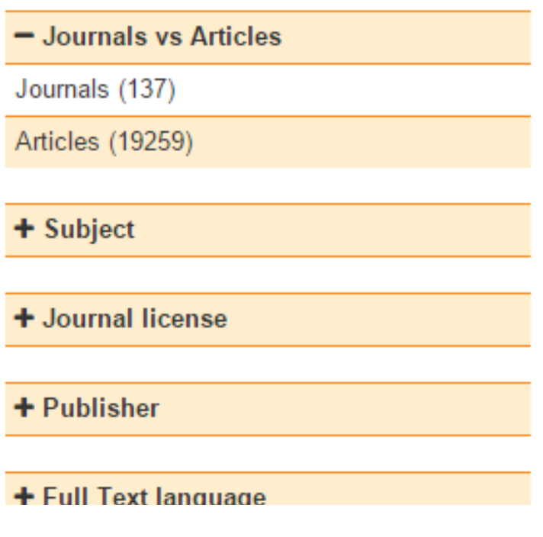
Ketik
Indonesia
Klik
Journals

Slide 7

Hasil
Indonesian Journal of Biotechnology ISSN 0853-8654 (Print). 2089-2241 (Online) http //ijbiolech ugm ac id
Subject: Technology Chemical technology Biotechnology
Date added to DOAJ 24 Feb 2013
Journal of Dmarruka Hukum
ISSN: 1410-0797 (Print); 2407-6562 (Online)
http //dinamikahukum fh unsoed ac id
Peer review
Subject: Law
Date added to DOAJ: 14 May 2015
~
Media of Health Research and Development
M,
P 1 ii 1 n P
10 ,r, 10 n I
1 I n
ISSN: 0853-9987 (Print); 2338-3445 (Online)
http //ejournal litbang depkes go id/index php/MPK Subject: Medicine: Public aspects of medicine Date added to DOAJ: 4 Sept 2013
B1oteknolog1
ISSN: 0216-6887 (Print)
http //biosains mipa uns ac id/C/index him
Subject: Technology: Chemical technology: Biotechnology
Date added to DOAJ: 28 Jan 2013
lnternattonal Journal of Social Networking and Virtual Cornrnunmes
ISSN: 2252-8784 (Print)
http //www iaesjournal com/online/index php/VirCom Subject: Social Sciences: Social sciences (General) Date added to DOAJ: 4 Apr 2013
Jurnal Tanah Tropika

Slide 8

Klik
Judul
Jurnal

Slide 9

Klik
Homepage
Indonesian
Journal of
Educational
Review
/JER
2338-2015
(Print); 2355-8407 (Online)
Homepage
Publisher: lkacana Publisher
Society/Institution: Program Pascasarjana, Universitas
Negeri Jakarta
Country of publisher: Indonesia
Platform/Host/Aggregator: OJS
Date added to DOAJ: 29 Apr 2015
lCC Subject Category: Education
Publisher's keywords: education, indonesian journal,
educational review, UNJ
language of fulltext: English
Full-text formats available: PDF
PUBLICATION CHARGES
Article Processing Charges (APCs): Yes. 4USD
Submission Charges: No.
Waiver policy for charges? No.
EDITORIAL INFORMATION
Peer review
Editorial Board
Aims and scope
Instructions for authors
Time From Submission to Publication:
12 weeks
less
OPEN ACCESS & LICENSING
BEST PRACTICE POLICIES

Slide 10
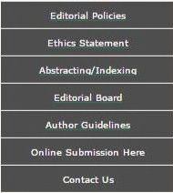

Selesai
•••
~.• ) IJER INDONESIAN JOURNAL OF EDUCATIONAL
~.• ) IJER
INDONESIAN JOURNAL OF EDUCATIONAL REVIEW
HOME
ABOUT
LOGJN
CATEGORIES
SEARCH
CURRENT
ARCH JV ES
USER
AN NO UN CEMENTS
Usernameladmin
Password ... ..,-,- .-..,-- .---,
Home > Vol 1, No 2 (2014)
l J Remember me
Log,n !
INDONESIAN JOURNAL
OF EDUCATIONAL REVIEW
Indonesian Journal of Educational Review (IJER) is printed in Indonesia and published twice a year by the Graduate School of Universitas Negeri Jakarta. IJER is dedicated to the advancement of knowledge and understanding of educational theories and issues in various disciplines, in regard to their input, process, output, outcome and impact on the education system and their implementation.
JOURNAL CONTENT
Search
•
p-JSSN 2338-2015
(Print)
••
Browse
By Issue By Author By Title
other Journals
Categories
e-lSSN 2355-8407
(Online)
•
•
_;IJER
Today
Total
2
2
••
Online
4
KEYWORDS
Qi[ GMIGD? SHA .it1.1-,i1 t.a\.!;.r ?r 11:u1-l!.1•1-1:,-1
~CO!>pet<lllv*~
d1rr.e,,,,bdle;,t..<1tr..;1., l!,:!v.:.11..t;.1 ;11 pl,u, ,-,a
e-lhi; fill~ t,~:.kd~ f+t-!tt<1~V <l!:Nt'~e,tl"'l t
tr11!1..d~yi-,H•4-,'>"> 1"',i!t,~! .,l(a,m, ,it,,.:-r· 11 ,., ,..u,
••
l!ll 1 Pakistan
- 3 Indonesia
IndonesianJournal
ofEducational Review
rJti::)1,111001><~ ().!TI!'!! k.irr-1:9 oi.1ii.i,;.:·1 ~r
t.i'>ll; t:JLJ.4,LJ.t.,: £!-1?'~1 t."'-•!'rlpt_!t:I~
~
tt";1cl,11?9:m~1~_,)ooy ~
Ydha.e w1P.lt:-1U,:-ll<1\.!:l"!'
Visitors
-ID 135
1iiiJ3 us 24
:;:m 4
CURRENT ISSUE
.PT
l!PK
p-lSSN (print) 2338-2015
DHK

Slide 11
Panduan Penulisan & Contact
•••
~.• ) IJER INDONESIAN JOURNAL OF EDUCATIONAL
~.• ) IJER
INDONESIAN JOURNAL OF EDUCATIONAL REVIEW
HOME
ABOUT
LOGJN
CATEGORIES
SEARCH
CURRENT
ARCH JV ES
USER
AN NO UN CEMENTS
Usernameladmin
Password ... ..,-,- .-..,-- .---,
Home > Vol 1, No 2 (2014)
l J Remember me
Log,n !
INDONESIAN JOURNAL
OF EDUCATIONAL REVIEW
Indonesian Journal of Educational Review (IJER) is printed in Indonesia and published twice a year by the Graduate School of Universitas Negeri Jakarta. IJER is dedicated to the advancement of knowledge and understanding of educational theories and issues in various disciplines, in regard to their input, process, output, outcome and impact on the education system and their implementation.
JOURNAL CONTENT
Search
•
p-JSSN 2338-2015
(Print)
••
Browse
By Issue By Author By Title
other Journals
Categories
e-lSSN 2355-8407
(Online)
•
•
_;IJER
Today
Total
2
2
••
Online
4
KEYWORDS
Qi[ GMIGD? SHA .it1.1-,i1 t.a\.!;.r ?r 11:u1-l!.1•1-1:,-1
~CO!>pet<lllv*~
d1rr.e,,,,bdle;,t..<1tr..;1., l!,:!v.:.11..t;.1 ;11 pl,u, ,-,a
e-lhi; fill~ t,~:.kd~ f+t-!tt<1~V <l!:Nt'~e,tl"'l t
tr11!1..d~yi-,H•4-,'>"> 1"',i!t,~! .,l(a,m, ,it,,.:-r· 11 ,., ,..u,
••
l!ll 1 Pakistan
- 3 Indonesia
IndonesianJournal
ofEducational Review
rJti::)1,111001><~ ().!TI!'!! k.irr-1:9 oi.1ii.i,;.:·1 ~r
t.i'>ll; t:JLJ.4,LJ.t.,: £!-1?'~1 t."'-•!'rlpt_!t:I~
~
tt";1cl,11?9:m~1~_,)ooy ~
Ydha.e w1P.lt:-1U,:-ll<1\.!:l"!'
Visitors
-ID 135
1iiiJ3 us 24
:;:m 4
CURRENT ISSUE
.PT
l!PK
p-lSSN (print) 2338-2015
DHK

Slide 12
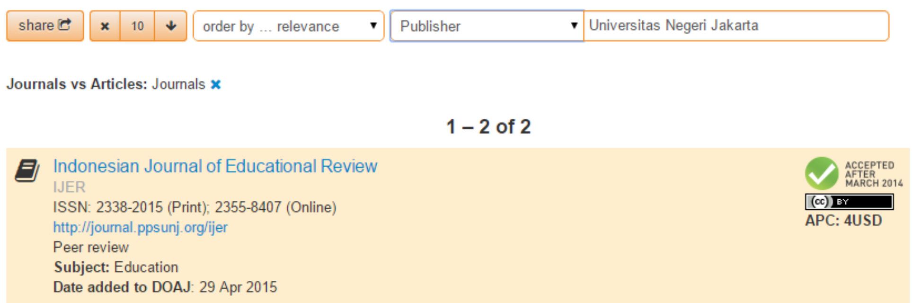
Indonesian Journal of Educational Review
adalah Jurnal PERTAMA dan SATU-SATUNYA di
Universitas Negeri Jakarta yang sudah terindex
DOAJ

Slide 13
Panduan Cara Akses
Jurnal
Internasional Terindex
SCOPUS
Yoris Adi Maretta
Associate Editor DOAJ

Slide 14
Check
Jurnal
Pilihan
Anda
•
•
SCOPUS melalui website SCIMAGOJR.COM
THOMSON REUTERS melalui website IP- SCIENCE.THOMSONREUTERS.COM
JEFFREY BEALL’S LIST untuk mengecek daftar
jurnal predator/abal-abal melalui website
•
SCHOLARLYOA.COM

Slide 15


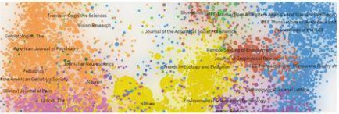

Ketik
SC Imago
scimagojr.com
EST
MODUS IN REBUS
Ho, o (S 1110 I 1. IO. J
Journal
Rank
& Country
The
Shape
of
Science
SClmago
on Media
Journal
Rankings
.\a~ '2,
15
Journal
Search
KaK y11y'HJJHTb no1<a3are11H peHTHHra
YHHBepCHTeTa c OOMOl!lblO 11HTepHeTa
Country
Rankings
iAay ...2. ~lt15
Estudo europeu publicado na conceituada
revista Endocrine revela que e possivel
emagrecer de forma rapida e segura, perdendo
predominanternente gordura
Country
Search
Compare
Map Generator
The Shape of Science is a new graphical interface designed to access
the bibliometric indicators database of the SClmago Journal a Country
Ma~ 22, 2015
La Universitat Jaume I de Castellon apuesta por
un modelo educativo unlco
Help
About Us
Rank portal (based
on 2012 data).
Open The Shape of Science •
>lay 22, 2015
Citan investigadores BUAP en mejores revistas
ecademicas del mundo
Related
product
About
The SClmago Journal a Country Rank is a portal thac includes the journals and country scientific indicators developed from the
information contained in the Scopus©database (Elsevier B.V.). These
indicators can be used to assess and analyze scientific domains.
,la~ 22. 2015
Don't judge our education based on old OECD
data, says Idris Jusoh
""'~ 22, 2015
Universidade do ABC ganha visibilidade corn
inova~oes
This platform takes its name from the sctmaco Journal Rank fSJRl

Slide 16
Untuk
SC Imago
Mencari
Jurnal
EST
MODUS IN REBUS
Ho, o (S 1110 I 1. IO. J
Journal
Rank
& Country
The
Shape
of
Science
SClmago
on Media
Journal
Rankings
.\a~ '2,
15
Journal
Search
KaK y11y'HJJHTb no1<a3are11H peHTHHra
YHHBepCHTeTa c OOMOl!lblO 11HTepHeTa
Country
Rankings
iAay ...2. ~lt15
Estudo europeu publicado na conceituada
revista Endocrine revela que e possivel
emagrecer de forma rapida e segura, perdendo
predominanternente gordura
Country
Search
Compare
Map Generator
The Shape of Science is a new graphical interface designed to access
the bibliometric indicators database of the SClmago Journal a Country
Ma~ 22, 2015
La Universitat Jaume I de Castellon apuesta por
un modelo educativo unlco
Help
About Us
Rank portal (based
on 2012 data).
Open The Shape of Science •
>lay 22, 2015
Citan investigadores BUAP en mejores revistas
ecademicas del mundo
Related
product
About
The SClmago Journal a Country Rank is a portal thac includes the journals and country scientific indicators developed from the
information contained in the Scopus©database (Elsevier B.V.). These
indicators can be used to assess and analyze scientific domains.
,la~ 22. 2015
Don't judge our education based on old OECD
data, says Idris Jusoh
""'~ 22, 2015
Universidade do ABC ganha visibilidade corn
inova~oes
This platform takes its name from the sctmaco Journal Rank fSJRl

Slide 17


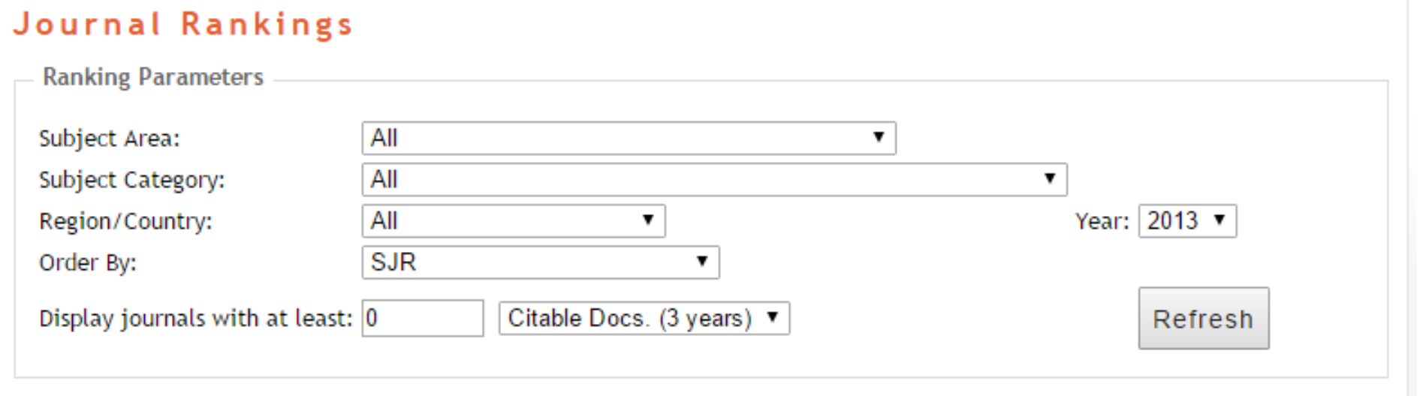


Pilih
Category
Jika tidak ada pada Subject Area,
silahkan cari pada Subject Category,
Klik Refresh

Slide 18
Klik
Title
Judul
Jurnal
H
index
Total
Docs.
{2013)
Total
Docs. (3years)
Total
Refs.
Total
Cites
(3years)
Citable
Docs.
{3years)
Cites I
Doc. (2years)
Ref. I
Doc.
Type
SJR
Country
1
Journal of Engineering
Education
Journal of Research in Science
Teaching
Science Education
Review of Educational Research
Handbook of the Economics of
Education
American Educational Research
Journal
Sociology of Education
Educational Evaluation and
Policy Analysis
Educational Researcher
j
a16,515
57
19
98
1.169
534
92
5,88
61,53
~
2
j
al 4,717
(lD 4,476 a14,358
70
51
174
3.490
692
160
3,72
68,43
~
3
4
j
j
63
80
37
16
152
59
2.292
2.110
478
340
132
48
3,36
6,97
61,95
131,88
~
~
-
~
5
k
a13,990
13
0
20
0
58
9
6,44
0,00
6
j
~
3,885
64
43
109
2.987
432
107
3, 13
69,47
7
j
a13,745
aJ 3,596
a 3,575
a13,404
3,398
a13,361
3,122
al 3,071
a13,044
aJ 2,869
53
28
56
1.035
182
55
2,79
36,96
~
8
j
43
24
73
1.126
179
71
2,40
46,92
~
9
j
j j j j
46
42
157
57
21
52
40
187
52
30
134
113
424
158
43
2.069
1.530
10.324
2.736
2.395
493
383
2.309
740
267
117
98
414
147
40
3,61
2,88
4,24
4, 16
5,00
39,79
38,25
55,21
52,62
79,83
~
~
~
10 Journal of Teacher Education
11 Child Development
12 Learning and Instruction
13 Educational Research Review
Journal of the Learning
-
~
1 4 .
Sciences
15 Studies in Science Education
Journal of Educational
j
56
25
54
1.275
206
48
3,38
51,00
~
j
7
6
19
640
62
19
2,58
106,67
~
16
Psychology
j
115
95
215
5.894
946
213
3,36
62,04
~

Slide 19
Klik
Show
full
scope
Journal
Search
Search query
~---------------------------~
O Exact phrase
in! Journal Title
• II Search I
Journal
of
Research
in Science
Teaching
Country: United States
Subject Area: Social Sciences
Subject Category:
Category
Quartile (Q1 means highest values and Q4 lowest values)
1999 2000 2001 2002 2003 2004 2005 2006 2007 2008 2009 2010 2011 2012 2013
Education
Publisher: John Wiley and Sons Inc.. Publication type: Journals. ISSN: 10982736, 00224308
Coverage: 1996-2014
Hlndex: 70
Scope:
Journal of Research in Science and Teaching , the official journal of the National Association for Research in Science Teaching
[...]
Show f ult scope

Slide 20
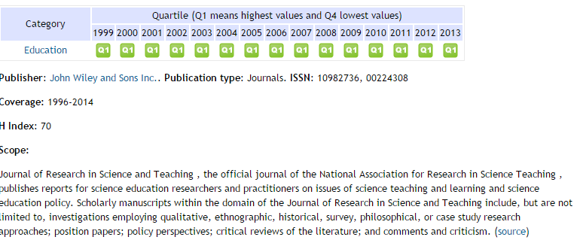
Klik
Source

Slide 21



Hasilnya, akan diarahkan
ke
website jurnal
Wiley Online Library
.I. Log in I Register
O
Now FREE for Wiley authors
KUDOSt.7
WILEY
Home> Education> Science>
Joumal of Research In Science Teaching
JOURNAL TOOLS
+
Gel New Con1en1 Alem
Ge1RSSfeed
Save 10 My Pralle
Gee S•mple Copy
Reconvnend to Your
U>ranon
(}
~
..
~ .
Journal
of Research
in Science
Teaching
T ilth"'!I (NARSTl
SEARCH
"' lo, R arch '" ...c nc
@nisjourn•I
Edited By: Incoming Editors: Fouad Abd·El·Kl1alick and Dana L. Zeidler; Current Issues Edited by Angela Calabrese Barton and Joseph Krajcik, Outgoing Editors
Impact Factor: 3.02
ISi Journal Citation Reports© Ranking: 2013: 6/219 (Education & Educational
Research)
Online ISSN: 1098-2736
-~O
Advanced > Saved Searches>
JOURNAL MENU
Journal Home
FINO ISSUES
Current Issue
Al Issues
\lw'tual Issues
NARST
FINO ARTICLES
Early'""'
GET ACCESS SUbscri>e I Renew
Recently Published Issues
I
See all
Updated Author Guidelines
Current ls.sue: May 2015
Volume 52, Issue 5
April 2015
Volume 52, Issue 4
T dated Author Guidelines
Our Author Guidelines have recently
FOR CONTRIBUTORS

Slide 22
Cara lain Mencari Sekaligus
Mengecek Jurnal
SC Imago
EST
MODUS IN REBUS
Ho, o (S 1110 I 1. IO. J
Journal
Rank
& Country
The
Shape
of
Science
SClmago
on Media
Journal
Rankings
.\a~ '2,
15
Journal
Search
KaK y11y'HJJHTb no1<a3are11H peHTHHra
YHHBepCHTeTa c OOMOl!lblO 11HTepHeTa
Country
Rankings
iAay ...2. ~lt15
Estudo europeu publicado na conceituada
revista Endocrine revela que e possivel
emagrecer de forma rapida e segura, perdendo
predominanternente gordura
Country
Search
Compare
Map Generator
The Shape of Science is a new graphical interface designed to access Ma~ 22, 2015
the bibliometric indicators database of the SClmago Journal a Country La Universitat Jaume I de Castellon
^{Us} Kl^{R}i^{ank}k^{portal (ba}J^{sed o}u rnal Sea^{un mod}r^{elo e}c^{ducati}h^{vo unlco}
Help
the bibliometric indicators database of the SClmago Journal a Country
La Universitat Jaume I de Castellon apuesta por
About
Open The Shape of Science •
>lay 22, 2015
Related
product
Citan investigadores BUAP en mejores revistas
ecademicas del mundo
About
The SClmago Journal a Country Rank is a portal thac includes the journals and country scientific indicators developed from the
information contained in the Scopus©database (Elsevier B.V.). These
indicators can be used to assess and analyze scientific domains.
,la~ 22. 2015
Don't judge our education based on old OECD
data, says Idris Jusoh
""'~ 22, 2015
Universidade do ABC ganha visibilidade corn
inova~oes
This platform takes its name from the sctmaco Journal Rank fSJRl

Slide 23
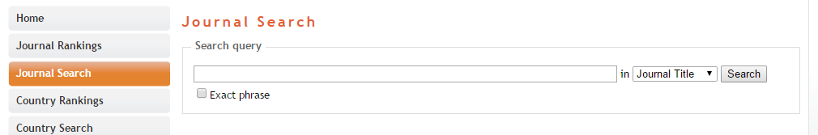
Ketik Keyword atau Nama Jurnal

Slide 24

Hasil
Pencarian
Home
Journal
Search
Journal
Rankings
Search query
,_e_du_c_a_ti_on
O Exact phrase
, in I Journal
Title
• I! Search I
Country
Rankings
Country
Search
Please,
select
journal:
Compare
I - 50 of 759 items «
First I < Previous I Next > I Last
Map Generator
I.
Journal of Educational
Psychology.
United States.
Help
2.
Medical Education. United Kingdom.
About Us
3.
Patient Education and Counseling. Ireland.
4.
Review of Educational Research. United States.
Related
product
5. Computers and Education. United Kingdom.
6. Educational Psychologist. United Kingdom.
7. Health Education Research. United Kingdom.
8. American Educational Research Journal. United Kingdom.
9. Science Education. United States.
10. Educational Psychology Review. United States.

Slide 25
Tips
Trik
Cara Paling Mudah agar artikel
lolos pada jurnal internasional
terindex Scopus adalah mencari
JURNAL INDONESIA yang sudah
terindex SCOPUS

Slide 26
H
Total
Total
Docs.
(3years)
168
Total
^{R} e^{f}s.
2.090
Total
Cites
(3years)
139
Citable
Docs.
(3years)
122
Cites
Doc.
I Ref.
t
Title
Type SJR
Country
index(~)
(2years) Doc.
-
Nutrition Bulletin
Bulletin of Chemical Reaction
and Catalysis
Acta medfca lndonesiana
Telkomnika
j
0,365
23
49
I, 15
42,65
-
2
Engineering
j
0,303
3
29
30
699
22
29
0,76
24, 10
-
3
4
5
j
J
j
0,250
0,236
0, 171
I 1
5
28
100
37
156
162
45
0
1.545
857
116
98
6
145
160
42
0,81
0,61
0, 14
0,00
15,45
23, 16
-
-
Indonesian Journal of Chemistry
International Journal on Electrical
Engineering and Informatics
Kukila
Critical Care and Shock
Journal of Engineering and Technological
Sciences
....
....
6
j
0, 168
5
40
118
735
62
118
0,51
18,38
j
j
0, 147
0, 141
1
7
10
10
18,80
18,70
...
7
8
8
44
188
187
2
5
8
40
0,25
0,05
-
9
j
0, 139
2
20
48
343
8
48
0, 17
17, 15
-
10
~:;~:;:t:~;nal of Power Electronics
j
0,134
2
46
70
747
14
70
0,20
16,24
-
11
12
13
14
International Journal of Technology
ITB Journal of Science
Biotropfa
j
j
J J
0, 123
0, 115
0, 112
0, 107
2
3
35
8
12
5
65
53
29
28
556
85
349
122
9
14
3
6
59
53
29
28
0, 12
0,30
0,09
0,21
15,89
10,63
29,08
24,40
-
-
...
....
...
Journal of ICT Research
Proceedings of the 26th
and Applications
Pacific Asia
2
15
Conference on Language, Information and
Computation, PACLIC 2012
Gadjah Mada International Journal of
.
Business
p
0, 104
1
0
73
0
5
70
0,07
0,00
1 6
j
0, 100
1
15
46
617
1
44
0,00
41, 13
-
17 Proceedings· APCHI-ERGOFUTURE 2010
p
0, 100
0
126
0
0
122
0,00
0,00

Slide 27

Panduan Cara Akses
Jurnal Internasional Terindex
THOMSON REUTERS
Yoris Adi Maretta
Associate Editor DOAJ

Slide 28



Klik ip-science.thomsonreuters.com/mjl
.· ;-;.
_{(.'} ···.••
\·\.:· ·.^{11 THOMSON REUTERS}
Site Search
INTELLECTUAL PROPERTY & SCIENCE
....
....
CONTACTUS
IP & Science Master Journal Lest
MASTER JOURNAL
LIST
FAQS
How do I submit a journal?
SEARCH OUR MASTER
The Master Journal List includes all
journal titles covered in Web of
Science
SOURCE
PUBLICATION
JOURNAL
Seareh Terms
[
Seareh Type
nue Word
LIST
DOCUMENTS
J
Arts and Humanities Citation
Index Source Publication
tlJ PDF
Science Citation Index
Expanded Source Publication
f2l PDF
What is the status of my
journal submission?
Refer to the Journal Submission
Process if you wish to submit a print
or electronic journal for evaluation
Available Now
----~
Our essay The Thomson Scientific
Database· The Journal Selection _{Social Science Citation Index}
process used.
_{JOURNAL LISTS} MORE INFORMATIONABOUT
end J)f'OCeedlng,
Arts & Humanities Citation Index® to Web at Sciena?"
Biolog.ical Abstracts ~
Process. describes the selection
Source Publication It) PDF
Joum.(. boo6c O
submtulons
JOURNAL
LISTS FOR SEARCHABLE DATABASES

Slide 29

Mencari
Jurnal
Internasional
Terindex
Thomson
Reuters

Slide 30

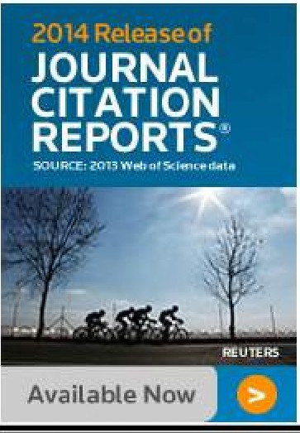

Ketik keyword,
lalu
Search
•• 4 ••
(i°:,F,·:;~·1 THOMSON
REUTERS
INTELLECTUAL PROPERTY
&
SCIENCE
··:f~!~ ~·:··
Site Search
IP & Science Master Journal List
MASTER JOURNAL
UST
SEARCH OUR MASTER
JOURNAL LIST
Search Terms,
The Master Journal list includes
journal titles covered in Web of
Science.
all
SOURCE PUBLICATION DOCUMENTS
FAQS
How do I submit a journal?
Arts and Humanities Citation
Index Source Publication
ftt PDF
Science Citation Index
Expanded Source Publication
0 PDF
What is the status of my
journal submission?
Refer to the Journal Submission
Process if you wish to submit a print or electronic journal for evaluation.
Search Type:
!Title Word
i1%id30
Our essay, The Thomson Scientific
Database: The Journal Selection Social Science Citation Index Process, describes the selection _{Source Publication 0 PDF} process used.
JOURNAL LISTS JOURNAL EVALUATION SCOPE NOTES ^{MORE tNFORMAllON ABOlJT}
Joutn ~ bouk
and proce@drng,.
Arts & Humanities Citation Index® > (Web of Science} ^{to} Web ^{of Scienc~}
Biological Abstracts >
JOURNAL
LISTS FOR SEARCHABLE DATABASES
iubmtssions

Slide 31
Hasil Pencarian dengan keyword
EDUCATION
MORE INFORMATION ABOUT
JOum;il, book
and proceedlng11 submission, to Web of Science Core Callee tlan
O
Search Terms: EDUCATION
Total Journals found: 179
THE FOLLOWING TITLE($) MATCHED YOUR REQUEST:
Journals 1-10
<1 <
(of 179)
FORMAT FOR PRINT
ACADEMY
OF MANAGEMENT LEARNING & EDUCATION
A
Quarterly ISSN: 1537·260X
ACAO MANAGEMENT, PACE UNIV. PO BOX 3020, 235 ELM RO, BRIARCLIFF
Coverage
SUBMITTING
A JOURNAL?
MANOR, USA, NY, 10510·8020
ACM TRANSACTIONS ON COMPUTING EDUCATION
Quarterly ISSN· 1946-6226
ASSOC COMPUTING MACHINERY, 2 PENN PLAZA. STE 701, NEW YORK, USA, NY, 10121·0701
Coverage
Build bibliographies
In more than 5,000
different styles.
wlthEndNote·
endnote.com
>
ACTIVE LEARNING IN HIGHER EDUCATION
Tri-annual ISSN: 1469-7874
SAGE PUBLICATIONS INC. 2455 TELLER RD, THOUSAND OAKS, USA, CA, 91320
Coverage
ADULT EDUCATION QUARTERLY
Quarterly ISSN: 0741-7136
SAGE PUBLICATIONS INC, 2455 TELLER RO, THOUSAND OAKS, USA, CA, 91320
JOURNAL
Coverage
I

Slide 32
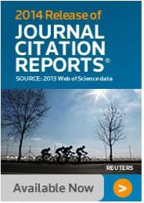
Mencari
Pada
Database
MASTER JOURNAL LIST
FAQS
How do I submit a journal?
SEARCH OUR MASTER
JOURNAL LIST
Search Terms:
The Master Journal List includes
journal titles covered in Web of
Science.
all
SOURCE PUBLICATION DOCUMENTS
Arts and Humanities Citation
Index Source Publication
rt:J PDF
Science Citation Index
Expanded Source Publication
!2}POF
What is the status of my
journal submission?
!education
Refer to the Journal Submission
Process if you wish to submit a print or electronic journal for evaluation.
Search Type:
I Title Word
119 itiiih
Our essay, The Thomson Scientific
Database: The Journal Selection
Process, describes the selection process used.
Social Science Citation Index
Source Publication r2:I PDF
,JOUf!NAL LISTS
JOURNAL EVALUATION SCOPE NOTES
MORE CNFORMA TION ABOUT
Joumlll, book
and proceeding,
submissions
8
JOURNAL LISTS FOR SEARCHABLE DATABASES
Arts & Humanities Citation Index® > (Web of Science)
to Web of Scienn!""
Biological Abstracts >
BIOSIS PREVIEWS
,
Klik Salah
Biological Abstracts/RRM >
Current Contents® I Agriculture, Biology & Environmental
Current Contents® I Arts & Humanities >
SUBMITT A
Satu
>
ING
Sciences
A JOURNAL?
Current Contents® I Clinical Medicine >
Current Contents® I Engineering, Computing
Build bibliographies
in more than S,000
different s les.
& Technology >

Slide 33
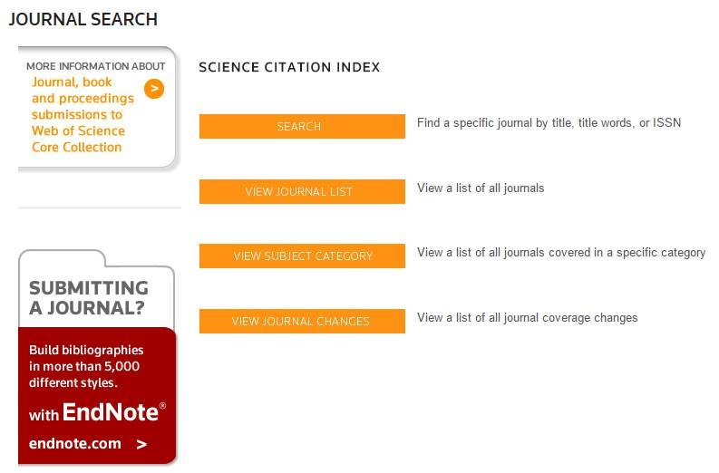
Klik
View Subject
Category

Slide 34
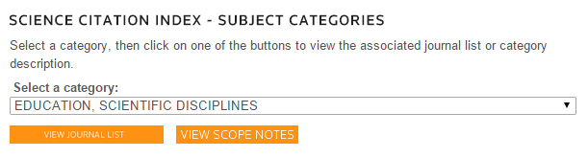
Pilih Education, lalu View Journal List

Slide 35
Hasil
Pencarian
JOURNAL SEARCH
MORE INFORMATION ABOUT
SCIENCE
LIST
CITATION
INDEX
- EDUCATION,
SCIENTIFIC DISCIPLINES - JOURNAL
Journal, book
and proceedings submissions to Web of Science Core Collection
O
Total journals: 7
Journals 1-7 (of 7)
4 <
>
~
FORMAT FOR PRINT
ACADEMIC MEDICINE
Monthly ISSN: 1040-2446
LIPPINCOTT WILLIAMS & WILKINS,
19103
Coverage
A
TWO COMMERCE
SQ, 2001 MARKET ST, PHILADELPHIA, USA, PA,
SUBMITTING
A JOURNAL?
Build bibliographies
in more than 5,000 different styles.
with End Note·
endnote.com >
AMERICAN JOURNAL OF PHARMACEUTICAL EDUCATION
Monthly ISSN: 0002-9459
AMER ASSOC COLL PHARMACY, 1426 PRINCE STREET, ALEXANDRIA, USA, VA, 22314-2815
Coverage
AMERICAN JOURNAL OF PHYSICS
Monthly ISSN: 0002-9505
AMER ASSOC PHYSICS TEACHERS AMER INST PHYSICS, STE 1 NO 1, 2 HUNTINGTON QUADRANGLE,
MEL VILLE, USA, NY, 117 4 7-4502
Coverage

Slide 36
Mengecek Jurnal
Internasional
Terindex
Thomson
Reuters

Slide 37
Ketik nama jurnal yang akan dicek,
lalu pilih Full Journal
Title
(t~:)THOMSON
Site Search
INTELLECTUAL PROPERTY & SCIENCE
REUTERS
....
••••
CONTActUS
Global Sites "'
IP & Science Master Journal List
MASTER JOURNAL
LIST
FAQS
How do I submit a journal?
SEARCH OUR MASTER JOURNAL LIST
Search Terms:
The Master Journal List includes all
journal titles covered in Web of
Science.
SOURCE PUBLICATION DOCUMENTS
Arts and Humanities Citation
Index Source Publication
t2:IPDF
What is the status of my
journal submission?
•.,,,,
Refer to the Journal Submission
Process if you wish to submit a print
or electronic journal for evaluation.
Search Type:
l Full Journal Title
Science Citation Index
Expanded Source Publication
t2:IPDF
2014 Release of
JOURNAL
CITATION
REPORTS~
SOURar 20i3 'W<'OolS<i~(;,cWfiil
Our essay, The Thomson Scientific
Database: The Journal Selection Process, describes the selection process used.
Social Science Citation Index
Source Publication 12:1 PDF
•
JOURNAL LISTS
MOREINFORMATIONABOUT
Journ.i, book

Slide 38
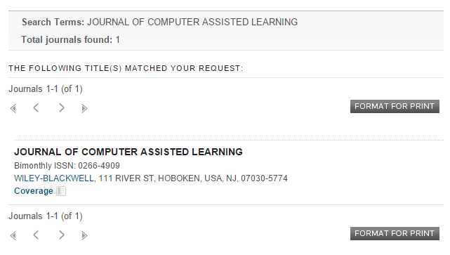
Hasil
Pengecekan

Slide 39
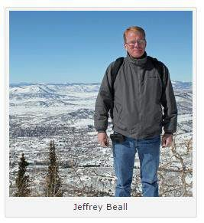
Mengecek
Jurnal
Predator/Abal-Abal
via
Jeffrey
Beall List
scholarlyoa.com

Slide 40


Klik
scholarlyoa.com
Home About the Author Disclaimer UST OF PUBLISHERS UST OF STANDALONE JOURNALS
Other pages
Counterfeit Australian Society Recycles and Renames
'-----------'
RECENT POSTS
o Counterfeit Australian Society Recycles and Renames Researchers' Images
o CA Publisher with a long, Strange Name is Based in a Place wlth a Long, Strange Name
o More Junk Science Proudly
A royal mess. Publisher SCIRP
o Lew Quality, "No Author-Fee" OA
A completely bogus scholarly society, the Australian Society for Commerce Journal Has Hidden Charges
"Institute" Journal Badmouths
them new names, and advertises them as editors-in-chief of its mediocre journals.
ARCHIVES
Researchers' Images
May 21. 2015
I Search I
Published by Chinese
o Editor-in-Chief of Clute
the DOI
Industry & Engineering. uses numerous tricks to make itself look
legitimate. This publisher lifts pictures of professorsfrom the internet,
gives

Slide 41
Daftar
Publisher
Abal-Abal
Home About the Author Disclaimer UST OF PUBLISHERS UST OF STANDALONE JOURNALS
Other pages
Counterfeit Australian Society Recycles and Renames
'-----------'
RECENT POSTS
o Counterfeit Australian Society Recycles and Renames Researchers' Images
o CA Publisher with a long, Strange Name is Based in a Place wlth a Long, Strange Name
o More Junk Science Proudly
Chinese
Publisher SCIRP
o Lew Quality, "No Author-Fee" OA
Industry & Engineering. uses numerous tricks to make itself look ^{o Editor-in-Chief of Clute}
legitimate. This publisher lifts pictures of professorsfrom the internet, gives the DOI
them new names, and advertises them as editors-in-chief of its mediocre
journals.
ARCHIVES
Researchers' Images
May 21. 2015
I Search I
kan Ctrl + F pada keybo
Te A royal mess. ar
^{A comple}k^{tely}e^{bo}t^{gu}i^{s}k^{scho}n^{larly}a^{so}m^{ciety,} a^{the A}p^{ustr}u^{alia}b^{n S}l^{oc}i^{ie}s^{ty}h^{for} e^{Com}rmey^{rce}an
Published by
_{g}Journ_{d}al H_{i}as_{c}Hi_{e}dden_{k}Charges
T
e _{A royal}
ard anda, lalu
mess.
"Institute" Journal Badmouths

Slide 42
LIST OF PUBLISHERS
~[Search!
Beall's List:
RECEHT POST'S
Potential, possible, or probable predatory scholarly open•
This Is a list of questionable, scholarly open-accesspublishers. We recommend that scholars read the available reviews, assessments and
want to submit articles, serve as editors or on editorial boards. The criteria
We hope that tenure and promotion committees can also decide for journals in the context of their own institutional standards and/or
geocultural locus. We emphasize that journal publishers and journals
change in their business and editorial practices over time. This list is kept
up-to-date to the best extent possible but may not reflect sudden, ^{ARCHIVES}
o The 5th Publisher
o AM Publishers ^{CATEGORIES}
o Counterfeit Austral,an Soc,ety Recycles and Renarn•s Res.archers' lm•~s
o OA Publisher w,th a Long, Stt'llnge Name is Based in a Place w,th a Long. Strano- Name
o More Junk Science Proudly Published by Chlrwse Publisher SCJRP
o Low Quality. •No Author-Fee" OA
Journal Has Hldckn CNrges
o Editor-In-Chief of Clute
•tnstitute• Journal Badmouths
the DOI
access publishers
descriptions provided here, and then decidefor themselves whether they
for determining predatory publishers are here.
themselves
how importantly
or not to
rate
articles
published
in
these
unreported,
or unknown enhancements.
! Select Month
• I
o Abhinav
o Academe Research Journals
o Academia Publishing
o Academia Research
o Academia Scholarly Journals (ASJ)
o Academic and Business Research Institute o Academic and Scientific Publishing
o article processing charges
o Australia
o Misleading metrics
o Open-access policy
o Open- access sanctions
o Plagiarism
o Pseudo-science
o Scholarly Open-Access Publishers
o Mandates
o Platinum open access

Slide 43
Daftar
Jurnal
Abal-Abal
Home About the Author Disclaimer UST OF PUBLISHERS UST OF STANDALONE JOURNALS
Other pages
Counterfeit Australian Society Recycles and Renames
'-----------'
RECENT POSTS
o Counterfeit Australian Society Recycles and Renames Researchers' Images
o CA Publisher with a long, Strange Name is Based in a Place wlth a Long, Strange Name
o More Junk Science Proudly
Chinese
Publisher SCIRP
o Lew Quality, "No Author-Fee" OA
Industry & Engineering. uses numerous tricks to make itself look ^{o Editor-in-Chief of Clute}
legitimate. This publisher lifts pictures of professorsfrom the internet, gives the DOI
them new names, and advertises them as editors-in-chief of its mediocre
journals.
ARCHIVES
Researchers' Images
May 21. 2015
I Search I
kan Ctrl + F pada keybo
Te A royal mess. ar
^{A comp}k^{letely} t^{bo}i^{g}k^{us sc}n^{hola}a^{rly} m^{societ}a^{y, the}ju^{Aust}r^{ra}n^{lian}a^{So}l^{ciety fo}a^{r C}n^{omm}g^{erce}ak
Published by
"Institute" Journal Badmouths
T
e _{A royal mess.}
ard anda, lalu
^{A comp}k^{letely} t^{bo}i^{g}k^{us sc}n^{hola}a^{rly} m^{societ}a^{y, the}ju^{Aust}r^{ra}n^{lian}a^{So}l^{ciety fo}a^{r C}n^{omm}g^{erce}aka^{Jo}n^{urnal} d^{Has} i^{H}c^{idde}e^{n}
^{C}k^{harges}

Slide 44
LIST OF STANDALONE JOURNALS
Potential. possible. or probable predatory scholarly open-access journals
~----~Usearch!
This is a list of questionable, scholarly open-access standalone journals. For
journals published by a publisher, please look for the publisher on the list of
publishers, here. This list Is only for single, standalone Journals.
RECENT POSTS
o Counterfeit Australian Society Recvcl11 and Fl1Nmu fte1411rchers' Images
o OA Publisher with a long, Strange Name is Based in a Place wlth a Long, Strange N.ame
o More Junk Science ProudJy Published by Chinese Publisher SCJRP
o Lew Quality, •No Author-Fee" OA
Journal Has Hidden Charges
o Editor-in-Chief of Clute
•institute" Joumal Badmouths
the 001
We recommend that scholars read the available reviews, assessments and
descriptions provided here, and then decide for themselves whether they want to submit articles, serve as editors or on editorial boards. The criteria for determining predatory journals are here.
We hope that tenure and promotion committees can also decide for
themselves how importantly or not to rate articles published in these
journals in the context of their own institutional standards and/or geo•
cultural locus. We emphasize that journals change in their business and
editorial practices over time.
possible but may not reflect enhancements
This list is kept up-to-date to the best extent
sudden, unreported, or unknown
ARCHlVES
I Select Month
o Academic Exchange Quarterly
o Academic Research Reviews
o Academy of Contemporary Research Journal (AOCRJ)
o ACME Intellects
o Acta de Gerencia Ciencia (CAGENA)
o Acta Advances in Agricultural Sciences (AAAS)
o Acta Medica International
o Advances in Forestry Letter
o Afrasian Journal of Humanities and Social Sciences (AAJHSS)
CATEGORIES
o article processing charges
o Australia
o Mandates
o Mlsle1dlng metrics
o Op1n·1cc1ss pol,cy
o Op1n·1cc111sanctions
o Plagiarism
o Platinum open access o Pseudo-science

Slide 45
Apa yang harus dibaca sebelum
submit artikel?
•
SJR (SCImago Journal Rank) atau
Factor (Thomson Reuters)
Aims and scope
Impact
•
•
•
•
Guide for Author/Intruction fo Author
Download free sample artikel
Memperbaiki artikel sesuai petunjuk penulisan & sampel artikel

Slide 46

Panduan
Submit
Akses
&
Artikel
Elsevier
Yoris Adi Maretta
Associate Editor DOAJ

Slide 47


ELSEVIER
Type here to search on Elsevier com
p
Advanced search
Follow us IJ IJlS
''I
~
Help& come
Journals
& books
^{Solution}a^{s} ims
and
Authors, editors
& reviewers
About
Elsevier
Community
Store
Compu^{s}t^{c}eºrs^{p}&^{e} Education Guide for Authors •
An International Journal
See also Elsevier Educational Research Programme home
Computing and communication technology continue to make an ever• ^{Track Your Paper •}
increasing impact on all aspects of cognition, education and training, from
primary to tertiary and in the growing open and distance learning ... ^{Order Journal}
View.fuUaims.and.scope _{View Articles}
Editors: C-C_ Tsai, R.S. Heller, M. Nussbaum, P. Twining
View full editorial board
Share this page:
Submit Your Paper
•
AOVERTlsae,.r
POST DOC
PROGRAM
In between jobs?
Apply for up to
12 months of free access to Elsevier's content on ScienceDirect
FREE ACCESS
Journal Metrics
This journal supports the following content innovations
AudioSlides
Source Normalized
(SNIP): 3.292
Impact per Paper
SClrnago Journal Rank
(SJR): 2.558
Altmetrics • Top Rated Articles
I
News
SJR (SCImago Journal Rank) atau
Impact
Laptop multitasking
I
II
See you at EARLi!
Impact Factor: 2.630
hinders classroom lFeaarncintgor (Thomson Reuters)
for both users and nearby peers
5-Year Impact Factor:
_{3.242}
New - Computers &
Education papers with
AudioSlides
The power of play: The
II
111111

Slide 48
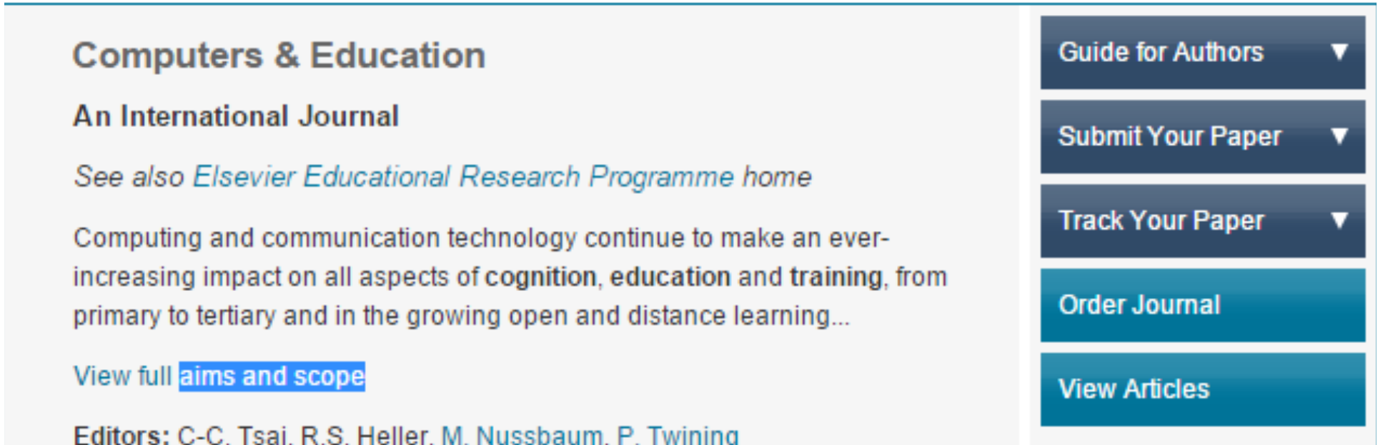
Panduan
Penulis
Kirim Artikel
Cek Status Artikel
Contoh Artikel

Slide 49


Panduan
Penulisan
Elsevier
COMPUTERS & EDUCATION
An International Journal
a...sE'vlr" See also Elsevier Educational Research Programme home
AUTHOR
INFORMATION
PACK
TABLE OF CONTENTS
•
Description
Audience
Impact Factor
p.1
p.1
p.1
p.2
p.2
p.4
•
•
•
Abstracting
and Indexing
•
Editorial Board
Guide for Authors
•
ISSN: 0360-1315
DESCRIPTION
Computing and communication technology continue to make an ever-increasing Impact on all aspects of cognition, education and training, from primary to tertiary and in the growing open and distance learning environment. The journal is an established technically-based, interdisciplinary forum for communication in the use of all forms of computing in this socially and technologically significant
"!:lrQ"!:I ,...f "!:l,...,...fj,..,:,,t,;,...,... "!:lnA u,ill ,..,.,,... .. ;,..., '"" .. ,... no ,hlit"I-, AAf1nit,h,A ,..,.......,..,h, , ..;,..,..,.- ..,... ..-.,.~,.,.. "!:Ir "!:I r""'f..,.,...,.,..,,....,. r .. '!>l"\.-l"!:1.-A

Slide 50


Free
Sample
Article
Elsevier
Computers & Educ.arion SO (2015) 77-il3
Contents litit$ available at screnceDlrtM:t
Computers & Education
ELSEVlER
journal homepage: ww w.etaevl e r.corn/locato/compttdu
Instructional quality of Massive Open Online Courses (MOOCs)
Anoush Margaryan'. Manuela Bianco, Allison Littlejohn
Catedonian Academy. Glasgow Cakdanlan Unlwrsity, c:rosgow C4 OBA. UK
(l)cross~brk
ARTICLE
INFO
ABSTRACT
Arrfcl,e hiscory:
Received 7 February 2014
Received In revised focm
8 August 2014
Accepted 12 August 2014
Av.tllable online 26 Augus1 2014
We present an anaJysis of instructional design quality of 76 randomly selected Masstve Open Online
Courses {MOOCs). The qu.1Uty o( MOOCs was determined from first prindples of instruction. using a
course! survey instrument. Two types of f,.100Cs {xl\.100Cs and cMOOCs) were analysed and their instruction.at design quality was assessed and ccrnpared. We found th.at the majority of l\.400Cs scored poorly on most instructional design principles. However. most l\.100Cs scored higltty on organisation and presenratlcn of course material The results indic.ate that although most ~100Cs are well-pac:ka,gcd, their
Keywords:
Mass.iw Online Open Courses
Disrrlbtlred learning environments
£v.aluarion methodologies
Lifelong le.amlng
Pedagogic.al Issues
ins.tructional design quality is IO\V. We outline implications
(or practice and ideas for future research.
C 2014 Elsevier ltd. All rights reserved.
1. Introduction
Massive Open Online Courses (MOOCs) are said to be a new form of online learning .
·-·- ••••-•• ,,.. .....: •• ,.---.Jr·--·-'--•• "-····•-.J- .. ,,..,...,,..,..,, .. L.:.L. ··-· .J .... ,.-.J ..
..-.... ··- ••••• C--··•••.J •• .J •• ......:L.. ·- ·-"-·

Slide 51

Panduan
Submit
Akses
&
Artikel
Springer
Yoris Adi Maretta
Associate Editor DOAJ

Slide 52
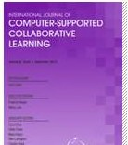
,..,
~
Springer
Horne
Subjects
My Springer
Services
Products
Springer Shop
About
us
Learning & Instruction
Horne >
Education & Language > Learning & Instruction
SUBDISCIPLINES JOURNALS BOOKS SERIES REFERENCE WORKS OD
READ THIS JOURNAL ON SPRINGERLINK
Online First Articles
All volumes & issues
Free: Sample A rtidcs
International Journal of Computer-Supported
Collaborative Learning
Free Sample Articles
An Official Pubricationof the International Society of the Learning
Sciences
Ed~or-in-Chief:Gerry Stahl
ISSN: 1556-1607 (print version)
II
FOR AUTHORS AND EDITORS
--
II) 2013 lmpacl Faclor
1.830
ISSN: 1556-1615 (electronic version)
Journal no. 11412
Aims & Scope
Aims and Scope
Submit Online
Open Choice - Your Way to Open Access
Mission and Scope (doc, 36 kB}
^{lnslruclions for Auth}-^{ors}
Submit Article
,.. RECOMMEND TO LIBRARIAN
fti!IG ~Tweet@
8+1 9
Panduan Penulisan
ABOUT THISJOURNAL
EDITORIAL BOARD
SOCIETIES

Slide 53
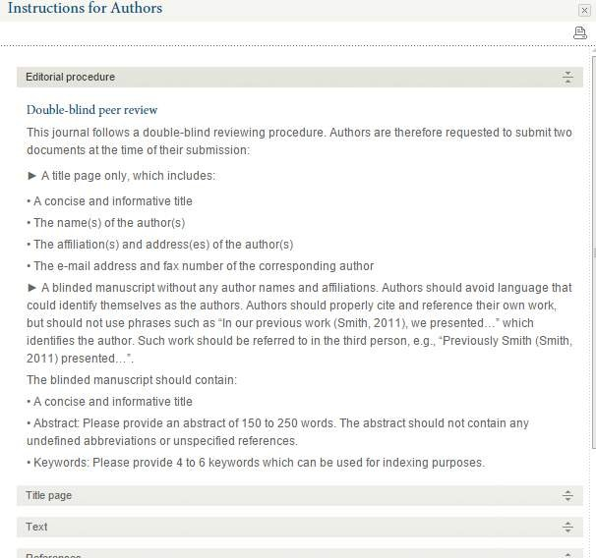
Instrutions For Author (Springer)

Slide 54
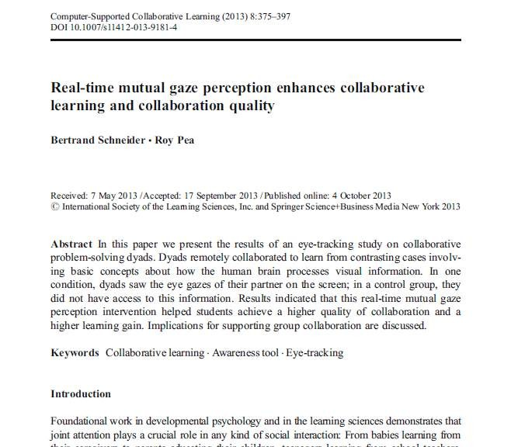
Free
Sample
Article
Springer

Slide 55

Panduan
Submit
Akses
&
Artikel
Wiley
Online
Library
Yoris Adi Maretta
Associate Editor DOAJ

Slide 56
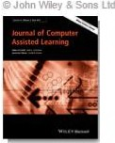

Wiley Online Library
.&, Log in I Register O
Home> Education> General & Introductory Education>
Journal of Computer Assisted Learning
JOURNAL TOOLS
' (
+
~
C}
~
•
Get New ContentAlerts
Get RSS feed
Save to My Pfofie
Get SampleCopy
Reconvnend to Your
Librarian
, .. ^{I} ",' I I) IJ.I^{!' 1'}I",
•
,, '
.
,,
^{f'} ,1111,J '
FreJeouSranmal polef CAormtipclueter Assisted Learning
SEARCH
I._In _this joomal
_{_,o}
E
E
O
JOURNAL MENU
JournaJ Home
dited By: Paul A. Kirschner and Liesbeth Kester
Impact Factor: 1.023
ISi Journal Citation Reports© Ranking: 2013: 61/219 (Education &
ducational Research)
nline ISSN: 1365-2729
Advanced>
Saved Searches >
FIND ISSUES
Current Issue
AU Issues
FIND ARTICLES
EMly Vitfw
Recently Published Issues I See all
Current Issue: June 2015
Volurne 3'1, Issue 3
April 2015
Volmne 31, Issue 2
AutMr Guidelines f Clock Here
GET ACCESS
SubscribeI Ren~v
nes
_{Author}
le
Guideli
FOR CONTRIBUTORS
OnlineOpen
Author Guidefll~ Submit an Article
Author Guideline & Submit Artic
February 2015
VolU1ne 31, Issue 1
December 2014
Volu,ne 30, Issue 6
October 2014
Volume 30, Issue 5
ABOUT THIS JOURNAL
News
overvew
Ed<orial Board
Permissions

Slide 57
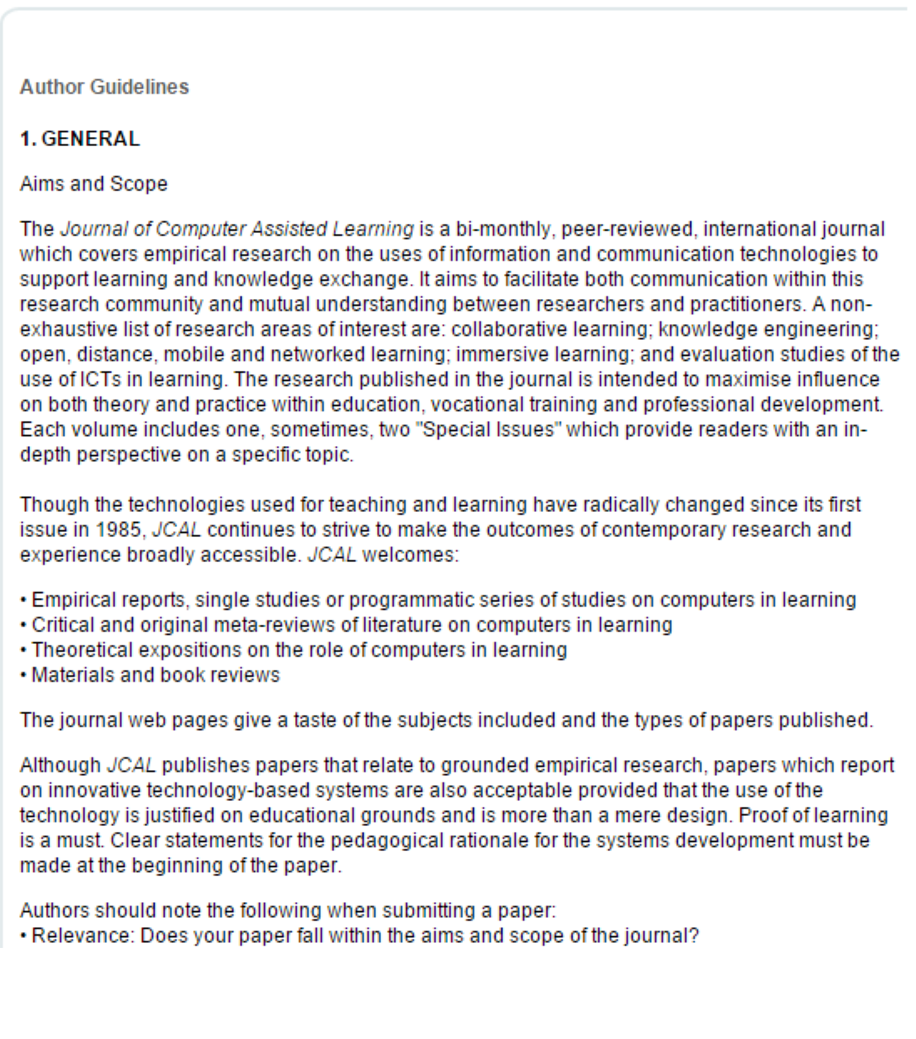
Author Guidelines Wiley Online Library

Slide 58

Free Sample Article
Wiley Online Library
doi: t0.1111Jjcal.J2073
Social Science, Hong Kong Baptist University, Kowloon Tong, KO\vlooo, Hong Kong
level activities on student's performance in the group inquiry learning project. Further. the results also indicate, that the level of collaboration within a group
Original article
Journal
of Computer Assisted
Learninq
A delineation of the cognitive processes
manifested
in a social annotation
environment
S.C. Li, J.W.C. Pow & W.C. Cheung
Department of Education Studies. Faculty of
Abstract
This study aims to examine how students' learning trajectories progressin an online social
annotation environment, and how their cognitive processes and levels of interaction correlate
with their learning outcomes. Three different types of activities (cognitive, rnetacognitive and
social) were identified in the online environment. The time series of different levels of
cognitive and metacognitive activities correlate with one another, indicating that a kind of
symbiotic or ecological relationship exists among the cognitive and metacognitive processes.
The multiple regression results show that low..cognitive level activities mediate the effect of
high-cognitive
The results of multilevel analysis indicate that the average number of highlighted texts posted
per person in a group accounted for over 50% of the variance of the group inquiry learning
projectscores.
explains over 70% of the variance of the high-level cognitive and rnetacognitive activities
across different groups. In sum, group collaboration is found to be conducive 10 fostering
high-level cognitive and rnetacognitive activities.

Slide 59

Panduan
Submit
Akses
&
Artikel
Taylor &
Francis
Yoris Adi Maretta
Associate Editor DOAJ

Slide 60




..... ##o·•-•
# o,o-0 # .. , .. ,,
_# .. , -• ·--·"''l,"·•"·'"'"I
_#
.,
,._,....._••• HO•-••--' _., -··----
-·-
,
Register Sign in Mobile Librarians Authors a Editors
I
I
Q
Search
Advanced and citation search
• \Vithin current JOUmal
Entire site
Home > list of Issues > Table
of Contents
Brov.rse journal
Volume
24,
Issue
2, 2015
< Prev
I
I
2013 & 2014 volumes
FREEto you for 14 days
View aU volumes
issues
aod
-~-....-.,.~ >·,·
Technology, Pedagogy
and
Education
Most read
Most c.ited
-
Current issue
fintegrity
Latest articles
Factors affeding use
of inforn1ation
ccmmunscatsons t
a review of the
Sbeaie Mumtaz
Volume 9, Issue 3,
teachers'
and
echnology:
2000
an effective
, 2004
Most read a rt ides
Journal of the Association of Jnformation TKhnology in Teacher Education
(JTTE)
Routledge
a review of the literature
Most cited art:icle:§
Publication History
Purchase issu~
147S-939X(Print),
1747-5139 (ont;ne)
Submit
>
San1plethis
title
Free Sample Article
Teacher use of
whiteboard in
schools: towards
transition
Gary Beauchamp
Volume 13, Issue 3
Alert me
Publication Frequency
S issues per year. S issues
_.,ill be print.
Teacher use of the interactive
Subscribe
whiteboard in prin1ary
[ About thi§ journal
Recommend to: D, A friend £'- librarian
transition fearnewcek

Slide 61
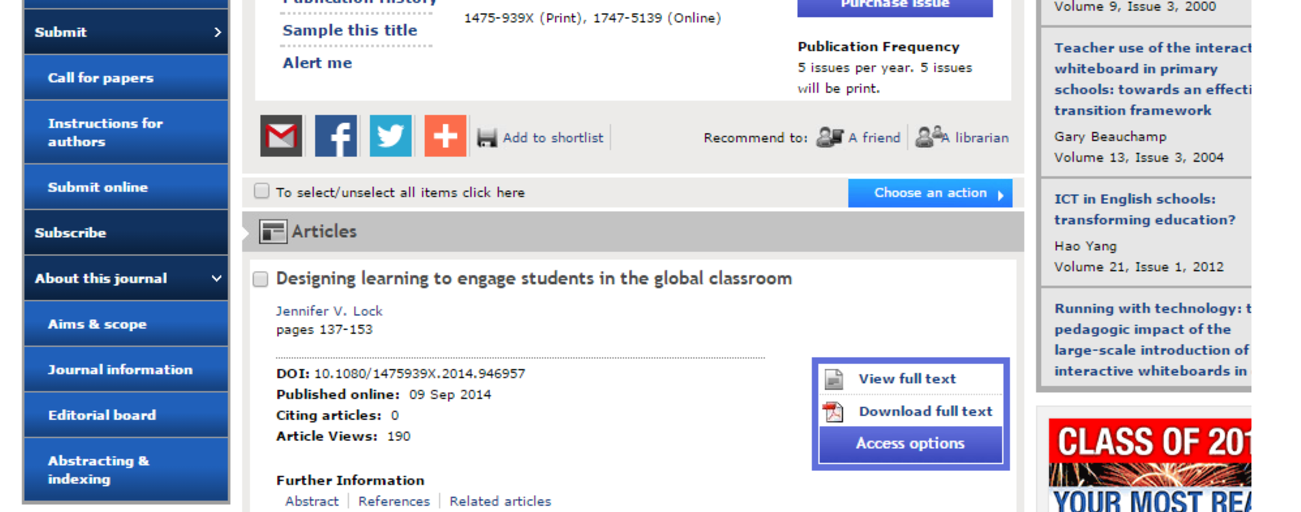
Instrution for Author & Submit Online
Aims & Scope

Slide 62
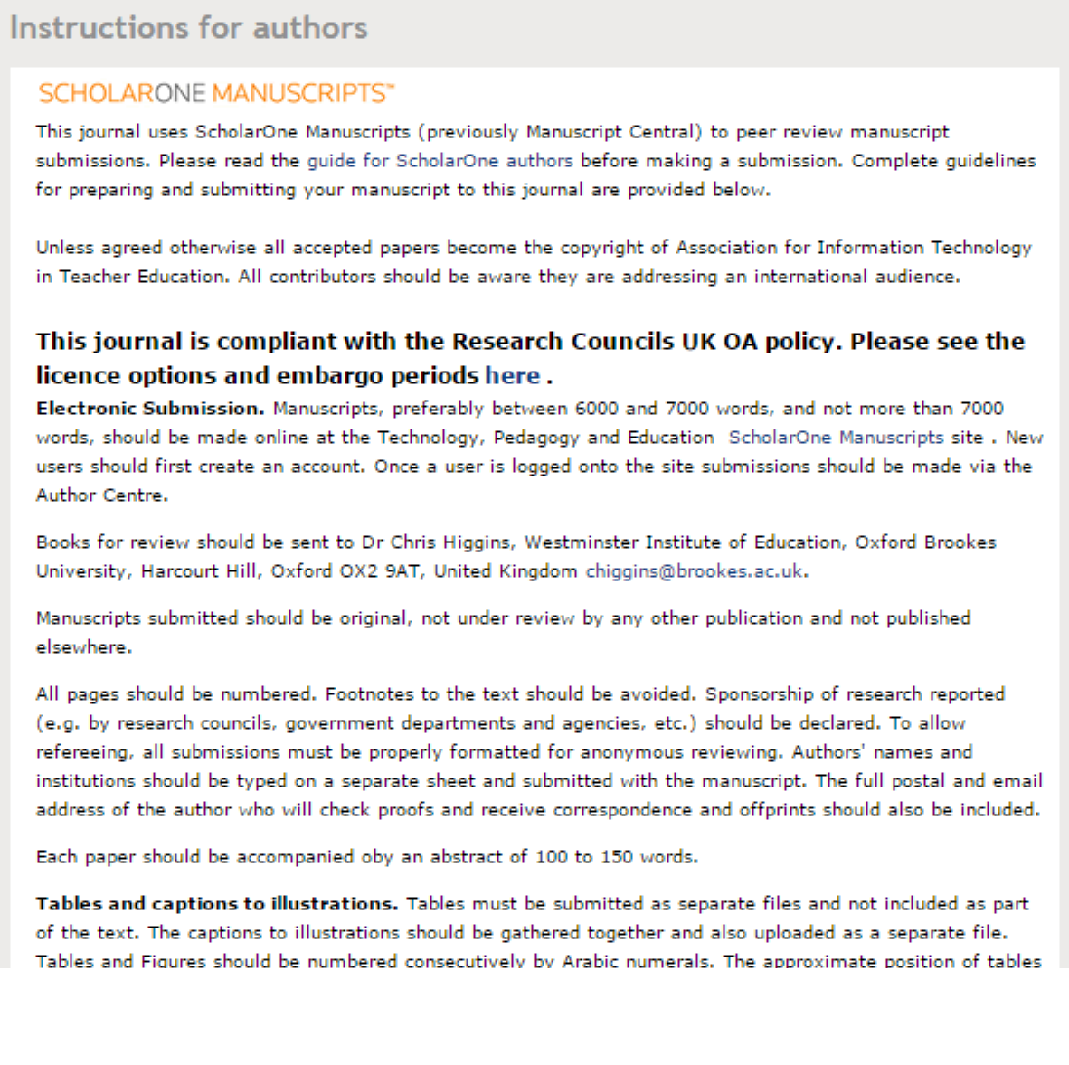
Instructions for authors Taylor & Francis

Slide 63
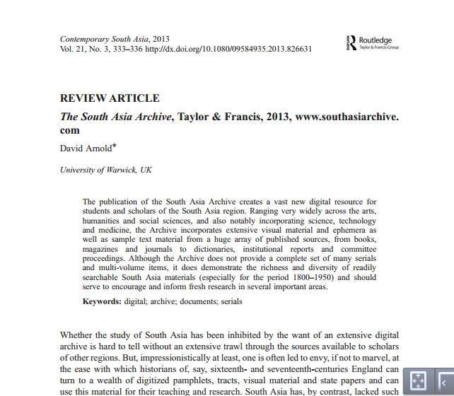
Free Sample Article Taylor & Francis

Slide 64
Panduan
Submit
Akses
&
Artikel
SAGE
Publications
Yoris Adi Maretta
Associate Editor DOAJ

Slide 65

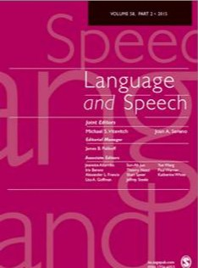
®SAGE journals
Q) Advanced Search
Search History
Browse Journals
Advanced Journal Search•
Impact Factor. 1.120 I Ranking:
Audiology & Speech-language Palhology 16 out of 221 Linguistics 34 out of 1691 Psychology.
Source: 2013 JoumalCi:at.011 P~pons!::
(7nomson Rs:ut=-tS.. 2014)
Experimental 73 out of 8315-Year Impact Factor: 1.46315-Year Ranking: Audiology & Speech-Language Palhology 15 out of 221
Linguistics 32 out of 1691
Psychology, Experimental 64 outof83
^{Language}Fre^{an}e^{d}Sa^{S}m^{pe}p^{e}l^{c}e^{h}&
~
Submit a Manuscript
Submit Article
-,;
Free Sample Copy
Language and Speech provides an international forum for
communication among researchers in the disciplines that contribute
l,ij
Emaii Alerts
to
our undetStanding of the production. perception. processing. learning
use. and disorder.; of speech and language The journal accepts reports of original research in all these areas. lntefdisciplinary submissions are encouraged. Corpus-based. experimental. and obselvational research bringing spoken or written language within the domain of linguistic. psychological. or computational models are particularly welcome.
This journal is a member of the Committee on Publication Ethics
(COPE).
RSSfeed
El More about this journal
Most Read
Most Cited
• Fadors Alfecmg Stress Placement for Engish Nonwordsilcllde Sylabic Struaure, Lexical Class. and StressPatterns of Phonnlnnir..:1lv~r Word.-t
O OnlineFirst
(Forthcoming artides published ahead of print)

Slide 66
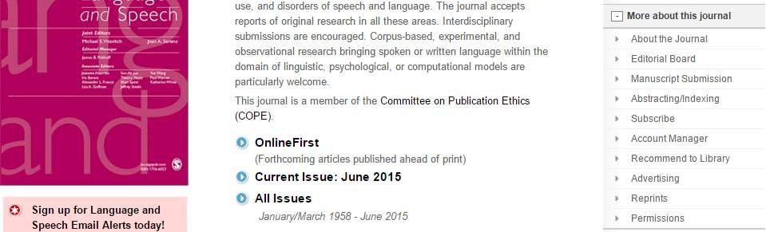
Author Guideline

Slide 67
Pedoman Penulisan SAGE Pub.
About the Title Editorial Board Abstracting/lndexing
Manuscript
Submissionl
Subscribe
1.
2.
3.
4.
Poor review policy
Article types
How to submit your manuscript
Journal contributor's publishing agreement
4.1 SAGE Choice and 011eo Access
Declaration of conflicting interests policy
Other conventions
Acknowledgments
7.1 Funding acknowledgement
Permissions
Manuscript style
9. 1 File types
9.2 Journal style
9. 3 Reference style
9.4 Manuscript preparation
5.
6.
7.
8.
9.
9.4. 1
9.4.2
9.4.3
9.4.4
Keywords and abstracts: Helping readers find your
Corresponding author contact details
article online
Guidelines for submitting artwork, figures and other graphics
Guidelines for submitting supplemental files
9.4.5
English language editing seNjces
10.
After acw111ance
10.1 Proofs
10.2 E-Pcints
10.3 SAGE production
10.4 OnlineFirst publication
Further information
11.

Slide 68
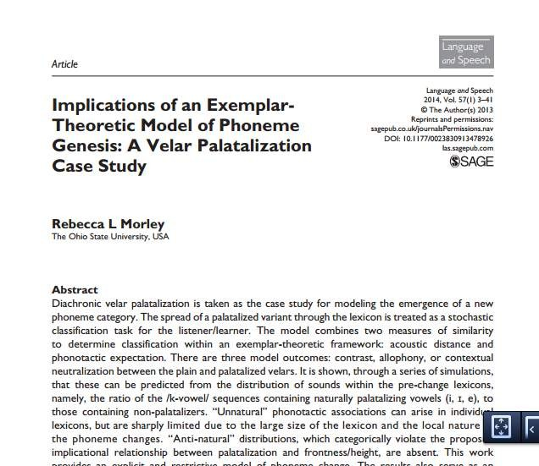
Free Sample Article SAGE Pub.

Slide 69

Panduan
Submit
Akses
&
Artikel
Emerald
Insight
Yoris Adi Maretta
Associate Editor DOAJ

Slide 70




Emerald
GROUP PUBLISHING
nuntt, I I e::r.1 Yll:n'I I \,,Ullld\;t U:$ I .:,11t, IVldl) I .:,uppu111 CflJt:fdaJ 1'1Vllltl
Site search: ~
search t&
m
• Login
Welcome:
Universitas Negeri Semarang
Home > Emeraldjournals> International Journal of Educational ManagementInformation
International Journal of Educational Management
!~: 0951-354X
Search in this title:
I ...
_.u:search
,,,
Product Information -
Ful lext O<lllne
ContentTable or Contents I Latest Issue RSS M;f\i
Information: Journol information I Ed•ort11Team I Author Guidelines
I Other. Sample articles I Events I Reconvnend this journal
uidelin
This tiHe
is indexed
G e^{in}s^{Scopus}
For Journals
Author
Emera1d Backffies
Emera1d En-gneemg Sa~s
Aims and Scope
The International Journal of Educational Management (IJEM) provides those interested in !he effective management of !he educational process with a broad overview of developments and
_{N-•}Su. bject Zone
Emeta1d Sa~s Additions
Hlghllghls • Updates
Emeta1d MsnagementF'rst
For Books
For Case Studies
Regional information
best practice in !he field, with particular reference to how new ideas can be applied worldwide. The journal contains material relating to innovation
In educational management across the spectrum, the development of educational delivery mechanisms, and the creation of an environment in
^{which the management of res}Sºa^{ur}m^{ces}p^{pr}lºevides the most efficient outputs achievable on an International basis to allow the sharing of new Initiatives.
^{As the whole structure and ph}a^{ilo}r^{s}tºi^{p}c^{hy}le^{of}seducation goes through a sea-change, and as budgets are cat, educational managers need to keep
Services
abreast of new developments in order to maximize !heir resources and determine the most appropriate management strategy for !heir institution.
The International Journal of Educational Management addresses the increasingly complex role of !he educational manager, offering international perspectives on common problems and providing a forum for !he sharing of ideas, information and expertise.
Publishing Services
Research and Pubislmg
Pathway
Event Services
Testimonial
"Leading scholars chOose to publish in IJEM. As an example, since 2010 the following thoughtteaders have contributed to IJEM: Raymond Calabrese; Ron Heel<; Wayne Hoy; Stephen Jacobson; Olof Johansson; John McCormick; Reynold Macpherson; Jorunn Moller; Le)f Moos; Daniel Mul)s; Bill Mulford; tzhar Oplatka; Petros Pashlardls; and Pat Sammons have chosen IJEM as an oudet for !heir work.
rv1ost imoortanllv IJEM covers an exoansive arrav of sectors lhiaher education_ business faculties· schools· TVET: amono others) with a breadth of
Resources
Licensing -s
For Authors

Slide 71
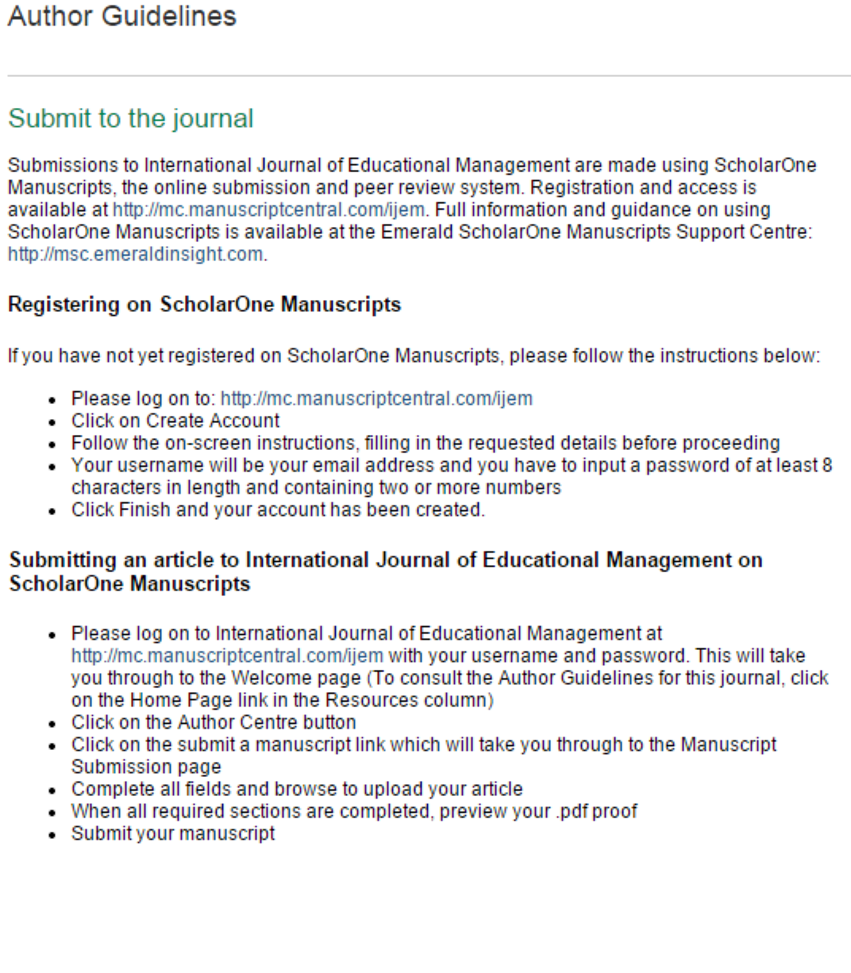
Author Guidelines Emerald

Slide 72
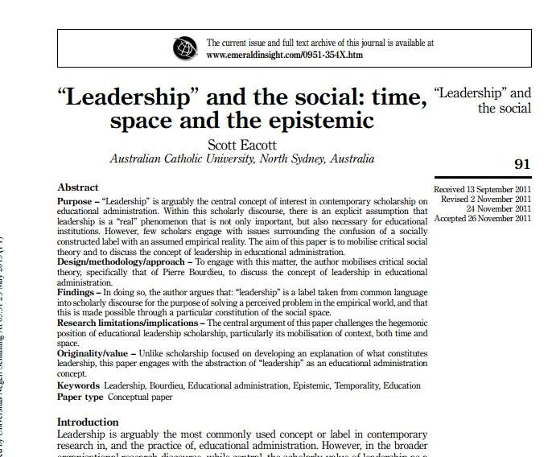
Sample Article Emerald

Slide 73

Panduan
Submit
Akses
&
Artikel
Oxford
Journals
Yoris Adi Maretta
Associate Editor DOAJ

Slide 74


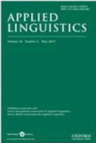
ABOUT THIS JOURNAL
CONTACT THIS .JOURNAL SUBSCRIPTIONS
CURRENT ISSUE
ARCHIVE
SEARCH
Institution: Universitas Negeri Sen1ara119 Sign In as Personal Subscriber
Oxford Journals > Arts & Humanities > Applied Linguistics
READ THIS .JOURNAL
TH£ .JOURNAL
View Current Issue (Volume 36 Issue
Advance Access
Browse the Archive
Applied Ungul•llcs publishes research
2 May 2015)
Aims & Scope
into language with relevance to real wortd
> About this Journal
> Rights & Permissions
> Dispatch date of the
approaches to research on
next issue
problems. It promotes principled and multidisciplinary
> Wt art mobile - find out more
> This journal is a member of the Committee on
Publication Ethics ( COPE)
> Journals Career Network
language·related concerns in the various fields encompassed by applied linguistics.
Published in collaboration with
> British Association for Applied Linguistics
> International Association for Applied Linguistics
LATEST ARTICLES
B. MacWhinney, A. Malchukov, and E. Moravcsik (eds): COMPETING MOTIVATIONS IN GRAMMAR AND
USAGE.
Broccias, C.
Imoact factor: 1.833

Slide 75

Instructions
to authors
Submit Article

Slide 76
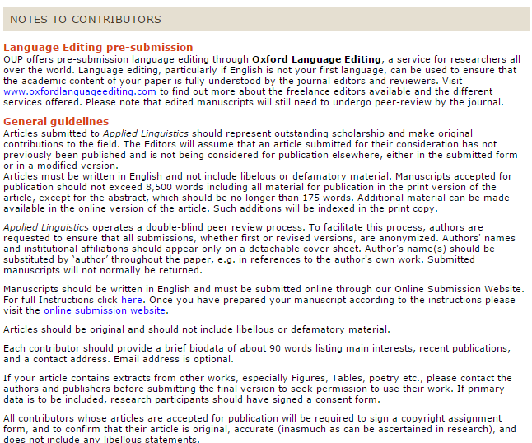
Pedoman Penulisan Oxford Journals

Slide 77
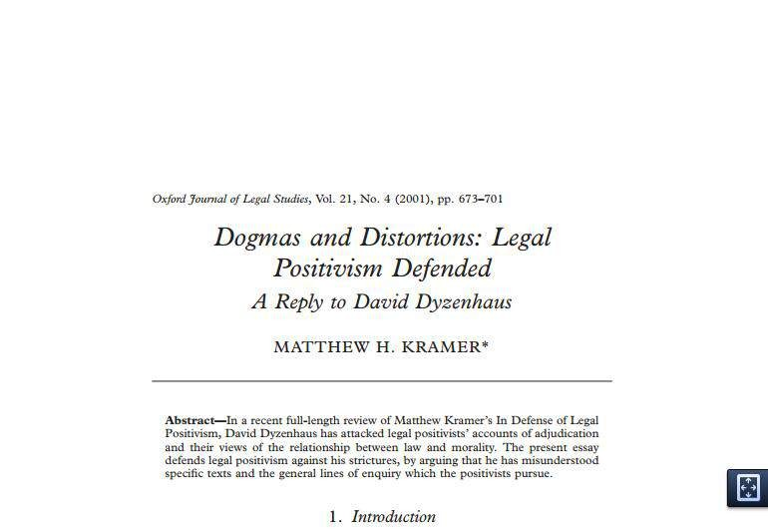
Free Sample Article Oxford Journals

Slide 78

Panduan
Submit
Akses
&
Artikel
JSTOR
Journals
Yoris Adi Maretta
Associate Editor DOAJ

Slide 79
1 CHICAGO JOURNALS ^{nThisTitle • 8¥8}
1
! 1
1
Tile Elementary School Journal
> AboutJournal
Yoor access to JSTOR pr<Mdedby State Uniloeniy ol
Semarang
The Elementary School Journal Publication Into
JOURNAL TRACKING
Receive updates by emall leTOCl
RSSfeed
SJ
'lh<
About Journal
News & Announcements
For Authors Related Information
Coverage: 1914-2015 (Vols. 15-115)
Published by: The University or Chicago Press
• Latestlssue • Ahead of Print
• All Issues
IMPORTANT LINKS
Ek1ncntuy
RECOMMEND
The Elementary
School Journal
TO YOUR LIBRARY.
~hool
}ounwl
Subscribe or Renew
ABOUT JOURNAL
Author
Guide
Description
Editorjal Board
Contact Editorial Office
Explore more in
The Elementary
School Journal.
DESCRIPTION
The ElemencarySchool Journal has served researchers, teacher educators, and practitioners in the elementary and middle school education for over one hundred years. ESJ publishes peer-reviewed articles dealing with both education theory and research and their implications for teaching practice. In addition. ESJ presents articles that relate the latest research in child development, cognitive psychology, and sociology to school learning and teaching.
ESJ prefers to publish original studies that contain data about school and classroom processes in elementary or middle schools while occasionally publishing integrative research reviews and in-depth conceptual analyses or schooling.
SUBSCRIBE NOW

Slide 80
Pedoman Penulisan JSTOR
Journals
THE
BOOKS
UNIVERSITY OF CHICAGO PRESS
ABOUT CORTAC1
JOURNALS
DISTRIBUTION { INFO & SERVICES}
The
University of Chicago Press Guidelines
for Journal Authors' Rights
As a leader in scholarly publishing, the University of Chicago Press has embraced its obligation to disseminate
scholarship of the highest standard, to advance scholarly conversation within and across traditional disciplines, and
to help define new areas of knowledge and intellectual endeavor. When you publish an article in a journal of the
University of Chicago Press or one of its publishing pa1tners, you reap the benefit of a professional publishing
house with over a century of commitment to the scholarly enterprise. With our publishing expertise in both
traditional and emerging channels of communication, we ensure the widespread distribution of your article
throughout the world and to the broadest audience.
The University of Chicago Press supports and encourages our authors' own efforts to promote and disseminate
their works. These Guidelines answer the questions we hear most often from our authors about their rights to reuse
their articles. Your rights are governed by your Publication Agreement and by the provisions of these Guidelines, as
in effect at the time of your proposed use of your article. If you have a question that is not addressed here, please
contact:
Permis sjons Departrnent
University of Chicago Press, Journals Division
1427 East 6oth Street, Chicago, IL 60637
Email: journalpermissions@press.uchicago.edu

Slide 81
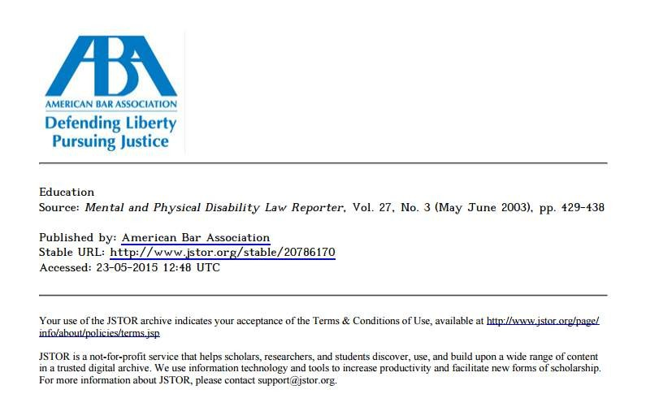
Free Sample Article JSTOR Journals

Slide 82
Sekian
Terimakasih atas perhatian & partisipasinya
•
•
Mohon maaf jika ada tutur kata yang salah
tingkah laku yang kurang sopan
Silahkan jika ada yang ditanyakan
&
•
Materi ini dibawakan oleh Yoris Adi Maretta Associate Editor DOAJ (yorisadi@gmail.com)
pada “Seminar dan
Lokakarya Penulisan Artikel dan Akses Jurnal Internasional yang Terindeks Scopus, Thomson, DOAJ bagi
Pimpinan dan Dosen PPs UNJ” Hari, Tanggal : Senin, 25 Mei 2015 @ Ruang Sidang Gedung Perpustakaan
Lantai 1 UNJ
This work is licensed under a Creative Commons Attribution 4.0 International License

