Slide 1
PASSIVE VOICE

Slide 2
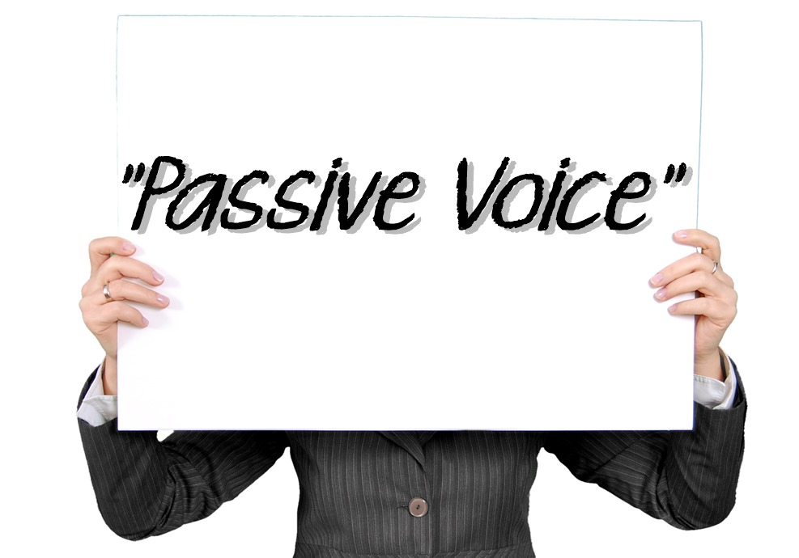

Slide 3
Sentences can be in the form of active or passive
Trial
Premium
In an active sentence, subject usually comes first in the sentence and become the center of information. On the other hand, a passive voice is a type of sentence, in which an action or an object of a sentence is emphasized rather than its subject
Active Sentence
Passive Sentence
Brown wrote “Teaching by Principles” book in 1991
“Teaching by Principle” book was written
in 1991

Slide 4
S + was/were + V3
“Subject + to be + V3”
Simple Past Tense
What is the form of passive voice?
S + is/am/are + V3
S + will be + V3
.
Simple Present Tense
Future Tense
Pri_Delta

Slide 5
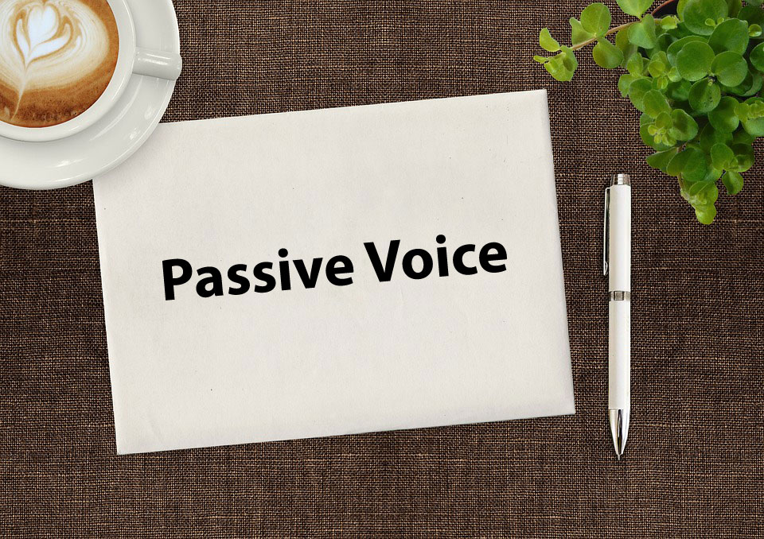
S + has/have been + V3
Present Perfect Tense
S + is/am/are + being + V3
Present Continuous Tense
.
Pri_Delta

Slide 6
Forms of Passive Voice
1.Simple Present
S + is/was + V3
Samsung is made in Korea
2.Simple PastTense
5.Present Continuous Tense
S + was/were + V3
Roger Palmer was invited to speak at CONAPLIN 9 conference in Bandung
Tenses, Forms, Examples
S + is/am/are + being + V3
The Package is being sent from Spain
3.Future Tense
4.Present Perfect Tense
S + will be + V3
The research proposal will approved by Professor Jamie tomorrow
S + have/has + been + V3
The instruments have been validated by the expert judgment

Slide 7
01
02
03 Case:
Case:
The subject of the action is not important or is not known
Case:
Talking about a general truth
In writing in a scientific paper that traditionally relies on passive voice
USE
When to Use Passive Voice
Example:
The sodium hydroxide was dissolved in water. This solution was then titrated with hydrochloric acid
Example:
A new virus, called Corona, was found in Wuhan
Example:
Rules are made to be broken
01’
02’
03’
Pri_delta

Slide 8
Why passive voice is used in a research paper?
Trial
Premium
1. Passive voice is useful in writing a research paper because it allows authors to highlight the most important participants or events within sentences by placing them at the beginning of the sentence.
Active
Passive
Scientists classify glass as a solid
Glass is classified as a solid

Slide 9
Why passive voice is used in a research paper?
2. Passive voice is useful in writing a research paper to avoid repetitive sentence to mention the subject of the action. It is also useful to avoid using personal pronouns
Trial
Premium
Example 1
Example 2
The participants were chosen based on purposive sampling technique nursing staff. Hand washing, or failure to hand wash, following patient contact was recorded. Leaving the area without hand washing was considered failure to wash
The hand washing practices of staff were observed by 4 members
Passive voice is used to avoid repeated reference

Slide 10
Why passive voice is used in a research paper?
2’. Passive voice is useful in writing a research paper to avoid repetitive sentence to mention the subject of the action. It is also useful to avoid using personal pronouns
Trial
Premium
Example 3
A number of participants were given briefing before the focus group interview

Slide 11
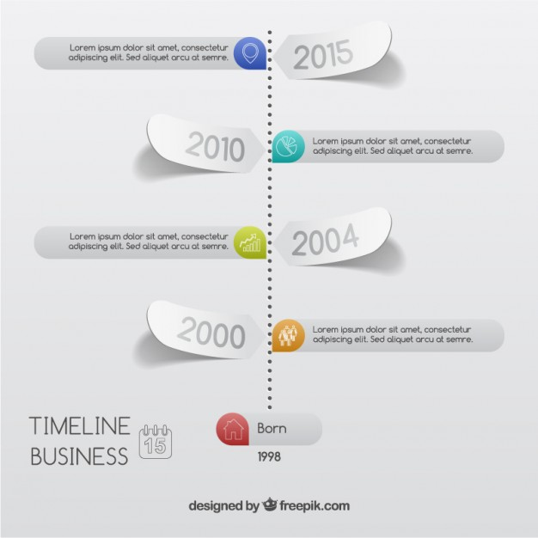
….
Tea
in China. (grow)
Whales
…
by an international ban on whaling. (must protect)
….
Statements
from all the witnesses at this moment. (take)
Penicillin
…..
by Alexander Fleming in 1928. (discover)
Exercises 1: Write down the correct passive voice forms of the verbs in parentheses.

Slide 12
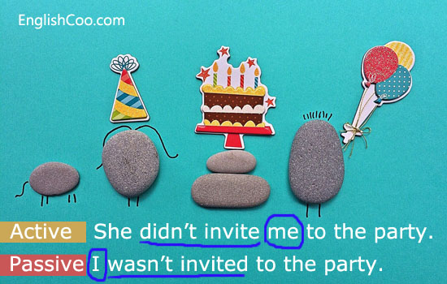
01
02
03 Active
Active
Someone had reported the theft to the police.
Active
Somebody has bought the land next to the university
People expect better results soon
EXERCISE
Exercise 2:Rewrite these sentences using passive voice form.
For example: “We can solve the problem » The problem can be solved”.
Passive?
……………………………………………………………….
Passive?
…………………………………………………….
Passive?
…………………………………............................
01’
02’
03’

